Slide 1

Git Management (Tortoise git)
Presenter,
Mary Greeshma T. V,
Junior Software Engineer Trainee,
Maxwell GeoSystems India Private Ltd

Slide 2
Overview
What is version control ?
What is Git?
Tortoise Git
Features
Commands
Bitbucket
GitHub
Implementation

Slide 3
What is version control?
Category of s/w tool that help a s/w team to manage changes of source code over time.
Keeps track of every modification to the code
Two types
Centralized VCS
Distributed VCS
Benefits
Developing s/w without version control is risky, like not having backup.
A complete long term change history of every file.
Branching & Merging
Traceability

Slide 4
What is Git?
Git : Most widely used modern version control system in the world today is Git.
Git is open source project, originally developed in 2005 by Linus Torvalds.
Git is an example of DVCS
Goal of Git
Speed
Support for non linear development. (Thousands of parallel branches)
Fully Distributed
Able to handle large projects efficiently.

Slide 5
What is Git?
Performance
Git focuses on the file content
Object format of git repository file uses a combination of delta encoding, compression and explicitly stores directory contents and version metdata objects.
Being distributed enable significant performance.
Security
Git has been designed with the integrity of managed source code as a top priority
All the objects in git repository are secured with cryptographically secure hashing algorithm.
Flexibility
It is compatible with many existing systems and protocols.

Slide 6
Workflow of Git
The working directory is the place where files are checked out.
Git doesn’t track each and every modified file. Whenever you do commit an operation, Git looks for the files present in the staging area. Only those files present in the staging area are considered for commit and not all the modified files.
Let us see the basic workflow of Git.
Step 1: You modify a file from the working directory.
Step 2: You add these files to the staging area.
Step 3: You perform commit operation that moves the files from the staging area. After push operation, it stores the changes permanently to the Git repository.

Slide 7
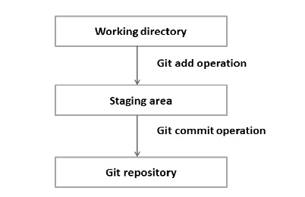
Workflow of Git

Slide 8

Tortoise git

Slide 9
Tortoise Git
Free Open source client for git Version control system
Founder - Frank Li
It manages files over time
Files are stored in local repository
Repository : It is like an ordinary file server, except that it remembers every change ever made to your files and directories.
Git Clone
Git clone is a full fledged repository with complete history and full version tracking capabilities, not dependent on network access or a central server.

Slide 10
Features
Shell Integration
Icon overlays
Easy access to git commands
Distributed version control
Atomic commits
Efficient handling of large project

Slide 11
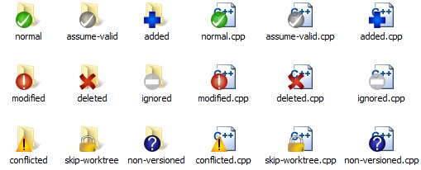
Icon Overlays

Slide 12
Major Commands
git config - sets configuration values
git init - initializes a git repository
git clone - Make a git repository copy from a remote source
git add - adds file changes in your working directory to your index
git rm - remove files from your index and your working directory
git commit – takes all the changes written in the index, creates a new commit object pointer to it and sets the branch to point to that new commit.
git status – Shows your status of files in the index versus the working directory
git branch – List existing branches
git checkout – checkout a different branch – switches branches by updating the index, working tree and HEAD to reflect the chosen branch

Slide 13
Major Commamds
git merge - Merge one or more branches into you current branch
git reset – Resets your index and working directory to the state of your last commit
git stash - Temporarily saves changes that you dont want to commit immediately.
git tag – tags a specific commit with a simple human readable handle that never moves
git fetch - fetches all objects from the remote repository that are not present in the local one
git pull - fetches the files from the remote repository and merges it with your local one
git push - pushes all modified local objects to the remote repository and advances its branches

Slide 14
Major Commands
git remote - show all the remote versions of your repository
git show - show information about git object
git log - Shows a listing of commitson a branch includes the corresponding details
git diff - generate patch files or statistics of differences between path or file in your repository
git archive - creates a tar or zip file
git gc - grbage collector optimises your repositor
git prune - remove object that are no longer pointed.

Slide 15
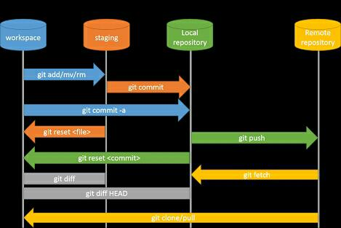

Slide 16

GitHub
GitHub.com is a site for online storage of git repositories.
You can create a remote repo there and push code to it
Many open source projects use it, such as the Linux kernel
You can get free space for open source projects, or you can pay for private projects.

Slide 17

BitBucket
Bitbucket is a web-based hosting service for projects.
Bitbucket offers both commercial plans and free accounts.
GitHub does not offer private repositories with their free plan.
This is where Bitbucket comes in. With Bitbucket, you get unlimited private repositories, and they are free for small teams of 5.
Bitbucket is written in Python using the Django web framework.

Slide 18
Steps
Prerequisites
You already have a GitHub account
You already have a Bitbucket account
Step 1: Install GitHub for Windows
Download GitHub for Windows
Log into GitHub for Windows, using your GitHub account.
Configure Git. Note: Git will label your commits with this info (including your Bitbucket commits).
There is no step 4. GitHub for Windows will automatically add a new public SSH key to your account. Honestly, they have the easiest setup.

Slide 19
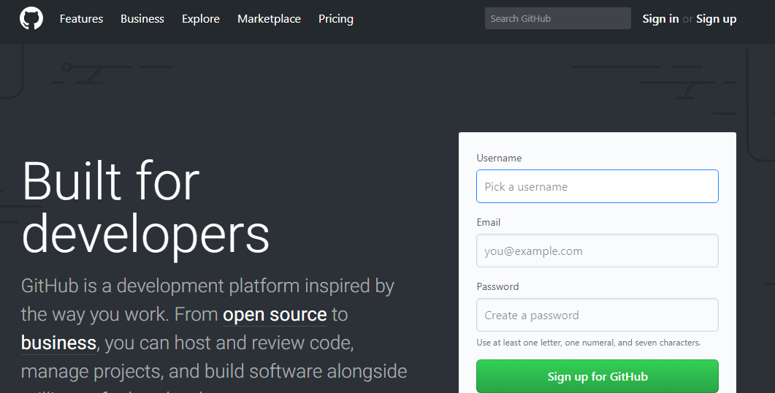
Github account creation
Go to link : https://github.com/
Provide username ,e-mail and a password for creating account

Slide 20
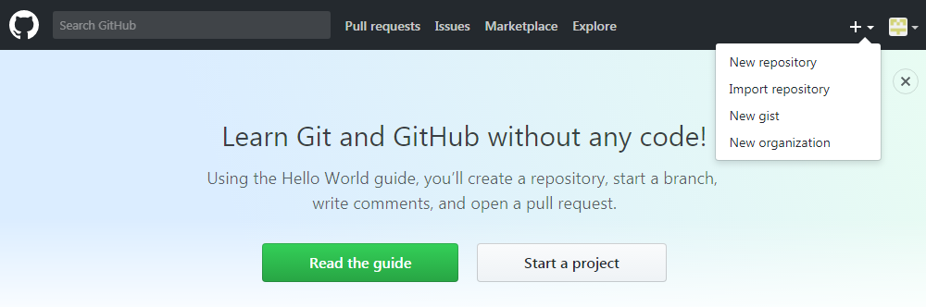
Continue….
Sign in to GitHub
You can create repositories there

Slide 21
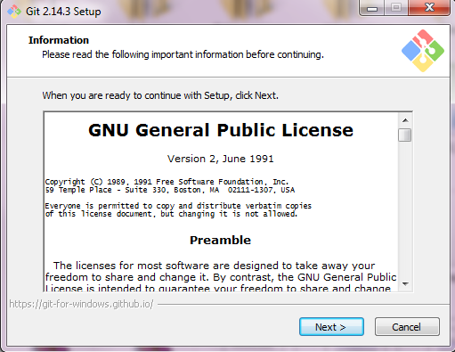
Install Git
Go to url : https://git-scm.com/download/win
Download git for your windows .current version 2.15.0
Install git on your system

Slide 22
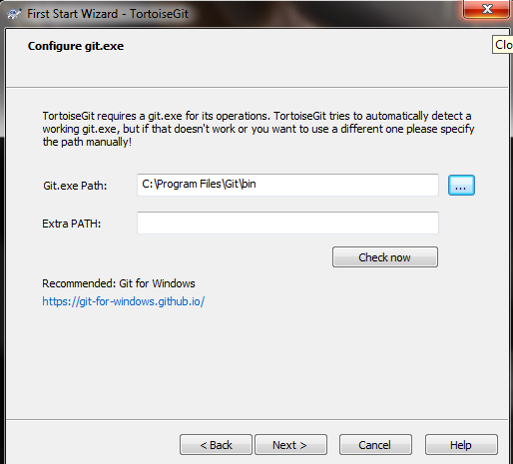
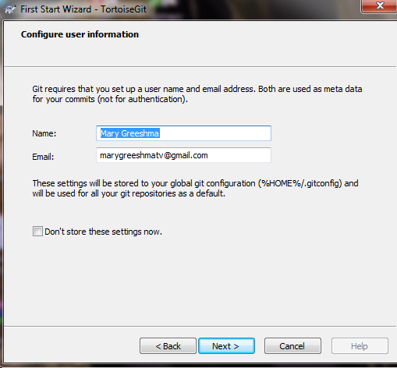
Continue….

Slide 23
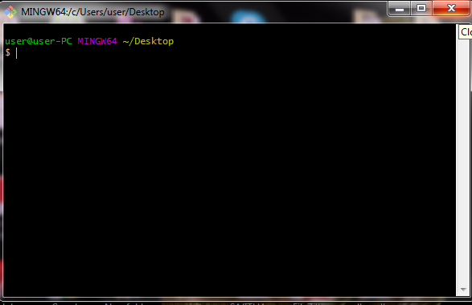
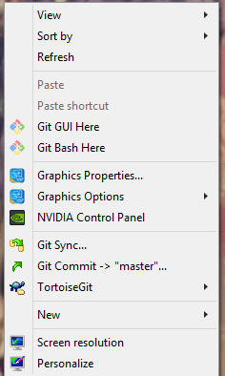
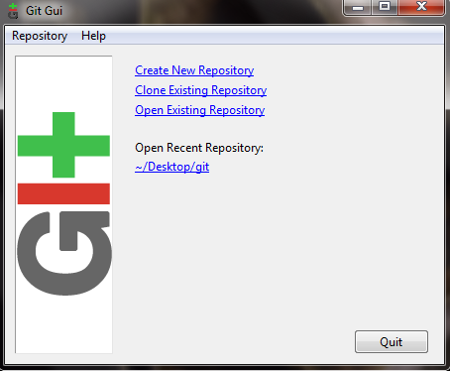
Continue….

Slide 24
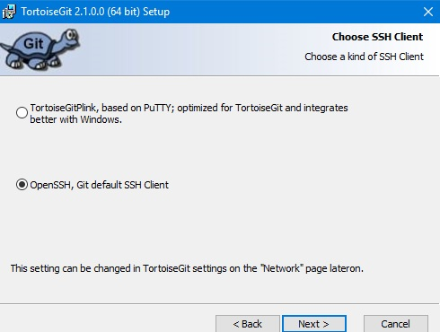
Continue….
Step 5. Install TortoiseGit
Download TortoiseGit.
Start the installation and keep clicking Next until you come to the following step. Choose OpenSSH, Git default SSH Client here.

Slide 25

Continue….
Keep clicking Next until you have completed the setup.
Right-click on your desktop and select TortoiseGit > Settings from the context menu. You should see the following screen. Click on: Set Git path.
Paste this in the text box labelled Git.exe Path: C:\Users\<your user name>\AppData\Local\GitHub\PORTAB~1\cmd

Slide 26
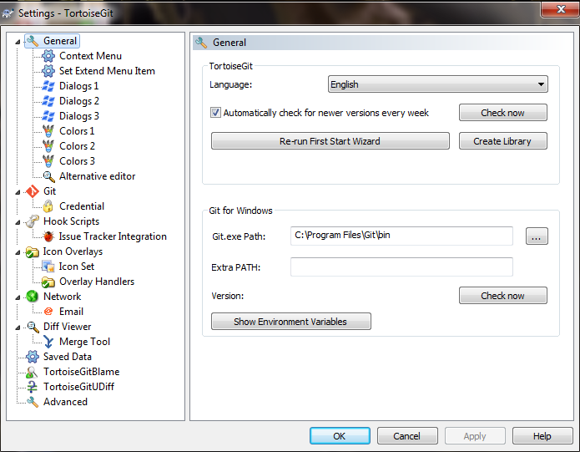
Continue….

Slide 27
Continue….
Click on the button labelled Check now (optional).
Click on OK.
Right-click on your desktop and select TortoiseGit > Settings from the context menu.
Click on Network in de side bar.
Paste this in the text box labelled SSH client: C:\Users\<your user name>\AppData\Local\GitHub\PORTAB~1\usr\bin\ssh.exe (use your Windows user name)

Slide 28
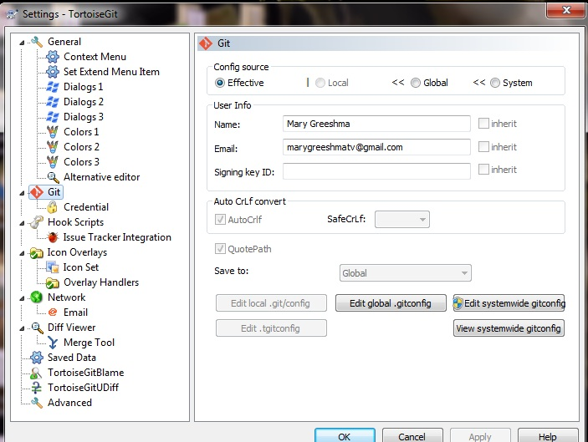
Continue….

Slide 29
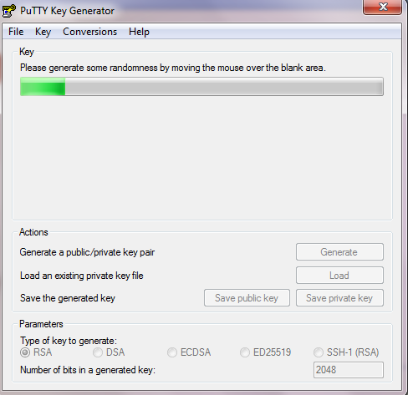
SSH Key generation
SSH keys are generated for making secure connection with github
Two ways
1) Using PuTTY Key generator

Slide 30
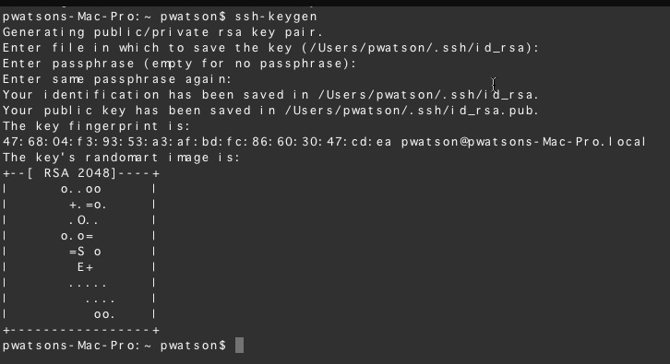
Continue….
2) using commands

Slide 31
Continue….
Step 6. Clone a GitHub repo
Log into Github
Go to an existing repository or create a new repository.
Click on Clone in the side bar.
Select SSH from the drop-down.
You will see a text box to the right with all its text selected. git clone is a command and we don’t need that now. So, copy everything else.

Slide 32
Continue….
If you paste the copied text to your favorite text editor, it should look something like the following: git@bitbucket.org:svanas/sample-repository.git This is our clone URL. Note that there’s no git clone command in it. If you accidentally included that, copy again WITHOUT it. Some parts will be different for you because you will have a different username and repository name.
Right-click on your desktop and select Git Clone… from the context menu.
The following window will appear. Paste the copied clone URL in the text box labelled URL and then click on OK.
If everything went fine, you should see a blue success message at the bottom in TortoiseGit once the cloning is complete.

Slide 33
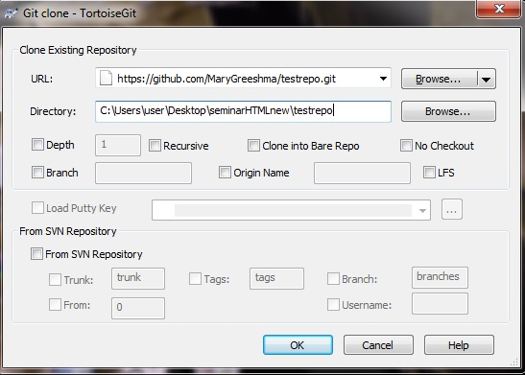
Continue….

Slide 34
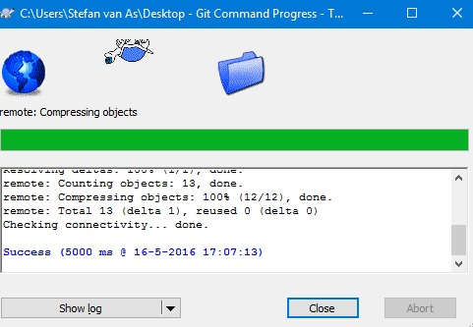
Continue….

Slide 35
Conclusion
Version Control System (VCS) is a software that helps software developers to work together and maintain a complete history of their work.
Two types of VCS:
• Centralized version control system (CVCS).
• Distributed/Decentralized version control system (DVCS).
Most widely used modern version control system in the world today is Git.
GitHub.com is a site for online storage of git repositories.
Bitbucket is a web-based hosting service, Bitbucket, you get unlimited private repositories, and they are free for small teams of 5.
Tortoise git is, Free Open source client for git Version control system

Slide 36
Thank you.

