Slide 1

Trends and Predictions
MEDIA
IN
An analysis into the patterns that shape our consumption and production of film and tv.
Made by Veronika, Mary, Yvonne, and Karoline
Notes:
Why should you care - 10s - Mary
Data Introduction 1min
Dataset - Veronika
Karo - Imputation and Cleansing
Text-Preprocessing - Mary
Vectorization & Binning - Yvonne
* jump in on parts missed
Each topic 1 min * 4
Title - Mary
Runtime - V
Production Country - V
Genres - K
Score 30s - Yvonne
Findings 30s - Veronika
Machine learning model 90s - Yvonne
Limitations 15s - Mary
Improvements 15s - Karoline
Today we are discussing trends and predictions in Media, we are looking to explore the patterns that shape our consumption and production of film and tv

Slide 2
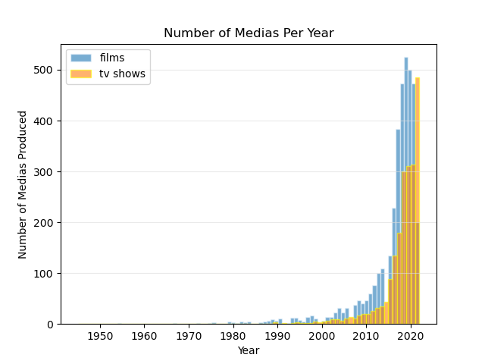
Why should you care?
Growingly competitive market
Digital boom since the 1990s
Choose and invest wisely!
Crucial to be investing the right, trendy movies
Opportunity after the pandemic
Slight decline in movies since 2018

Slide 3
01
Data Introduction
Dataset and Pre-Processing Techniques

Slide 4

Case folding
Noise Reduction
Tokenization
Stop words
Lemmatizing
Movies and tv shows
78 yrs of data
Removing records
Cleansing and Imputation
Vectorization and Binning
Dataset
Text Pre-processing
Genre
Production country
Runtime
IMDB/TMDB scores
Release Year
Genre
Title: Bag of Words
‘Score Index’
Notes:
We started of by removing impurities in the dataset through cleansing and cleaned up the formatting.
As veronika mentioned we found decent number of missing values in all categories of our dataset, so we took great care in not skewing the dataset. For all numeric values such as scores we imputed the respective mode, for production country we imputed the missing values proportionally to the population, and for genre we simply did not consider the missing values for our analysis as there is no reliable way to predict this from other information alone.

Slide 5
02
Analysis
A discussion of specific features in the dataset

Slide 6
Runtime
Title
Production Countries
The Features
Genre
Notes:
The main features we focus on are title, runtime, production countries, and genre

Slide 7
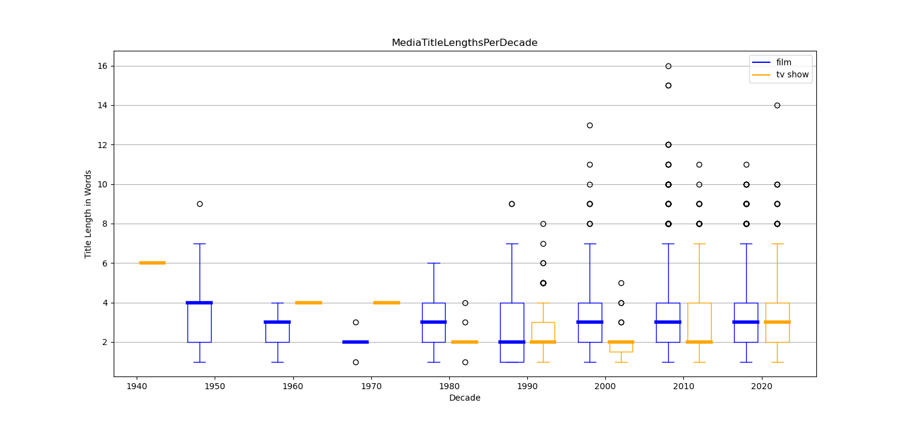
Analysis on Trends: Titles
Titles deliver core message
Language
Theme
What is desirable?
Concise?
But also less rigidity now
Notes:
What’s the first thing people see when they browse for something to watch? Not content, and even before trailor, it’s the title

Slide 8
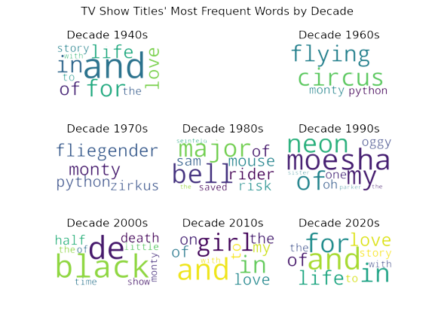
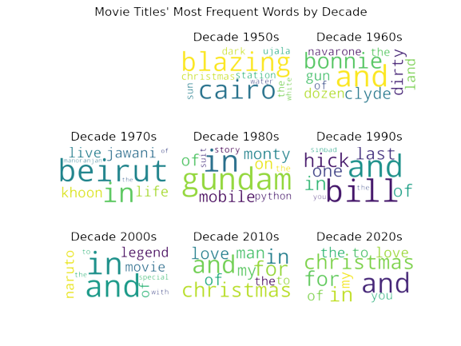
Analysis on Trends: Titles - Language & Theme
Language:
Concise but not too concise, as filler words are consistently used in all decades
Dominant movie market shifted from foreign language regions to English
Theme: Evolving from conflictual, depressing to casual and life

Slide 9
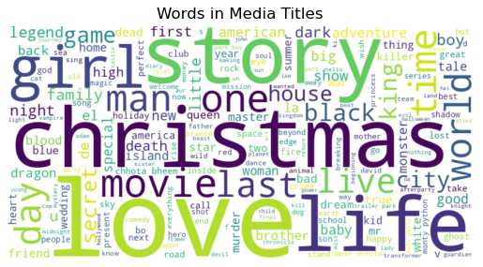

Slide 10
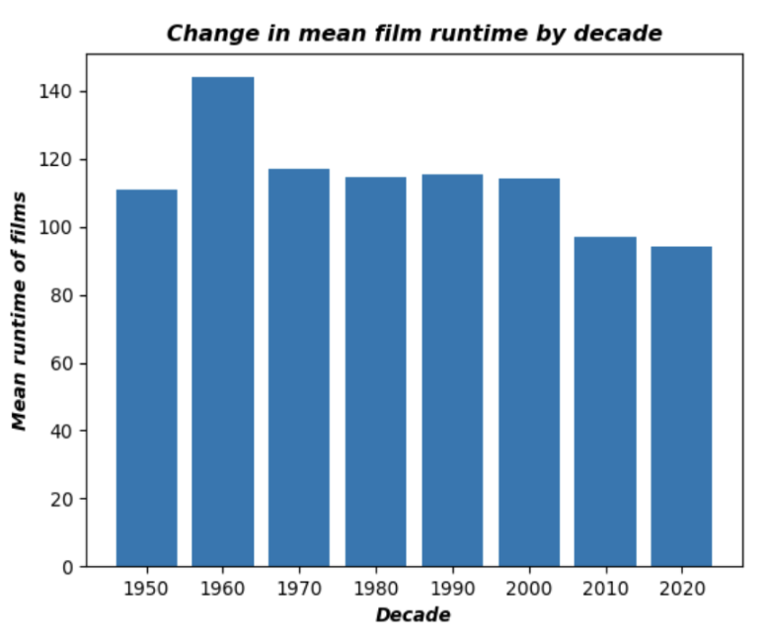
Analysis on Trends: Runtime
General decrease
Correlation of -0.69
What does this mean for films in 2023?
What could be potential causes?

Slide 11
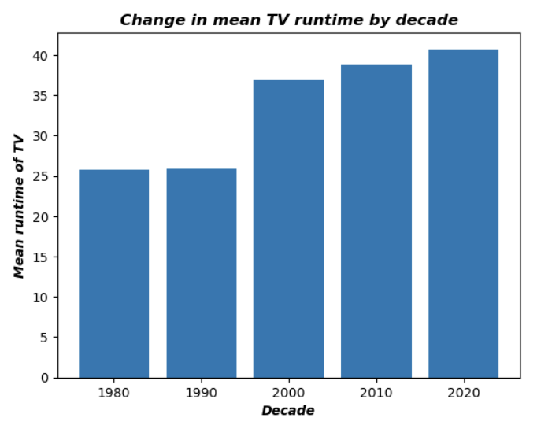
Analysis on Trends: Runtime
General increase
Correlation of 0.94
What does this mean for TV in 2023?
What are possible explanations?

Slide 12
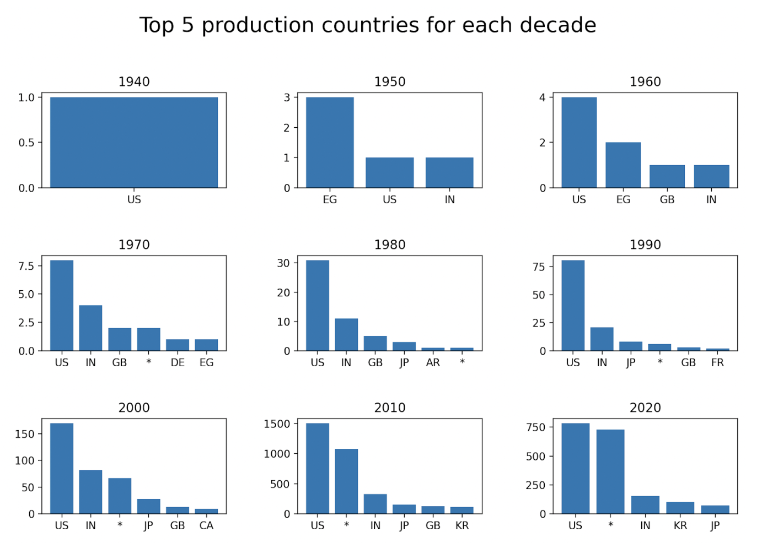
Analysis on Trends: Production Country
Analysis of top five production countries
Variability of market
inconsistent top five
USA is prevalent
‘Other category is increasing…

Slide 13
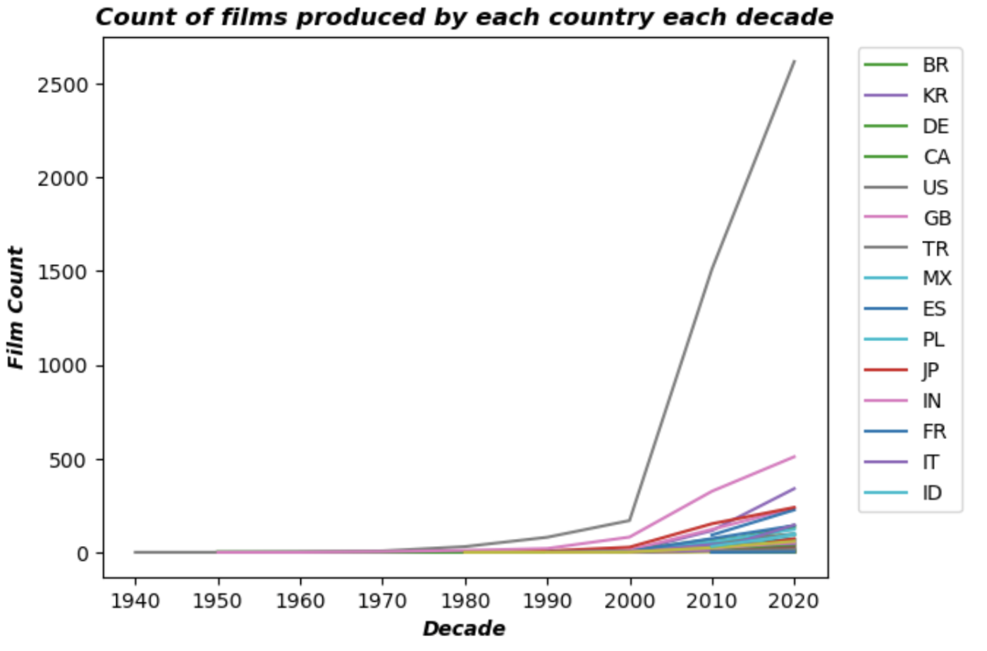
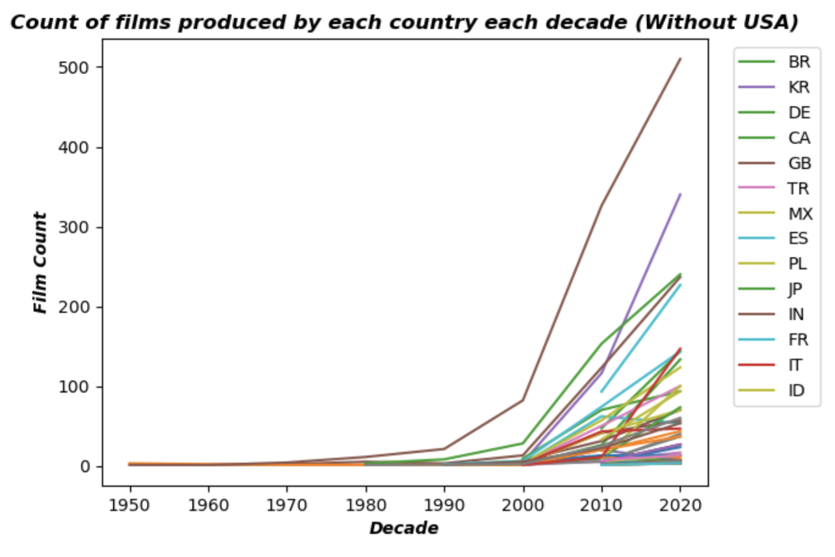
Analysis on Trends: Production Country
Small production countries growing
While Titles Analysis shows shift to English titles, we see more variety in the countries producing them
What does this mean for Media being produced in 2023?

Slide 14
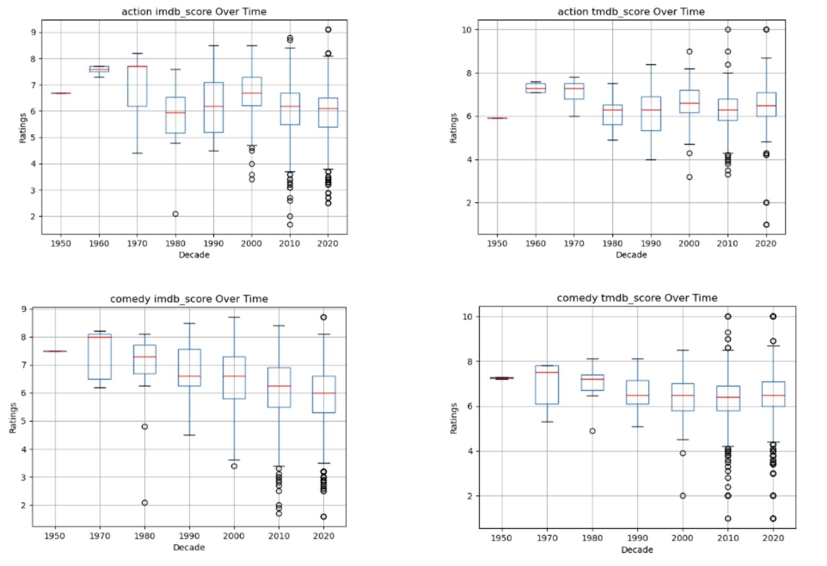
Analysis on Trends: Genres and Scores
Notes:
For genre we started out by plotting all the imdb scores and tmdb scores over time to see check for any initial patterns.
These are two of the examples, namely action and comedy
Among all our findings the one that stood out the most was a significant increase in range over time. We suspect this was due to the significant increase in movies made overall but also due to an improvement in technology which made movies cheaper to make.
Other than that, despite some genres being more popular some decades, score is clearly not entirely dependant on genre. Tmdb scores tended also to be higher than imdb scores, suggesting audiences rank movies higher than critics.

Slide 15
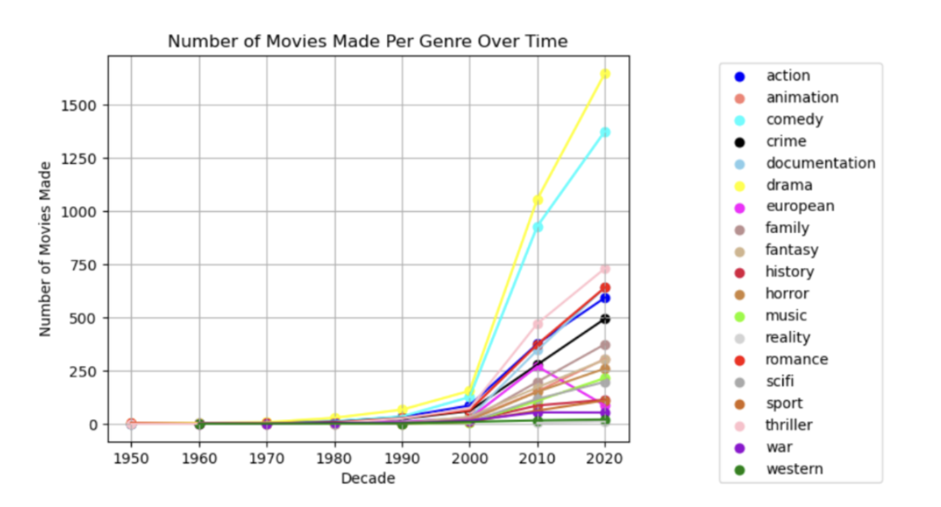
Notes:
Secondly we plotted all movies produced within each genre over time. As you can see drama and comedy have been significantly on the rise the past two decades,
and even though it is hard to see here, drama and comedy remained the most popularly produced genre of all time. This could suggest that they do well and are timeless and is definitely something we should keep an eye out for.

Slide 16
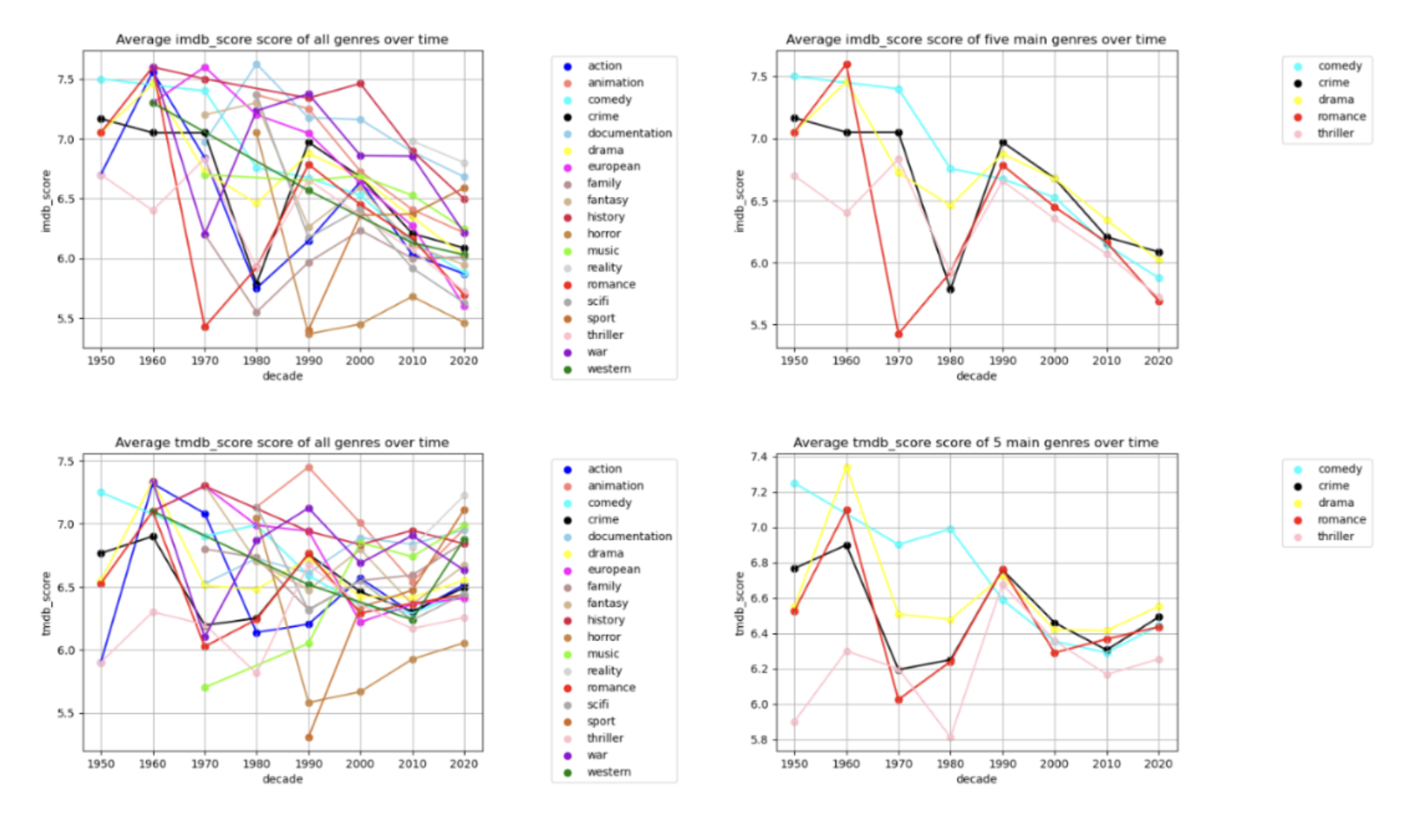
Notes:
Later we plotted all average imdb scores and tmdb scores over time in order to see if there was any overarching themes. The five main genres are plotted to the right for a simplified view. As can be seen, a lot of genres have been added recently such as reality as movies gain more variation. There was not a lot of overarching trends other than that averages drop over time which could be attributed to an increase in range.

Slide 17
03
Findings
Concluding statements and next steps

Slide 18
Our key findings:
The market for media is very variable, especially with regards to time
A piece of media in 2023 will likely be…
A TV show of comparatively long runtime
Produced in the USA
Christmas or love-themed
With a concise, simple title of 2-4 words
A drama or a comedy film.
Ultimately, this variability will make it hard for us to scale these predictions for even a few years in the future.
We need a longer-term approach, so we have created a machine learning model…

Slide 19
04
Our Model
A prediction of media’s score based on key factors

Slide 20
The Target Variable: ScoreIndex

Slide 21
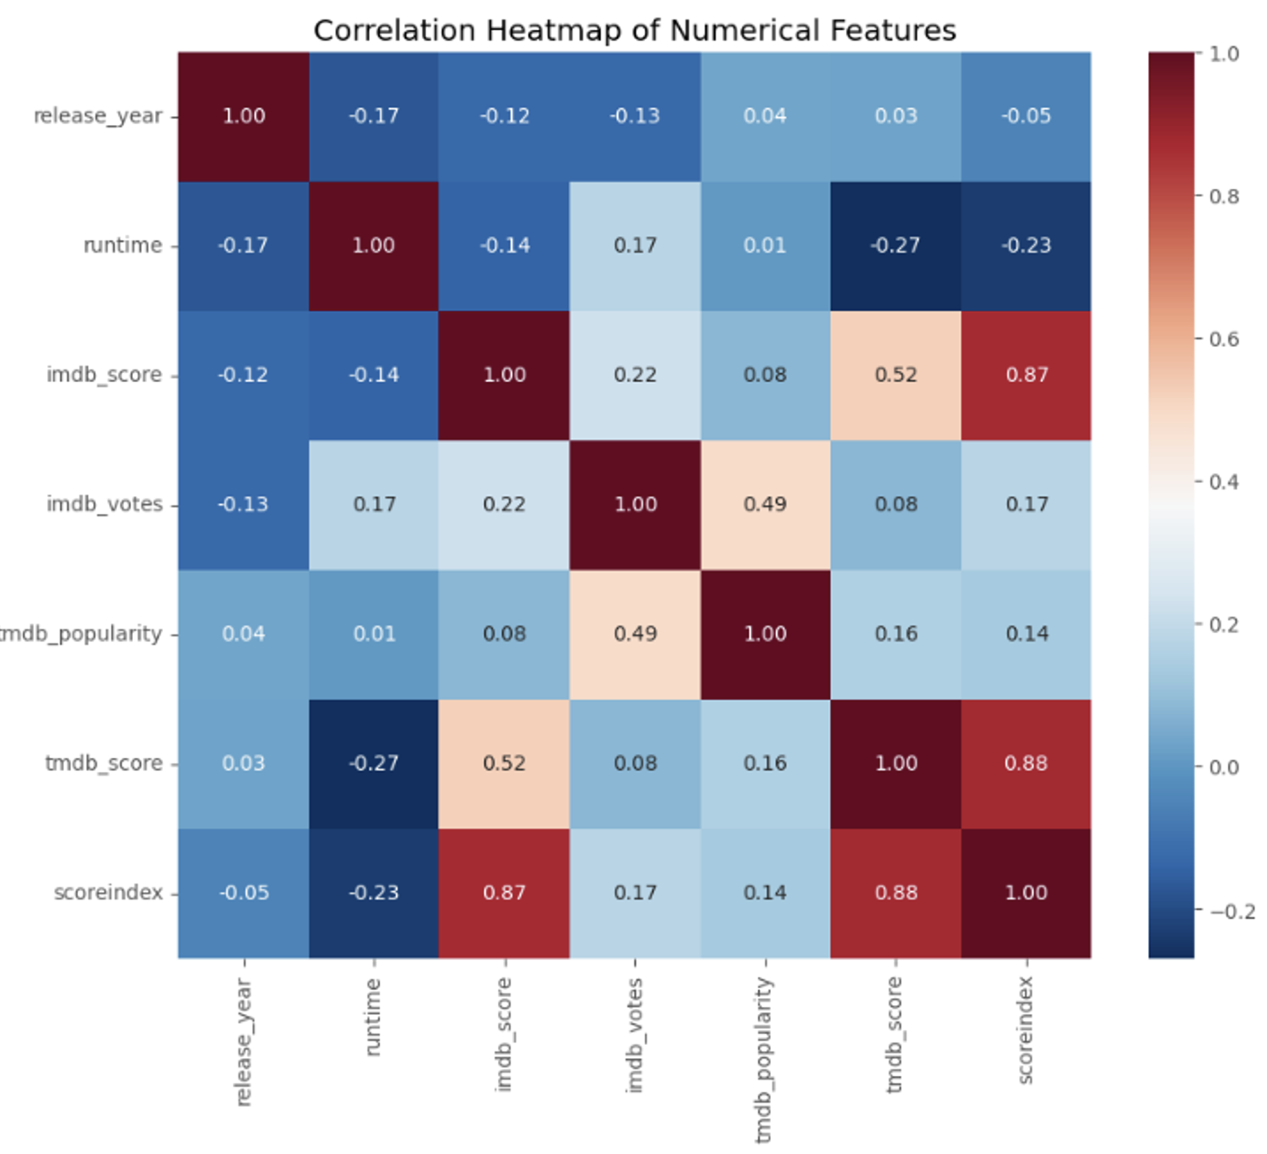
Preparation and Feature Selection
Transformation: categorical data → numerical format via label encoding
Standardization of all numerical data using a standard scaler
NOT Including high correlation variables

Slide 22
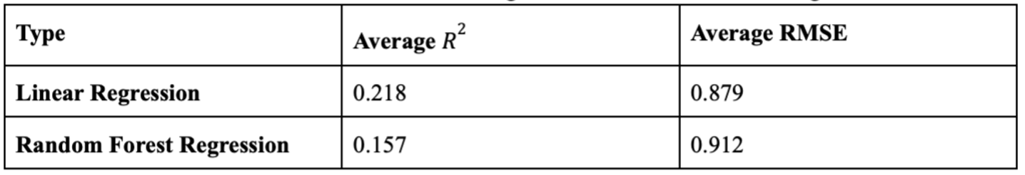
Supervised Machine Learning
Linear Regression/Random Forest Regression
80% training 20% testing (24 features)
5-fold cross-validation
Root Mean Square Error (RMSE) and R² score → Model Performance
Not strong predictive capabilities

Slide 23
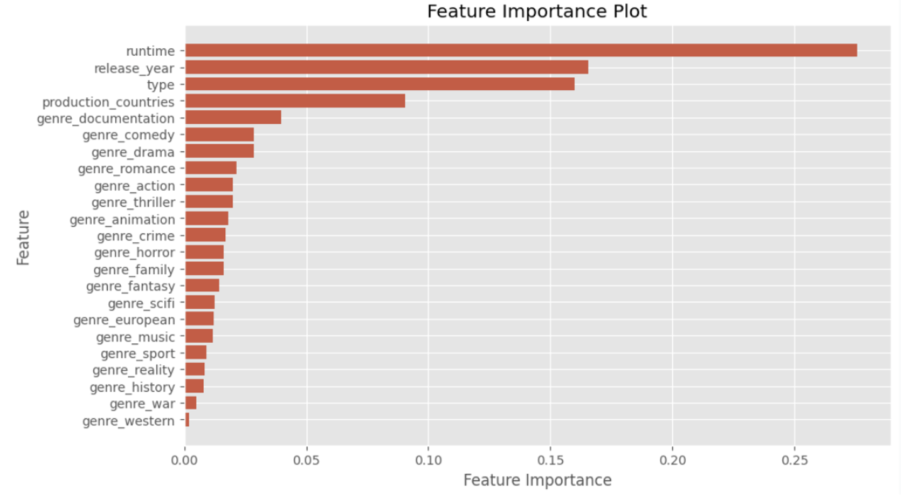
Feature Importance

Slide 24
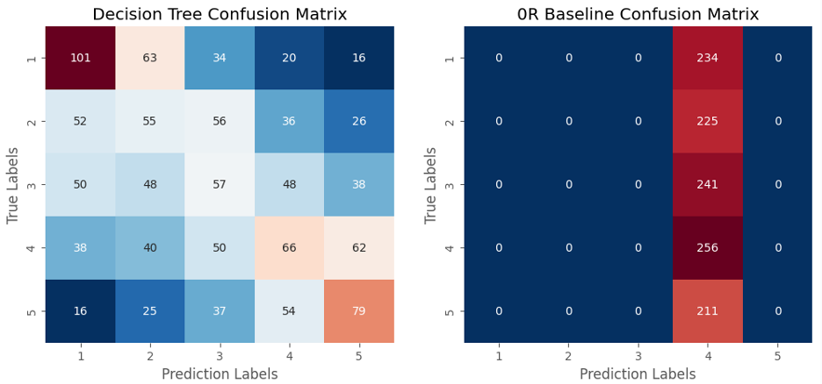
Supervised Machine Learning
Decision Tree
Manually segmenting the “scoreindex“ into five distinct categories (1-5)
Zero-R baseline model
Confusion Matrix

Slide 25
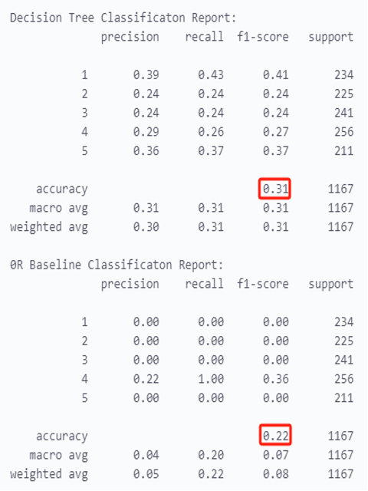
Supervised Machine Learning
Decision Tree
Overall accuracy:
Our: 0.31
Zero-R baseline: 0.22
K-means: improve accuracy (99%)
Not provide robust and credible predictive insights for the real-world movie industry

Slide 26
05
Limitations + Improvements
What were our constraints, what are our next steps?

Slide 27
Limitations
Improvements
Data scarcity for 1940s-1980s
Potential unknown bias in data
Machine Learning Model inherent limitations
Linear regression model limitations:
Assumption of linearity between IVs
Intolerance towards multicollinearity
Random forest model limitations:
Slow to predict
Not a lot of TV series data
Lots of missing data that had to be imputed or removed
Dummy variable for each genre may cause diverged weighting in machine learning.
Genre intersections & boxing
Incomplete usage of data (e.g. Directors data)
Stratification, more complex training of model
Source larger dataset to prevent overfitting of model
Dimensionality reduction methods to reduce effect of potential multicollinearity between features
Notes:
Some possible improvements would be to look at genre intersections and boxing, for example seeing whether romcoms do better than just comedies or just romance, and grouping categories such as action and war.
We could also look at using a more complete version of the dataset by including directors and actors as these could massively affect the score.
Could look at using stratification, a more complex training model to improve accuracy,
Or maybe source a larger dataset for more test data and such to prevent overfitting our model.
Could also look at dimensionality reduction methods to reduce potential multicollinearity we were not aware of which could contribute to bias in our model.

Slide 28
~
Thank you!
Any questions?

