Slide 1

Note: The data and information in this document is reflective of a hypothetical situation and client. This document is to be used for KPMG Virtual Internship purposes only.
Sprocket Central Pty Ltd
Data analytics approach
[Division Name] - [Engagement Manager], [Senior Consultant], [Junior Consultant]

Slide 2
Note: The data and information in this document is reflective of a hypothetical situation and client. This document is to be used for KPMG Virtual Internship purposes only.
Agenda
Introduction
Data Exploration
Model Development
Interpretation

Slide 3
Note: The data and information in this document is reflective of a hypothetical situation and client. This document is to be used for KPMG Virtual Internship purposes only.
Introduction
Leveraging customer demographic, address, and transaction data to identify new target customers for optimizing organizational value.
Steps Take:
Data quality assessment
Data cleaning
Feature engineering (Added new variables AGE and Margin Gain (Profit)
Identify high value customers based on Margin gain

Slide 4
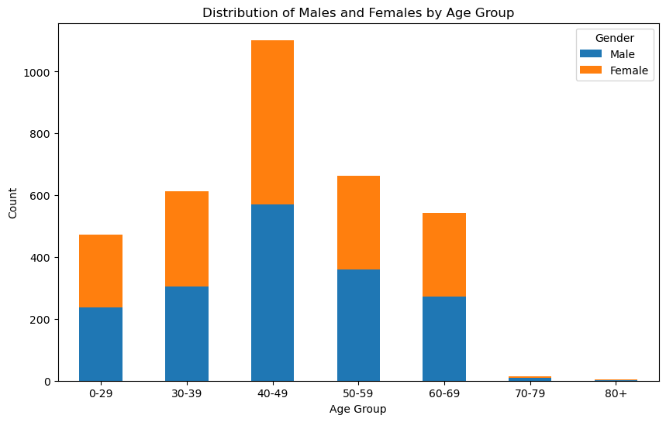
Note: The data and information in this document is reflective of a hypothetical situation and client. This document is to be used for KPMG Virtual Internship purposes only.
Data Exploration
Distribution of gender across the age groups
Most of the Customers are within the age of 40 to 49
Gender is evenly distributed across the age groups
Place any supporting images, graphs, data or extra text here.

Slide 5
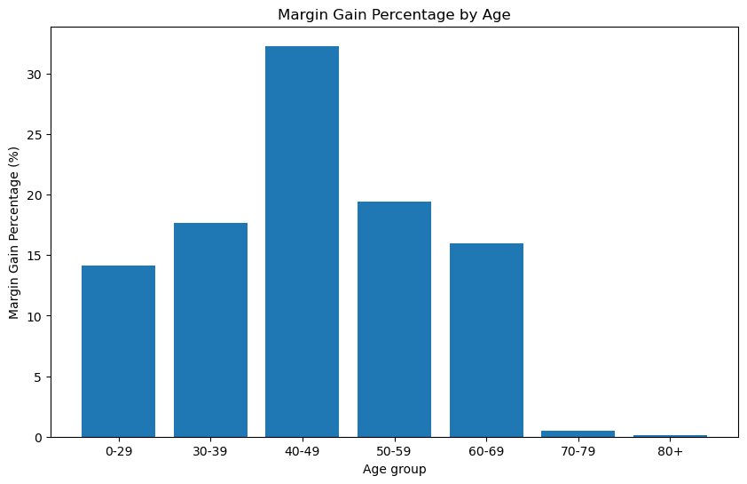
Note: The data and information in this document is reflective of a hypothetical situation and client. This document is to be used for KPMG Virtual Internship purposes only.
Data Exploration
Percentage of Margin Gain generated by each age groups
More than 30% of the generated profit comes from customers within the age of 40-49; followed by customers within the age of 50-59
Customers within the age of 70 above had the least profit
Place any supporting images, graphs, data or extra text here.

Slide 6
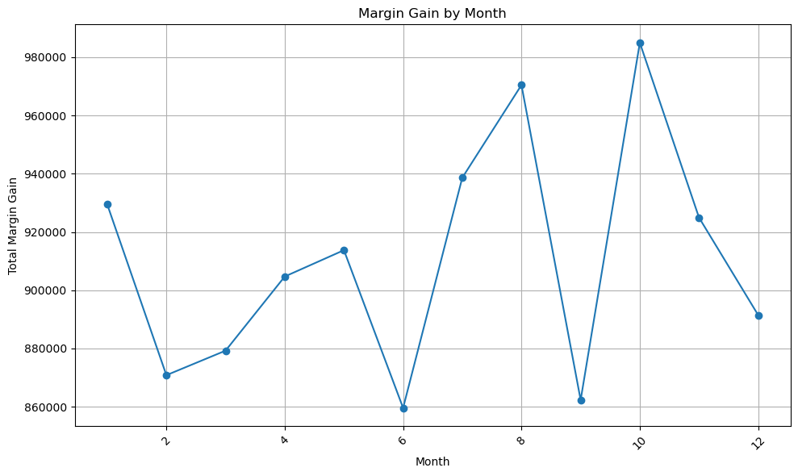
Note: The data and information in this document is reflective of a hypothetical situation and client. This document is to be used for KPMG Virtual Internship purposes only.
Data Exploration
Margin Gain generated in each month based on the Transaction dates
The profit generated fluctuate in each month and does not follow a particular trend
October had the highest profit with $990,000 profit, followed by August with $970,000
The least profitable month is June and September with $860,000 profit.
Place any supporting images, graphs, data or extra text here.

Slide 7
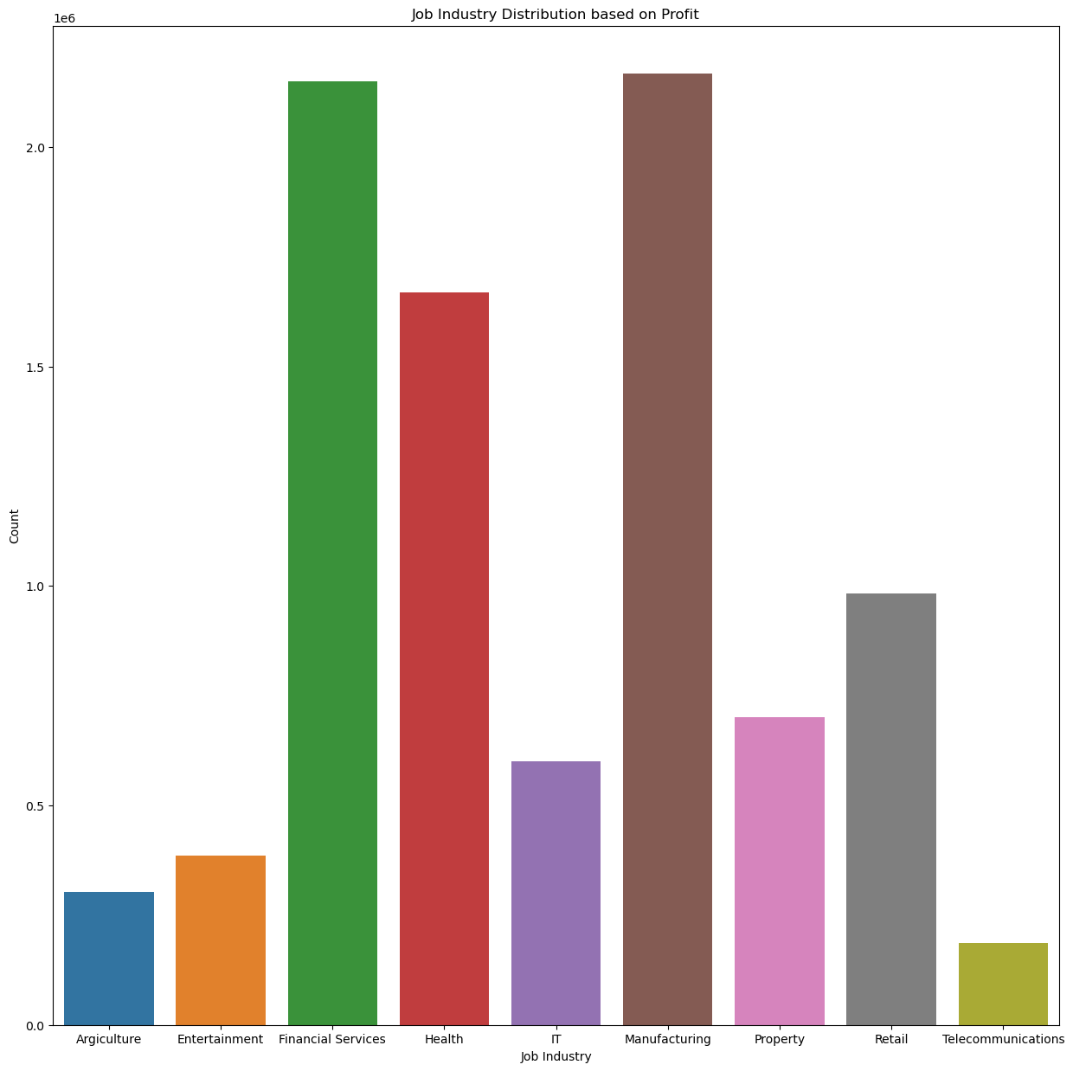
Note: The data and information in this document is reflective of a hypothetical situation and client. This document is to be used for KPMG Virtual Internship purposes only.
Data Exploration
Margin Gain generated in based on Job industry
Manufacturing and financial services industry generated the highest profit
Followed by Health
Place any supporting images, graphs, data or extra text here.

Slide 8
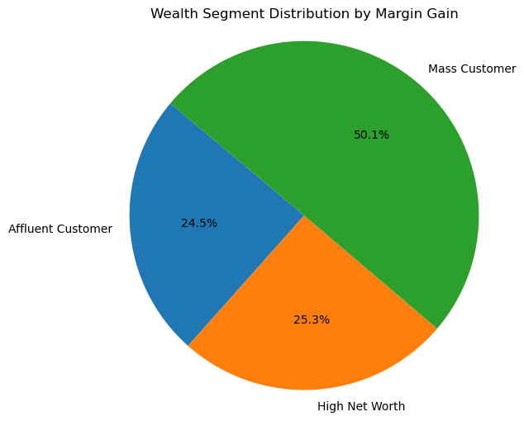
Note: The data and information in this document is reflective of a hypothetical situation and client. This document is to be used for KPMG Virtual Internship purposes only.
Data Exploration
Margin Gain generated by each wealth Segment
Most customers are within the Mass wealth segment
Half of the total margin gain was generated by the Mass wealth segment
High Net Worth and Affluent share evenly share the remaining 50%
Place any supporting images, graphs, data or extra text here.

Slide 9
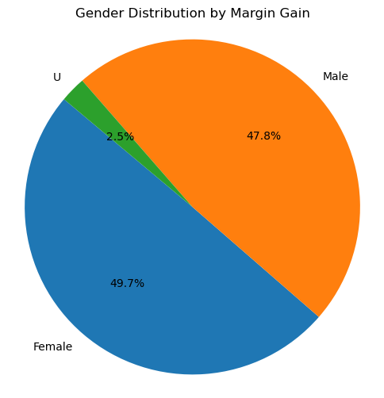
Note: The data and information in this document is reflective of a hypothetical situation and client. This document is to be used for KPMG Virtual Internship purposes only.
Data Exploration
Margin Gain generated by each gender
Both male and female genders contribute closely to the margin gain
Place any supporting images, graphs, data or extra text here.

Slide 10
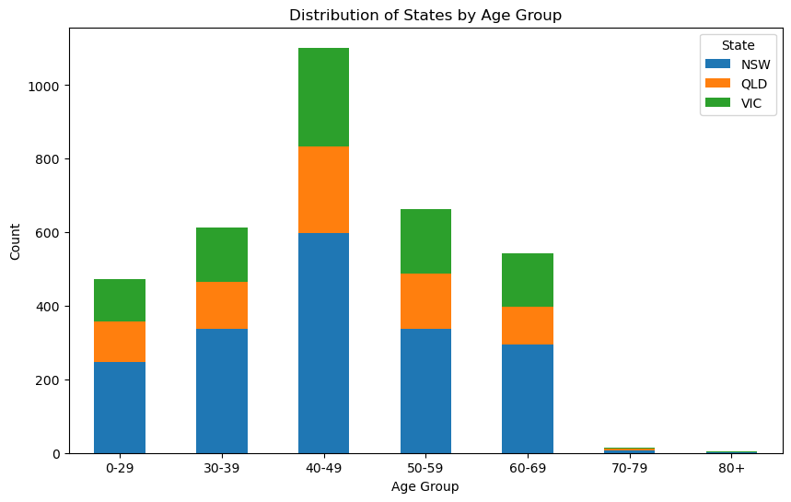
Note: The data and information in this document is reflective of a hypothetical situation and client. This document is to be used for KPMG Virtual Internship purposes only.
Data Exploration
Distribution of States by Age group and Margin gain
Most customers within the age of 40-49 live in NSW
Most customers are from NSW
Customers between the age of 40-49 generates the highest profits
Place any supporting images, graphs, data or extra text here.

Slide 11
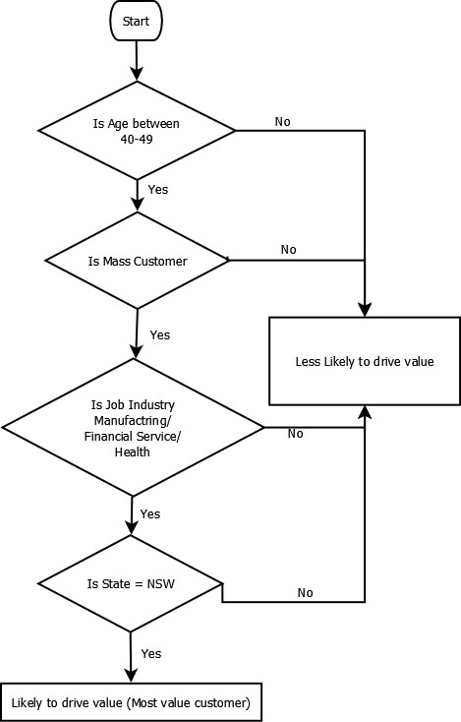
Note: The data and information in this document is reflective of a hypothetical situation and client. This document is to be used for KPMG Virtual Internship purposes only.
Model Development
The model will be developed using decision Tree
A flowchart of the decision model is shown
Where customers who has this 4 main characteristics are identified as high valued
Age 40-49
Mass customer segment
Manufacturing, Financial service or Health industry
Lives in NSW
Place any supporting images, graphs, data or extra text here.

Slide 12
Note: The data and information in this document is reflective of a hypothetical situation and client. This document is to be used for KPMG Virtual Internship purposes only.
Interpretation
High Value Customer
Age (40-49)
Mass Customer Wealth Segment
Lives IN NSW
Industry (Manufacturing, Financial Services, or Health)
Model interpretation
Applying these identified trends to the new customer dataset, we have identified 33 potential customers who are highly likely to make substantial contributions to the company's profit in the upcoming years.

