Slide 1
Water Pump Project
By Mary and Geetha

Slide 2
Features Used
Feature Engineering:
water_quality_quantity — Combined water quality + quantity
pump_age — Derived from construction year & date recorded
Data Cleaning & Transformations
Latitude / Longitude
Removed impossible coordinates (outside Tanzania bounds)
Added sin/cos transforms for smooth spatial patterns
amount_tsh
Kept zeros (valid “no pressure” readings)
Population
Capped extreme outliers (99th percentile)
gps_height
Invalid zeros replaced with region median

Slide 3
Handle high-cardinality variables
Installer Column
Cleaned & normalized with dictionary (aliases, acronyms)
Removed placeholders: "0", "nan", "none", "unknown", etc.
Unified common installers ("DANID" → "DANIDA")
Kept Top 14 installers (cover majority of data)
Remaining values grouped as "Other"
Columns Dropped (20+)
High-cardinality or redundant fields
Examples: wpt_name, subvillage, scheme_name, funder, region_code, district_code, etc.

Slide 4
Baseline models
DecisionTree
RandomForest
Model | Accuracy | Precision_macro | Recall_macro | F1_macro
Random Forest | 0.7963 | 0.6921 | 0.6958 | 0.6935
Decision Tree | 0.7479 | 0.6343 | 0.6491 | 0.6407

Slide 5
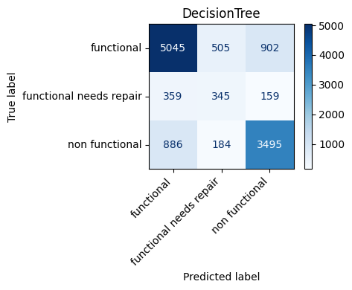

Confusion matrix

Slide 6
Models performance
Class | Model Strength | Issues
functional | High accuracy | Some pumps falsely flagged as broken
functional needs repair | Weakest performance | Often confused with the other classes
non functional | Strong performance | Some broken pumps predicted as functional

Slide 7
models
Smote: Accuracy: 0.7880, F1_macro: 0.6853
Cross validation: F1_macro scores: [0.6866, 0.6755, 0.6947, 0.6735, 0.6818]
Mean: 0.6824
Feature engineering
Hyperparameter tuning

Slide 8
Models Compared
Baseline Models
Logistic Regression (with StandardScaler + OHE)
Random Forest Classifier
Improved Model
Random Forest Classifier with Hyperparameter Tuning
Tuned with RandomizedSearchCV
Scored using macro F1
Balanced class weights
Optimized depth, features, and tree count

Slide 9
Model | Accuracy | F1 Macro
Logistic Regression | 0.6575 | 0.5642
Random Forest | 0.8048 | 0.6886
Random Forest (Random Search) | 0.7928 | 0.6955

Slide 10
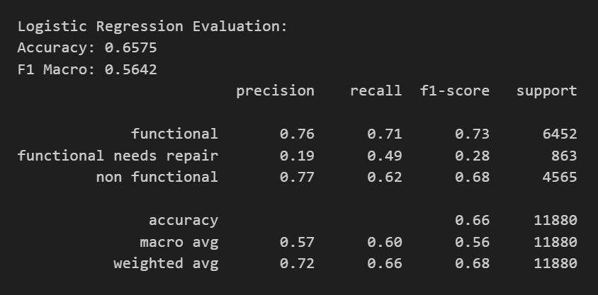
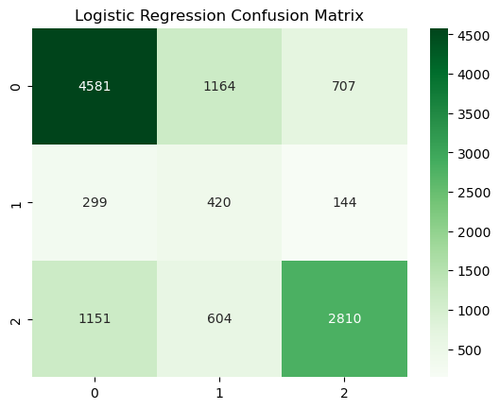
Logistic regression

Slide 11
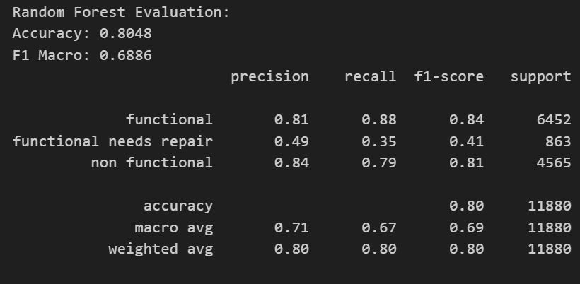
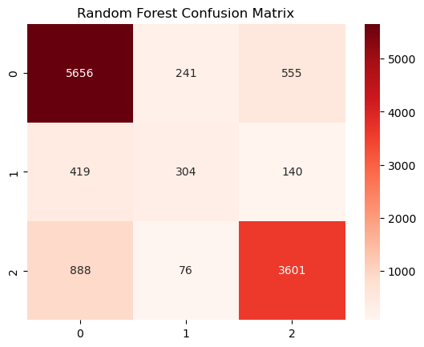
Random Forest Classifier without Tuning

Slide 12
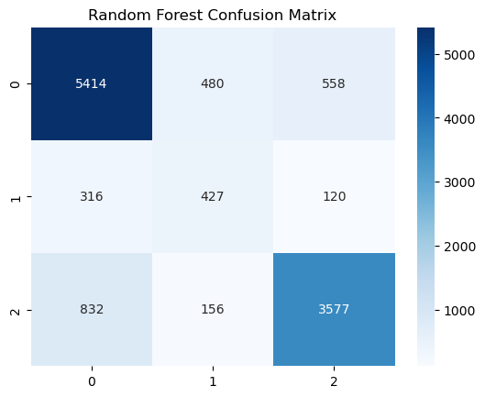
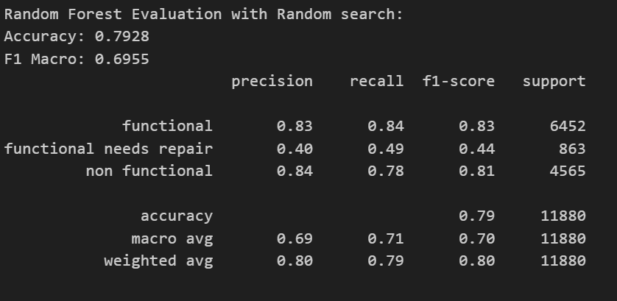
Random Forest Classifier with Tuning

