Slide 1
Real-Time Alerts using AWS SNS, SQS, and Lambda
Decoupled, Scalable, Event-Driven Architecture

Slide 2
Project Goal
- Send SMS/email alerts (e.g., for system failures)
- Learn decoupled systems and async messaging
- Use AWS managed services for real-time alerting

Slide 3
AWS Services Used
- Amazon SNS (publish/subscribe)
- Amazon SQS (message queue)
- AWS Lambda (serverless processing)
- Amazon CloudWatch (logging and monitoring)

Slide 4
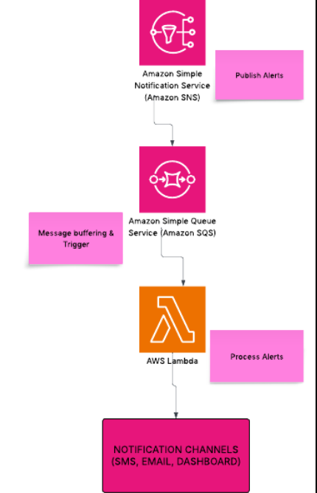
Architecture Overview
SNS → SQS → Lambda → Notification Channels (SMS, Email, Dashboard)

Slide 5
Step-by-Step Implementation
1. Create SNS topic and publish message
2. Create SQS queue and subscribe to SNS
3. Create Lambda function to process messages
4. Trigger Lambda using SQS
5. Monitor in CloudWatch
6. Send alert to SMS/Email/Dashboard

Slide 6
Lambda Function Overview
def lambda_handler(event, context):
for record in event['Records']:
message = record['body']
print('Received:', message)
return {'statusCode': 200, 'body': 'Alerts processed'}

Slide 7
USE CASES:
Application errors trigger SNS → SQS → Lambda for alert processing.
Monitoring system alerts sent to multiple subscribers.
Decoupling producers (publishers) from consumers.

