Slide 1
Assignment-02 Exploring wiki-data using word embeddings / Build LSTMs
Baojian Zhou
DATA130030.01 (自然语言处理)
School of Data Science Fudan University
10/22/2025
Notes:
Machine Translation

Slide 2
Tasks
Task 1 - Train word embeddings using SGNS (30 points)
Train models (20 points); Similar / Dissimilar pairs (10 points)
Task 2 Classify documents using embeddings (30 points)
Task 3 Use t-SNE to project training document embeddings (10 points)
Tas 4 Use LSTM to build a language model (30 points)
Train model (Loss and PPL), 20 points; generated sentence (10 points)
Notes:
机器翻译是将句子 x 从一种语言，我们叫源语言，翻译成另一种语言，我们目标语言的句子 y。

Slide 3
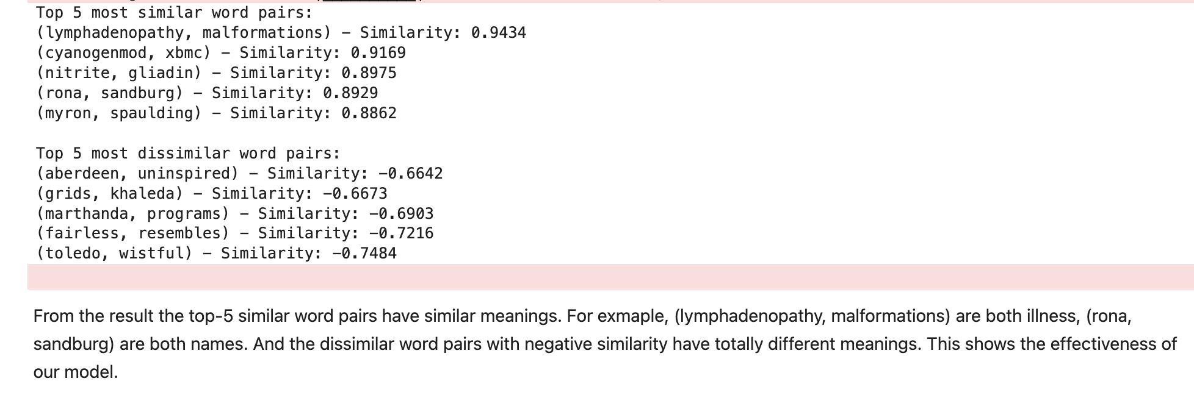
Examples – Task 1

Slide 4
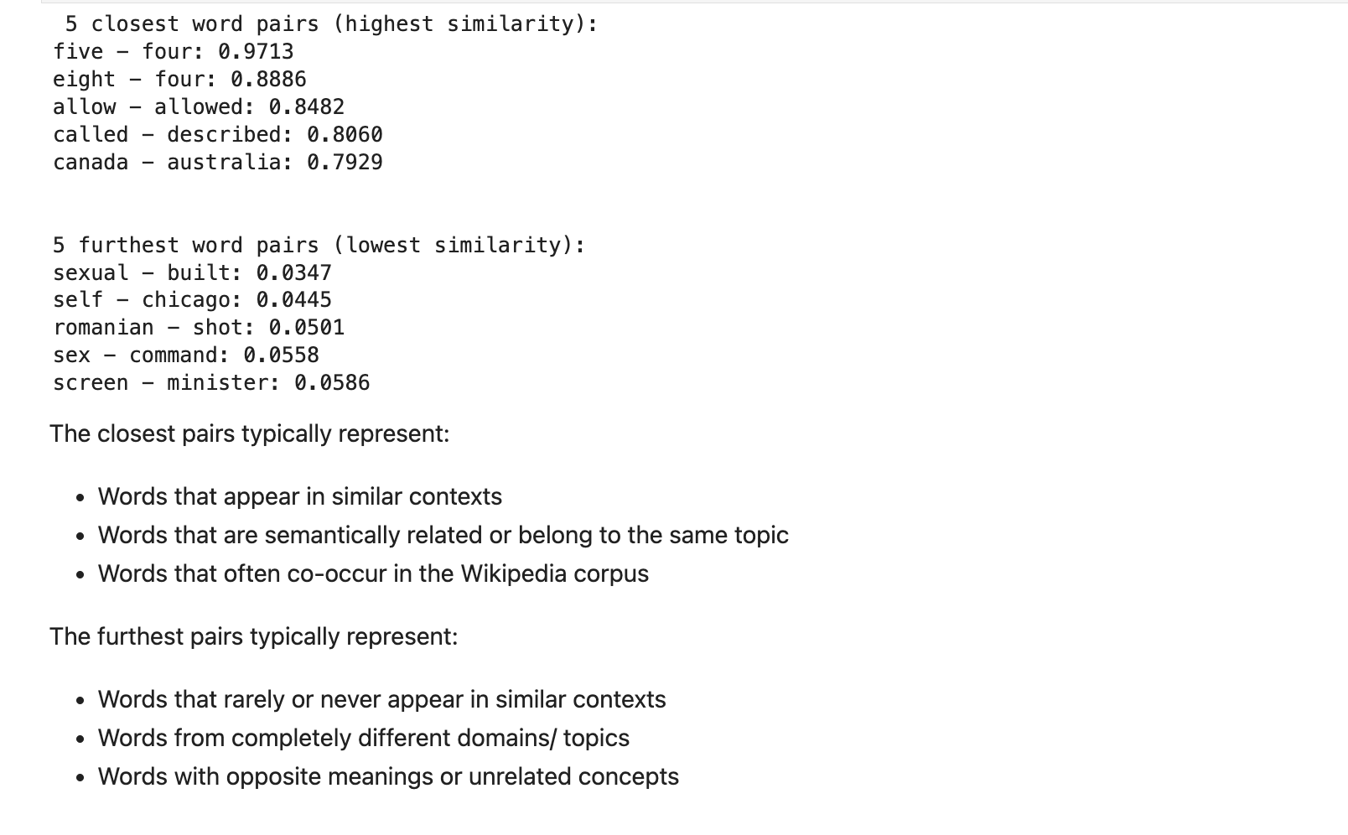
Examples – Task 1

Slide 5
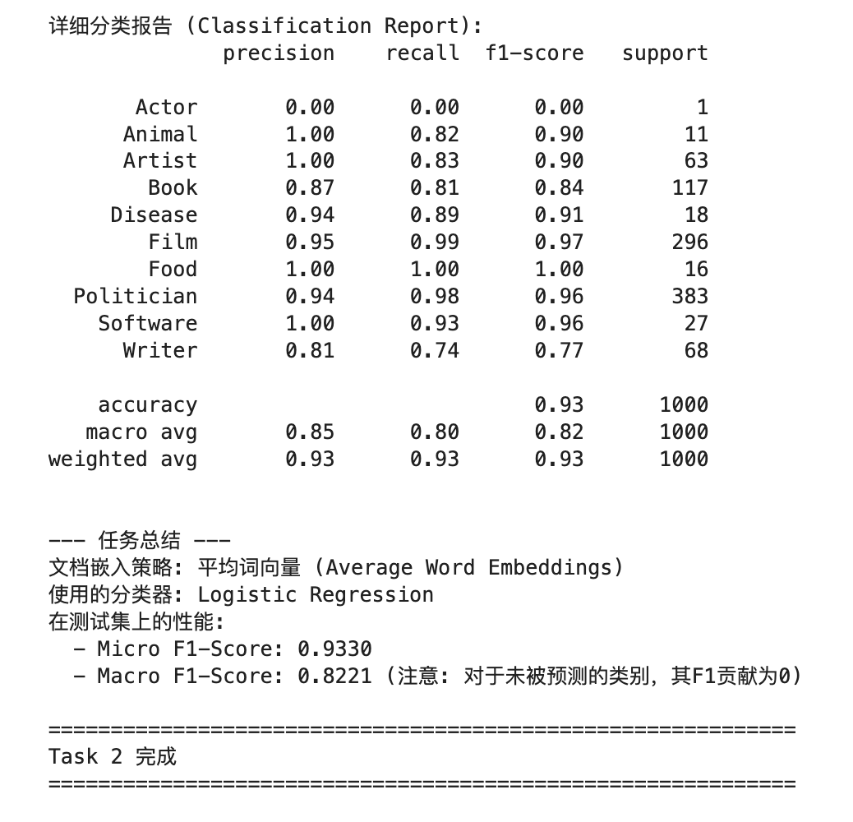
Examples – Task 2

Slide 6
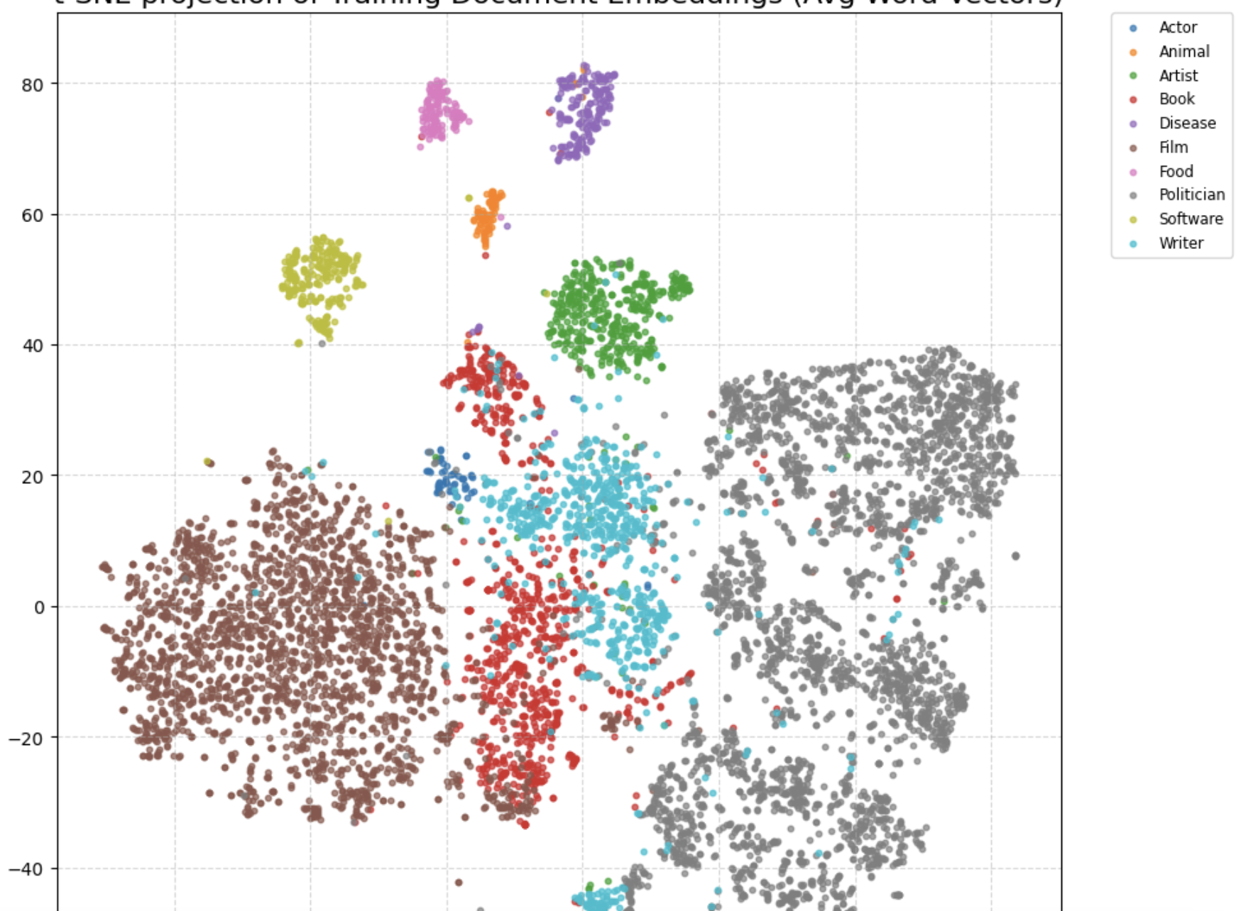
Examples – Task 3
t-SNE

Slide 7
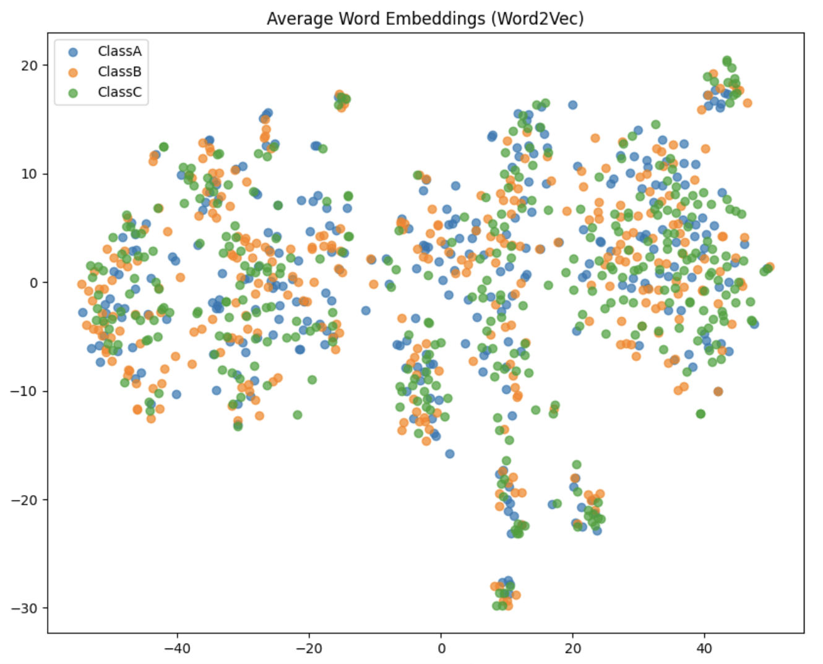
Examples – Task 3

Slide 8
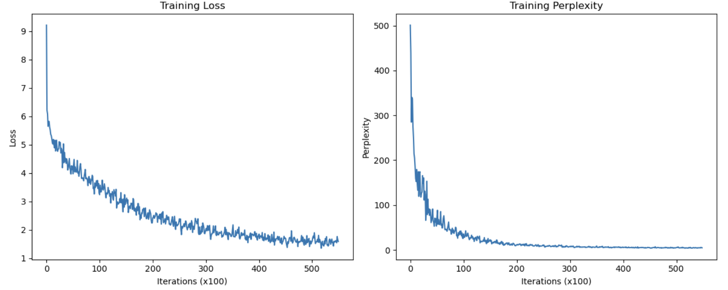
Examples – Task 4

Slide 9
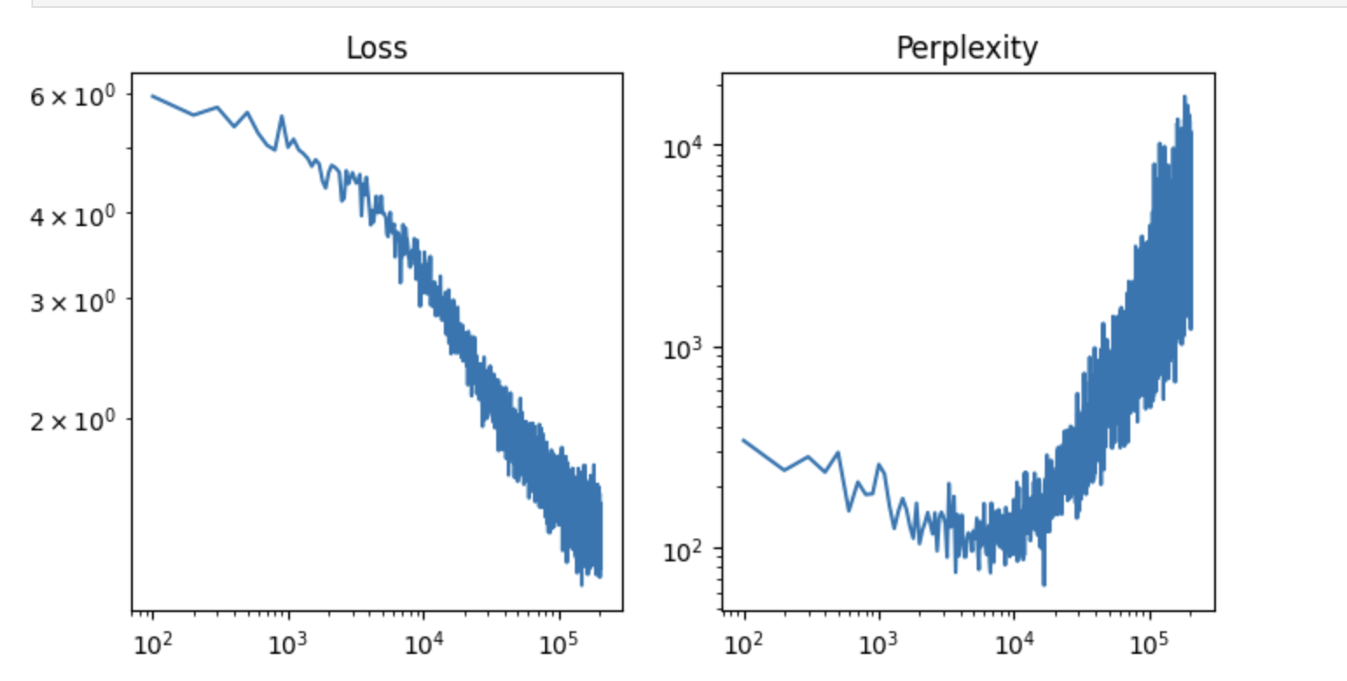
Examples – Task 4

Slide 10
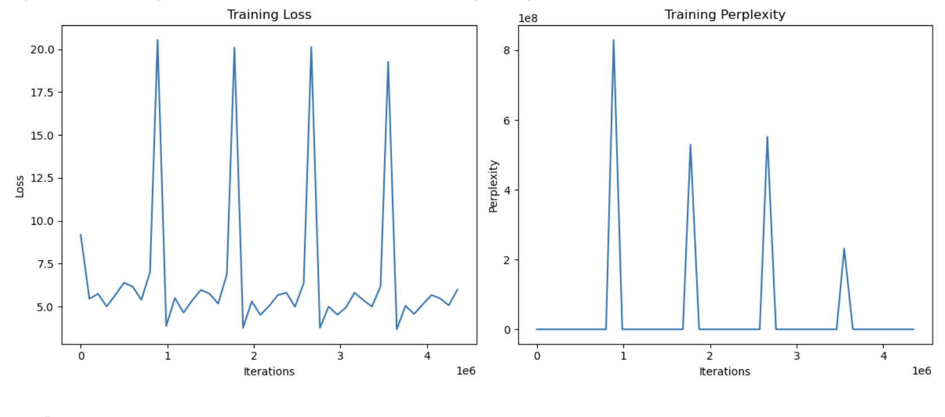
Examples – Task 4

Slide 11
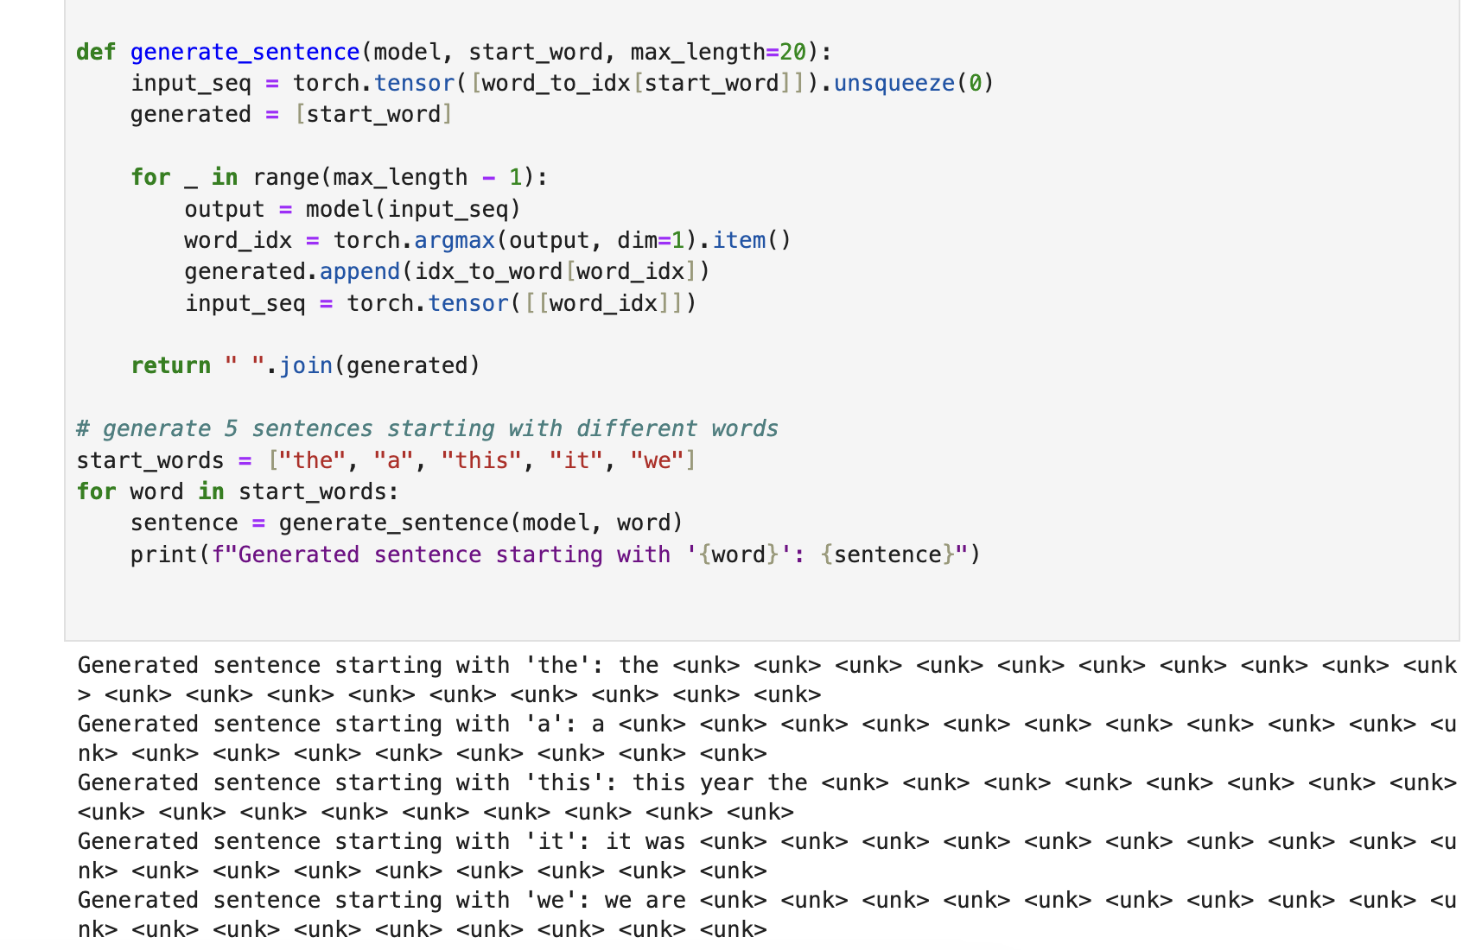
Examples – Task 4

Slide 12
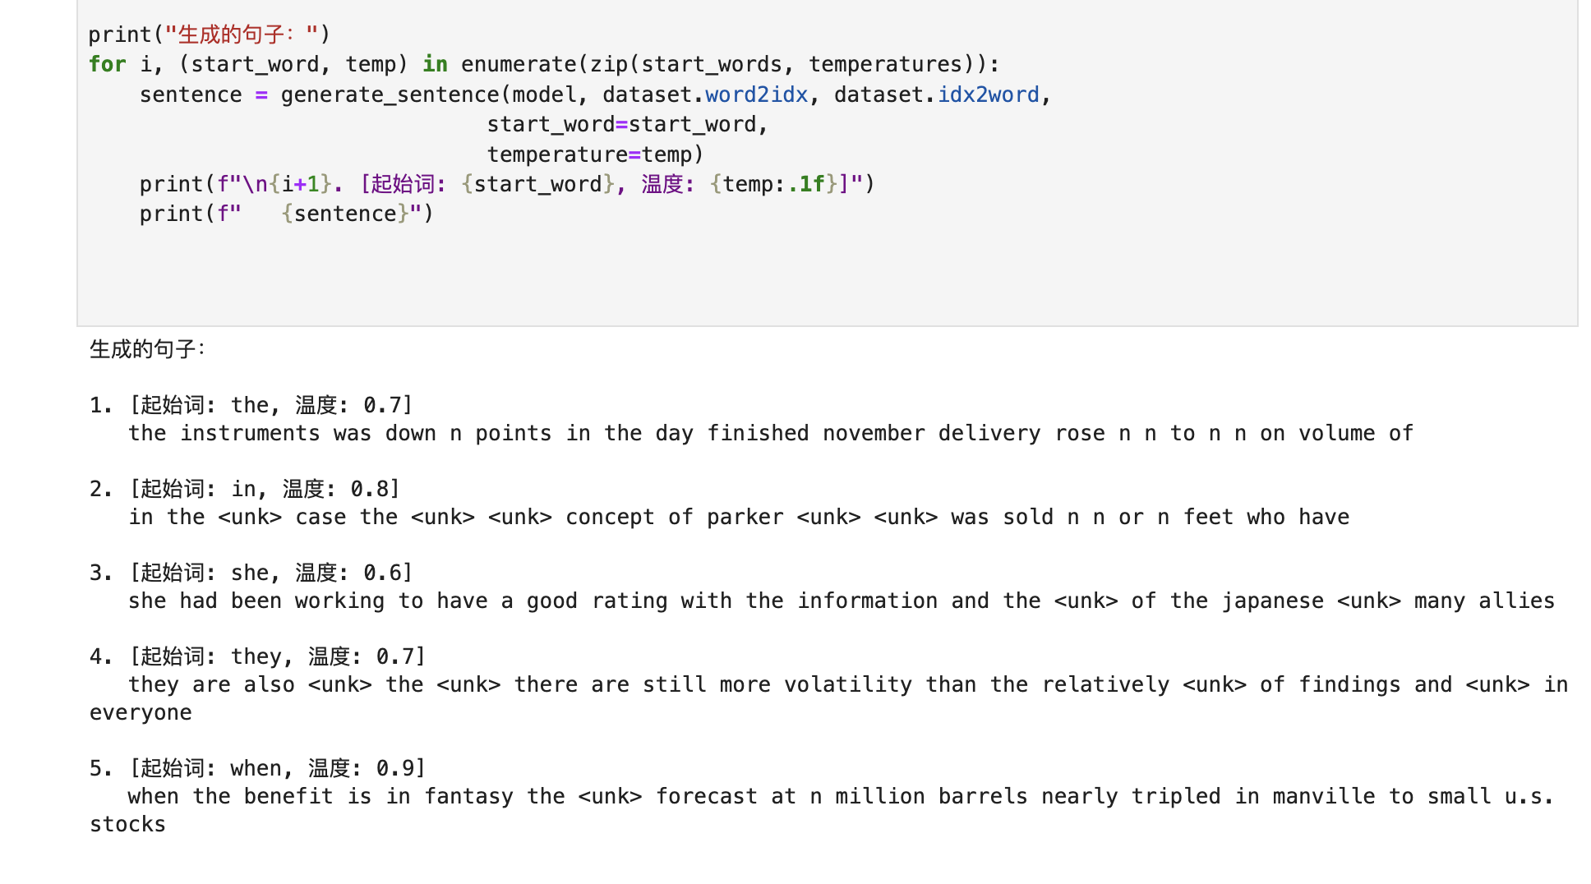
Examples – Task 4

Slide 13
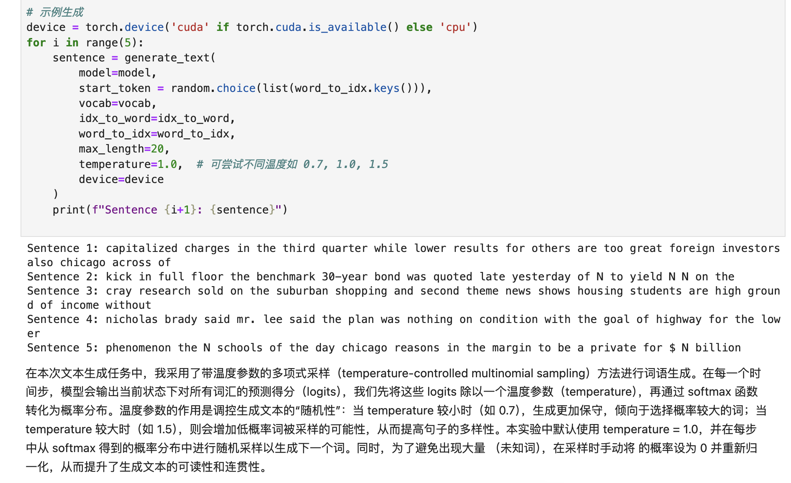
Examples – Task 4

Slide 14
Summize
Average score: 90.37
Task 1 (30/30 points): 1) 20 points; 2) 10 points;
Task 2 (30/30 points): 1) 30 points;
Task 3 (10/10 points): 1) 10 points;
Task 4 (30/30 points): 1) 20 points; 2) 10 points

