Slide 1
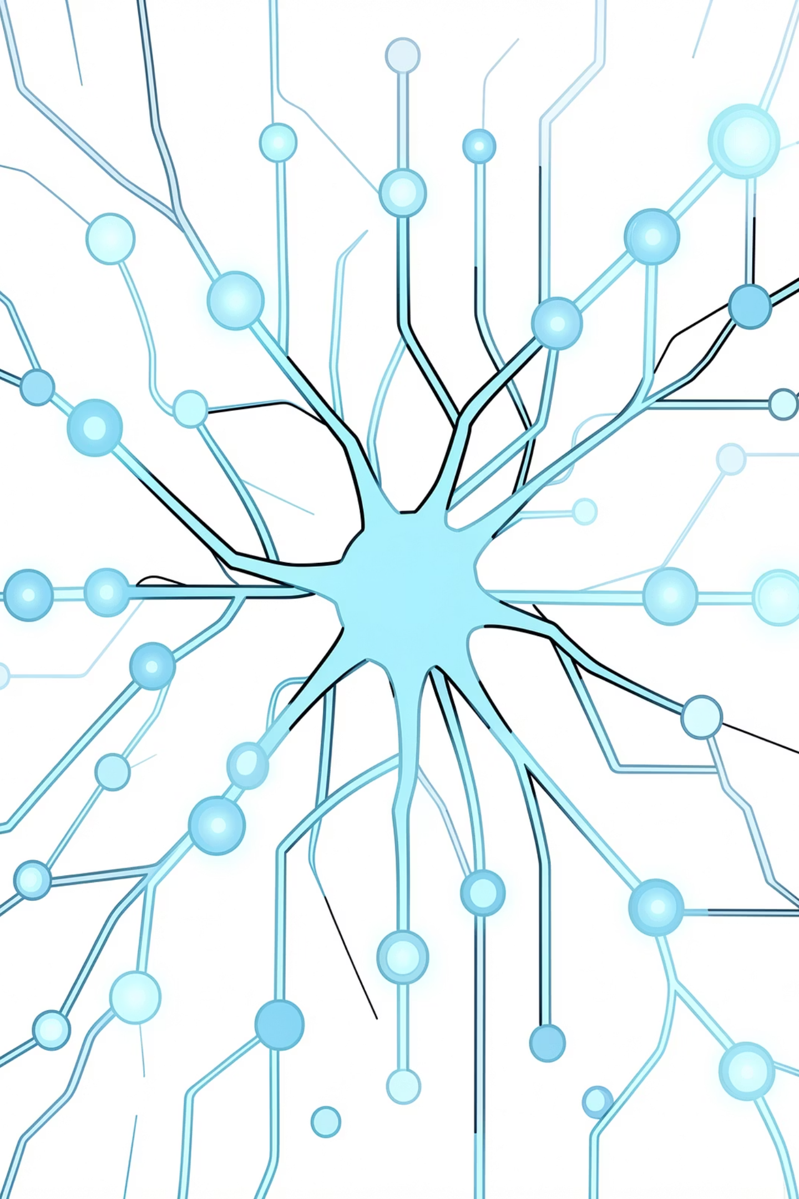
VGG: Visual Geometry Group CNN Architecture
A concise, visual guide to VGG (VGG16 & VGG19) — architecture, strengths, limitations, and modern context.
Presented by
Aya Essam Hussein Hefzy
Aya Ahmed Ahmed Nasef
Mariam Ahmed Abdelhamid Ali

Slide 2
Introduction to VGG
Origins
VGG (Visual Geometry Group) is one of the most important convolutional neural network (CNN) architectures developed for image recognition tasks. Introduced by the Visual Geometry Group, University of Oxford (Simonyan & Zisserman), 2014., VGG achieved excellent performance in the ImageNet competition and showed that increasing network depth can significantly improve image classification accuracy.
Key Idea
VGG has a simple architecture, which uses multiple small 3×3 convolutional filters stacked together instead of larger filters. This approach allows the network to learn detailed and complex image features efficiently. Although newer models like ResNet and EfficientNet are more efficient, VGG remains a foundational and widely studied deep learning architecture due to its simplicity and effectiveness.
Variants
VGG16 (16 weight layers) and VGG19 (19 weight layers)

Slide 3
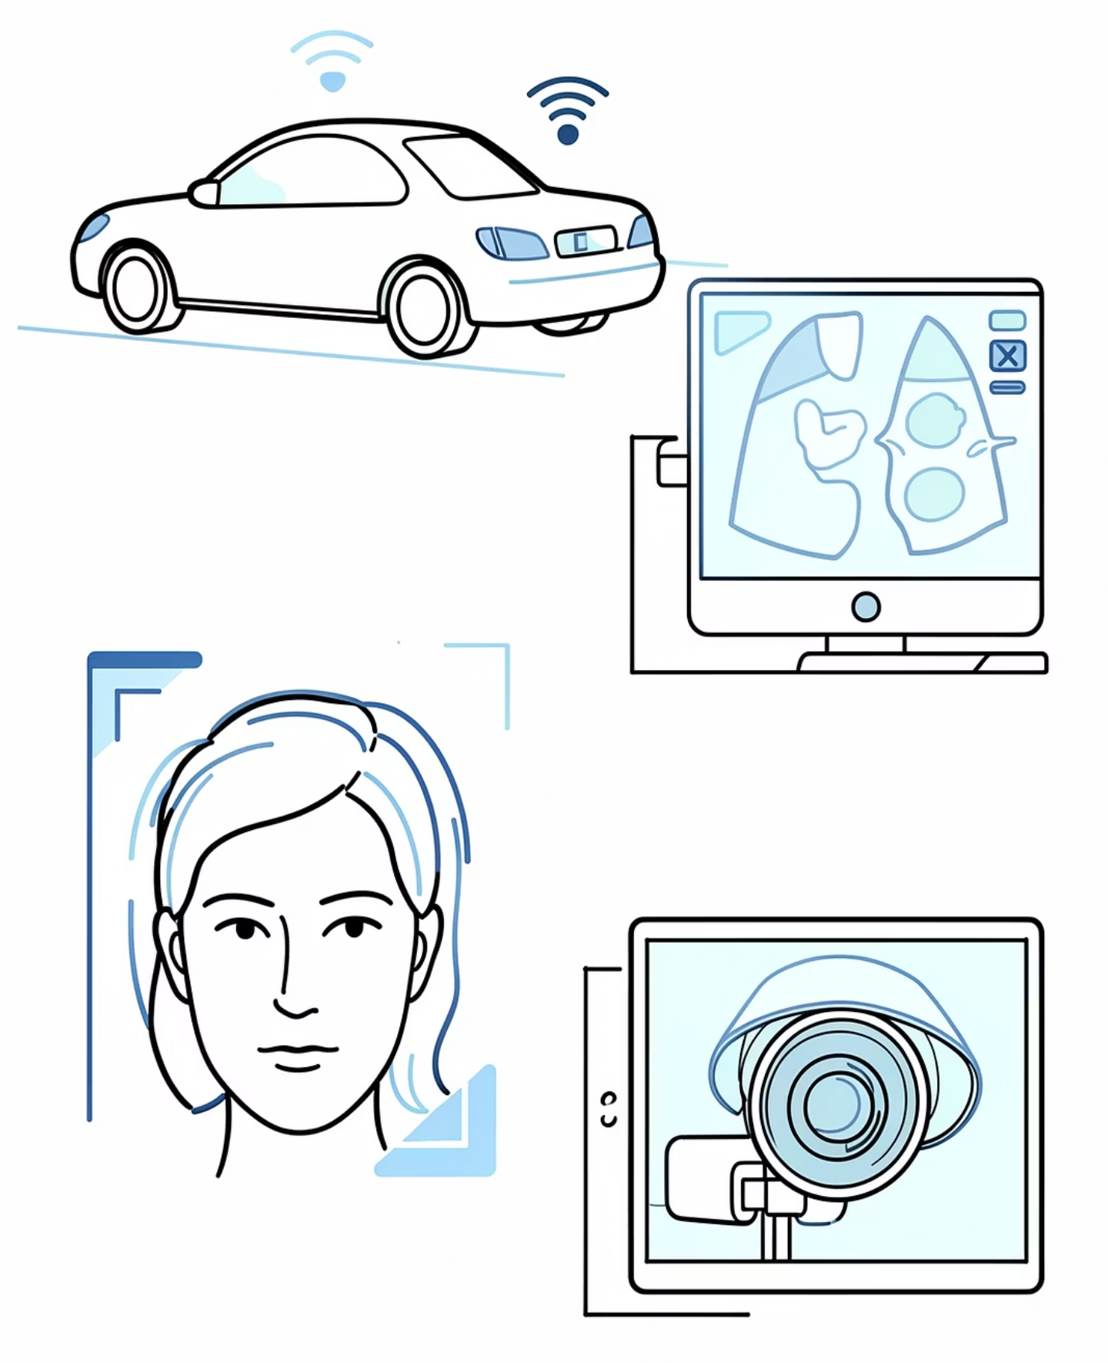
VGG in Computer Vision
VGG became widely used in computer vision applications such as image classification, transfer learning, facial recognition, and medical imaging
Why Computer Vision Matters
Autonomous vehicles: Real-time perception for safety: detection, segmentation, tracking.
Medical imaging: Assist diagnosis with high-resolution feature extraction.
Face recognition & biometrics: Identity, access control, and threat detection workflows.
Surveillance & retail: object detection and analytics
Visual systems power real products — VGG-style feature extractors are often part of those pipelines.

Slide 4
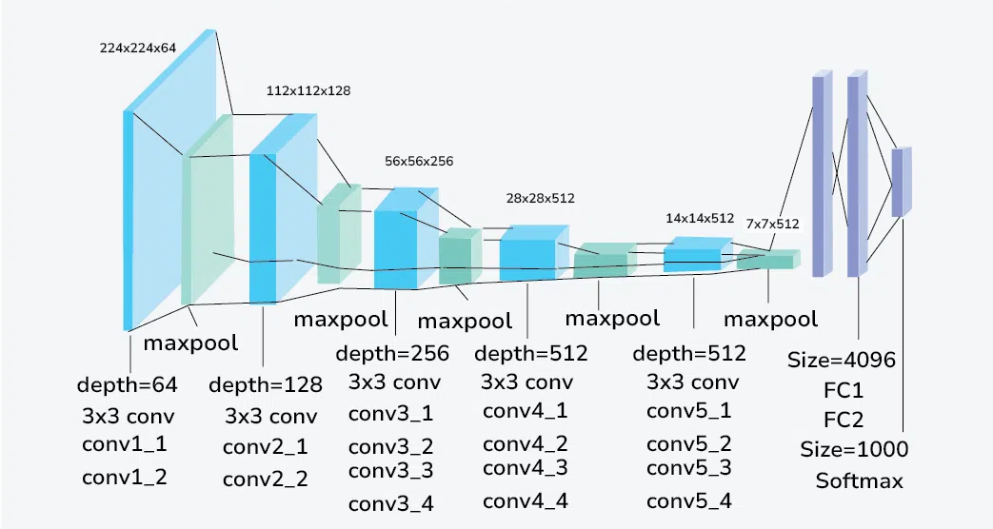
VGG Architecture
VGG-19 is a deep convolutional neural network with 19 weight layers, comprising 16 convolutional layers and 3 fully connected layers.
The architecture follows a straightforward and repetitive pattern, making it easier to understand and implement.
The key components of the VGG-19 architecture are:
Convolutional Layers
Activation Function
Pooling Layers
Fully Connected Layers
SoftMax Layer

Slide 5
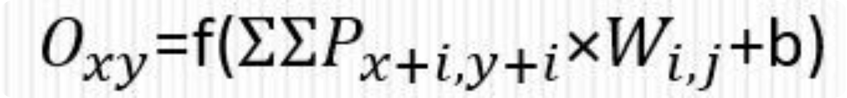

1. Convolutional Layer — Concept & Parameters
Convolution applies learnable filters across the input to produce feature maps. The operation at position (x,y): element-wise multiply, sum, add bias, then apply nonlinearity.
1
2
3
Filter Size (3x3
Stride
Padding
Stacking three 3x3 filters creates the same effective receptive field as one 7x7 filter, but with fewer parameters.
Controls step size of the filter; larger strides reduce output resolution.
Zero-padding preserves edges and controls output dimensions.

Slide 6
Convolutional Layer — Visual Intuition
Animated visualization illustrates how filters scan and extract structured responses from a 2D input tensor to form feature maps.

Slide 7

Activation Layer — ReLU
Operation
ReLU (Rectified Linear Unit) introduces non-linearity to the network by:
performing element wise operations
setting all negative pixels to zero
output the rectified feature map
Training Benefits
Activation functions play a vital role in preventing issues like vanishing gradients during the backpropagation training process, ensuring that learning signals can effectively propagate through deep networks

Slide 8
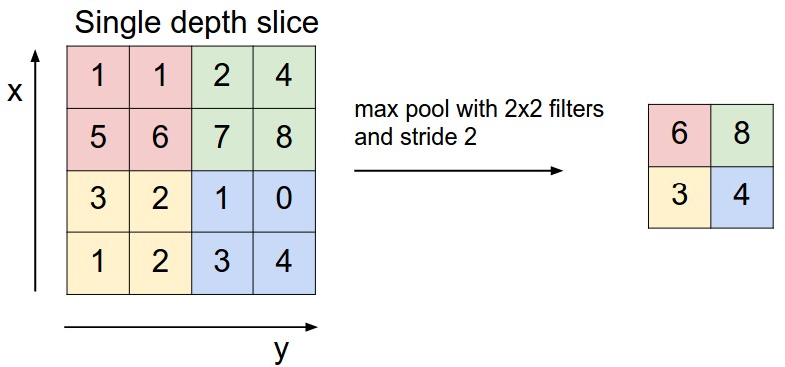
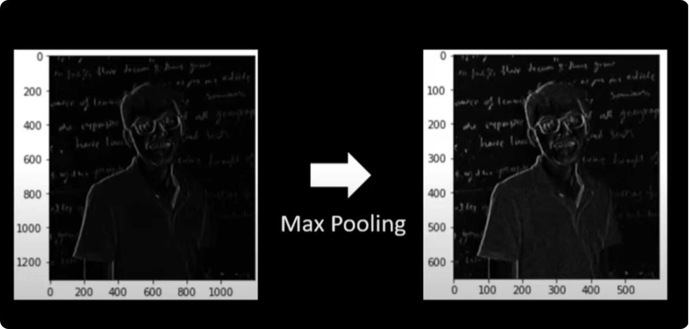
Max Pooling — Mechanism & Examples
Max pooling selects the maximum value in each local region. It reduces spatial size while retaining salient information. This lowers computations, reduces overfitting risk, and makes features robust to small shifts and distortions in input
Example: 2×2 max-pool reduces a 4×4 patch to one value per 2×2 region (see matrix example). No parameters; use selectively after conv blocks.

Slide 9
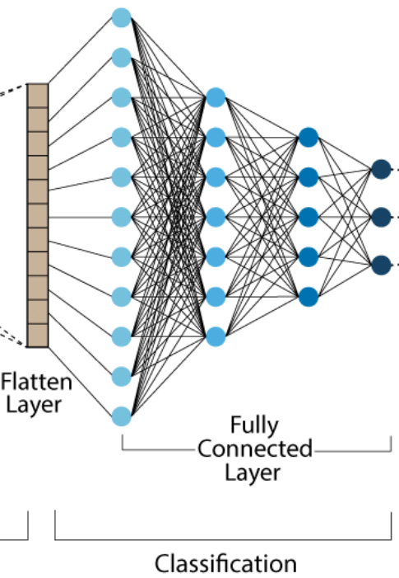
Fully Connected Layer — Final Decision
After convolution and pooling, feature maps are flattened into a 1D vector and fed into fully connected (FC) layers. FC layers associate extracted features to target classes; final layer uses softmax for class probabilities.
1
Flattening
After the final pooling layer, feature maps are converted into a 1D vector to be fed into the dense network.
2
Dense layers
Three FC layers (4096-4096-1000) act as the final decision center, associating features to target classes.
3
Softmax output
The final layer uses Softmax to produce a probability distribution across the 1,000 ImageNet object classes.

Slide 10
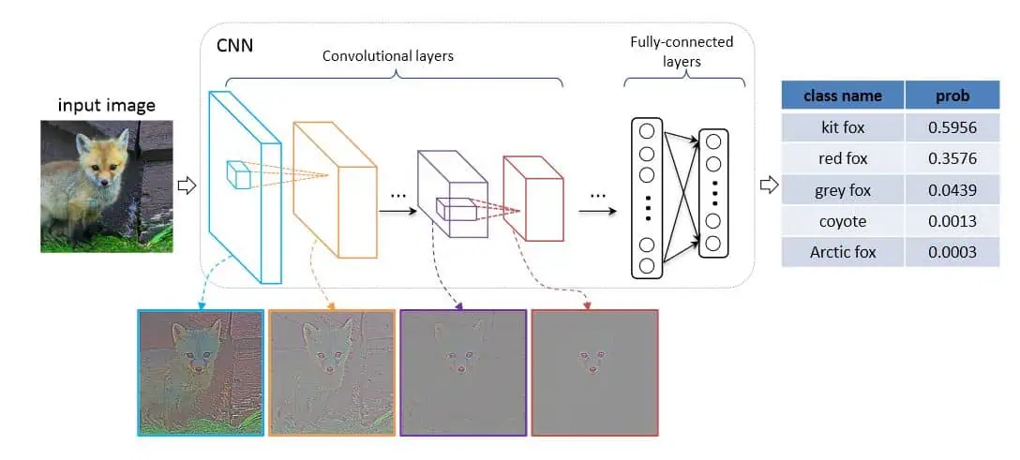
How VGG Learns Features
Early Layers
Detect edges, simple orientations, color contrasts.
Middle Layers
Capture textures, patterns, local motifs and parts.
Deep Layers
Assemble higher-level shapes and object prototypes used for classification.
Feature maps: visualize activations per layer to understand hierarchical learning.

Slide 11
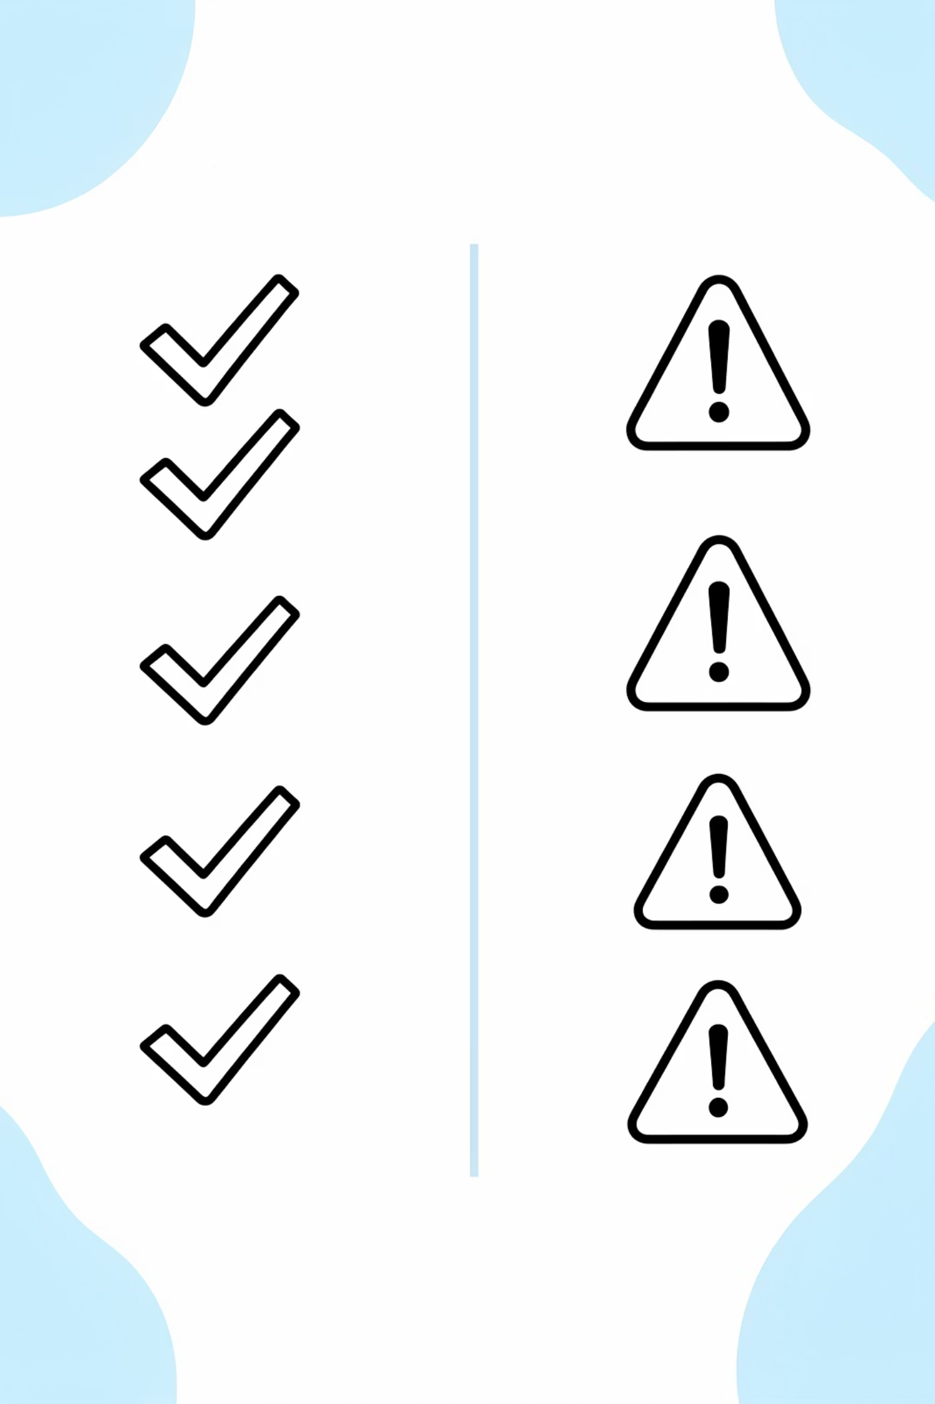
Advantages of VGG
Uniform & Intuitive
Strong Feature Extractor
Consistent 3×3 conv blocks simplify design and interpretation.
Deep convolutional stacks produce robust mid-level representations for many tasks.
Excellent for Transfer Learning
High Accuracy (Historical)
Pretrained VGG weights are widely used to fine-tune new tasks with limited data.
Competitive ImageNet results at time of publication — influential baseline model.

Slide 12
Limitations of VGG
Parameter Count
Compute & Memory
~138M parameters (VGG16) — storage and download cost is high.
Slow to train and heavy at inference — needs GPUs and large RAM.
Overfitting Risk
Not State-of-the-Art
Large capacity can overfit small datasets without regularization.
Modern architectures (ResNet, EfficientNet) improve accuracy/efficiency.

Slide 13
Comparison with Other Architectures
Architecture | Main Idea | Advantages | Limitations
AlexNet | Larger filters and fewer layers | Faster training | Less feature extraction capability
VGGNet | Deep architecture with repeated 3×3 filters | Better hierarchical feature learning | Heavy computational cost
ResNet | Skip connections | Solves vanishing gradient problem | More complex architecture
The Edge of VGG: proved that stacking multiple small filters is more efficient and powerful than single large filters.

Slide 14
IMAGE SOURCES
https://www.geeksforgeeks.org/computer-vision/vgg-net-architecture-explained/
Source: geeksforgeeks.org
https://upload.wikimedia.org/wikipedia/commons/1/19/2D_Convolution_Animation.gif?utm_source=commons.wikimedia.org&utm_campaign=index&utm_content=original
Source: commons.wikimedia.org
https://cs231n.github.io/assets/cnn/maxpool.jpeg
Source: cs231n.github.io
https://lumos.blog/understanding-convolutional-neural-networks-cnns/
Source: lumos.blog
https://miro.medium.com/v2/resize:fit:4800/format:webp/1*nsKxXL6VbGxloOsTNWF8Mg.png
Source: miro.medium.com

Slide 15
Thank you

