Slide 1

Smart Tire Pressure Monitoring System
Hadia Usman Maryam Shamshad
23-NTU-CS-1029 23-NTU-CS-1047

Slide 2
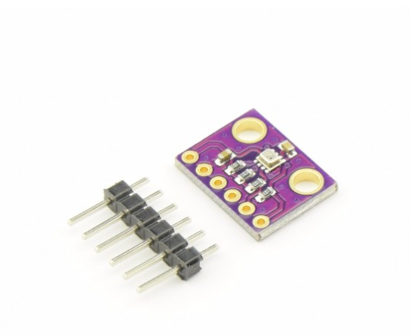
About Project:
Tyre pressure is vital for vehicle safety
Incorrect pressure can cause tyre burst and accidents
Manual pressure checking is often ignored
Low pressure and high temperature increases failure risk
No real-time monitoring for drivers
This project provides an automated IoT-based solution.

Slide 3

Objectives
Design an Embedded IoT-based Tyre Pressure Monitoring System
Continuously monitor tyre pressure and temperature
Detect unsafe pressure using predefined thresholds
Alert the user using:
LED
Buzzer
Send alerts via Email
Display real-time data on the Blynk App

Slide 4

Tools & Technologies
Hardware Components
ESP32 Dev Module
BMP280 Pressure Sensor
SSD1306 OLED Display
LED & Buzzer
Software Tools
PlatformIO (VS Code)
Arduino IDE
Blynk Cloud

Slide 5
Libraries
Adafruit BMP280 – Pressure & temperature sensing
Adafruit GFX – Graphics support
Adafruit SSD1306 – OLED display control
WiFi.h – ESP32 WiFi connectivity
BlynkSimpleEsp32 – Blynk App integration

Slide 6
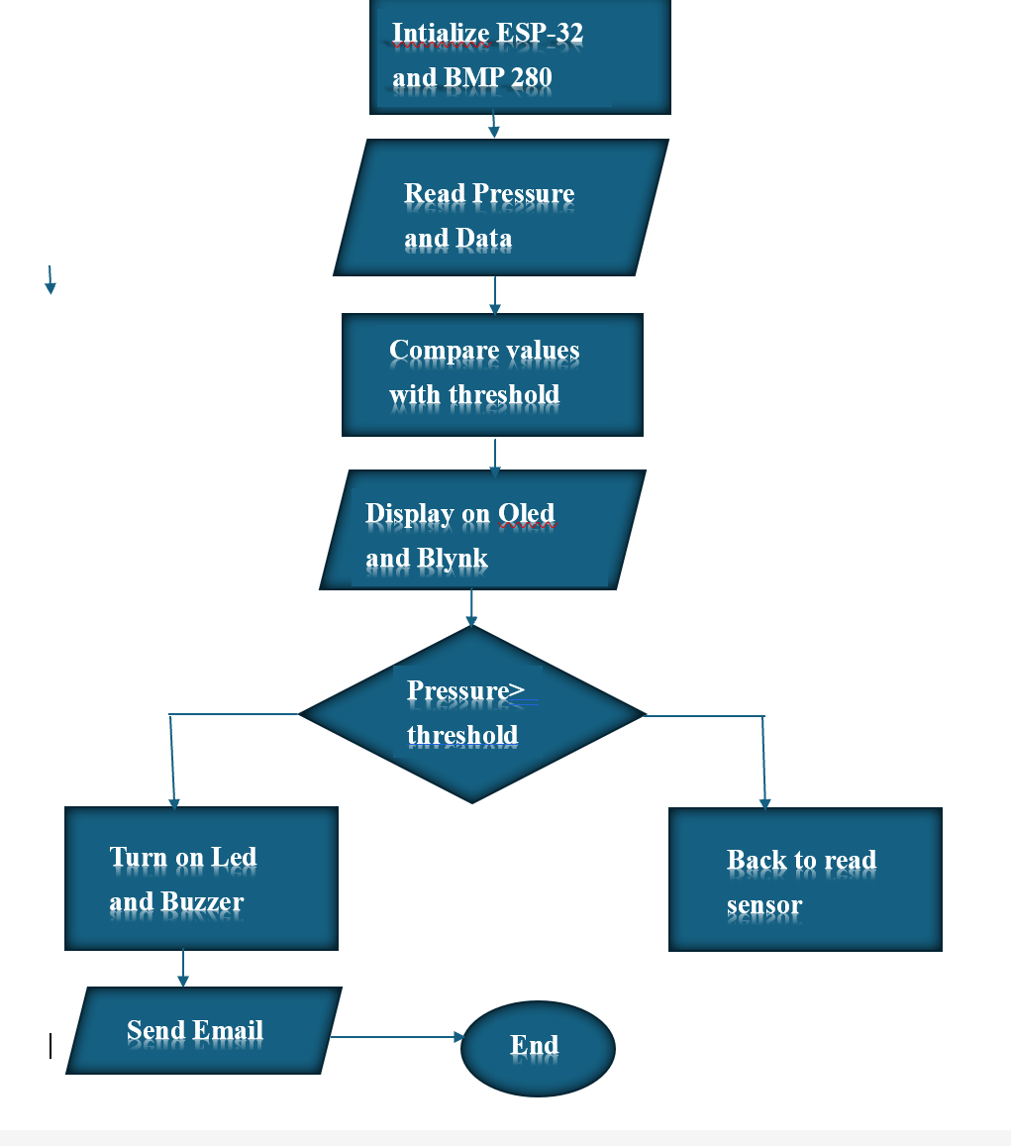
System’s Work Flow:
Sensor placed in a sealed chamber to simulate tyre
Syringe used to vary pressure
BMP280 detects pressure changes
ESP32:
Compares values with threshold
Triggers LED & buzzer if unsafe
Data sent to Blynk App in real time
Email alert sent automatically

Slide 7

Features and Functionality:
Real-time tyre pressure monitoring
LED & buzzer alerts
Live data on Blynk App
Email notifications
Easy demonstration using sealed chamber & syringe

Slide 8
Conclusion
The system continuously and efficiently monitors tyre pressure in real time
Immediate alerts via LED, buzzer, and email enhance driver safety
Simple and effective solution for preventing tyre-related accidents

Slide 9

Question???

Slide 10
Thankyou!!!

