Slide 1
"Innovating Healthcare: AI-Driven Drug Classification
Maryam Zubair

Slide 2
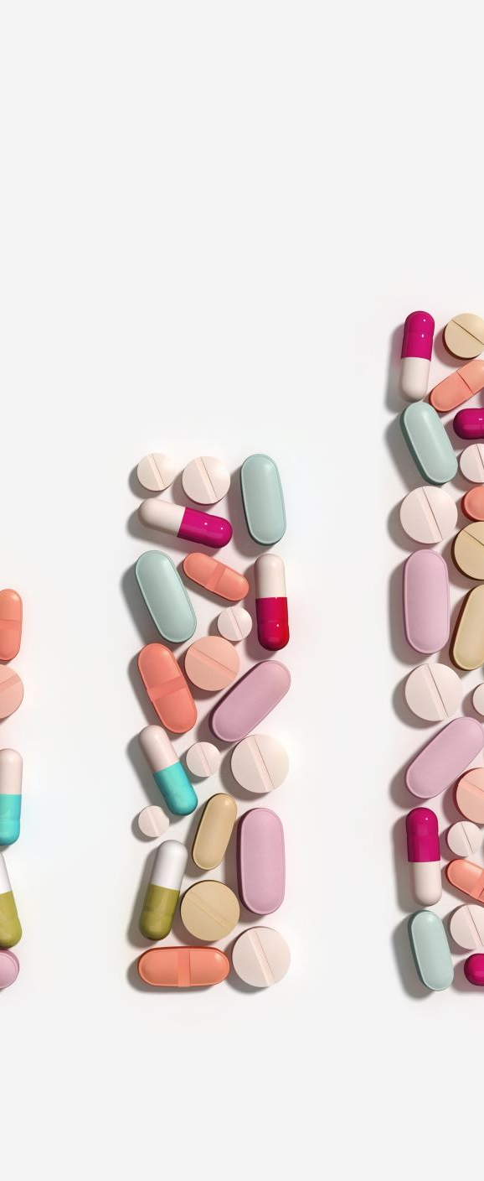
Introduction
In this project, we leverage the advanced capabilities of OpenAI's GPT-3.5 to fine-tune a model for drug classification. Utilizing a carefully selected dataset of 2,000 drug examples from an Excel file, our aim is to enhance the accuracy of drug categorization, focusing specifically on their associated ailments.
The essence of this project lies in training an intelligent computer system to identify the diseases targeted by various medications. Initially, we compile comprehensive data about numerous medicines and the conditions they treat. This data is then systematically organized to facilitate the computer's learning process. Upon successful training, the computer applies this knowledge to accurately identify the disease each medication is intended to treat.

Slide 3

Design
Preparing the Data
Data Conversion: We begin by transforming the XLSX data file into a JSONL format, suitable for model fine-tuning. This is achieved using Pandas and OpenAI tools, with the data being formatted to include drug names and corresponding illnesses in a prompt-completion style. Special care is taken to ensure that each completion begins with a whitespace.

Slide 4
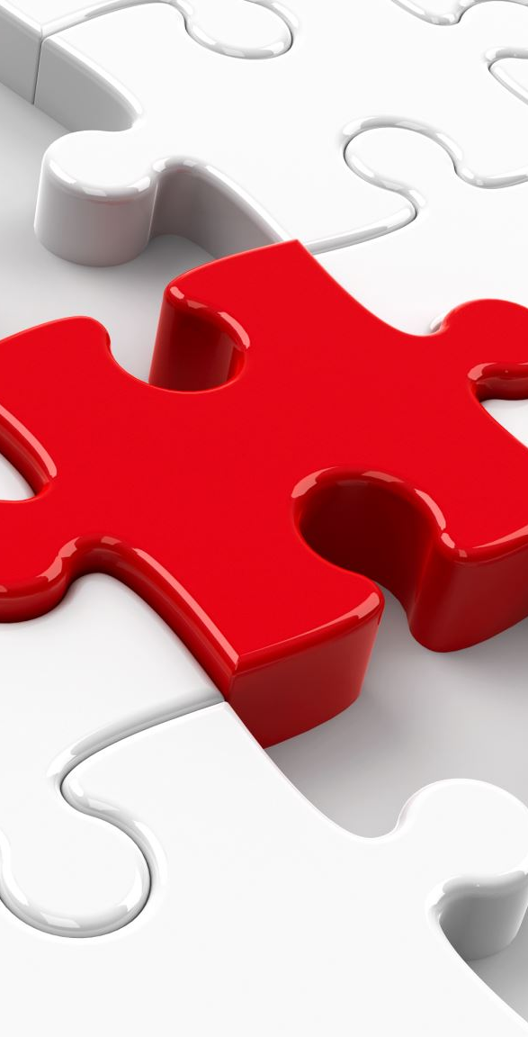
Design (cont.)
Fine-Tuning Commands
Data Analysis and Preparation: We utilize OpenAI's tools, specifically the fine_tunes.prepare_data command, to process the data. This involves dividing the dataset into training and validation sets, which are crucial for effective model training.
Model Training: The training of the model is carried out using the fine_tunes.create command. We set parameters like the model type (ada) and classification metrics, and specify the training and validation data files to guide the training process.
Monitoring Job Progress: In case of disconnection during fine-tuning, a command is provided to check the progress of the job.
Completion of Fine-Tuning: Upon the completion of the fine-tuning job, an output is received confirming the completion cost and other pertinent details. The fine-tuned model is then ready for generating completions based on the trained data.

Slide 5
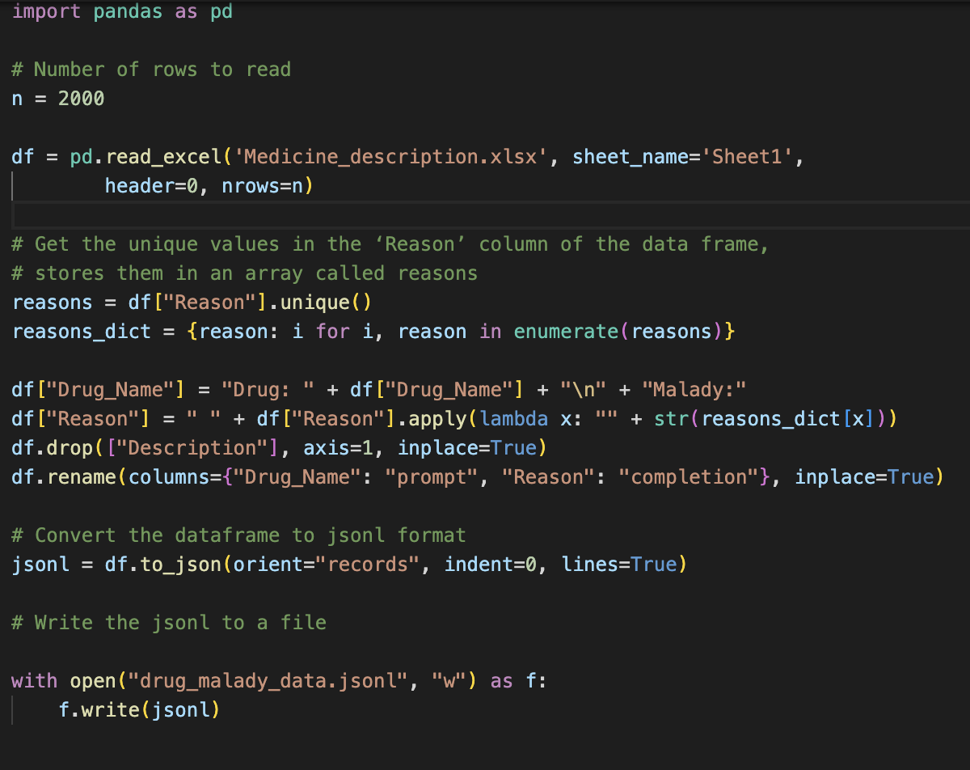
Code

Slide 6
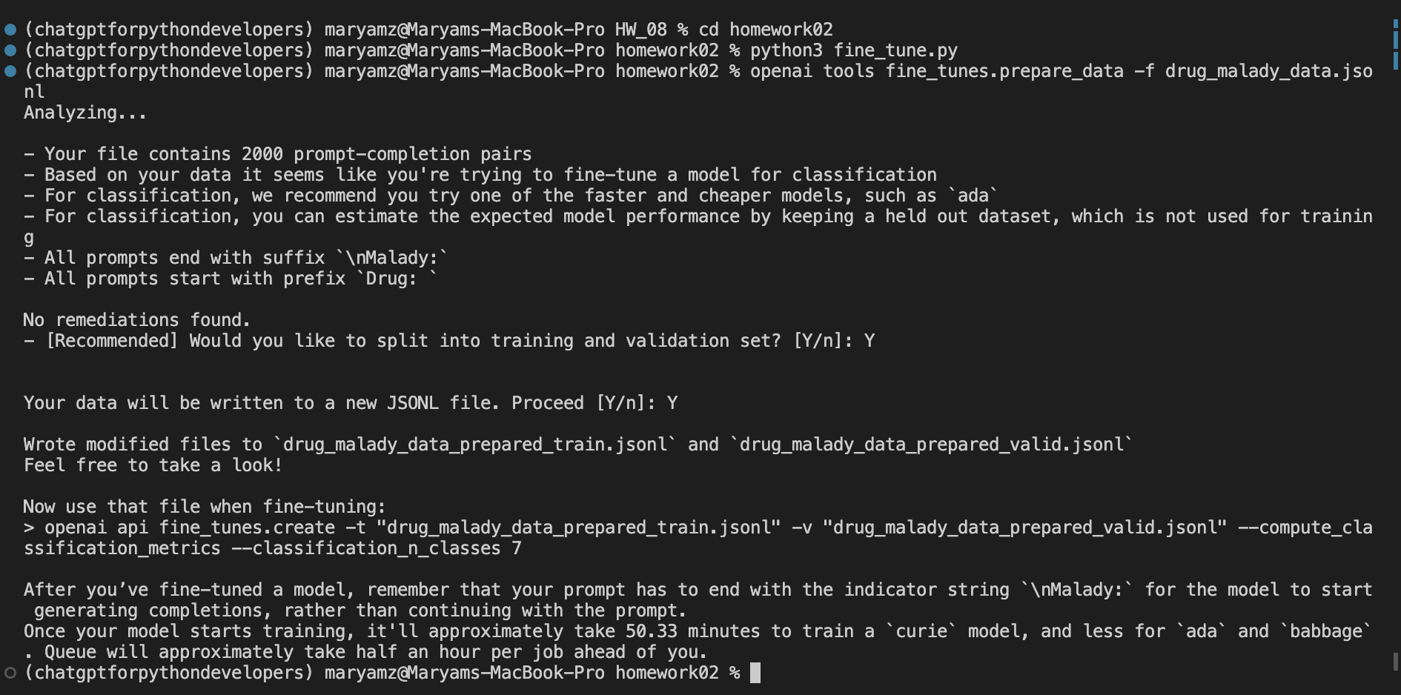
Implementation
Setting Up the Environment: To begin, activate or create a virtual environment.
Installing Necessary Packages: Install the required packages by executing pip install pandas openpyxl openai==0.28.
Data Processing: The next step involves processing the dataset in preparation for model fine-tuning.
Data Preparation for Fine-Tuning: Use the openai tools fine_tunes.prepare_data -f drug_malady_data.jsonl command to prepare the data for the fine-tuning process

Slide 7
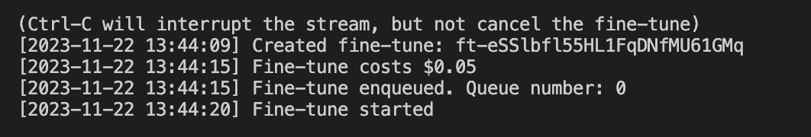
Implementation (cont.)
5. Configuring OpenAI API Key: Set up your OpenAI API key with the command export OPENAI_API_KEY="your_api_key_here”
6. Model Fine-Tuning: Fine-tune the model using the command openai api fine_tunes.create, specifying training data, validation data, classification metrics, the number of classes, model type, and suffix.

Slide 8
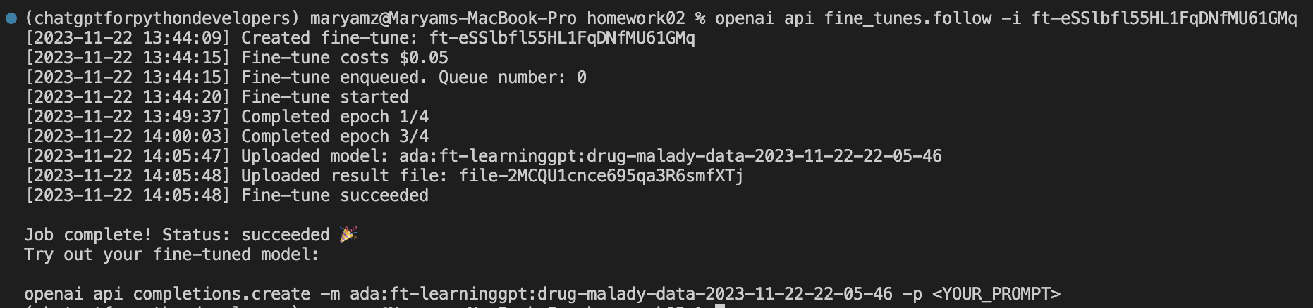
Implementation (cont.)
7. Monitoring the Fine-Tuning Job: Follow the progress of the fine-tuning job with openai api fine_tunes.follow -i <JOB ID>, where the job ID is provided in the final step of the setup.

Slide 9
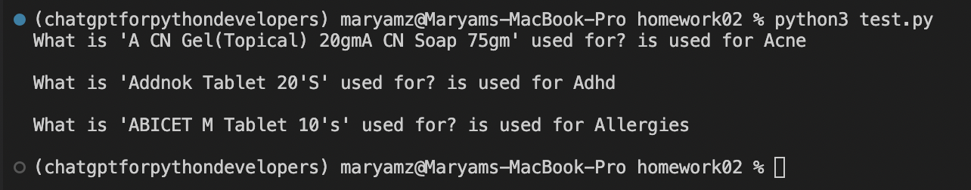
Implementation (cont.)
8. Executing the Test Script: Finally, run the test script using python3 test.py.

Slide 10

Test
This section details the testing procedures employed to evaluate the effectiveness of the fine-tuned model. It involves running specific scripts and analyzing the outcomes to ensure the model's accuracy and reliability in drug classification.

Slide 11
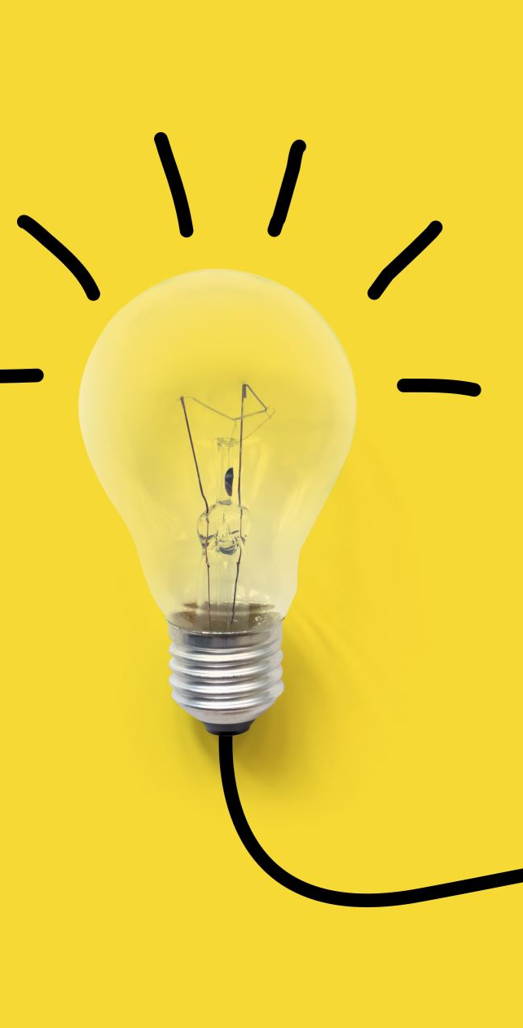
Enhancement
Enhancement
Advanced Feature Integration: We aim to augment the model's classification precision by incorporating additional elements such as dosage information, patient demographics, and potential side effects. This would expand the model's scope and enhance its accuracy.
Real-Time Classification: Developing a system capable of real-time drug classification is another objective. This would provide immediate insights and responses, particularly beneficial in dynamic healthcare scenarios.
Continuous Model Refinement: An ongoing process of model enhancement is envisioned, where periodic updates are made. These updates will include new drug information and maladies, ensuring the model remains up-to-date and effective.

Slide 12
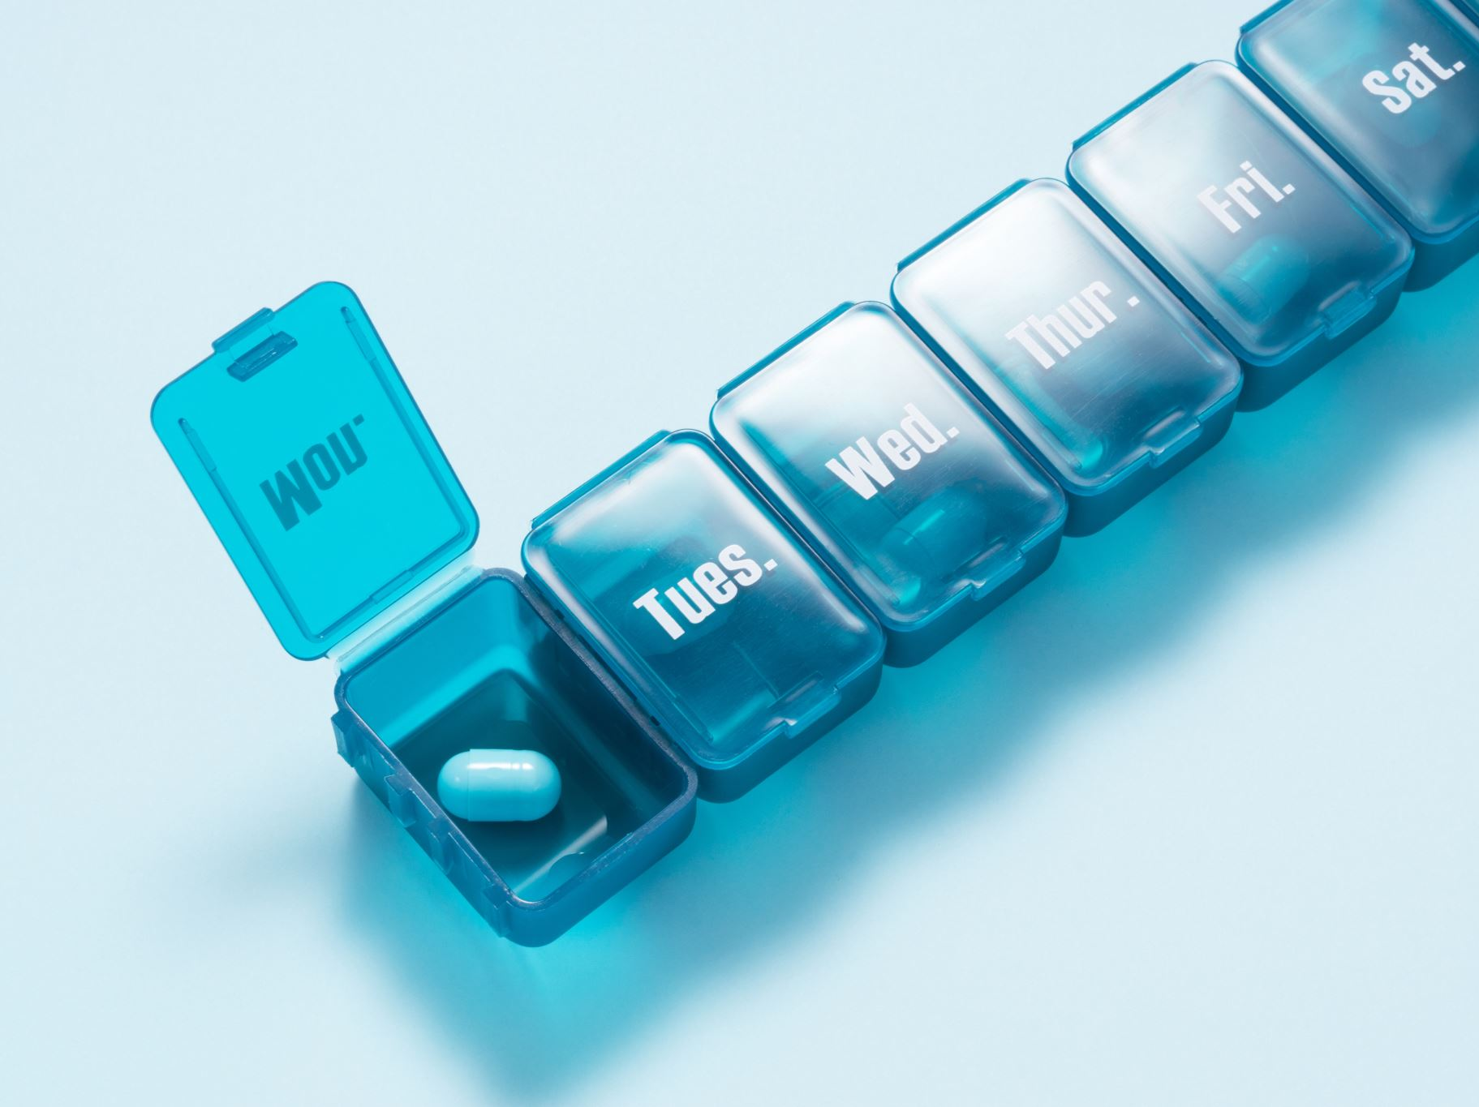
Conclusion
This project has successfully harnessed the power of OpenAI's GPT-3.5 to develop a model specialized in drug classification, using a dataset of 2,000 drug examples. The primary goal was to train the system to proficiently categorize medicines based on the illnesses they are designed to treat. This initiative demonstrates the vast potential of advanced machine learning in the healthcare sector, setting a precedent for future developments in efficient and refined drug classification systems.

Slide 13


GitHub Link
https://github.com/Maryam-Zubair/MachineLearning_Assignment/tree/main/ChatGPT/Fine_Tuning/Drug_Example

