Slide 1

Keyword and Semantic Search with Rerank
Maryam Zubair

Slide 2

Table of Content
Introduction
Design
Implementation
Test
Conclusion
GitHub Repository Link
Bibliography/References

Slide 3

Introduction
This project leverages advanced techniques in the field of natural language processing (NLP) and semantic search to significantly enhance the quality of search results. It does so by integrating two powerful APIs: Weaviate and Cohere.

Slide 4

API
Weaviate:
Weaviate is an open-source search engine powered by machine learning, specifically designed for scalable and vectorized data retrieval.
In the context of this project, Weaviate is used to facilitate semantic search and keyword-based retrieval, providing a more sophisticated method of sifting through data based on the meaning and context of the search queries.
Cohere :
Cohere provides powerful natural language understanding capabilities. It's used in this project to rerank search results, which means adjusting the order of search results so that the most relevant ones appear first.
This reranking is based on the comprehension of the text, making it more aligned with the user’s search intent.

Slide 5

Semantic Search Techniques:
Unlike traditional keyword-based search, semantic search seeks to understand the searcher's intent and the contextual meaning of terms as they appear in the searchable dataspace.
This approach allows for more accurate and relevant search results, as the system can interpret the query in a more human-like manner.

Slide 6

Combination of Keyword Search, Dense Retrieval, and Reranking Mechanisms:
Keyword Search: Traditional method of finding documents or data that contain specific words or phrases.
Dense Retrieval: A modern approach in NLP that retrieves information based on semantic representations. Instead of matching exact words, it understands the meaning behind the words.
Reranking Mechanisms: After the initial retrieval of data, reranking reorders these results to prioritize the ones most likely to be relevant to the query.

Slide 7
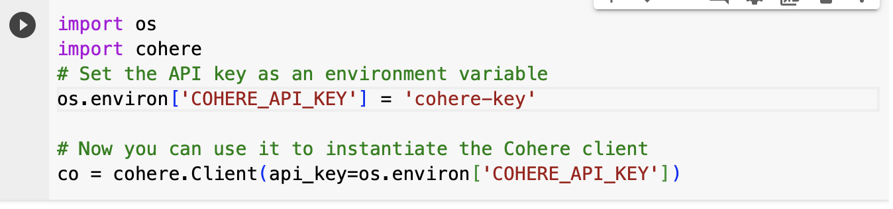
Design
Cohere API:
Implementing the Cohere API.
Setting Up the Cohere API Key.
Initializing the Cohere API.

Slide 8
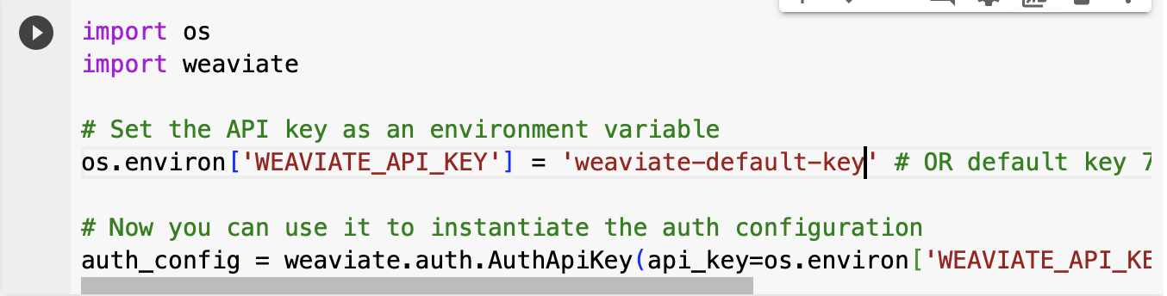
Design(cont..)
Weaviate API:
Setting Up the Weaviate API Key.
Utilizing the Weaviate API.
Initializing the Weaviate API.

Slide 9
Implementation
Setup API: Configuration of API keys and installation of necessary packages​​.
Weaviate Integration: Description of keyword search and dense retrieval functions​​.
Cohere Integration: Description of reranking search results function​​.

Slide 10
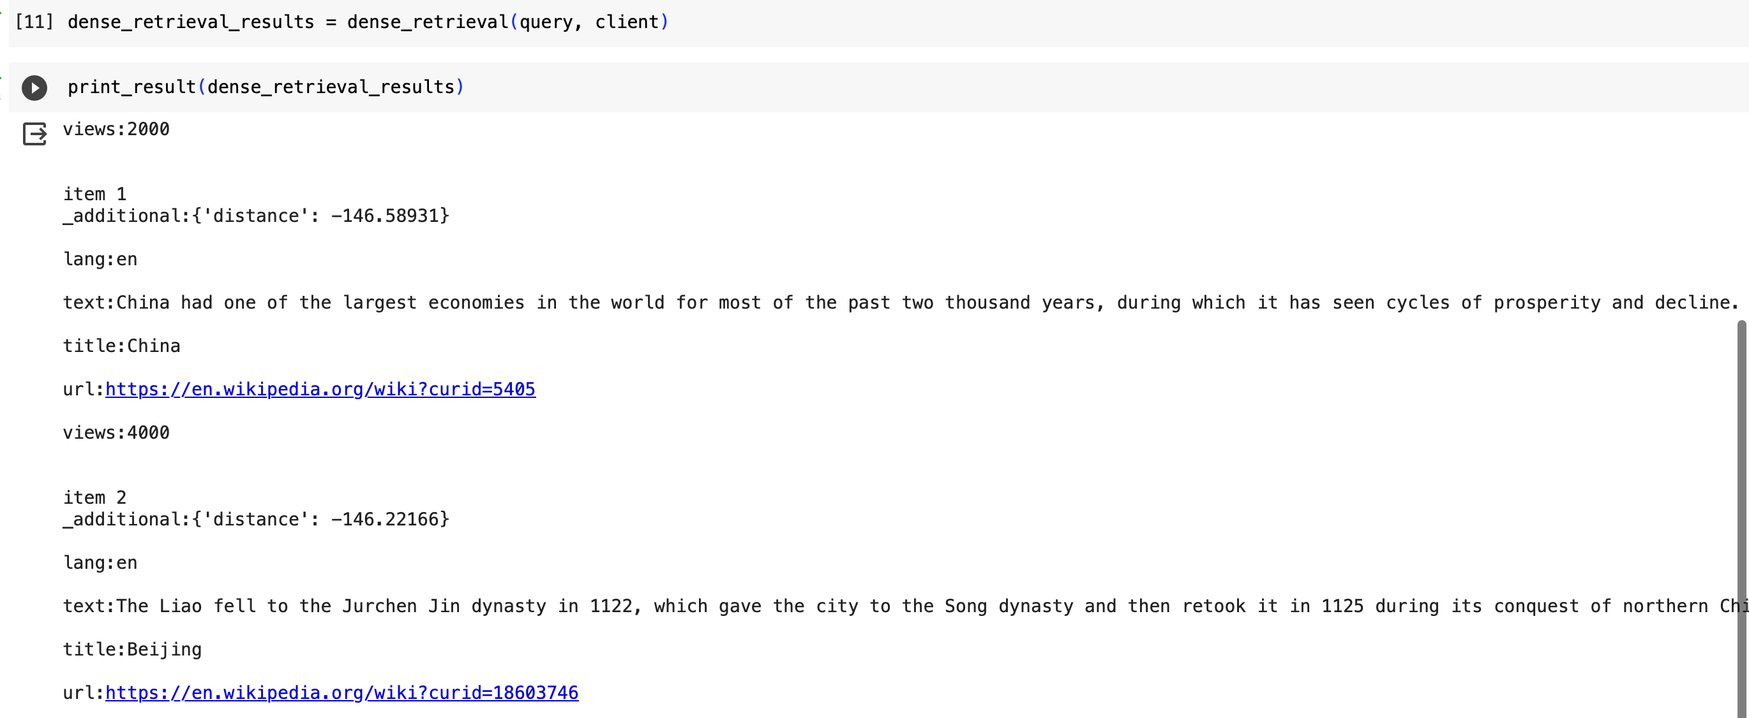
Implementation(cont..)
4. Keyword Search and Dense Retrieval: Implementation details and output​​.

Slide 11
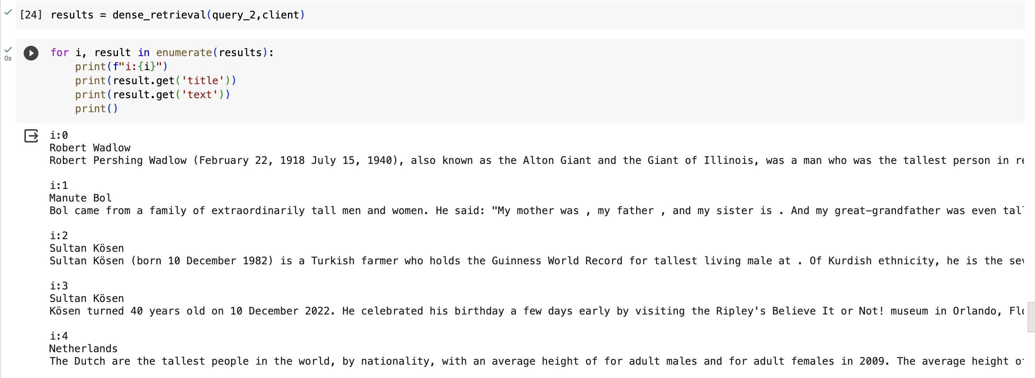
Implementation (cont..)
5. Reranking: Process and analysis of reranked results​​.

Slide 12
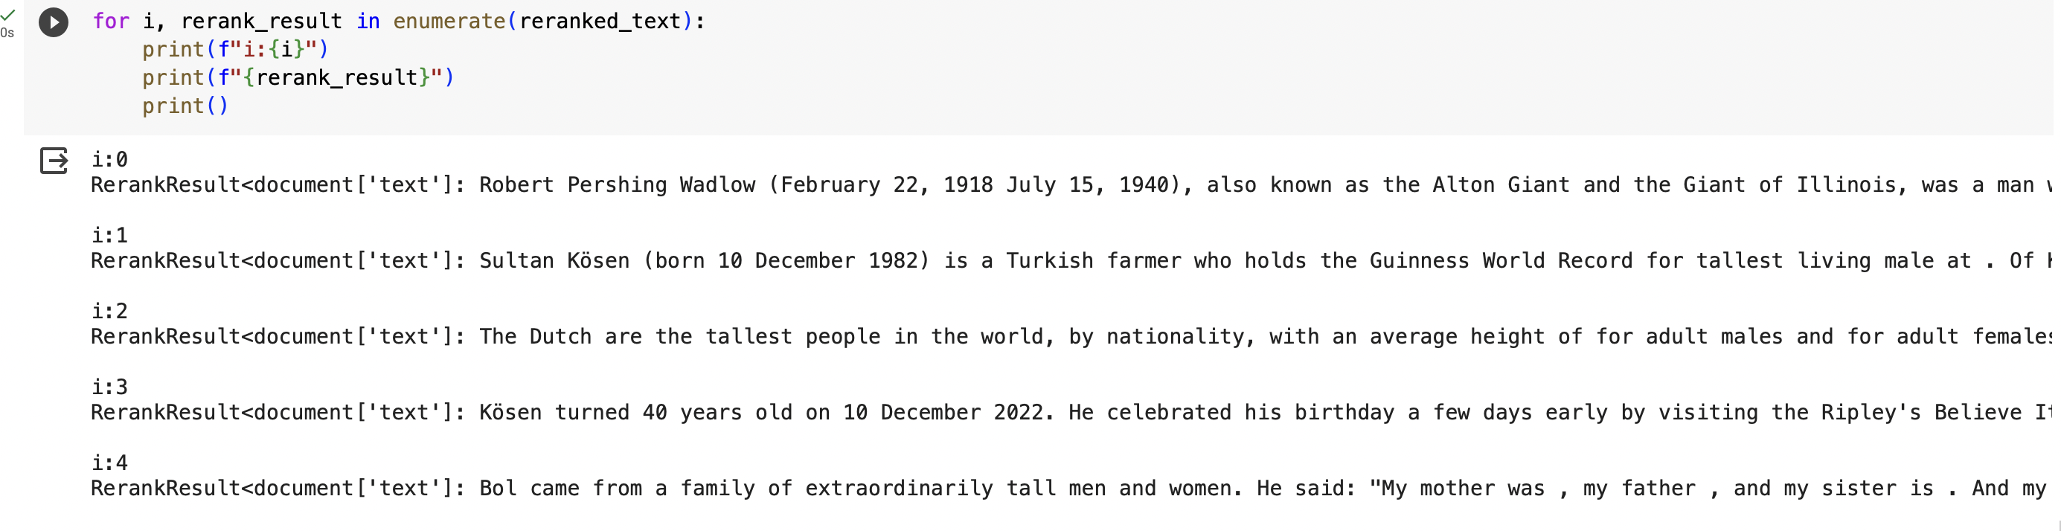
Testing

Slide 13
Conclusion
This project synergizes Cohere and Weaviate APIs, transcending traditional search limitations. By combining advanced NLP and semantic search, it delivers nuanced, context-aware results. The modular design ensures easy integration, serving as a blueprint for superior search application

Slide 14

GitHub Link
https://github.com/Maryam-Zubair/MachineLearning_Assignment/tree/main/ChatGPT/Rerank

