Slide 1


Robot Fight Competition Plan
Done By: Maryam Alabdulhadi
Done for: Smart methods - Industrial engineering department.

Slide 2

Contents
Organizational structure
Project Plan
Timeline & Tasks Distribution
Production line

Slide 3
Industrial eng.
Mechanical Dep.
Electrical Dep.
AI & Robotics Dep.
IoT Dep.
Mechanical eng. (A)
Electrical eng. (A)
AI & Robotics Eng. (A)
IoT eng. (A)
R
R
R
R
Mechanical eng. (B)
Electrical eng. (B)
AI & Robotics eng. (B)
IoT eng. (B)
R
R
Mechanical eng. (C)
AI & Robotics eng. (C)
= Office Attendance is Required
R

Slide 4
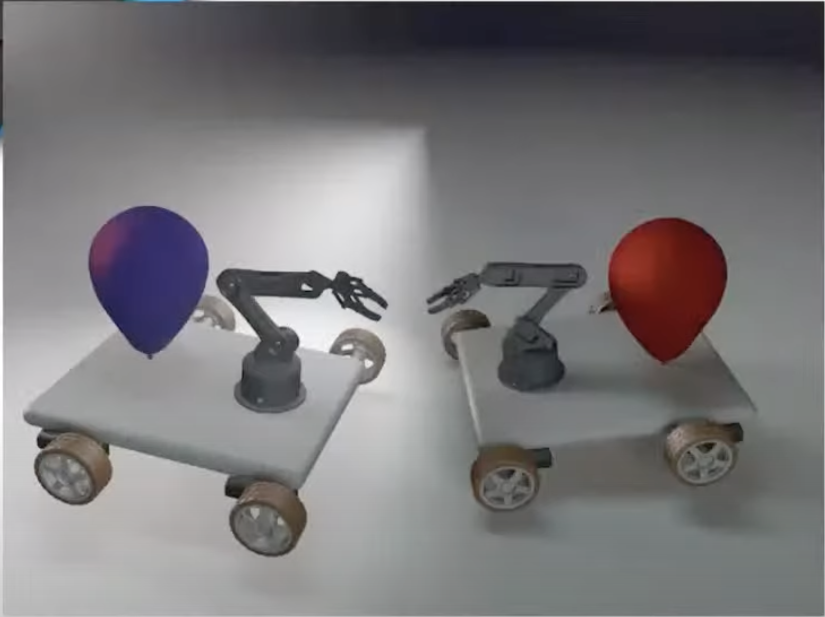
Project Plan
My Group will Work on the Robot Fight Competition project where I will Assign the tasks to each member of the group considering the project deadline and the amount of time each task will take.
To finish the robot successfully it will take around 5 weeks of teamwork, My job as a leader is to guide and inspire my group through the whole process
I chose this robot because the final results are really interesting where we will compete and hopefully win against another robots.

Slide 5
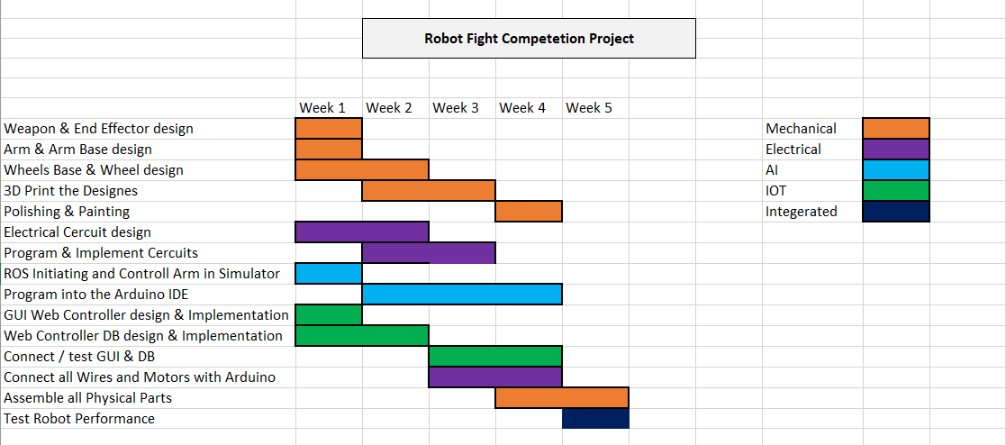
Timeline

Slide 6
Production Line
Modeling
3D Modeling
3D Printing/CNC
Design
Weapon – End effector – Arm – Arm Base – Wheels - Wheels Base - circuits – GUI Controller
Assembly
Manually assembling the Physical Parts, Motors, Wires, Arduino.
Programs
ROS – Arduino IDE - HTML /CSS – JS/PHP – Python.
MySQL - Cinema 4D – Maya – Blender - Notepad++.
Packages
Using Wooden box , Flint for extra protection for the arm.

Slide 7

Thank you for reading!

