Slide 1
CONFIRMATION RATE PROJECT
By: Maryam Bakhat

Slide 2
Problem Statement
Problem:
A program to calculate and display the confirmation rate for each user based on their signups and confirmations.

Slide 3
Libraries Used
Libraries:
- #include <iostream>: For input/output operations (cin/cout)
- #include <iomanip>: For formatted output (widths, precision)

Slide 4
Structures
Signup Structure:
- user_id: Unique ID for user
- time_stamp: Date/time of signup (string)
Confirmation Structure:
- user_id: ID of user who confirmed

Slide 5
Function Logic
Main Logic Overview:
Loop through signup and confirmation data
Track confirmations by user
Count confirmation rates and display them

Slide 6
Code Snippet
int maxUserId = 0;
for (int i = 0; i < signupCount; i++) {
if (signups[i].user_id > maxUserId)
maxUserId = signups[i].user_id;
}
This loop finds the maximum user ID from the signup array.

Slide 7
CODE :
#include <iostream>
#include <iomanip>
#include <cstring>
using namespace std;
// Structure to store signup information
struct Signup {
int user_id;
char time_stamp[20];
};
// Structure to store confirmation information
struct Confirmation {
int user_id;
char time_stamp[20];
char action[10];
};
// Function to calculate and display the confirmation rate
void calculateConfirmationRate(Signup signups[], int signupCount, Confirmation confirmations[], int confirmationCount) {

Slide 8
int maxUserId = 0;
// Find the maximum user_id to size arrays properly
for (int i = 0; i < signupCount; i++) {
if (signups[i].user_id > maxUserId) {
maxUserId = signups[i].user_id;
}
}
// Arrays to store counts
int totalRequests[maxUserId + 1] = {0};
int confirmedRequests[maxUserId + 1] = {0};
// Count total requests and confirmed actions
for (int i = 0; i < confirmationCount; i++) {
int user_id = confirmations[i].user_id;
totalRequests[user_id]++;
if (strcmp(confirmations[i].action, "confirmed") == 0) {
confirmedRequests[user_id]++;
}
}

Slide 9
// Print the header
cout << "+---------+-------------------+" << endl;
cout << "| user_id | confirmation_rate |" << endl;
cout << "+---------+-------------------+" << endl;
// Calculate and display confirmation rates
for (int i = 0; i < signupCount; i++) {
int user_id = signups[i].user_id;
double confirmationRate = 0.0;
if (totalRequests[user_id] > 0) {
confirmationRate = static_cast<double>(confirmedRequests[user_id]) / totalRequests[user_id];
}
cout << "| " << setw(7) << user_id
<< " | " << setw(17) << fixed << setprecision(2) << confirmationRate << " |" << endl;
}
cout << "+---------+-------------------+" << endl;
}

Slide 10
int main() {
int signupCount, confirmationCount;
// Input for signups
cout << "Enter the number of signups: ";
cin >> signupCount;
Signup signups[signupCount];
for (int i = 0; i < signupCount; i++) {
cout << "Enter user_id for signup " << i + 1 << ": ";
cin >> signups[i].user_id;
cout << "Enter time_stamp (YYYY-MM-DD HH:MM:SS) for signup " << i + 1 << ": ";
cin.ignore();
cin.getline(signups[i].time_stamp, 20);
}

Slide 11
// Input for confirmations
cout << "Enter the number of confirmations: ";
cin >> confirmationCount;
Confirmation confirmations[confirmationCount];
for (int i = 0; i < confirmationCount; i++) {
cout << "Enter user_id for confirmation " << i + 1 << ": ";
cin >> confirmations[i].user_id;
cout << "Enter time_stamp (YYYY-MM-DD HH:MM:SS) for confirmation " << i + 1 << ": ";
cin.ignore();
cin.getline(confirmations[i].time_stamp, 20);
cout << "Enter action (confirmed/timeout) for confirmation " << i + 1 << ": ";
cin >> confirmations[i].action;
}
// Calculate and display confirmation rates
calculateConfirmationRate(signups, signupCount, confirmations, confirmationCount);
return 0;
}

Slide 12
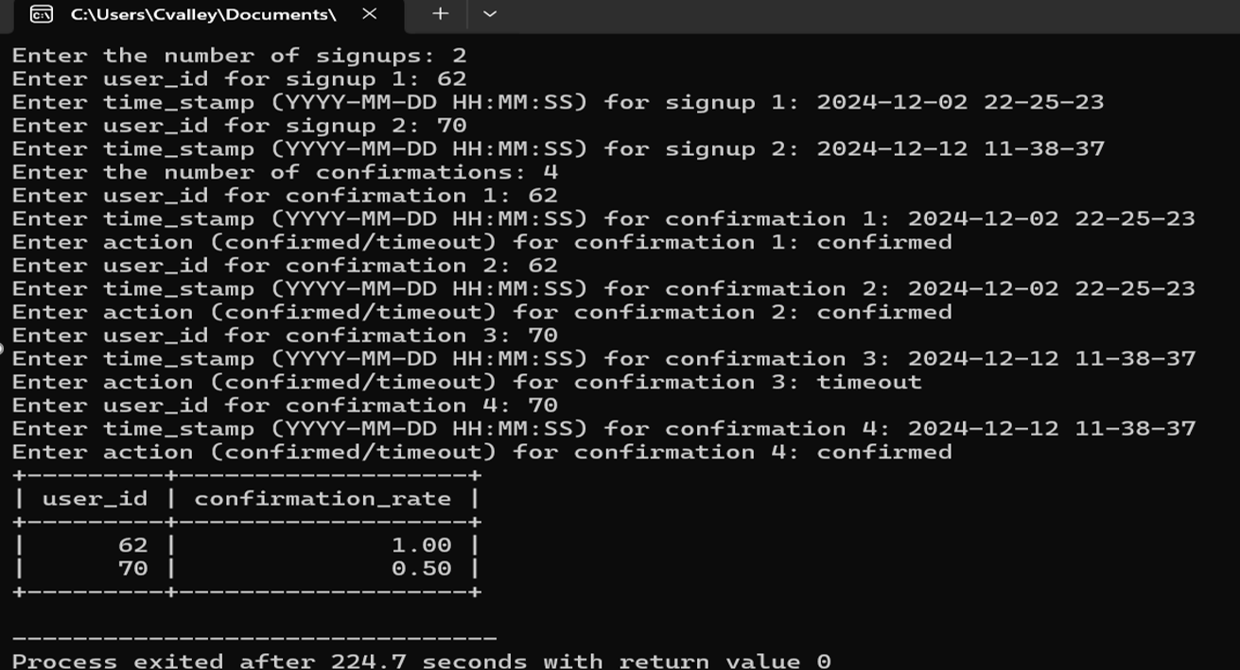
Output

Slide 13
Key Learnings
How to use structures in C++
Looping and conditional logic
Data organization and output formatting

Slide 14
Future Improvements
Store data in external files
Add user authentication
GUI version of the program

Slide 15
Thank You❤️
Thank You!
Questions or Feedback? 😊

