Slide 1
In the name of Allah the Most Beneficial and the Most Merciful
Mcsf19a039

Slide 2

Punjab University College of Information and Technology
Submitted by:
Mariam Shehzadi
Classwork (to do)
Submitted to:
Prof. Haq Nawaz
Date:
5 March 2021

Slide 3
GitHub Commands Practice
Create Account on github.com.
Create a Repository on GitHub.
Details of repository on your account
URL of repository on your account
Clone a repository
Create simple text file by clicking right click and then click on New and then Text Document
Now open git from start menu by searching git.
Now Add text file in git by writing command “git add test.txt”.

Slide 4
GitHub Commands Practice(Cont…)
Changes made with message to track.
Now push changes to server.
Now made some changing in text file.
Now check status on git by writing command “git status”.
Now again add file to git and commit change made with message to track and then push it to server git.
view of repository after push by opening git website on browser
Content of file in repository
Now pull changes to desktop file

Slide 5
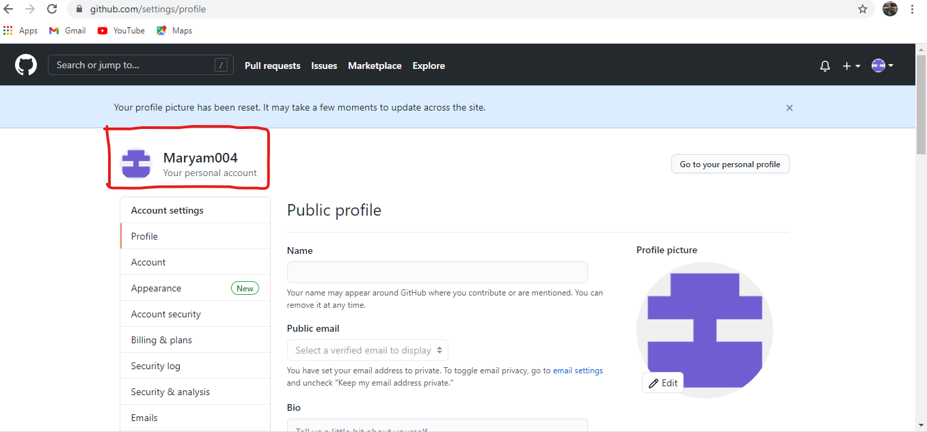
Create Account on github.com.

Slide 6
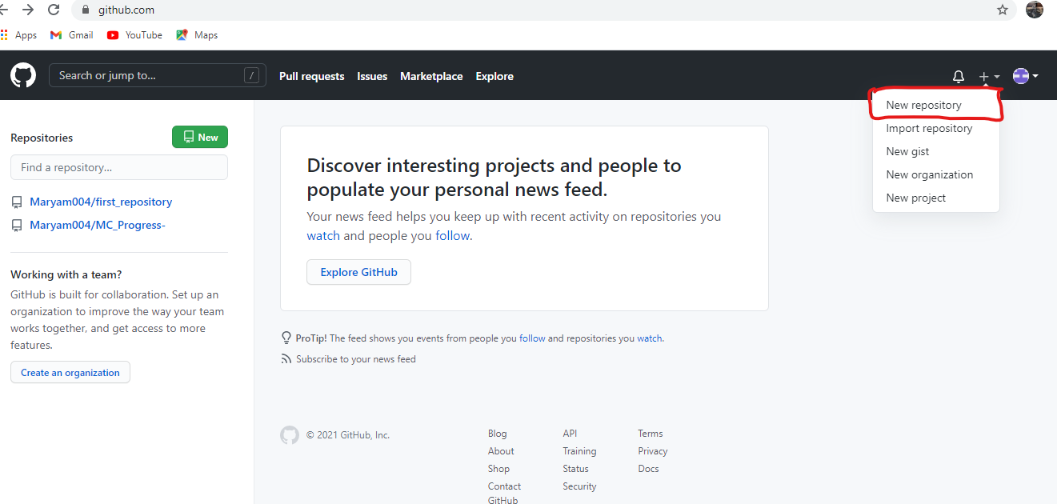
Create a Repository on GitHub

Slide 7
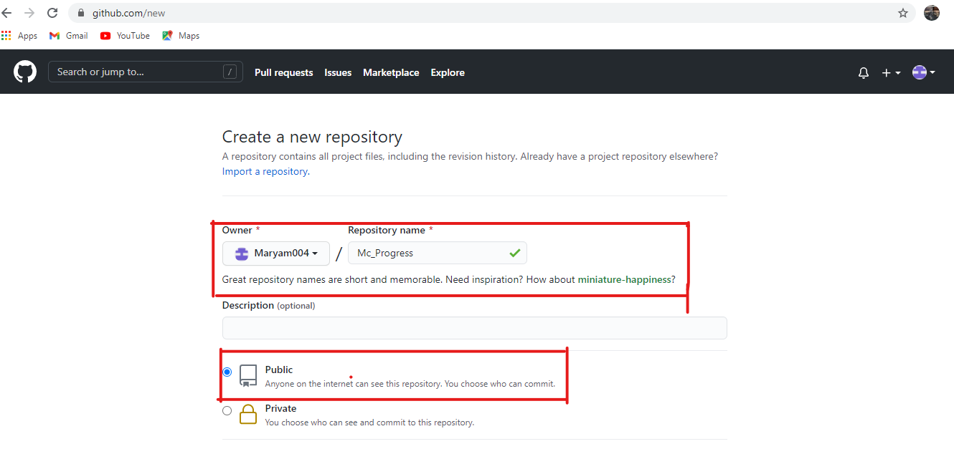
Details of repository on your account

Slide 8
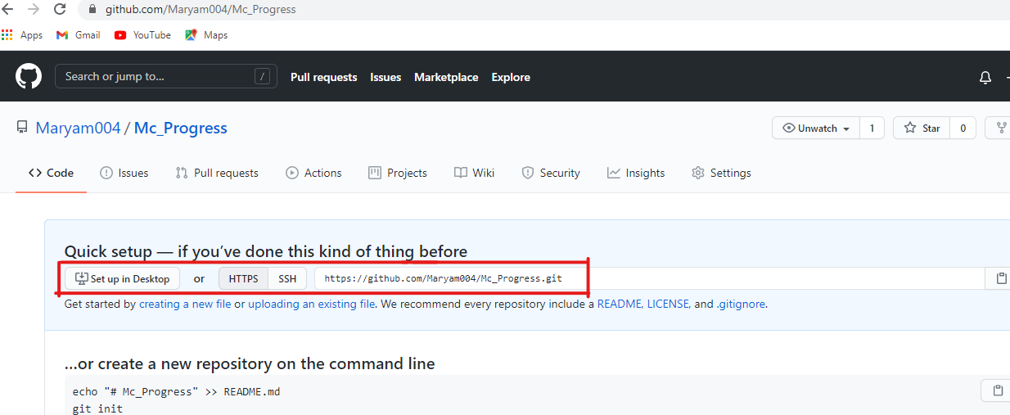
URL of repository on your account

Slide 9
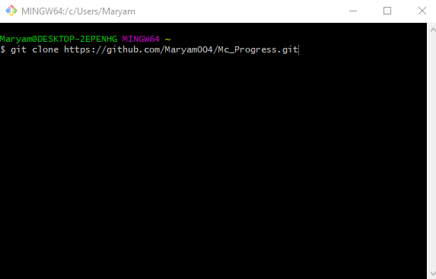
Clone a repository

Slide 10
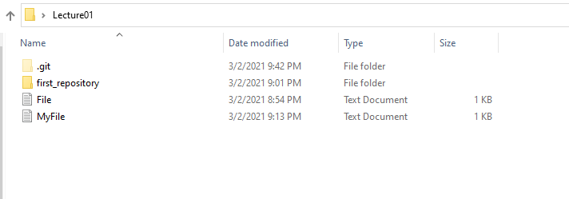
Create simple text file by clicking right click and then click on New and then Text Document

Slide 11
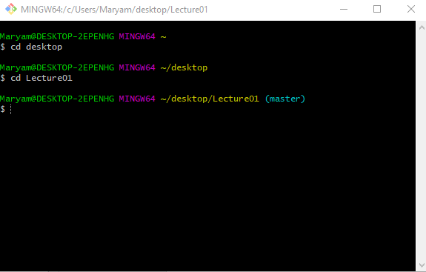
Now open git from start menu by searching git.

Slide 12
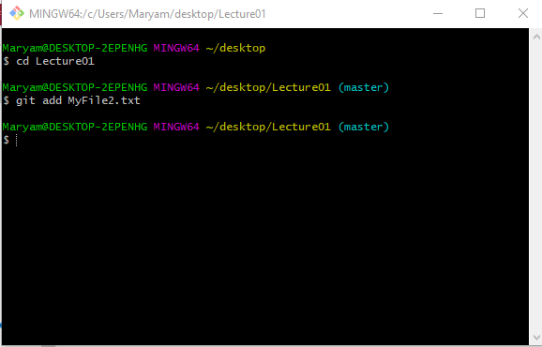
Now Add text file in git by writing command “git add MyFile2.txt”.

Slide 13
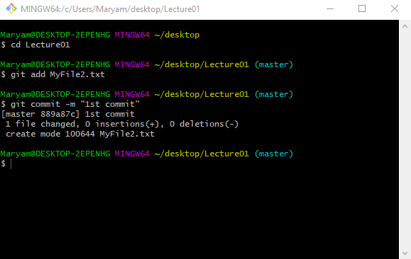
Changes made with message to track.

Slide 14
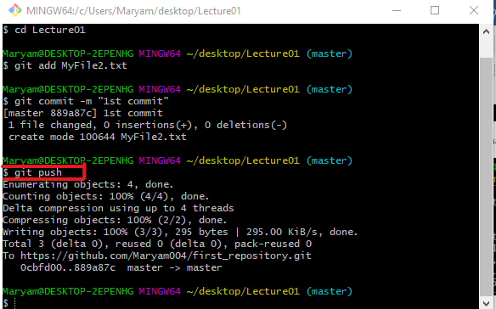
Now push changes to server.

Slide 15
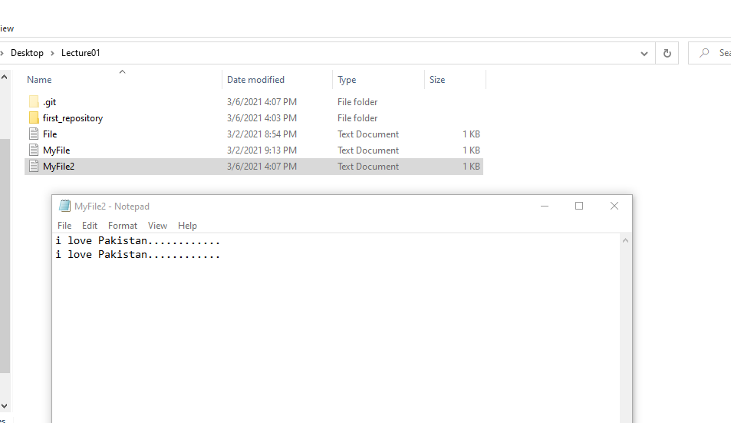
Now made some changing in text file

Slide 16
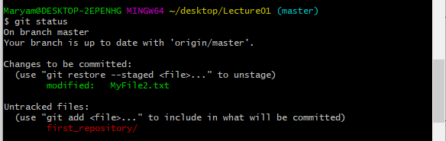
Now check status on git by writing command “git status”.

Slide 17
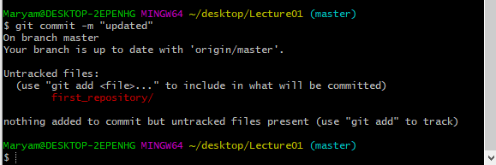
Now again add file to git and commit change made with message to track and then push it to server git.

Slide 18
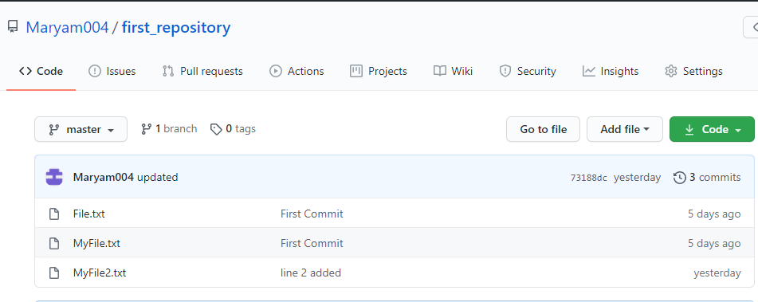
view of repository after push by opening git website on browser

Slide 19
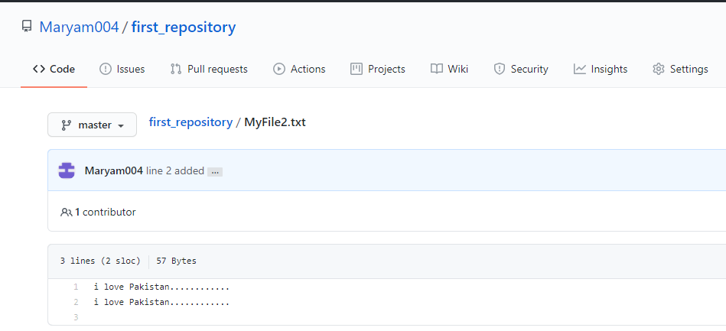
Content of file in repository

Slide 20
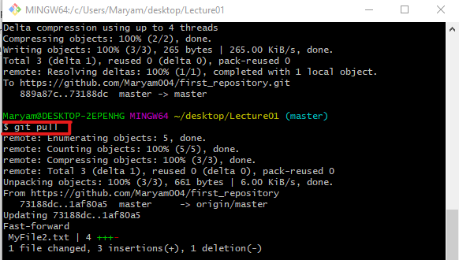
Now pull changes to desktop file

