Slide 1

Airline ticket reservation system
Semester Project Presentation
Group Members:
Tuba jabeen(fa21-bcs-033)
Isha Eman(fa21-bcs-046)
Maryam Bibi(fa21-bcs-047)

Slide 2

Main menu
Flight
Customer
Admin

Slide 3
classes:
Singly Linked List
Queue
Customer
Flight
Admin
Main

Slide 4
Singly Linked LIst
In this class, all functionalities of singly linked list is implemented
All other classes used this class to store data
In this class, additional functions are added so that all other classes can use these functions easily and the code should not repeat

Slide 5
Queue
Used in the Admin class to apply the discount on the bill of first five customers.

Slide 6
Customer
In this class, the data of customer( Name, CNIC and Destination) is stored using Singly LinkedList
The functions in this class are:
bookTicket
cancelTicket
informationOfUser

Slide 7
bookTicket
In this function we get the name of customers in String, CNIC in integer and Destination in String
We store all the data in linkedList
public void bookTicket(int cnic, String name, String des) {
// stores the customer data in the respective lists
listofCNIC.insert(cnic, listofCNIC.size + 1);
listOfDes.insert(des, listOfDes.size + 1);
listOfName.insert(name, listOfName.size + 1); }

Slide 8
cancelTicket
In this function, the ticket of customer is canceled by their CNIC number.
An int index of linkedlist where the data of customer is stored, returned to the admin class where this function has been called so that admin delete the fare of customer.
public int cancelTicket(int value) {
int index;
index = listofCNIC.deleteByValue(value);
String des = listOfDes.deleteDes(index);
listOfName.delete(index);
flight.deleteSeat(des);
return index;}

Slide 9
informationOfUser
In this function, the data (Name, CNIC and Designation )of all customers is printed along with their bills.
this function takes head of “CustomerBill” linked list, whenever it is called by admin class.

Slide 10
Flight
In this class we have two linked Lists
One, stores all available Destinations of flights and other stores the seats of all flights
Total functions in this class are:
BookSeats
DeleteSeats
StoreDestination
DeleteDestination

Slide 11
Store destination
This method take available destinations in the arguments and stores it in the linkedlist of destinations
When the destination is stored, at the same index in the seats list a node is created and initialized with zero.
void insertdestination(String name) {
destinations.insert(name.toUpperCase(), destinations.size + 1);
seats.insert(0, seats.size + 1);}

Slide 12
BookSeats
In this function, we passed the destination of customer and after the destination index, we pass the index to “allowSeat ” method so that it can increment the number of seats in the particular flight.
public boolean book(String destination) {
int index = searchdestinationIndex(destination);
return AllowSeat(index)
}

Slide 13
DeleteDestination
The method, take the destination as the argument and search its index and pass that index to the “delete” method of singly linklist
When the destination is deleted from the list, the in the linked list of seats, the seats of that destination are also deleted from the same index.
int searchdestinationIndex(String placename) {
return destinations.searchdestinationIndex(placename);
}

Slide 14
CancelSeat
In this method, we passed the destination of the customer and it decrement the number of seat by 1 at that index in link list
public void deleteSeat(String destination) {
int index = searchdestinationIndex(destination);
if (index != -1) {
seats.deleteSeat(index); }}

Slide 15
Admin
This class checks conditions and call functions of “Customer” and “Flight”
It stores the bills of all customers, after applying 10% discount on first 5 customer’s bill
Methods:
storeInformation, viewFlightInfo, UpdateInformation, viewCustomerInfo(), checkBill, CancelTicket, BookTicket()

Slide 16
Store Information:
In this method, we passed the destination to the “insertDestination” at flight class
flight.insertdestination(destination);
update Information:
In this function, we can insert new Destination or delete the destination

Slide 17
View flight and customer Information
In “view flight information”, admin can view information of available destinations
In “customer Information”, admin can view the data of all customers who have booked their seats

Slide 18
Book ticket
The function take the destination from customer and checks for the available flight. If it is available then it pass the information of customer to the method of customer class “bookTicket”
It checks the bill of that destination and apply the discount of 10% on the bill of first 5 customers

Slide 19
Book ticket
String destination = s.nextLine()
if (flight.searchdestinationIndex(destination) != -1 && flight.book(destination){ double fare = checkBill(destination);//Calculates Bill if (BillDiscount.size < 5) {//Checks for discount in queue :BillDiscount fare = fare - (fare * 10 / 100); BillDiscount.push(fare); } else { BillDiscount.push(fare); } CustomerFare.insert(BillDiscount.tail.data, CustomerFare.size + 1); customer.bookTicket(cnic, name, destination);

Slide 20
cancel ticket
The function take the CNIC from customer and pass it to the method of customer class “cancelTicket” , which return the index and then it delete customer’ bill at that index by using method of singly linked list class.
int location = customer.cancelTicket(CNIC)
if (location == -1) {
System.out.println("THERE IS NO TICKET BOOKED BY CNIC: " + CNIC);
return; }
CustomerFare.delete(location);
System.out.println("THE SEAT OF THE CUSTOMER OF " + CNIC + " IS CANCELED SUCCESSFULLY! ");}

Slide 21
Check Bill
This method, manually returns the bill by checking the destination by using the “.equals()” method.

Slide 22
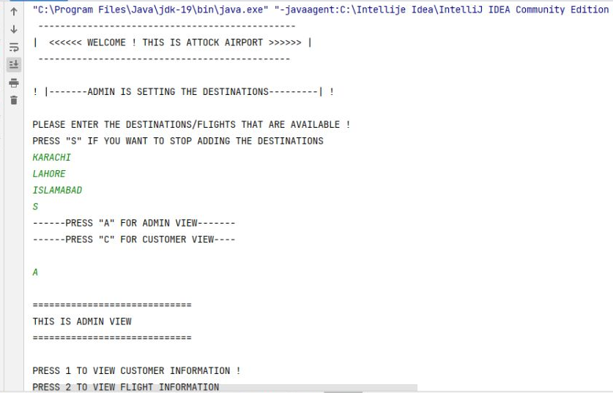
Outputs:

Slide 23
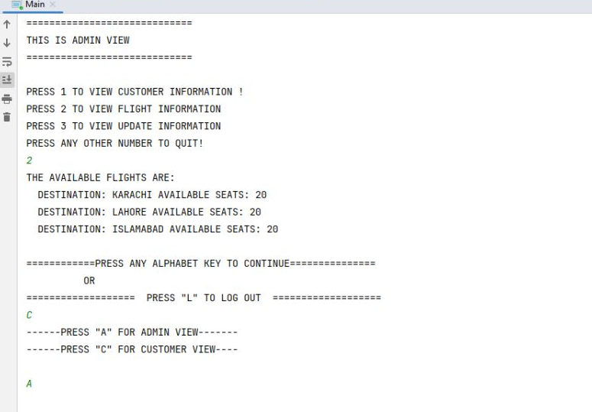

Slide 24
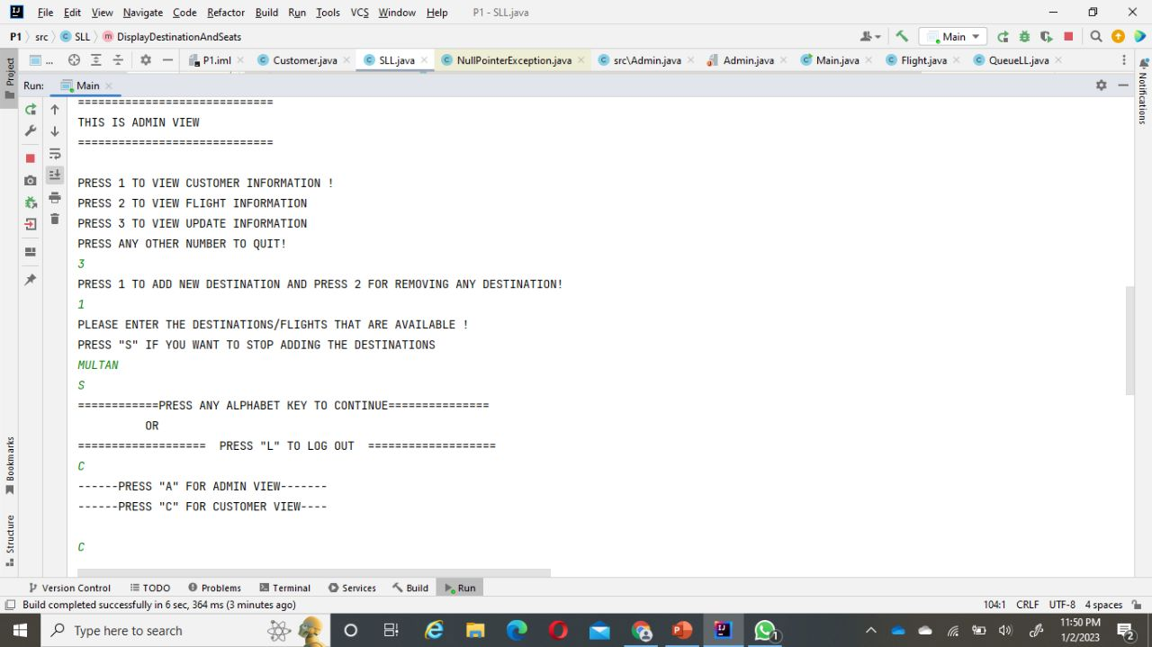

Slide 25
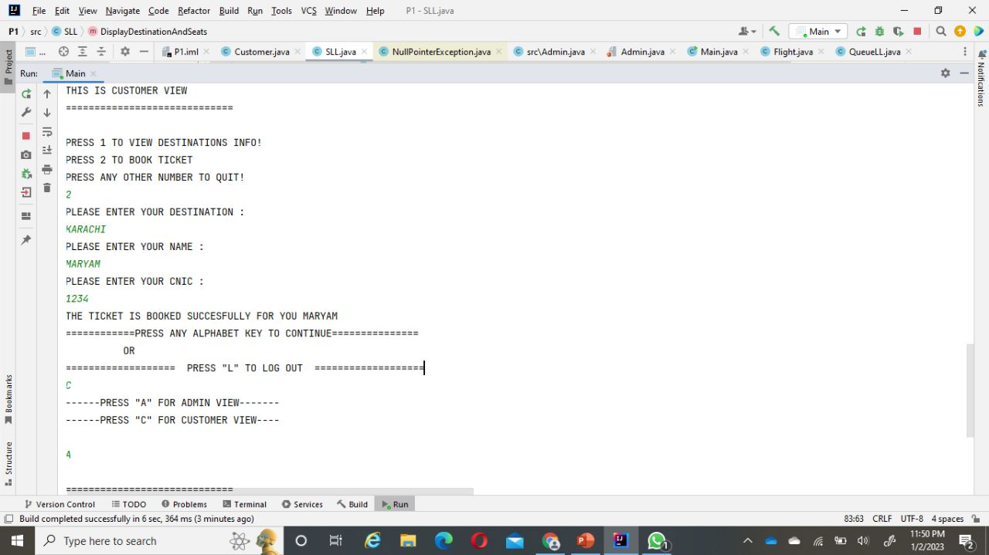

Slide 26
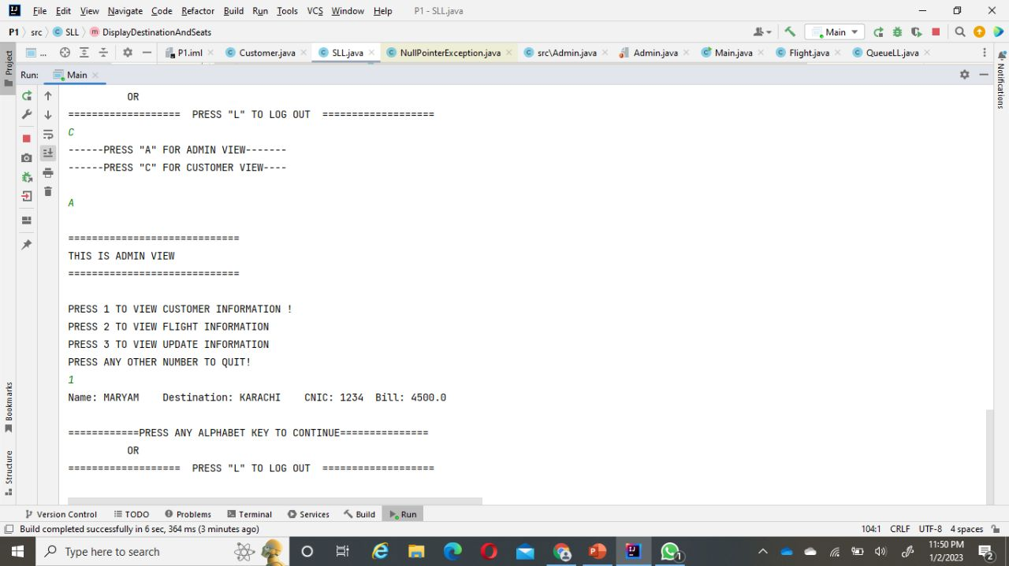

Slide 27
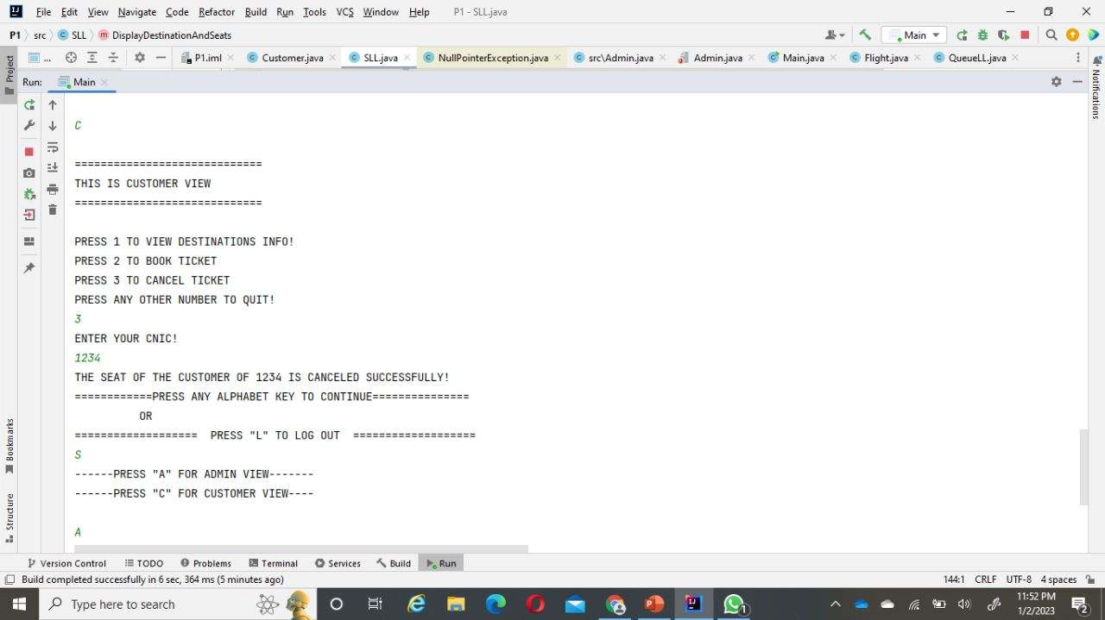

Slide 28
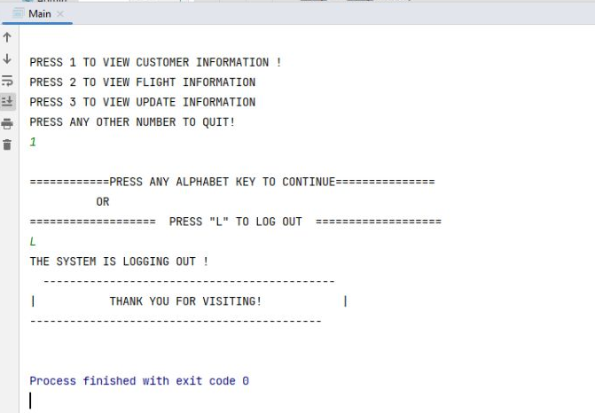

Slide 29
THANK YOU

