Slide 1
Predicting House Prices
Team: Cobra
Class: MSA 8010
Members: Devangi B., Fatima M., Maryam G., Kimmy W., Sam S.

Slide 2
Objective
Create machine learning models that can better predict sale prices of houses using data exploration, data cleaning and feature engineering.

Slide 3
Features,
Correlations
Transformation
Data Exploration
Data Preprocessing
Missing Value Imputation
Feature Creation, Label Encoding
Experiment 1
Skew, Overfit, Scaling
Model Testing/Evaluation
Outlier Handling
Model Testing/Evaluation
Experiment 2
Feature Selection
Model Testing/Evaluation
Experiment 3
Experiment 4
Hyper Parameter Tuning
Model Testing/Evaluation
**Last slide: Revision Post Presentation
Test Prediction/Conclusion
MAPE on Test
Conclusion

Slide 4
Data Exploration
1

Slide 5
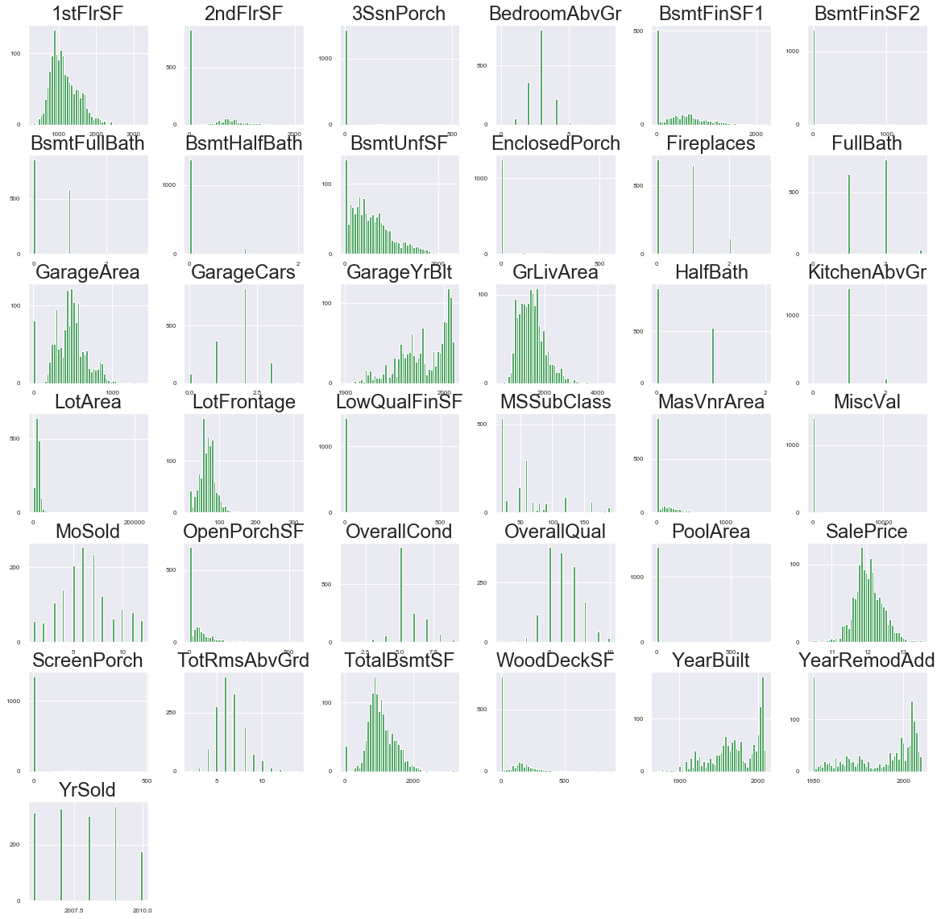
Data Exploration: Features
Distribution of features are similar to that of sale price
skews in some of the features such as GarageYrBuilt
Skewed features may require some sort of scaling/transformation

Slide 6
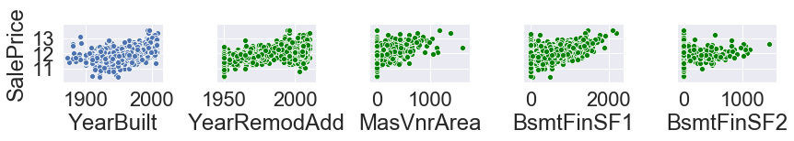
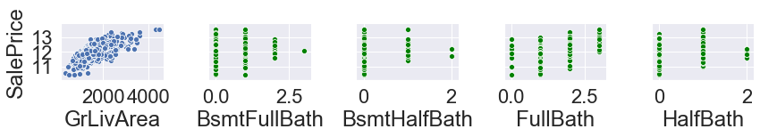
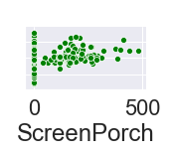
Data Exploration: Features
Some Features have clear associations with sale price
Some Features have low cardinality values
Some features are absent in some houses
Notes:
You mean slide 8 & 9?

Slide 7
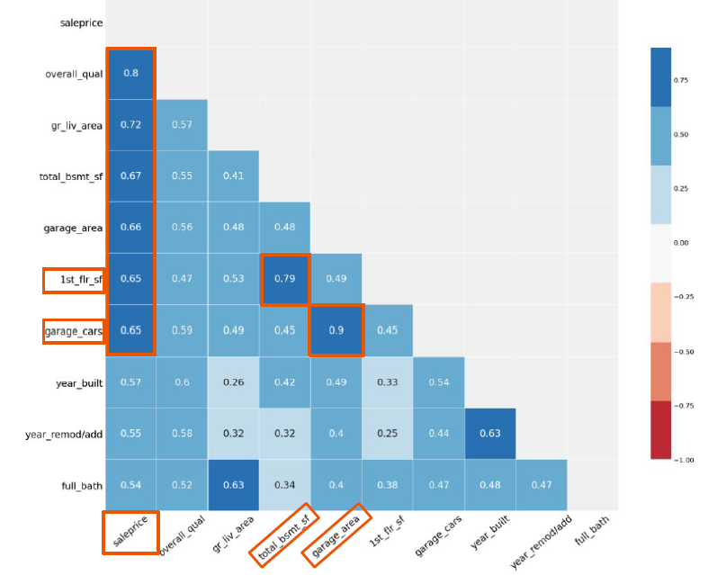
Data Exploration: Correlation

Slide 8
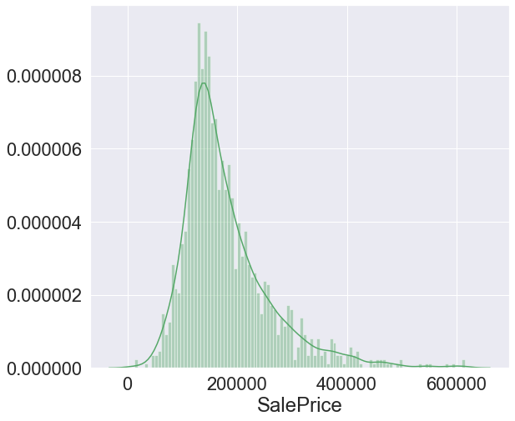
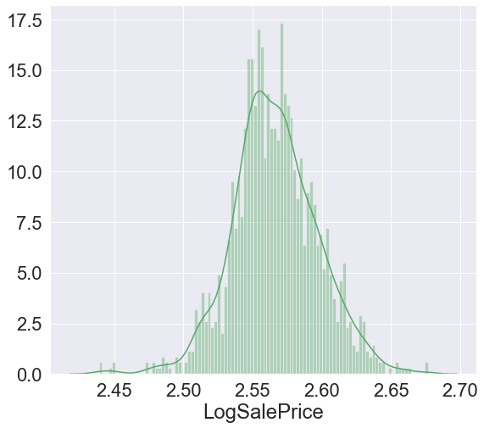
Data Exploration: Transformation
Distribution is skewed to the right
We use log transformation to fit a normal distribution

Slide 9
Data PreProcessing
2

Slide 10
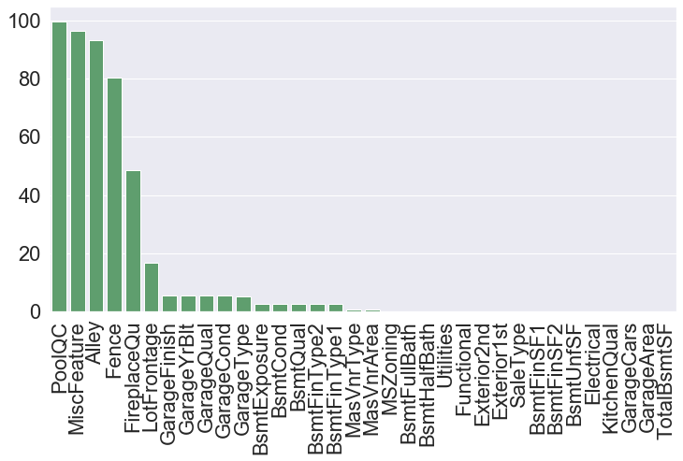
Data Preprocessing: Missing Value Imputation
Percent Missing
PoolQC: 99.69
MiscFeature: 96.4
Alley: 93.21
Fence: 80.43
FireplaceQu: 48.68
LotFrontage: 16.66
GarageYrBlt: 5.45
Since there are alot of null values, we do not want to drop the rows right away → violating integrity of data
We will try to impute some features in different ways

Slide 11
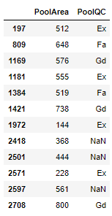
Data Preprocessing: Missing Value Imputation
Feature | Imputation
PoolQC | No pool according to the data dictionary So we fill with 0 BUT ID 2418, 2501, 2597 have a pool so we impute using avg distribution We use FA for those 3 cases
MiscFeature, Fence, utilities | We can use None according to data dict. But these features had no effect on our model so we delete
Notes:
We used the data dictionary to fill in the missing values accordingly, and removed those that had a high missing value percentage but no effect on our model

Slide 12
Data Preprocessing: Missing Value Imputation
Alley, FireplaceQu, Bsmt, MasVnrType, MasVnArea | use None (as per data dictionary)
LotFrontage | Group with neighborhood features, MICE
Garage , all other | Median and Mode ** We first tried all mode, but then looked at the distributions and chose median for skewed features as that provided us with the central value
Notes:
While with others, we used the median and mode depending ont he distribution of the feature

Slide 13
Data Preprocessing: Feature Creation, Label Enc.
Numerical Features:
Total House Square Footage
Total Porch Square Footage
Total Bathrooms
Binary Features
Has pool?
Has 2nd floor?
Has Garage?
Has Basement?
Has Fireplace?
Label Encoder
factorize the low cardinality features
Allowed us to keep same dimensionality (vs dummy creation)
l

Slide 14
Experiment One
3

Slide 15
Light GBM
Ridge
Fast splitting
Hard to tune parameters via grid search
Prevents overfitting
Less variance
High bias
Linear Regression
Lasso
Easy to understand
Too simple to capture complex relationships
Prone to overfitting
Shrinks coeff. To 0
Avoids overfitting
Feature selec. is random
Elastic Net
Selects more features (compared to lasso)
Costly
Gradient Boost
SVM
Uses weak decision trees
Less resistant to changes
Doesn’t generalize well
Sensitive to noise
Poor results with large data set
Underperforms with large dataset

Slide 16
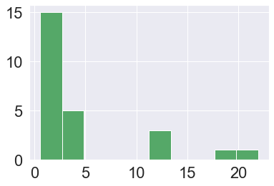
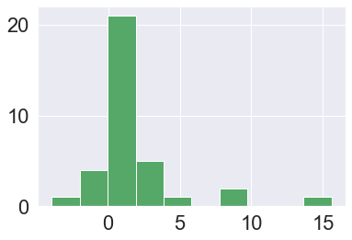
Experiment One: Skew, Scaling
To handle skew:
Boxcox1p:decrease skew in our features
To Ensure Normality :
Scale the data using StandardScaler so all values are normal
Normalized values are between 0 and 1
Allows us to assess tests as normality is a condition needed
The graph to the right shows how we have diminished skew

Slide 17
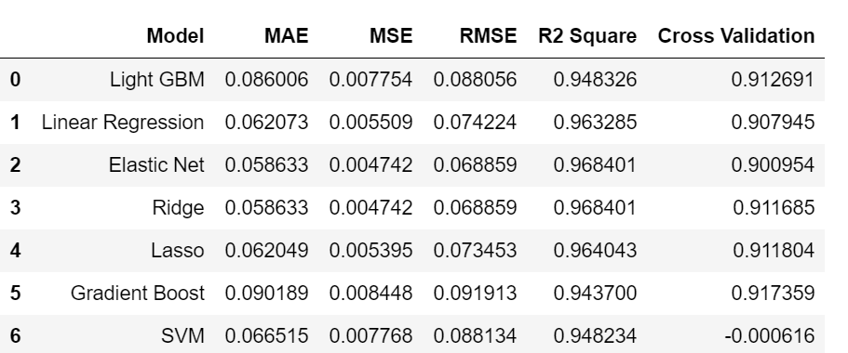
Experiment One: Testing/Evaluation
*** There could be potential noise leading to overfitting in our models. We will now remove outliers to see the impact on our evaluation metrics
Notes:
SVM is sensitive to noise - this could be one reason we drop it. It doesn’t like data it hasn’t seen

Slide 18
Experiment Two
4

Slide 19
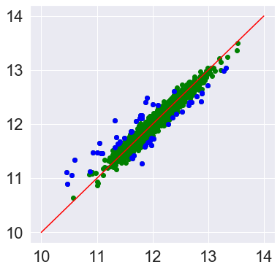
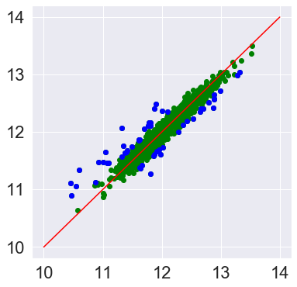
Experiment Two: Outlier Handling
Ridge
Elastic Net
We use Ridge and Elastic Net method to detect outliers
Since our data has been scaled to be normal, we use the standard deviation technique to detect
calculate the z-score (observation-mean/ standard deviation)
Z-Score beyond +/- 3 is considered to be an outlier
Both methods give use VERY similar results, so we use the intersecting values as our outliers
Elastic Net gave us one additional value
Notes:
We handled outliers witht he z score method because our features were scaled to be normal. According to empircal rule, anything beyond +/- 3 std dev is considered to be a possible outlier
Both methods gave the same rows of outlers (elastic net just gave us one more row)

Slide 20
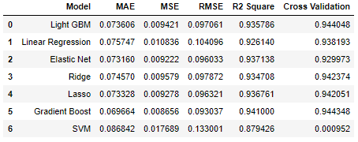
Experiment Two: Testing/Evaluation
*** Our R^2 might have gone down, but our cross validations improved which indicates we removed some noise and our model is performing better.

Slide 21
Experiment Three
5

Slide 22
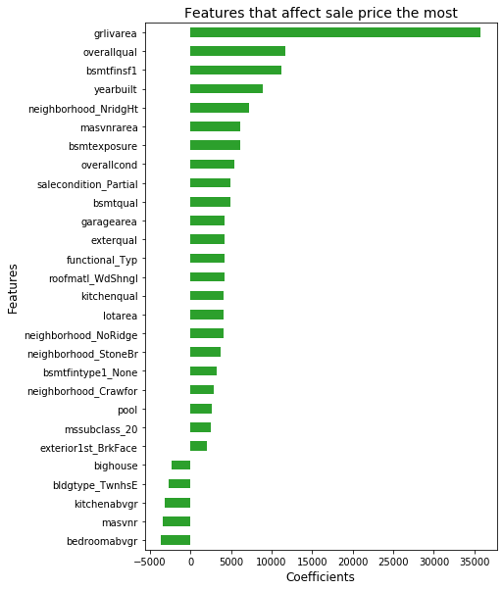
Experiment Three: Feature Selection
We calculate the coefficients of the features to determine the important features

Slide 23
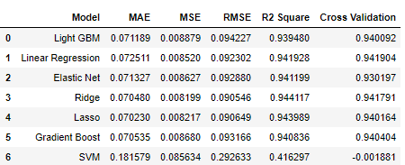
Experiment Three: Testing/Evaluation

Slide 24
Experiment Four
6

Slide 25
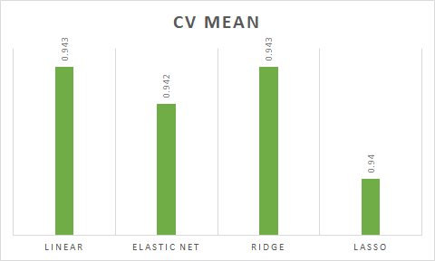
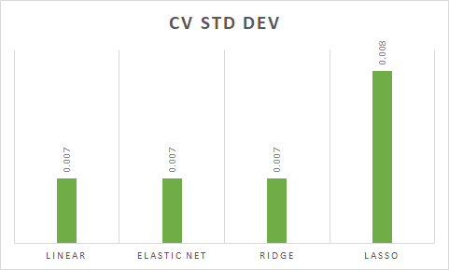
Experiment Four: Hyper-Parameter Tuning

Slide 26
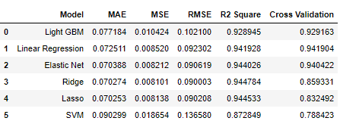
Experiment Four: Testing/Evaluation
A lot of hyperparameter tuning, the performance will usually be slightly worse than what you measured using cross-validation
Notes:
If you did a lot of hyperparameter tuning, the performance will usually be slightly worse than what you measured using cross-validation (because your system ends up fine-tuned to perform well on the validation data and will likely not perform as well on unknown datasets)

Slide 27
Conclusion
7

Slide 28

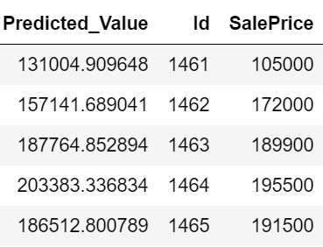
Experiment Four: Testing/Evaluation
Model Chosen: Ridge Regression
Notes:
We finalized ridge because it was performing consistenly well on our corss validation, R^2. It also was less resistant to noise and had a low MAE. W
We used the model to predict our test data set, and found the MAPE (mean absolute percentage error). This was calcuated by finding the mean of the absolute value of the residuals. A lower MAPE is better, we calculated a MAPE of 9.1%

Slide 29
Insights
Positive Effect on Sale Price
Size
Condition & Quality
Functional
Single story Homes
Recently Built
Location
Presence of fireplace
Brick Exterior
Negative Effect on Sale Price
Townhouse
Too many Bedrooms
Unfinished Features
Poor Quality

Slide 30
Recommendations for Homeowner
Improving Quality of Home Features
Improve condition & quality of Kitchen, Basement, Garage and External Areas
Ensure House is Finished Condition
Ideally, house should be in move_in condition when shown to the prospective homebuyers
Installing Features to keep House Warm
Install fireplaces & brick exterior for house

Slide 31

Revision Post Presentation
Stacked Model with top performing models (Lasso, Elastic Net, Ridge, Gradient Boost)
New MAPE:

Slide 32
Questions?

