Slide 1
Data Preparation and Handling

Slide 2
Dataset Description
I selected a dataset of Apartment/ Hotel listings for Data preparation and Handling project.
Our data contains character and numerical variables such as the listing ID, location of those listings, Host ID, price, customer reviews, number of properties listed by the host, availability of the accommodation during the year and the minimum number of nights it can be let out for.
I work on cleaning our dataset, treating the flaws in it such as missing values, transforming it for analysis purpose and analyzing it.

Slide 3
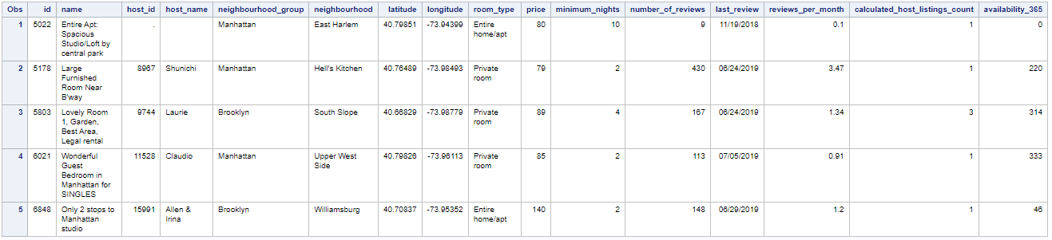
Loading the Data
A Library is created and named as “Clean”.
I use the Proc Import function to load the excel file.
The data shall look as per below snippet on importing it in SAS.

Slide 4
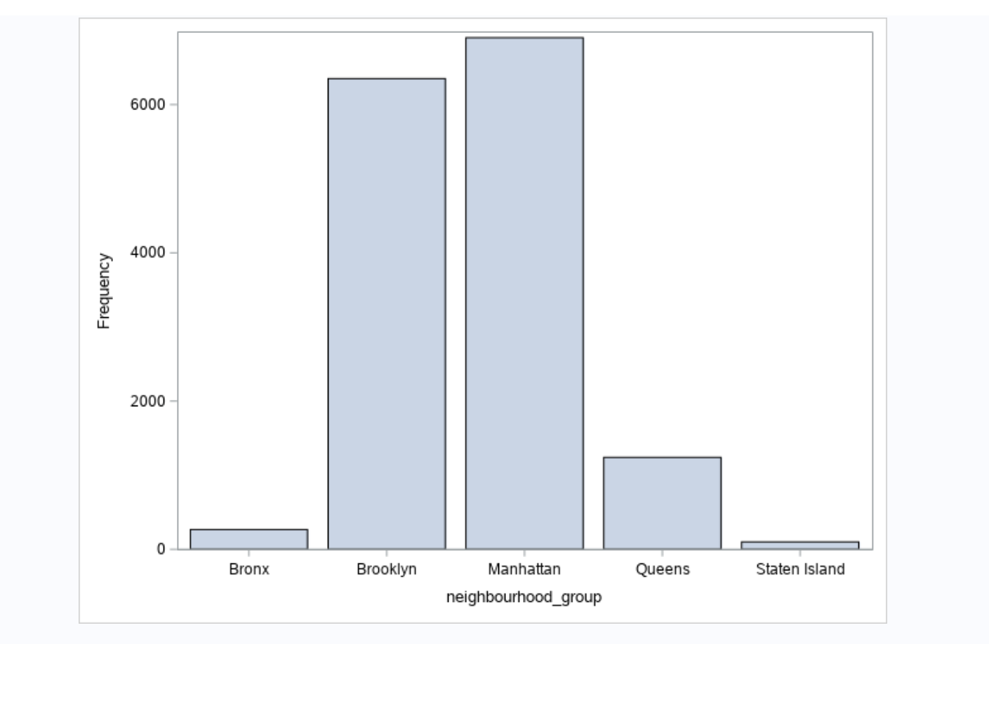
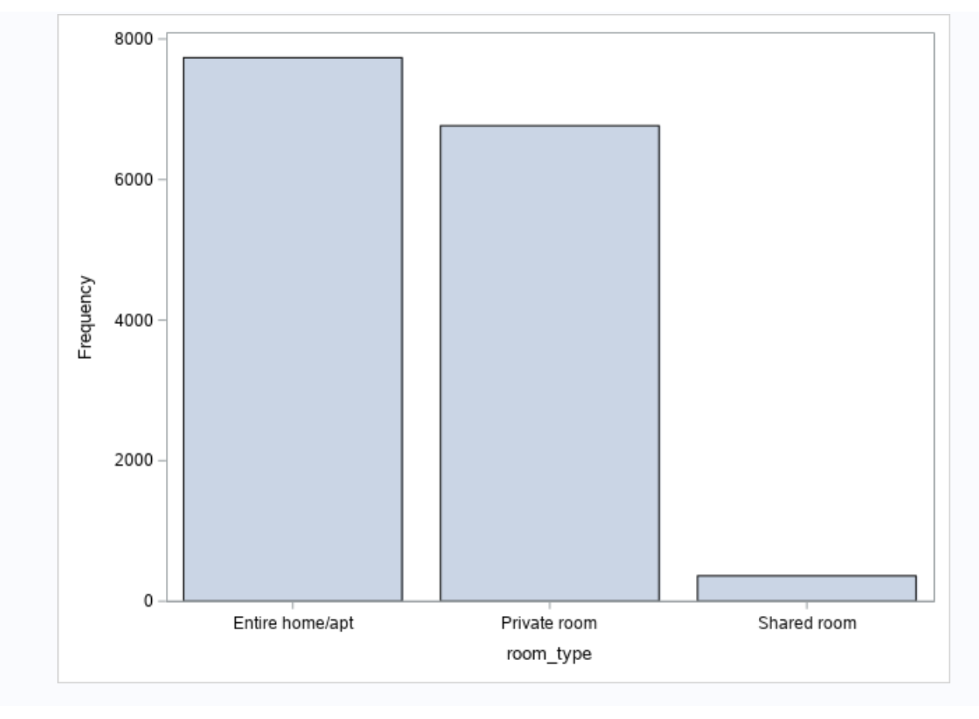
3. Dataset characteristics
1) Summery of Categorical variables
2) Analysis of Categorical variables

Slide 5
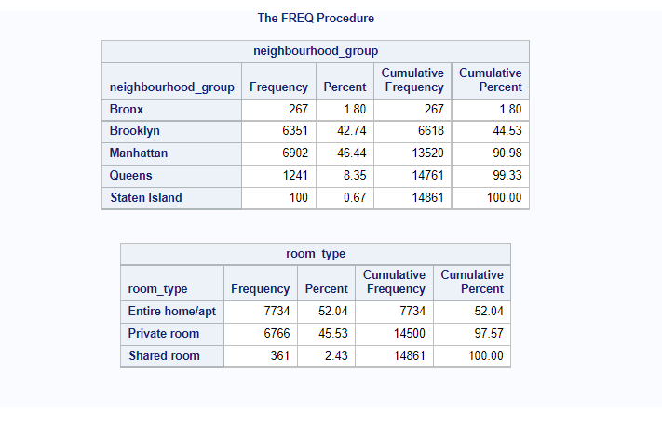
3. Dataset characteristics
3) Summery of Categorical variables

Slide 6
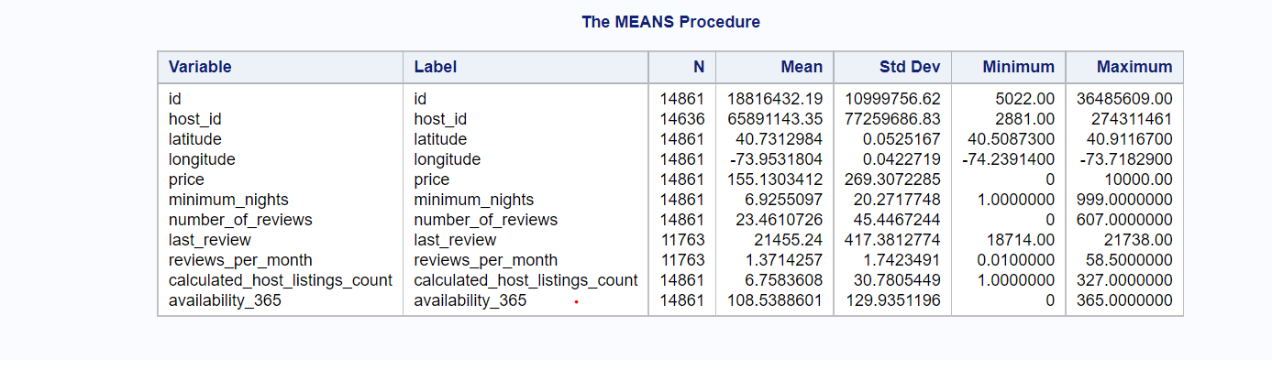
3. Dataset characteristics
Summery of Numeric Variables

Slide 7
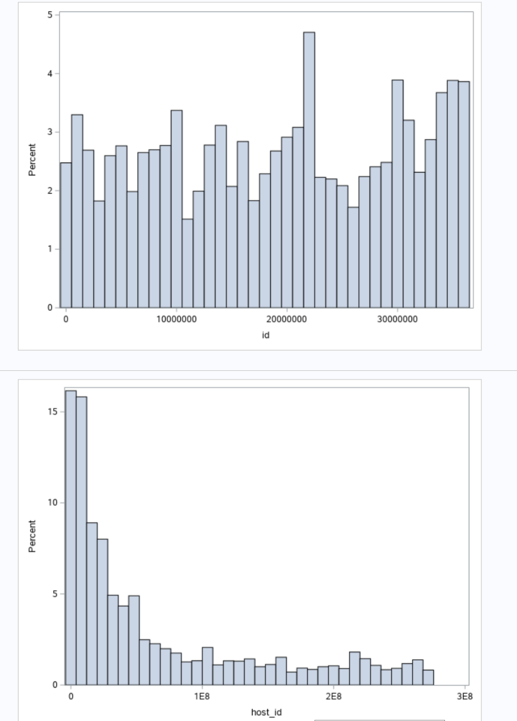
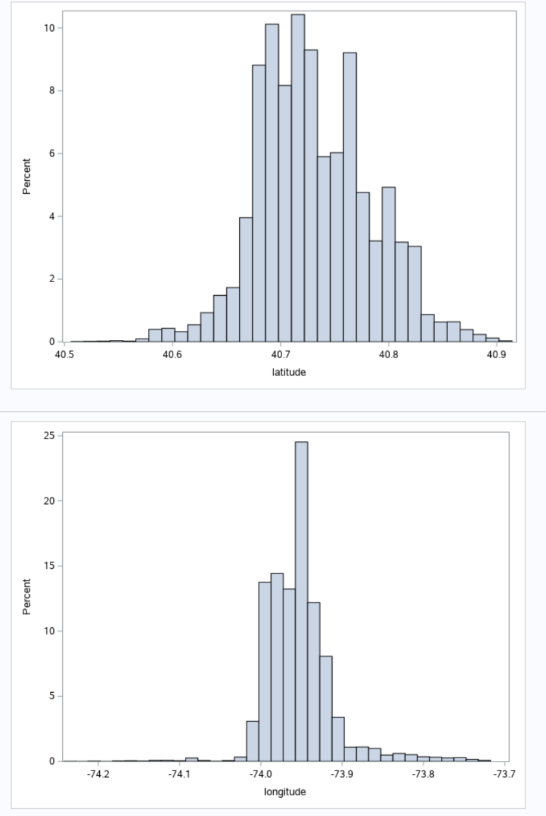
3. Dataset characteristics
Numeric Variables Distribution

Slide 8
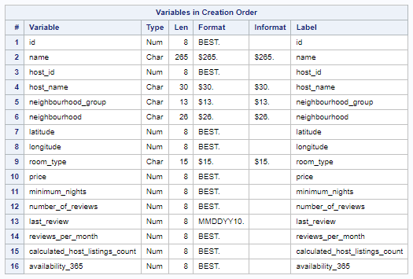
Categorical Variables
Examining Character Data
After importhing the file, I check the variables. As I see in the table there are 5 character variables in this dataset.

Slide 9

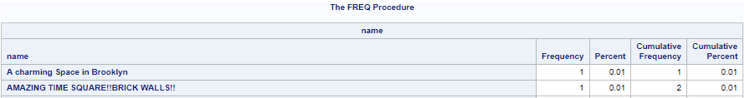
Categorical Variables
2. Checking Missing Values
As I show before and explained there are 5 character variables, values in our dataset. Only two of the variables, Name and Host Name, have missing values. Here I examine each of them
As you see there are 6 missing values in Name variable

Slide 10


Categorical Variables
2. Checking Missing Values
As I show before and explained there are 5 character variables, values in our dataset. Only two of the variables, Name and Host Name, have missing values. Here I examine each of them
As you see there are 235 missing values in Host Name variable

Slide 11
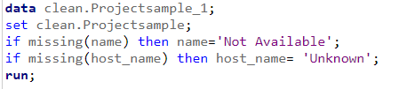
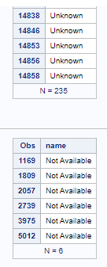
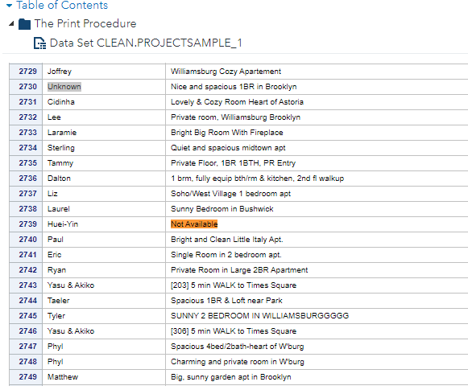
Categorical Variables
3. Treating Missing Values
In this part I I treat the mising values I examined in the previous section. As you remember there are two variable with missing values, Name and Host Name variables.
I use the codes below to treat missing values. You see the replaced values

Slide 12

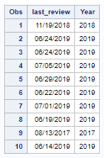
Categorical Variables
4. Creating Derived Variable
Derived variables, as the name suggests, the variable that is created by user.
In the code below, I create Year derived variable. Year function here is to get year from Last_Review column and extract. You can see the output.

Slide 13
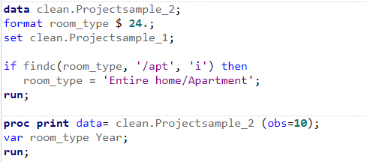
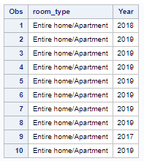
Categorical Variables
5. Correcting Errors
In this part I try to correct errors, mispelling. Using the code below, I examined Room Type variable and I want to replace 'Entire home/apt' value with more appropiate writing which is 'Entire home/Apartment’
I use Find function which is generally used for character values. You can see the output with Room Type set to be 'Entire home/Apartment’.

Slide 14
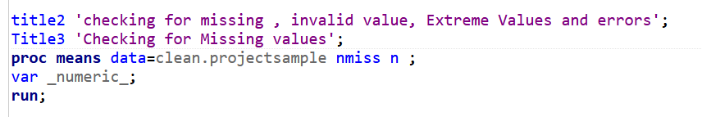
Numerical Variables
1. Examining the data
I examine the missing value count and total number of records using proc means.

Slide 15
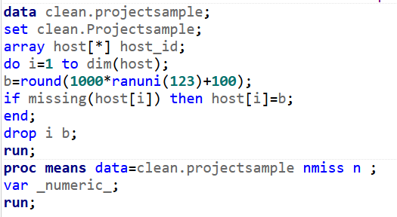
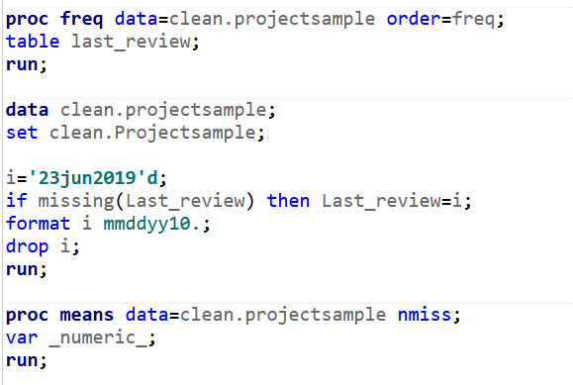
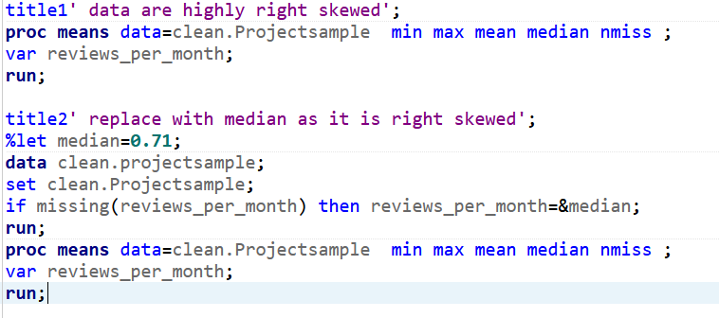
Numerical Variables
2. Replacing missing values with the respective values.
When I find any missing values, I check whether the data is skeId and replace them with the median values of that variable.
I often use histograms to check the skew of the data.

Slide 16
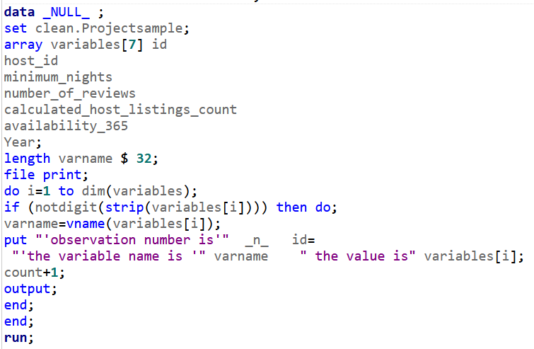
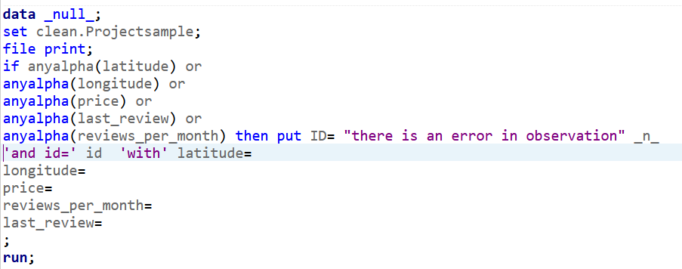
Numerical Variables
3. Verifying the data.
I finally verify the data to check for any invalid values. I proceed to Univariate analysis of the data when I find no invalid values.

