Slide 1
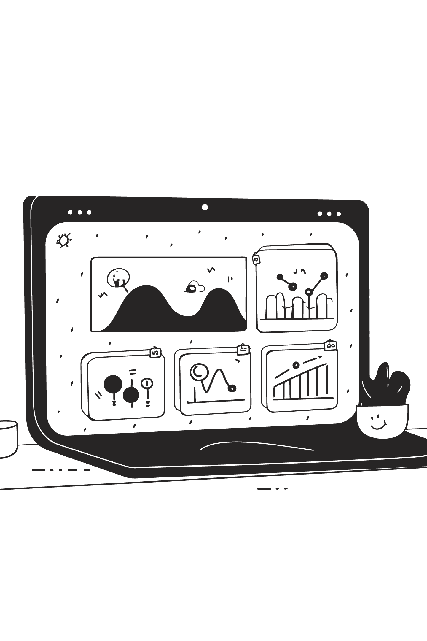
Customer Shopping Behavior Analysis
End-to-end data analytics project — Python · PostgreSQL · Power BI
Prepared by: Data Analytics Team | June 2026

Slide 2
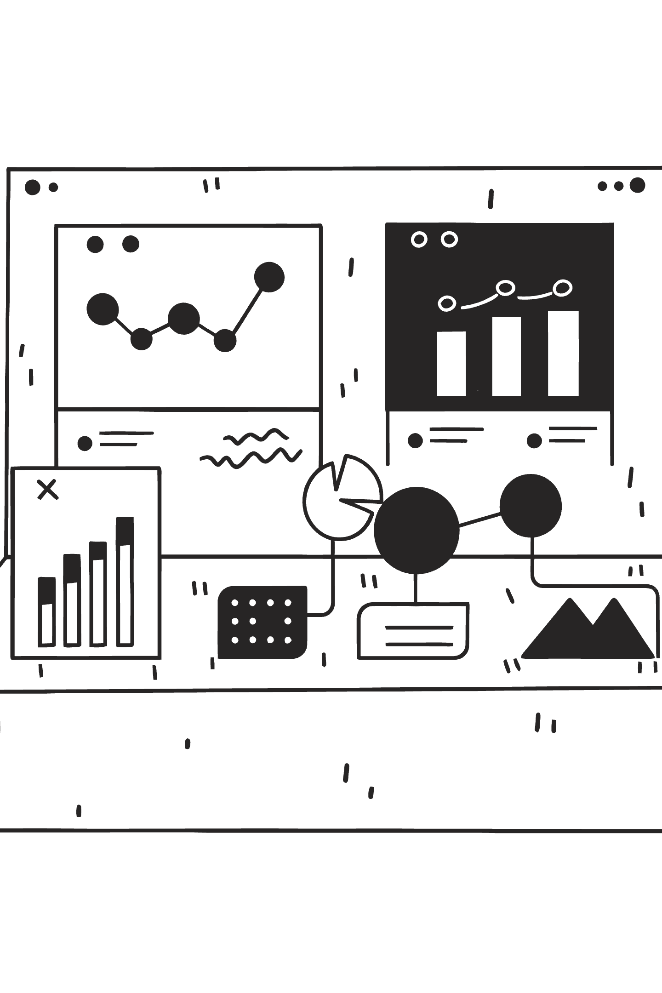
At-a-Glance Metrics
Customers
Columns
SQL Queries
3,900
18
10
Dashboard
1 (Power BI)

Slide 3

Business Problem
Understand customer shopping behavior to improve sales, satisfaction, and loyalty. Management observed shifts across demographics, categories, and channels and asked:
"How can the company leverage consumer shopping data to identify trends, improve customer engagement, and optimize marketing and product strategies?"

Slide 4

Project Overview
End-to-end workflow: data prep & modeling in Python, SQL analysis in PostgreSQL, interactive Power BI dashboard, and a reproducible GitHub repository containing scripts and queries.
Data Preparation & Modeling (Python)
Data Analysis (SQL)
Visualization & Insights (Power BI)
Report & Presentation
GitHub repository

Slide 5


Dataset Summary
Transactional and behavioral data for 3,900 customers; 18 columns; each row = one customer's most recent purchase interaction.
Demographics
Age, Gender, Location, Subscription Status
Purchase Details
Missing values: 37 (review_rating) — median imputed by product category
Redundancy removed: dropped promo_code_used (duplicate of discount_applied)
Item, Category, Amount, Season, Size, Color
Behavior
Discounts, Previous Purchases, Frequency, Rating, Shipping, Payment

Slide 6

Exploratory Data Analysis (Python)
Performed in Jupyter with pandas: data loading (pd.read_csv), df.info(), df.describe(), column standardization to snake_case, feature engineering, and database integration via SQLAlchemy.
01
02
Missing Value Treatment
Feature Engineering
37 null review_ratings imputed using category-wise median to preserve distribution.
Created age_group (qcut) and purchase_frequency_days (numeric mapping of textual labels).
03
Redundancy & Load
Dropped promo_code_used; loaded cleaned table into PostgreSQL database customer_behavior.

Slide 7

Data Analysis (SQL) — Ten Business Queries
Executed 10 structured queries using CTEs, CASE, window functions, and aggregates to answer core business questions.
Revenue by Gender
High-spend discount users
Top products by rating
Shipping vs. purchase behavior
Subscription & repeat buyer analysis

Slide 8




Key Findings (Selected)
Top-rated Products
Shipping Impact
Revenue by Age
Subscription vs. Revenue
Gloves, Sandals, Boots, Hat, Skirt ranked highest by rating.
Express-shipping customers show higher average purchase amounts.
Young Adults drive the highest total revenue.
Average spend similar for subscribers and non-subscribers; non-subscribers drive more revenue overall.

Slide 9

Dashboard — Power BI
An interactive Power BI dashboard was built on PostgreSQL to enable stakeholder exploration with dynamic slicers and KPI cards.
KPI Cards: Number of Customers, Avg Purchase Amount, Avg Review Rating
Donut: Subscription distribution
Clustered Columns/Bars: Revenue & Sales by Category and Age Group
Slicers: Subscription, Gender, Category, Shipping Type

Slide 10

Recommendations & Conclusion
1
2
Boost Subscriptions
Customer Loyalty Programs
The project produced a clean, reproducible dataset, ten SQL-driven insights, and an interactive Power BI dashboard to enable self-service analysis. All code and artifacts are available in the GitHub repository for reproducibility and knowledge transfer.
Promote exclusive benefits to convert the large non-subscribed base.
Reward repeat buyers to advance them into Loyal segments.
3
4
Review Discount Policy
Product & Marketing Focus
Balance discount-driven sales with margin control for discount-dependent products.
Highlight top-rated best-sellers and target high-revenue groups (Young Adults, Express-shipping users).

