Slide 1

Lab1
Digital Logic Design
SystemVerilog (SV)

Slide 2
Welcome to Dr. Das's Lab!
We hope you have a pleasant learning experience while working with this software.
In this session, we will design basic logic gates: NOT, AND, and OR together.
In the previous session, you successfully installed Modelsim software. Now, it's time to start writing code in the SystemVerilog .
For this purpose, we will need three main files:
1️⃣ Verilog file (to describe the logic circuit). 2️⃣ Testbench file (to test and evaluate the circuit’s performance). 3️⃣ DO file (to automate the simulation process).

Slide 3

What is a DO File?
A DO file in ModelSim is a script file that automates the simulation process by executing a sequence of commands. Instead of manually entering each command in the ModelSim command line, a DO file allows you to run multiple commands automatically with a single execution.
Why is a DO File Important?
Without a DO file, we would have to manually type every command in ModelSim, such as:
Compiling the Verilog files
Loading the testbench
Adding signals to the waveform
Running the simulation
This process would be time-consuming and error-prone, especially for large projects. By using a DO file, we can automate these tasks, ensuring consistency and efficiency in the simulation workflow.

Slide 4
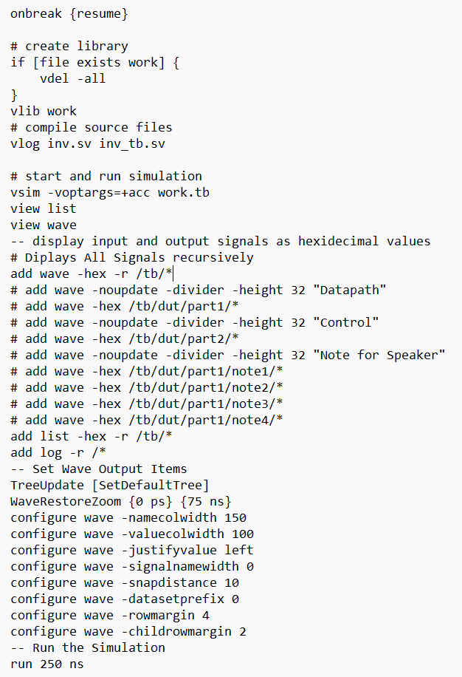
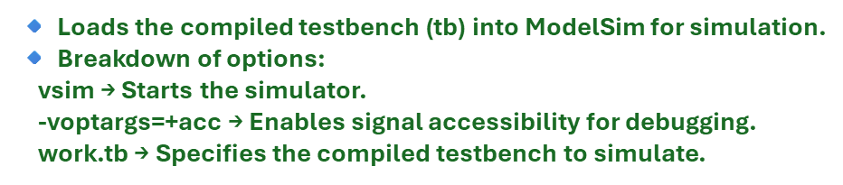


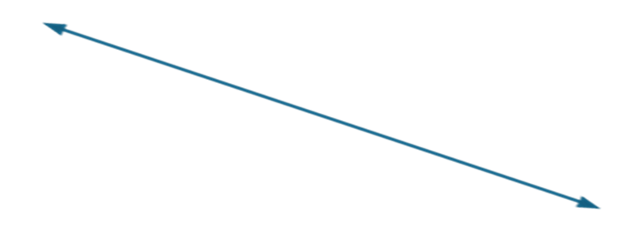


Handling Interruptions in the Simulation(🔹 Ensures that if the simulation pauses due to an error or manual stop, it resumes instead of terminating.)
🔹 Checks if the work library already exists.
🔹 If it does, it deletes (vdel -all) everything inside it.
🔹 Then, it creates a new library (vlib work) to store compiled simulation files.
🔹 Compiles the Verilog/SystemVerilog source files:
inv.sv → The file (DUT - Device Under Test).
inv_tb.sv → The testbench file (stimulates the DUT).
🔹 The command vlog is used in ModelSim for compilation.
Setting Up the Waveform View:
🔹 Opens two essential views in ModelSim:
List View → Displays signal values in tabular format.
Wave View → Displays signals as timing waveforms.
Adding Signals to the Waveform:
🔹 Adds all signals inside the testbench (tb) to the waveform view.
🔹 -hex → Displays signal values in hexadecimal format (useful for multi-bit signals).
🔹 -r → Recursive addition, meaning all sub-signals inside tb will be added.

Slide 5
Using this DO file automates the entire simulation process, eliminating the need to manually enter commands in Modelsim!
Key Actions of This DO File
1️⃣ Deletes and recreates the simulation library (work).
2️⃣ Compiles the Verilog files (inv.sv and inv_tb.sv).
3️⃣ Loads the testbench (tb) for simulation.
4️⃣ Adds signals to the waveform and list views.
5️⃣ Customizes the waveform display.
6️⃣ Runs the simulation for 250 ns.

Slide 6
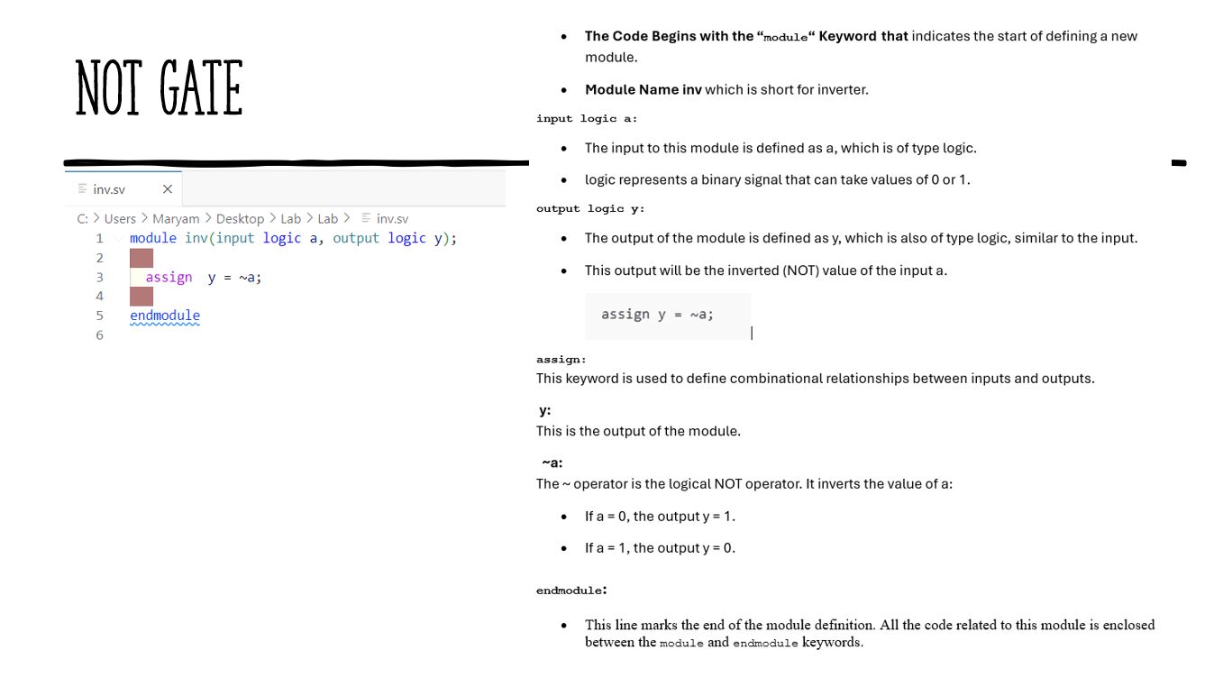

Slide 7
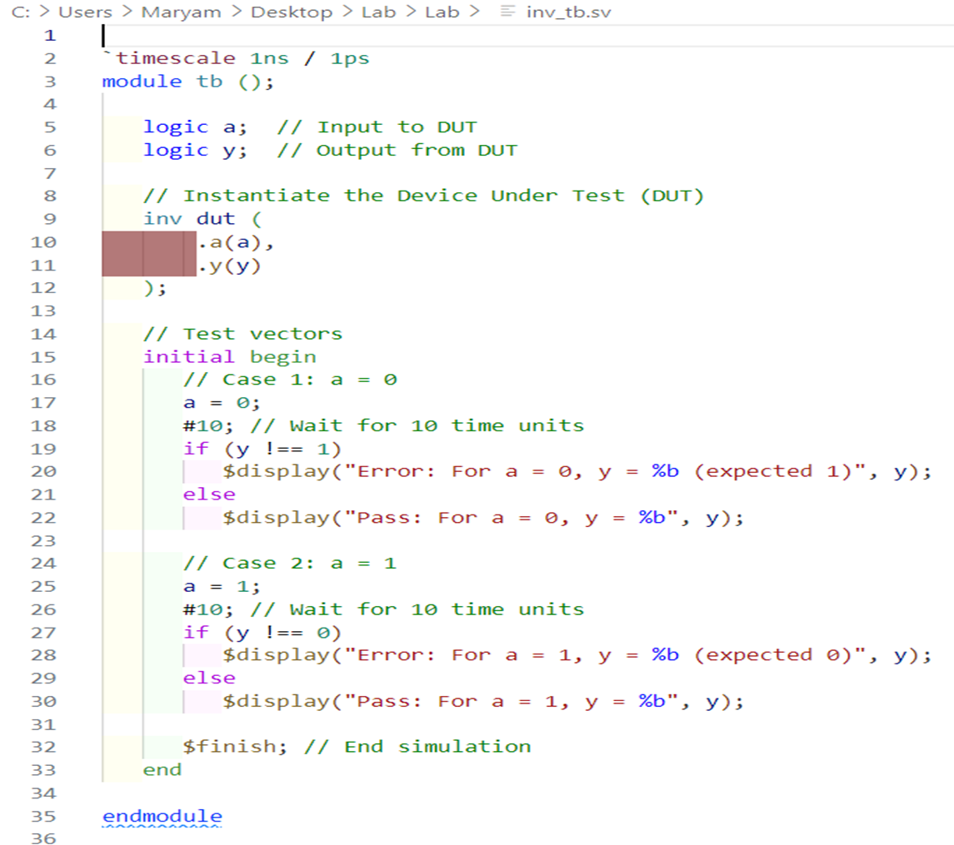



Slide 8

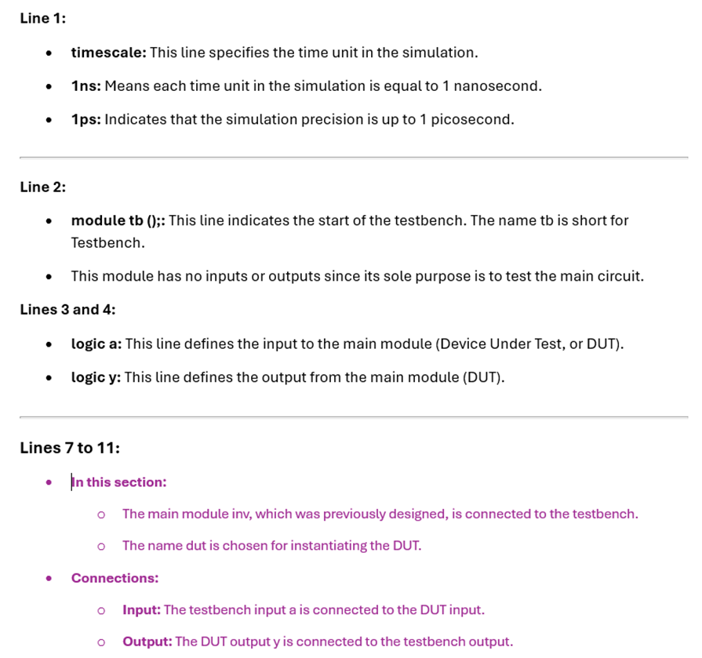
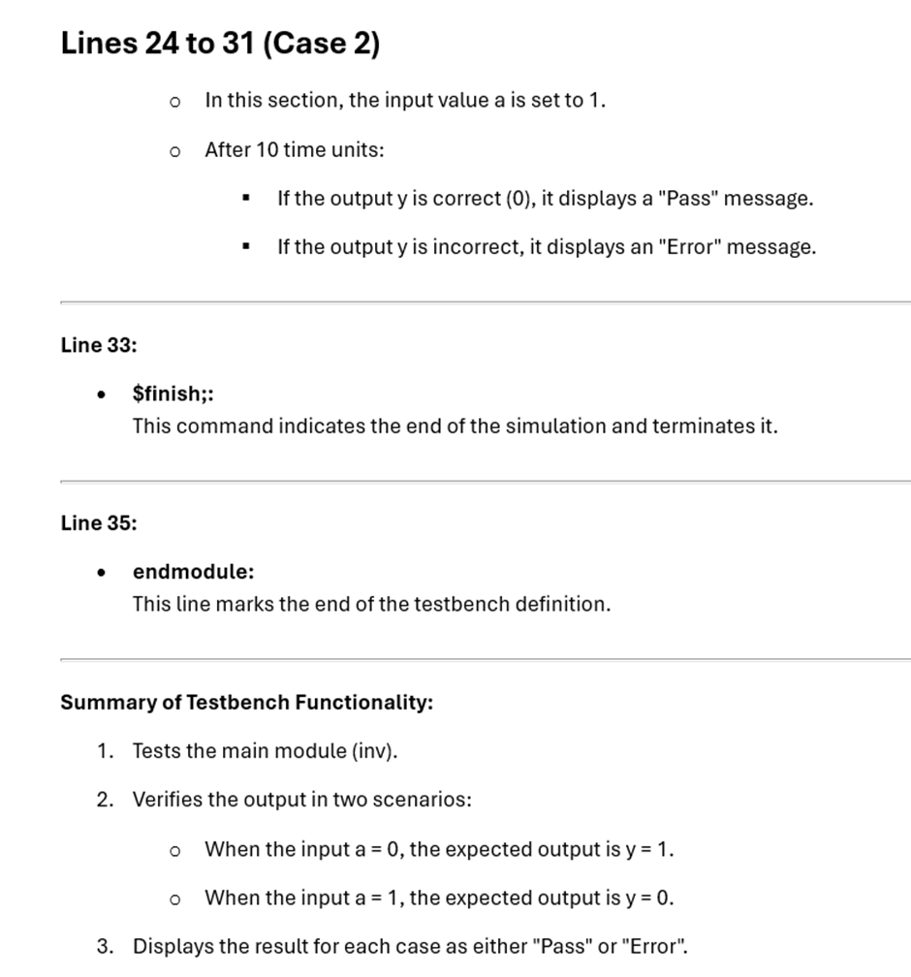

Slide 9
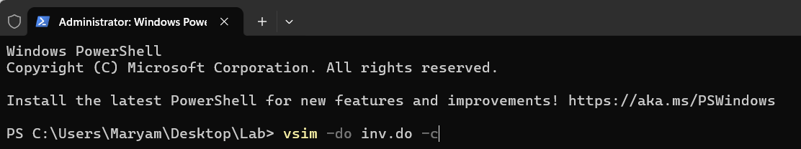
To simulate the testbench using ModelSim, follow these step-by-step instructions:
Step 1: Navigate to the Folder Containing the Required Files
(Make sure that your three necessary files are in the same folder):
Open the Terminal in the Correct Folder:
Go to the folder containing these files (inv.sv, inv_tb.sv, inv.do).
Right-click inside the folder and select "Open in Terminal" (or "Open PowerShell Here" in Windows).
You should now be inside the correct directory in the terminal
Step 2: Run the DO File in ModelSim (In the terminal, enter the following command and press Enter):
vsim -do inv.do -c
-c → Runs ModelSim in command-line mode (without opening the GUI).
vsim → Runs the ModelSim simulator.
-do inv.do → Executes the DO file (inv.do), which automates the simulation.
vsim -do inv.do
If you want to see the GUI while running the simulation, remove -c:
The graphical environment of ModelSim opens, and you can view signals in the Waveform window.

Slide 10
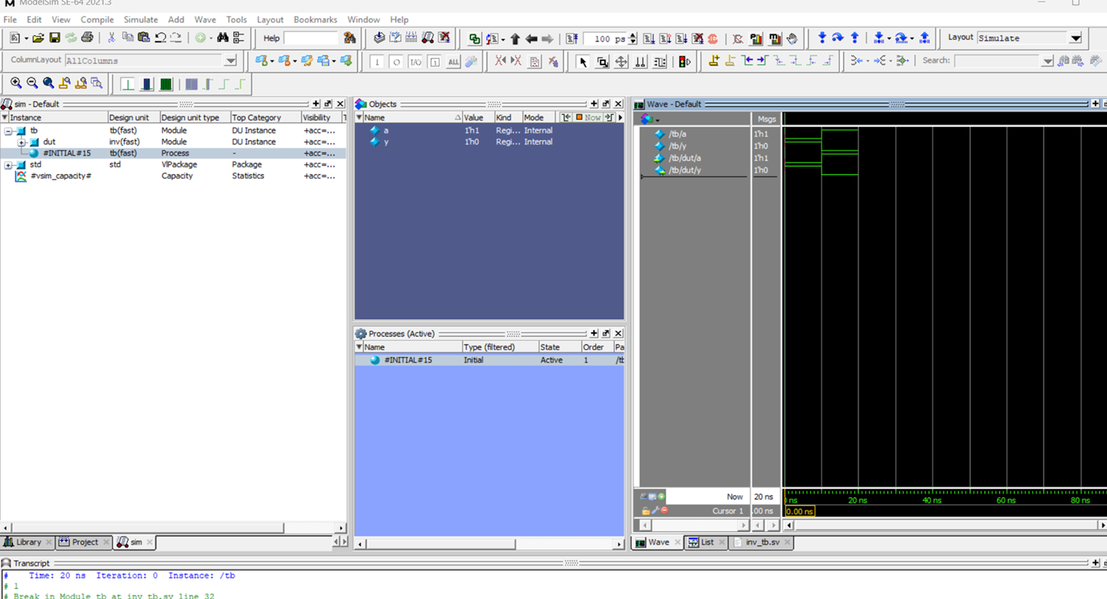
Simulation Results in ModelSim
The above image shows the successful execution of the NOT gate simulation in ModelSim.
The Instance Window confirms that the testbench (tb) and the inverter (dut) are correctly instantiated.
The Objects Window displays the input (a) and output (y) signals.
The Waveform Window verifies that the NOT operation is functioning correctly (y = ~a).
The Transcript Window confirms that the simulation ran for 20 ns without errors

Slide 11
Practice More – Implement AND & OR Gates
To further strengthen your understanding of combinational logic, please implement the AND and OR gates in Verilog.
Design and test both gates following the same approach as the NOT gate.
Use SystemVerilog and simulate your circuits in ModelSim.
For additional examples and reference codes, you can explore the following repository:
https://github.com/MaryamShahangian/DLD_DrDas.git
🔗 GitHub Repository – DLD Dr. Das

