Slide 1

Lab3
Half Adder & Full Adder

Slide 2
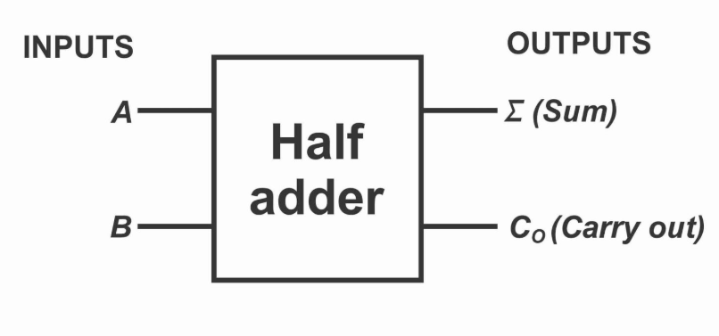
Half Adder

Slide 3

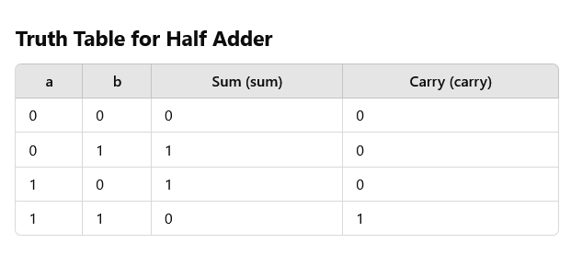
Half Adder Design in SystemVerilog
A Half Adder is the simplest type of digital adder that takes two input values and produces a sum output and a carry output. Unlike a Full Adder, a Half Adder does not have a carry-in input.

Slide 4
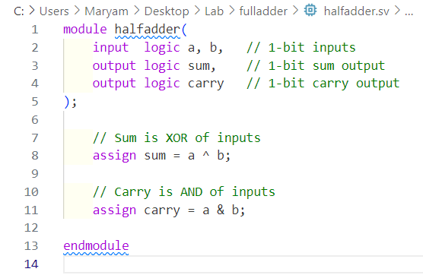
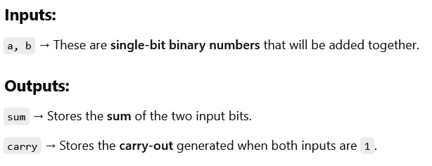
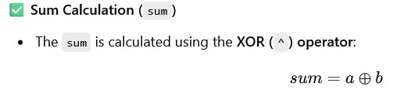
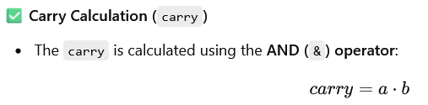
SystemVerilog Code for Half Adder

Slide 5
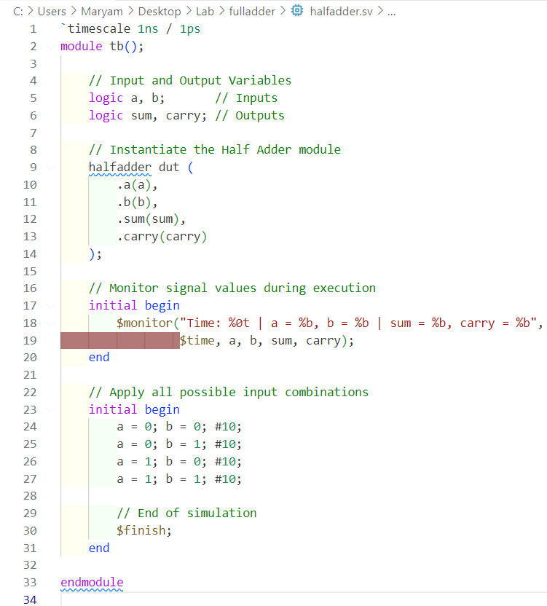
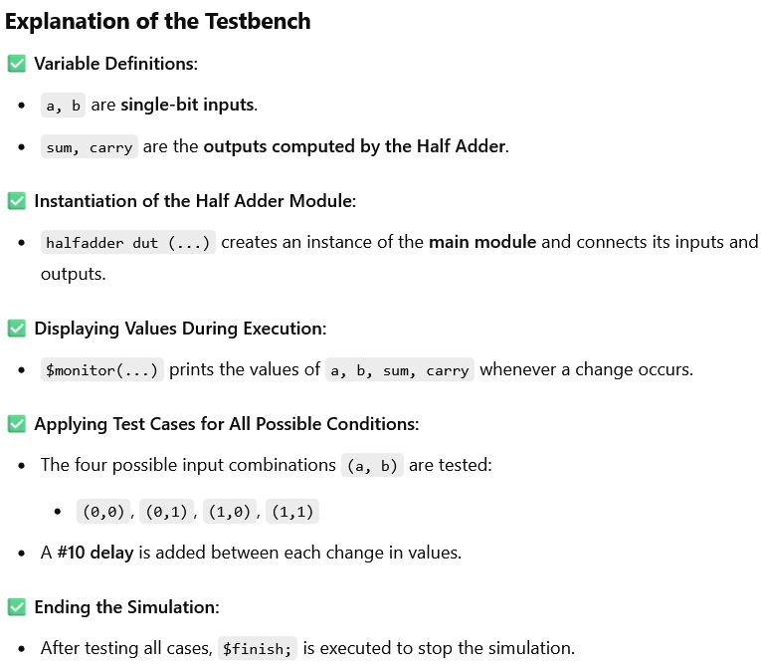
Testbench Code

Slide 6

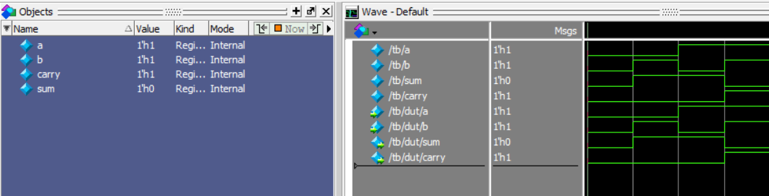
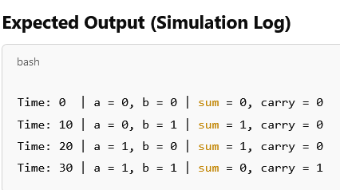
Simulation Waveform of Half Adder in ModelSim

Slide 7
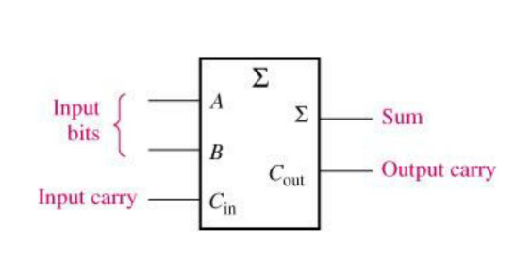
Full Adder

Slide 8
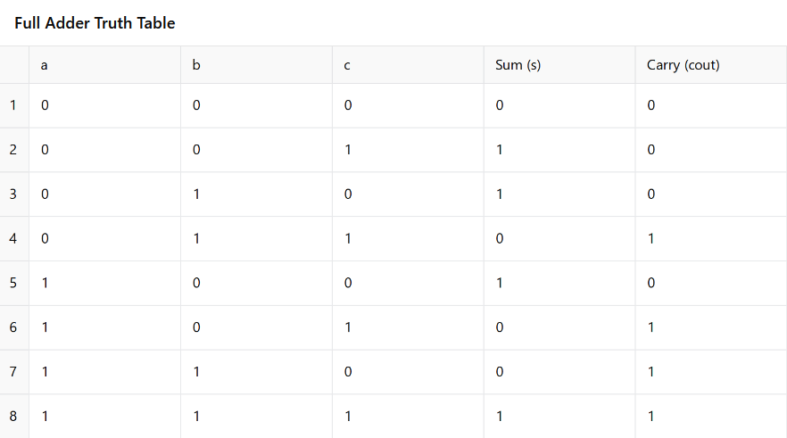
Full Adder Truth Table

Slide 9

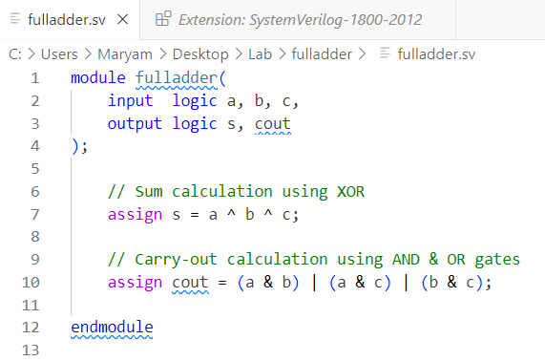
SystemVerilog Code for Full Adder

Slide 10
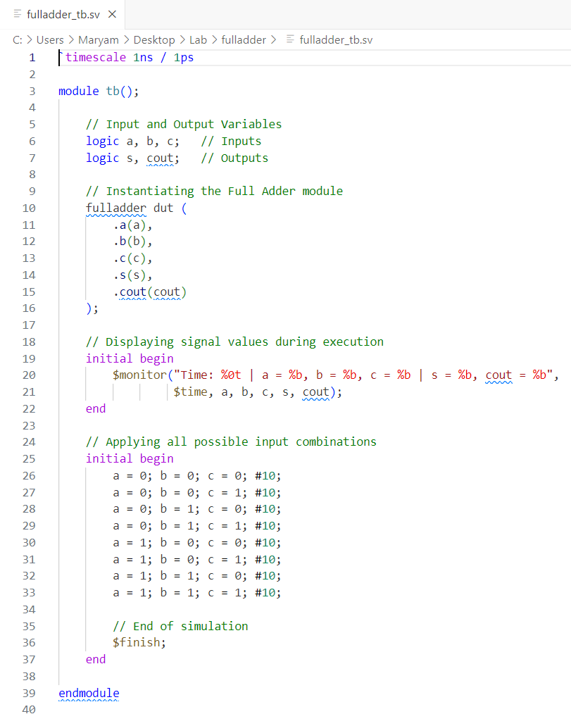
Testbench Code

Slide 11

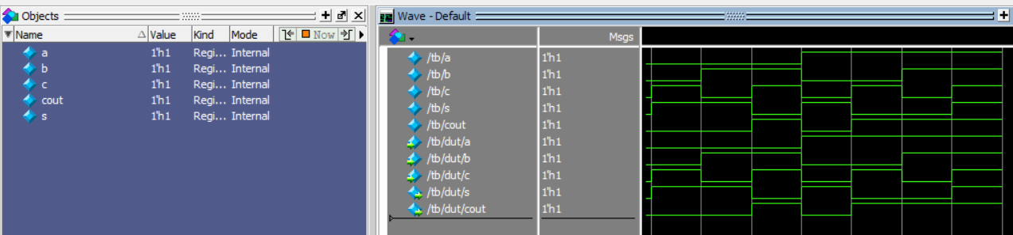
Full Adder Testbench Waveform Analysis

