Slide 2
Android File System
Peter Larsson-Green
Jönköping University
Spring 2020

Slide 3
Shared Preferences
Key/value pairs of String/primitive data types stored in files.
Inside an activity (Activity specific):
SharedPreferences preferences = getPreferences(MODE_PRIVATE);
Inside an activity (Activity independent):
SharedPreferences preferences = getSharedPreferences(
"the-name",
MODE_PRIVATE
);
Older versions of Android supported different modes.

Slide 4
Shared preferences
Write:
SharedPreferences.Editor editor = preferences.edit();
editor.putInt("luckyNumber", 7);
editor.putString("name", "Hello");
editor.apply(); // Save changes asynchronously or...
editor.commit(); // ...save change synchronously.
Read:
int luckyNumber = preferences.getInt("luckyNumber", -1);
String name = preferences.getString("name", "???");
Default value.
Default value.

Slide 5
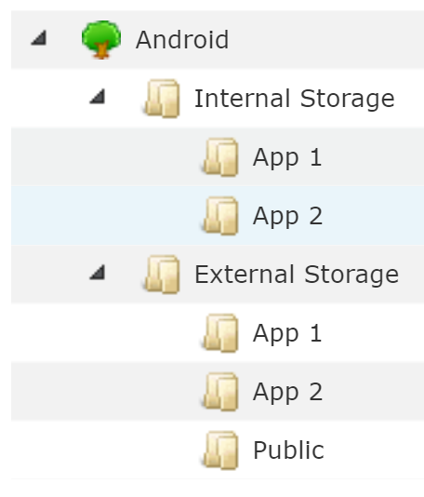
The file system
Android is built on Linux.
File system consist of folders and files.
Additional security measures has been added:
Each app has a "private" folder.
Only your app can read/write files from/to it.
The user can't see files inside of it.
Each app has a "public" folder.
Other apps can read/write files from/to it.
The user can see the files inside it, but typically shouldn't.
There also exists a shared "public" folder.
Any app can read/write files from/to it.
The user can see the files inside of it.

Slide 6
The file system - History lesson
In the beginning, there were two different storages:
Internal storage.
This is where applications are installed, and the "private" folders are stored.
On-board memory, always available.
External storage.
This is where the "public" folders are stored.
Can be a memory card ⇒ can be removed ⇒ not always available.
Can be connected to computer with USB cable ⇒ not always available.
Some OEMs then skipped the memory card.
The on-board memory contains both internal and external storage.
Users think they don't have an external storage; "There's no memory card :S"

Slide 7
The file system - History lesson
From API level 8:
Apps can be installed on external storage.
https://developer.android.com/guide/topics/data/install-location.html
From API level 3:
The permission WRITE_EXTERNAL_STORAGE is required to write to any "public" folder.
From API level 16:
The permission READ_EXTERNAL_STORAGE is required to read from any "public" folder.
From API level 19:
Your own public folder does not require the permissions READ_EXTERNAL_STORAGE and WRITE_EXTERNAL_STORAGE.
Android started to support "secondary external storage".
https://developer.android.com/about/versions/android-4.4.html#ExternalStorage

Slide 8
The file system - Summary
Internal
External
Read/Write access
Your application
All applications & Other devices
Cache
Yes
Yes
Accessible
Always
Not necessarily always
Delete on uninstall
Yes
Your folder
Files can belong to your app or the user.
SD Card removed.
Connected to PC.
At most 1024 open files on some devices (all applications!).

Slide 9
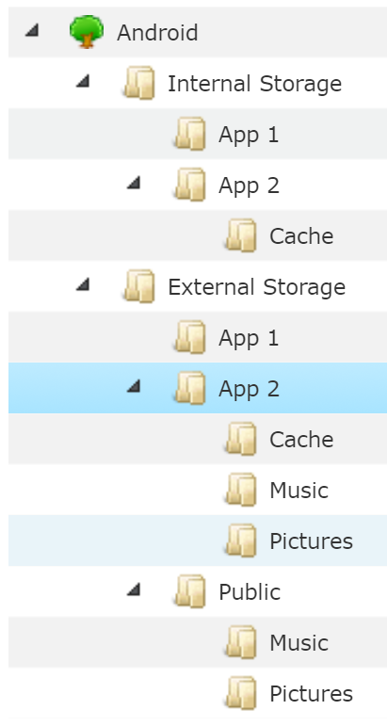
The file system
Think of it like this:

Slide 10
Write to internal storage
getCacheDir
File folder = aContext.getFilesDir();
File theFile = new File(folder, "my-file.txt");
FileOutputStream outputStream = new FileOutputStream(theFile);
OutputStreamWriter writer = new OutputStreamWriter(outputStream);
writer.write("The content of the file.");
writer.close();

Slide 11
Read from internal storage
getCacheDir
File folder = aContext.getFilesDir();
File theFile = new File(folder, "my-file.txt");
FileInputStream inputStream = new FileInputStream(theFile);
// Read from inputStream...
inputStream.close();

Slide 12
Checking external storage
String state = Environment.getExternalStorageState();
boolean canIWrite = Environment.MEDIA_MOUNTED.equals(state);
Path to external storage varies by Android version.
1 & 2: /sdcard
4 & 5: /mnt/shell/emulated/0
6 : /storage/emulated/0
Never use hardcoded paths!

Slide 13
Write to external storage
<uses-permission android:name="android.permission.WRITE_EXTERNAL_STORAGE"/>
getExternalCacheDir
File folder = aContext.getExternalFilesDir(Environment.DIRECTORY_MUSIC);
File theFile = new File(folder, "my-file.txt");
FileOutputStream outputStream = new FileOutputStream(theFile);
OutputStreamWriter writer = new OutputStreamWriter(outputStream);
writer.write("The content of the file.");
writer.close();

Slide 14
Read from external storage
getExternalCacheDir
File folder = aContext.getExternalDir(Environment.DIRECTORY_MUSIC);
File theFile = new File(folder, "my-file.txt");
FileInputStream inputStream = new FileInputStream(theFile);
// Read from inputStream...
inputStream.close();

Slide 15
Shared external storage
Folders shared by all applications on external storage.
File folder = Environment.getExternalStoragePublicDirectory(
Environment.DIRECTORY_MUSIC
);

