Slide 2
Android Scheduling
Peter Larsson-Green
Jönköping University
Spring 2020

Slide 3
Saving battery
User clicks on power button.
A few seconds later.
Name:
Pass:
Login
Sign up
Screen on
Screen off
Sleep mode
No ordinary applications run.
Not even services or background threads.
Phone calls & SMS messages can wake up the device
Alarms can wake up the device.
Awake mode

Slide 4
Time in Android
Can be changed by the user!
Real-time clock
Elapsed time since the Unix epoch (1 January 1970).
long now = Calendar.getInstance().getTimeInMillis();
Is resetting on reboot!
Elapsed real-time
Elapsed time since the device booted.
long now = SystemClock.elapsedRealtime();

Slide 5
One-Shot alarms
AlarmManager alarmManager = (AlarmManager)
aContext.getSystemService(Context.ALARM_SERVICE);
ELAPSED_REALTIME
ELAPSED_REALTIME_WAKEUP
RTC
RTC_WAKEUP
alarmManager.set(
AlarmManager.XXX,
SystemClock.elapsedRealtime() + 5*1000,
thePendingIntent
);

Slide 6
One-Shot alarms
alarmManager.set(...);
alarmManager.setExact(...);
Up to Android 4.3: is exact.
From Android 4.4 and on: is inexact
(the time is minimum).
Added in Android 4.4.

Slide 7
Repeating alarms
AlarmManager alarmManager = (AlarmManager)
aContext.getSystemService(Context.ALARM_SERVICE);
First time.
alarmManager.setRepeating(
AlarmManager.ELAPSED_REALTIME_WAKEUP,
SystemClock.elapsedRealtime() + 5*1000,
1000*60,
thePendingIntent
);
Interval.
At least one minute from Android 5.1 and on.

Slide 8
Repeating alarms
AlarmManager alarmManager = (AlarmManager)
aContext.getSystemService(Context.ALARM_SERVICE);
Min first time.
alarmManager.setInexactRepeating(
AlarmManager.ELAPSED_REALTIME_WAKEUP,
SystemClock.elapsedRealtime() + 5*1000,
AlarmManager.INTERVAL_XXX,
thePendingIntent
);
INTERVAL_FIFTEN_MINUTES
INTERVAL_HALF_HOUR
INTERVAL_HOUR
INTERVAL_HALF_DAY
INTERVAL_DAY

Slide 9
Repeating alarms
alarmManager.setRepeating();
alarmManager.setInexactRepeating();
Up to Android 4.3: is exact.
From Android 4.4 and on: is identical to setInexactRepeating.
Is inexact.

Slide 10
Canceling alarms
alarmManager.cancel(theAlarmIntent);

Slide 11
Saving battery
User clicks on power button.
A few seconds later.
~Device been still for a while and not charging
Name:
Pass:
Login
Sign up
Screen on
Screen off
Sleep mode
No ordinary applications run.
Not even services or background threads.
Phone calls & SMS messages can wake up the device
Alarms can wake up the device.
Doze mode
Introduced in Android 6.
Scheduled alarms/jobs won't run as scheduled.
Awake mode

Slide 12
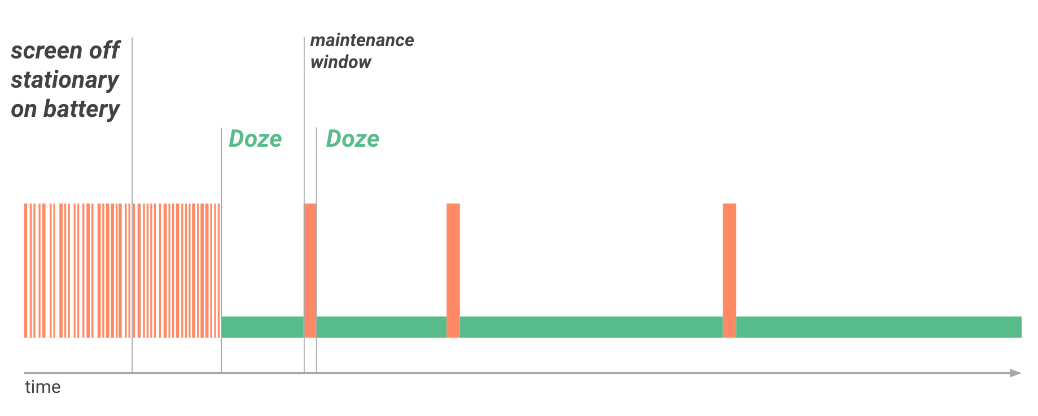
Handling Doze mode
Previously mentioned alarms are never fired in Doze mode.
The device will leave Doze mode every now and then to fire these.
https://developer.android.com/training/monitoring-device-state/doze-standby.html

Slide 13
Handling Doze mode
Want an alarm to go off in Doze mode?
Use setAndAllowWhileIdle(...) (from API level 23)
Use setExactAndAllowWhileIdle(...) (from API level 23)
But these may at most fire 1 alarm each 9 minutes.
And must complete within a few seconds or obtain an awake lock.
Requires the permission android.permission.WAKE_LOCK.
Another option:
Use setAlarmClock(...) (from API level 21)

Slide 14
Job Scheduler
A better version of the Alarm Manager.
Introduced in Android 5.0.
Improvements:
Scheduled alarms can survive reboots.
Job scheduler alarms can keep the device awake.
Only fire off alarm under certain conditions (e.g. internet access).
Implemented as a service.

Slide 15
Creating the job service
public class MyJobService extends JobService{
@Override
public boolean onStartJob(JobParameters params){
return false;
}
@Override
public boolean onStopJob(JobParameters params){
return false;
}
}

Slide 16
Creating the job service
Never granted to ordinary apps.
<manifest package="the.package" ...>
<application ...>
<service
android:name=".MyJobService"
android:permission="android.permission.BIND_JOB_SERVICE"
/>
</application>
</manifest>

Slide 17
Creating a job
int jobId = 31;
ComponentName jobService = new ComponentName(aContext, MyJobService.class);
JobInfo.Builder builder = new JobInfo.Builder(jobId, jobService);
builder.setPersisted(true);
builder.setRequiresCharging(true);
builder.setMinimumLatency(1000*60);
// builder.setPeriodic(1000*60);
builder.setExtras(new PersistableBundle());
builder.setRequiredNetworkType(JobInfo.XXX);
JobInfo theJob = builder.build();
Requires
RECEIVE_BOOT_COMPLETED
permission.
NETWORK_TYPE_NONE
NETWORK_TYPE_ANY
NETWORK_TYPE_UNMETERED

Slide 18
Scheduling jobs
JobScheduler jobScheduler = (JobScheduler) aContext.getSystemService(Context.JOB_SCHEDULER_SERVICE);
jobScheduler.schedule(theJob);
Canceling a job:
jobScheduler.cancel(jobId);

Slide 19
Implementing the job service
public boolean onStartJob(JobParameters params){
int jobId = params.getJobId();
PersistableBundle extras = params.getExtras();
return false;
}
We are done (no background thread is running).
If you return true:
boolean needsRescheduled = false;
theJobScheduler.jobFinished(params, needsRescheduled);

Slide 20
the workManager
Many changes, staying backward compatible is hard ☹
WorkManager part of the support library:
Use AlarmManager for exact timing.
Use WorkManager (or JobScheduler) otherwise.

