Slide 1



Bank Customer Churn Prediction
BAN 5573
Visual Analytics and Business Intelligence
Prepared by: Maryam Ahmadi , Dipendra Mainali
Advisor : Hamidreza Ahady Dolatsara
December 2022

Slide 2
Contents
Background
Introduction
1
Motivation
Descriptive Analysis
3
2
Dataset main information
5
4
Results
Predictive Analysis
6
Conclusion
Notes:
مدل ریاضیاتی
نتایج عددی به دست آمده
بررسی‌های ادبی و تحلیل حساسیت‌های مدل
جمع‌بندی-> نتایج به دست آمده

Slide 3
Introduction
Background
Churn customers are those who stopped being customers during certain periods
Credit score, geography, gender, and age play a certain role in churn.
Motivation
What are the values of churn of customers associated with different factors?
Predict whether a customer will exit the bank or not, based on his/her characteristics.
3

Slide 4
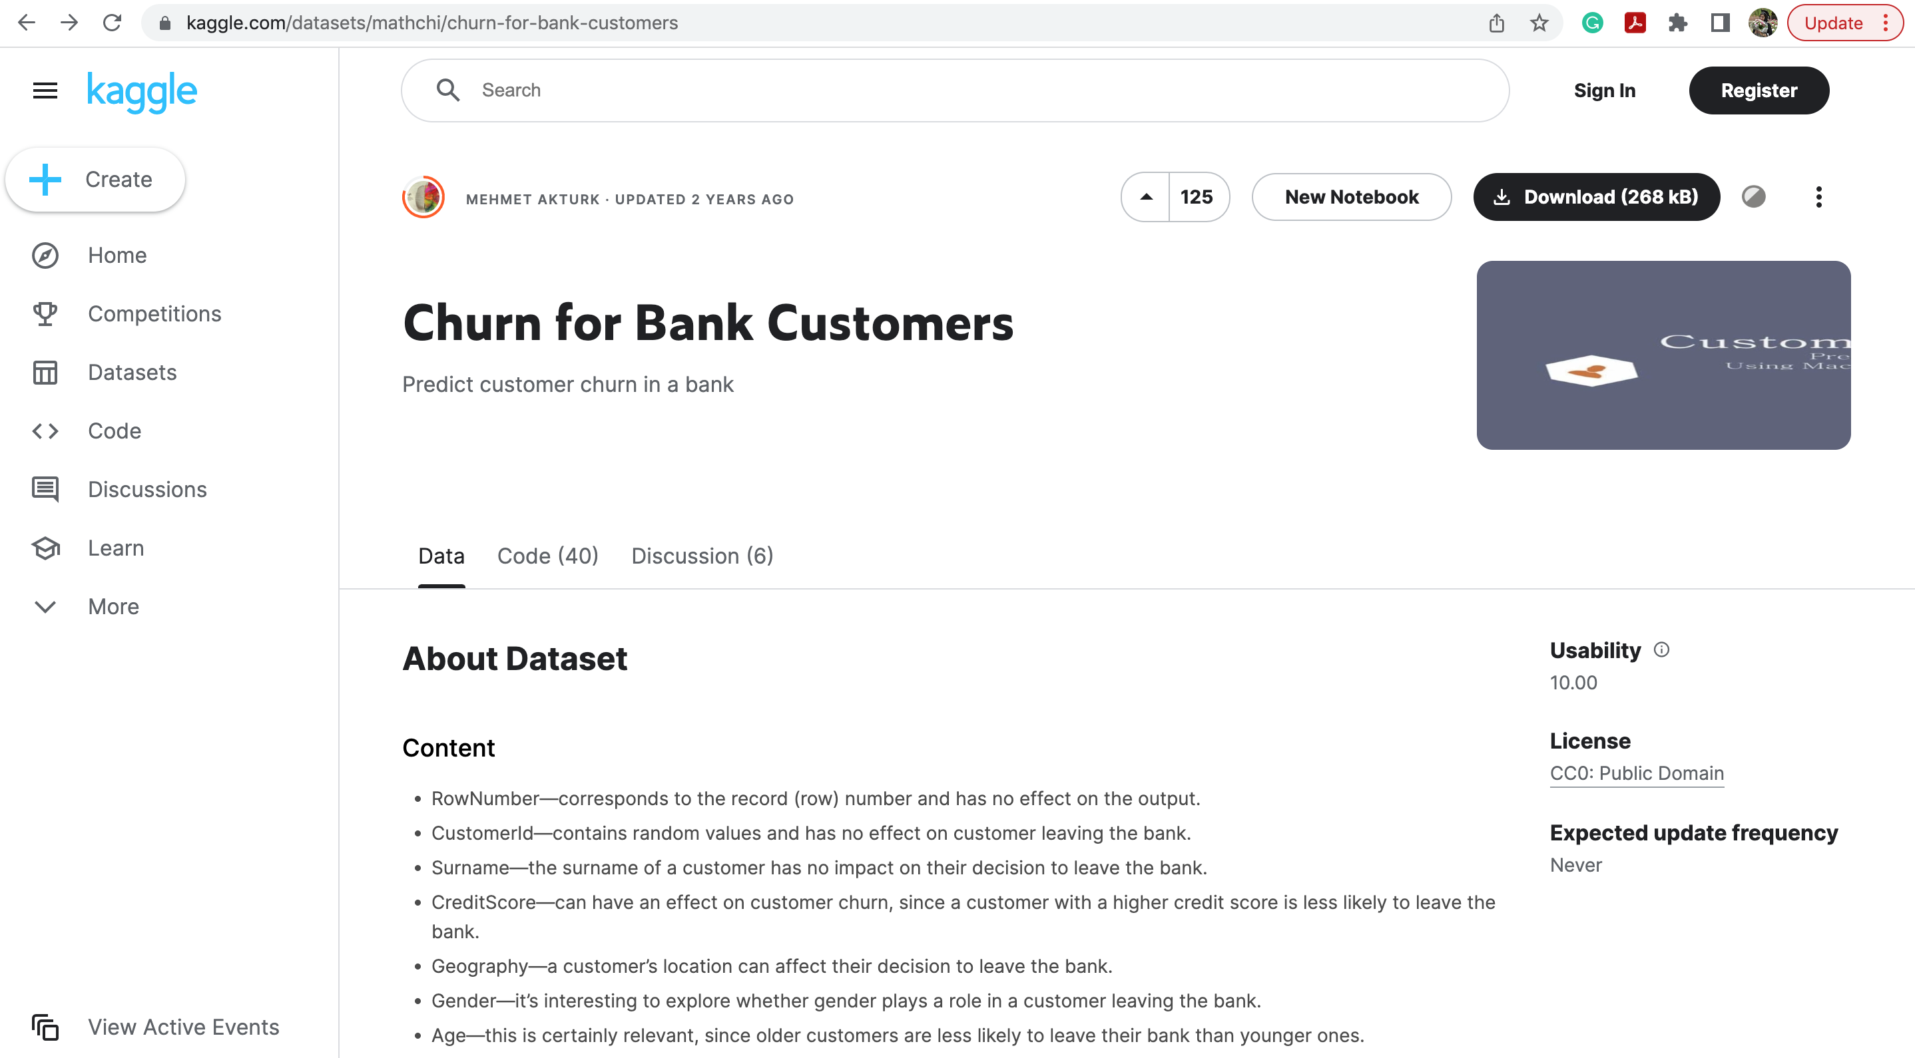
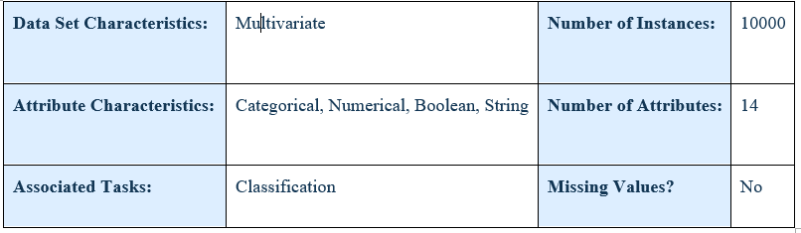
Dataset main information
4

Slide 5
Dataset Features Description
RowNumber
CustomerId
Surname
CreditScore
Geography
Gender
Age
Tenure
Balance
NumOfProducts
HasCrCard
IsActiveMember
EstimatedSalary
Exited
5

Slide 6
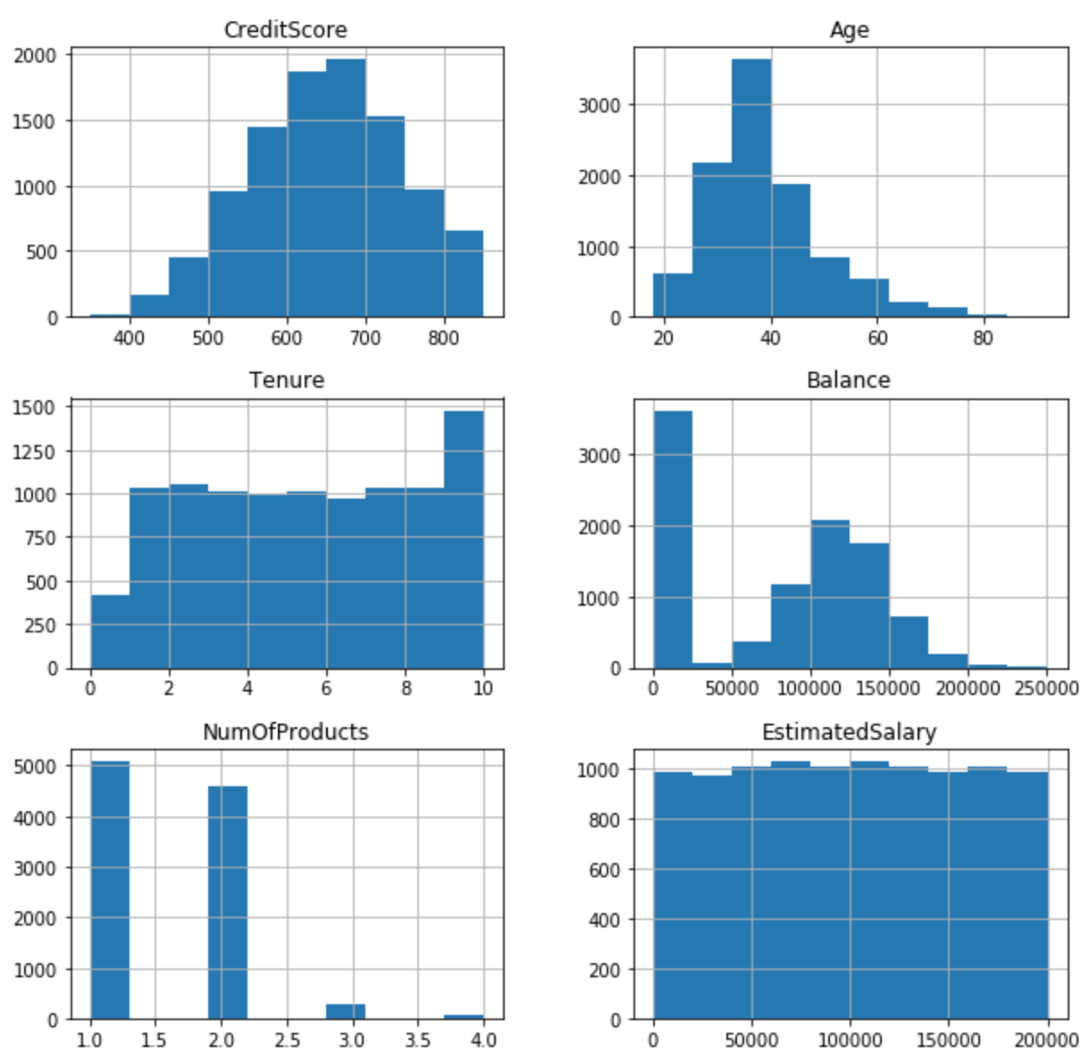
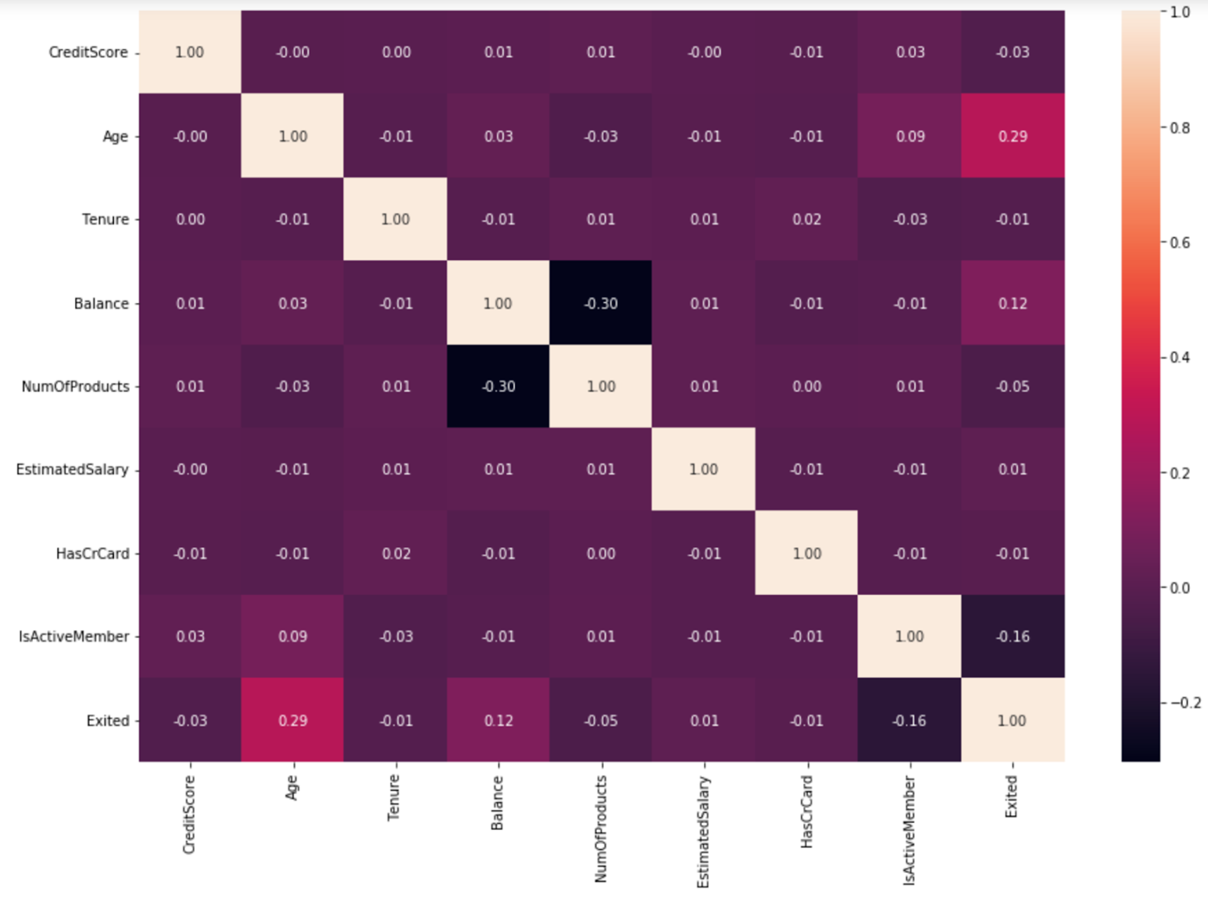
Descriptive Analysis
6
Notes:
Maybe Cutted

Slide 7
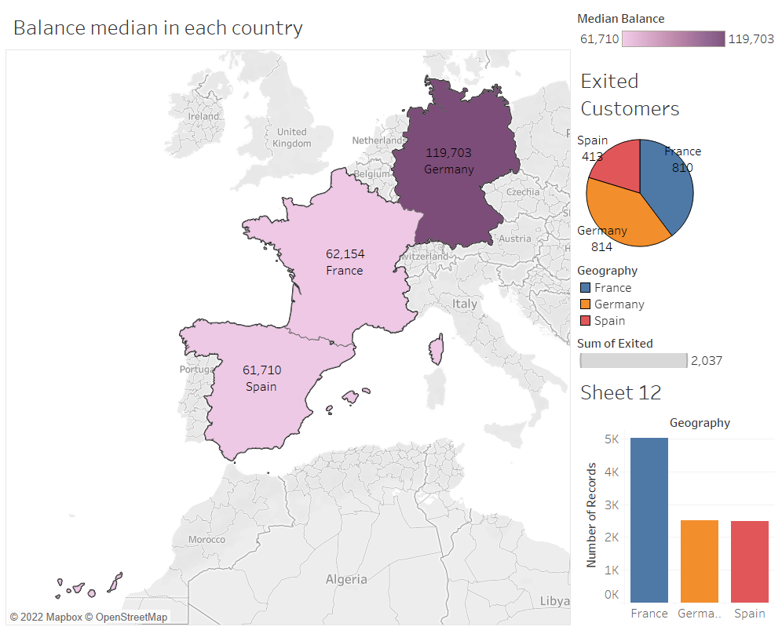
Visualization of Customers’ Information in Different Countries
7

Slide 8
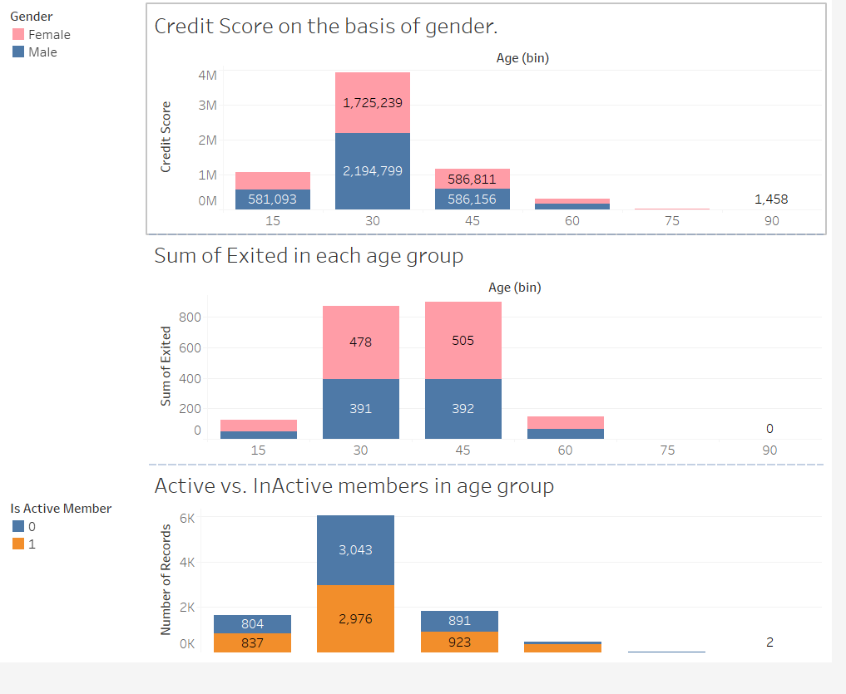
Customer Behavioral Pattern in Different Age Groups
8

Slide 9
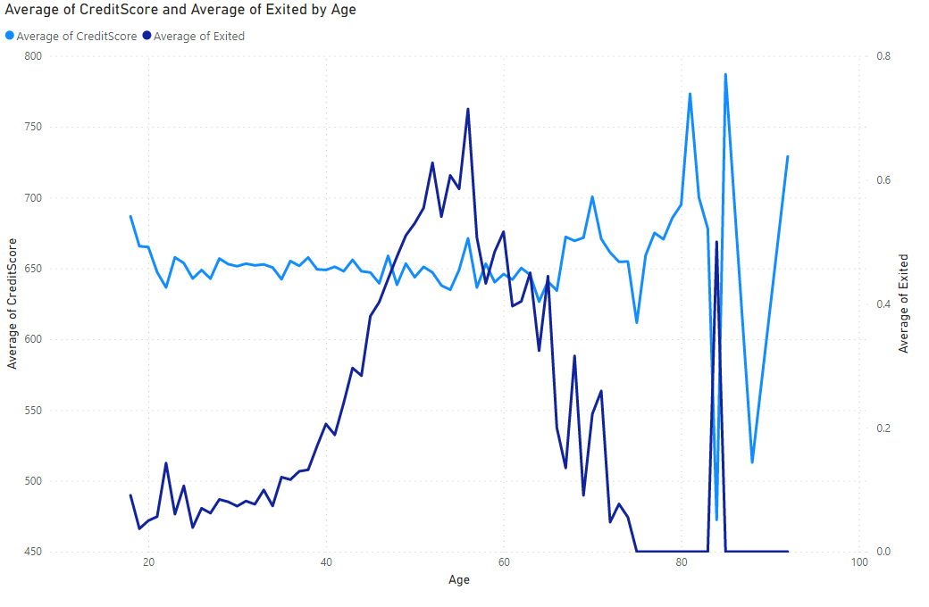
Average credit score and average exited age
9

Slide 10

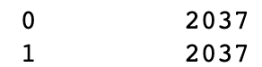
Data Preprocessing
Dataset Features Description
Remove useless columns
Under-Sampling
Feature Engineering
Columns:
1- RowNumber, 2- CustomerId,
3- Surname
Balance: Poor, Good, Excelent, Top
EstimatedSalary: Poor, Good, Excelent, Top
Scale (Standardize)
Supervised
Learning
Decision Tree
Random Forest
Logistic Regression
K Nearest Neighbor
Voting Classifier
10

Slide 11
Predictive Analysis
Model | Accuracy | Precision | Recall | F1-score
Decision Tree | 0.85 | 0.79 | 0.69 | 0.72
Random Forest | 0.86 | 0.81 | 0.70 | 0.73
Logistic Regression | 0.80 | 0.69 | 0.56 | 0.56
KNN | 0.83 | 0.75 | 0.65 | 0.68
Voting Classifier | 0.85 | 0.82 | 0.67 | 0.71
11

Slide 12
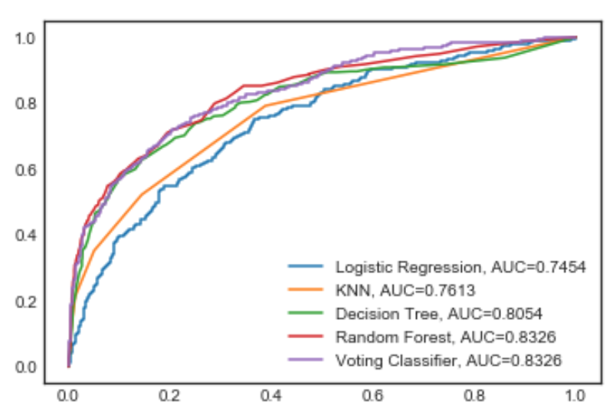
Predictive Analysis
Compare Models Using the area under the ROC curve
12

Slide 13
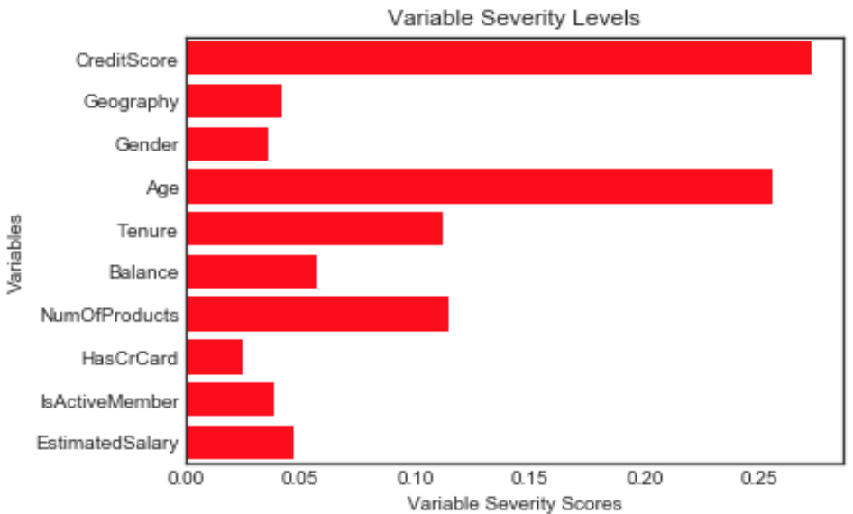
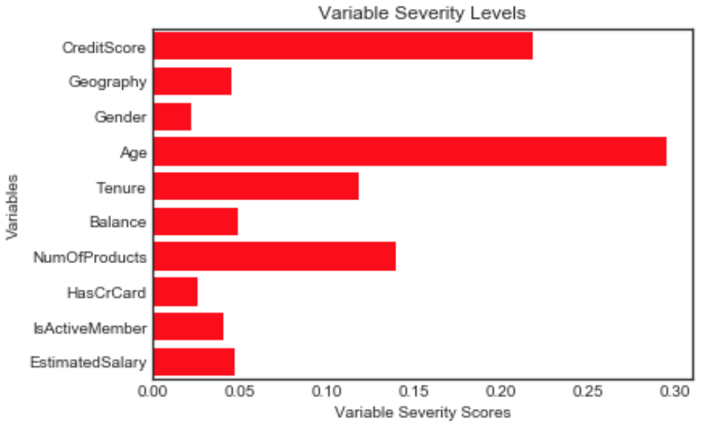
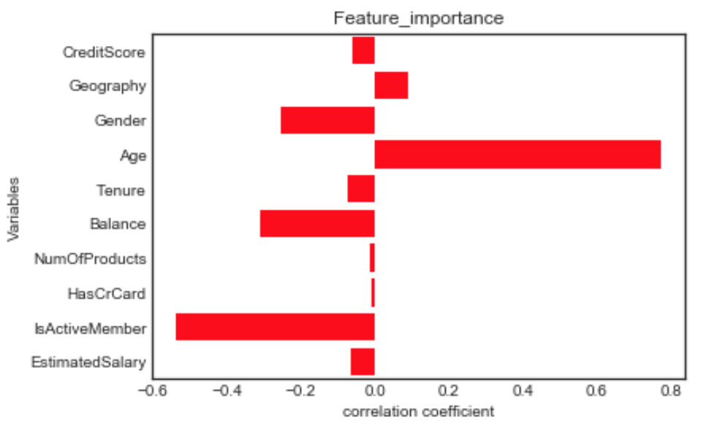
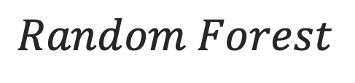
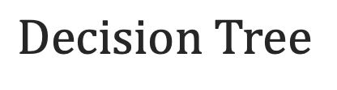
2
Feature Importance
Feature Importance
$$\text{Decision} \text{Tree}$$
$$Random Forest$$
Logistic Regression
13

Slide 14
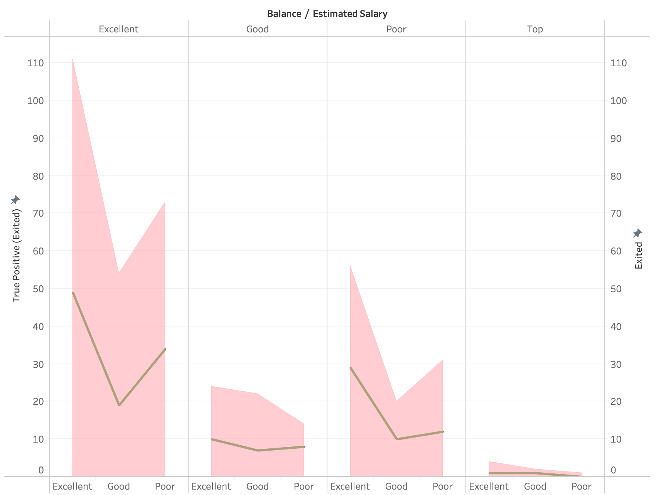
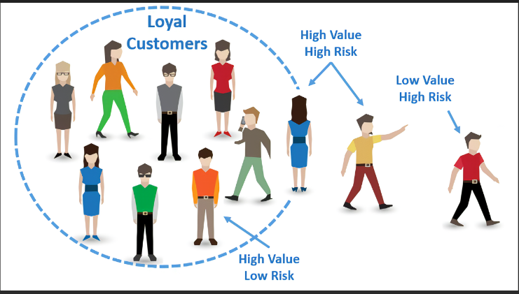
Focus on High Value - High Risk Customers
14

Slide 15

Result/Conclusion
Customers’ age, credit scores, and the number of products they use are the most important features for customer churn prediction.
Among models, Random Forest and voting model have the best performance based on accuracy, precision, recall, f-1 score, and area under the curve measurements.
Based on visualization, Almost half of the customers from Germany leave the bank. Therefore, we should investigate these two
groups and find the reason so we can design proper strategies to prevent them from exiting
Using machine learning algorithms, we were
able to predict 70% of exited customers.
Offering promotions to them makes it
possible to encourage them to stay.
15

Slide 16
Q & A

Slide 17
THANK YOU

