Slide 1

Book Recommendation system using KNN

Slide 2
What is Book Recommendation system?
A book recommendation system is a computer-based system that uses data and algorithms to recommend books to users based on their interests and preferences. The goal of a book recommendation system is to help users discover new books that they might enjoy reading, by presenting them with a list of recommendations based on their past reading history and other relevant factors.

Slide 3
What KNN ?
The k-nearest neighbors (KNN) algorithm is a method for classifying and predicting the value of an unknown data point based on its similarity to a set of known data points. It works by finding the k-nearest neighbors (where k is a user-defined parameter) of the unknown data point, and using the values of these neighbors to make a prediction. KNN is a non-parametric method, meaning that it does not make any assumptions about the underlying data distribution or the relationships between the features. It is often used in applications such as recommendation systems, where it can be used to find similar items and make recommendations based on the preferences of other users.

Slide 4
Why KNN ?
KNN was chosen because it is a simple and effective method for finding similar items and making recommendations based on the preferences of other users.
In the context of a book recommendation system, KNN can be used to recommend books to a user based on the ratings and preferences of other users who have rated similar books. By finding the k-nearest neighbors of a specific book and using their ratings to predict the rating that the user would give to that book, the system can recommend books that are likely to be of interest to the user based on their past reading history and the preferences of other users.
Overall, KNN is a popular choice for implementing book recommendation systems because it is simple to implement, flexible, and effective at finding similar items and making recommendations based on the preferences of other users.

Slide 5
What is the method used in Book Recommendation system ?
The method used in this book recommendation system is collaborative filtering, which recommends items to users based on the preferences of similar users. The Nearest Neighbors algorithm from scikit-learn is used to implement the collaborative filtering approach. Collaborative filtering is a widely used method for recommendation systems, as it is able to leverage the preferences of similar users to make personalized recommendations.

Slide 6
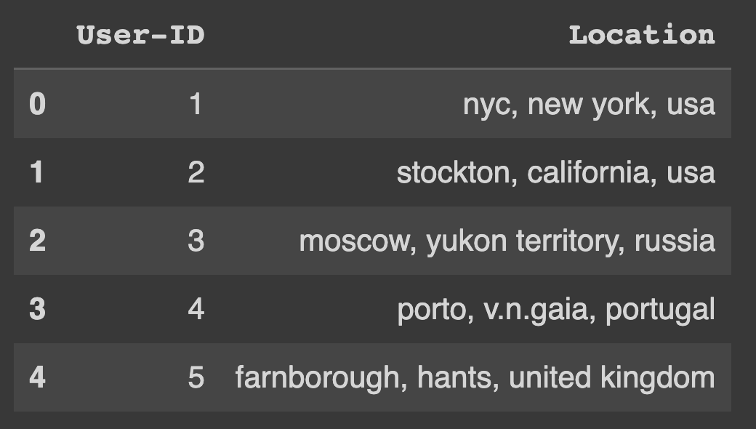
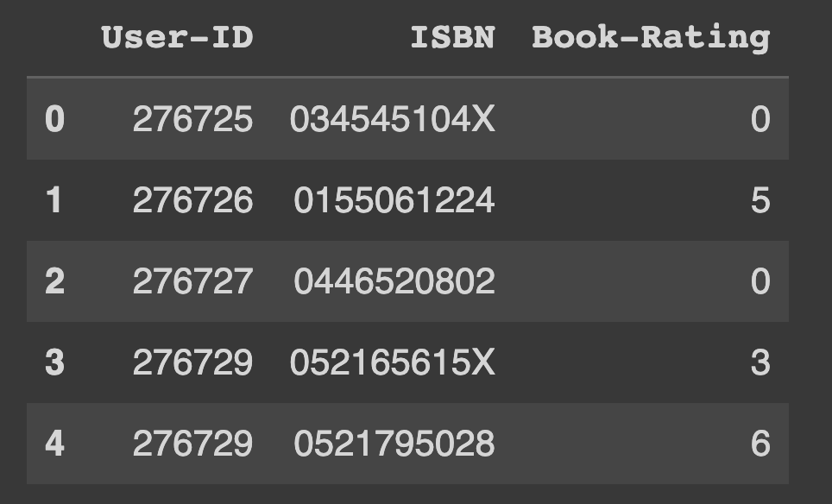

Data Set used after cleaning
The recommendation system has three dataset which are Books and book rating and also users dataset here is the sample of each dataset after preproccessing the data

Slide 7
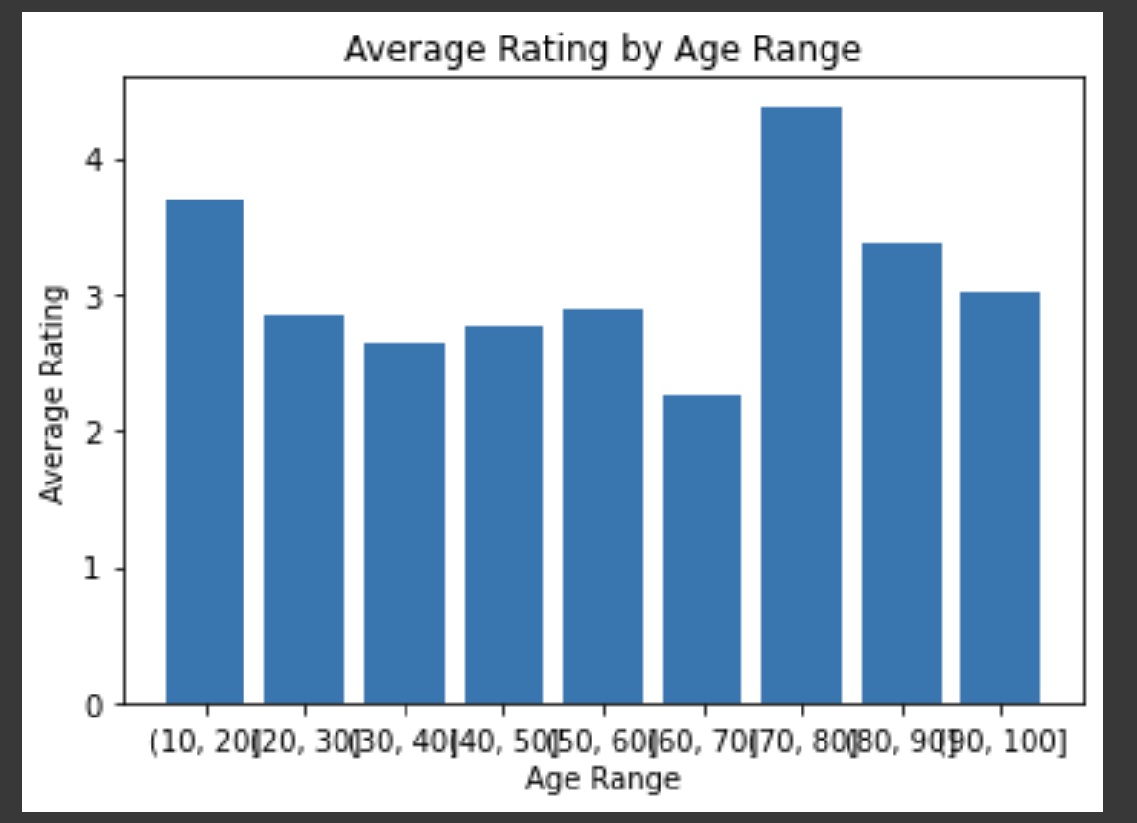
Data visualization
average ratings by age range

Slide 8
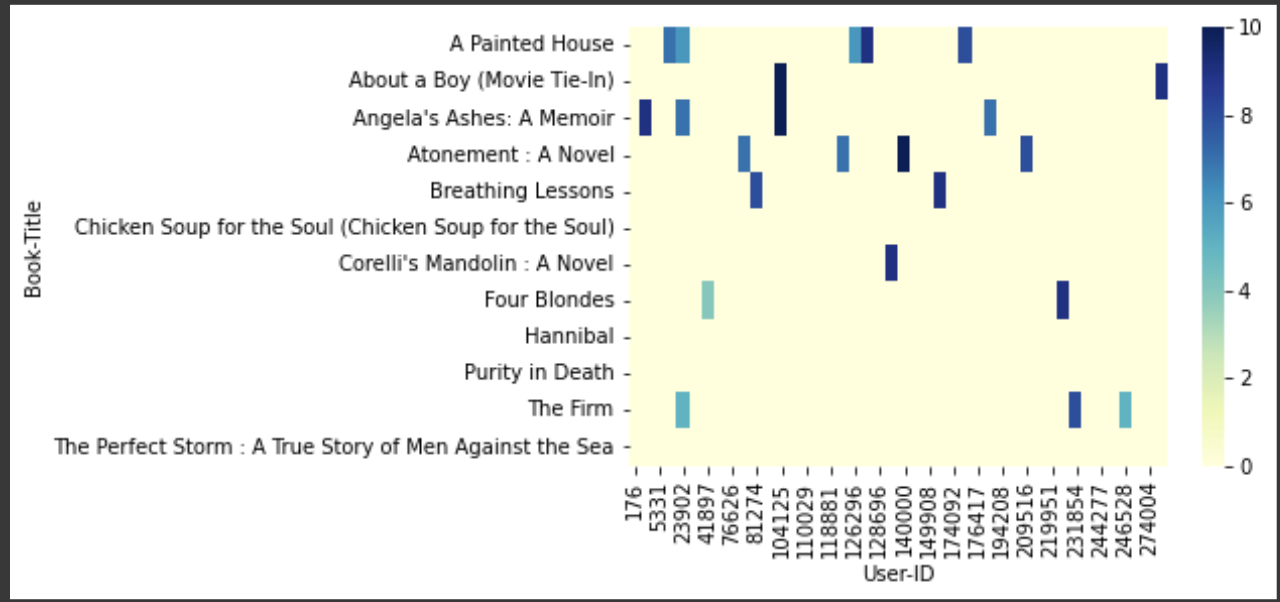
Data visualization
Distribution of ratings for different books

Slide 9
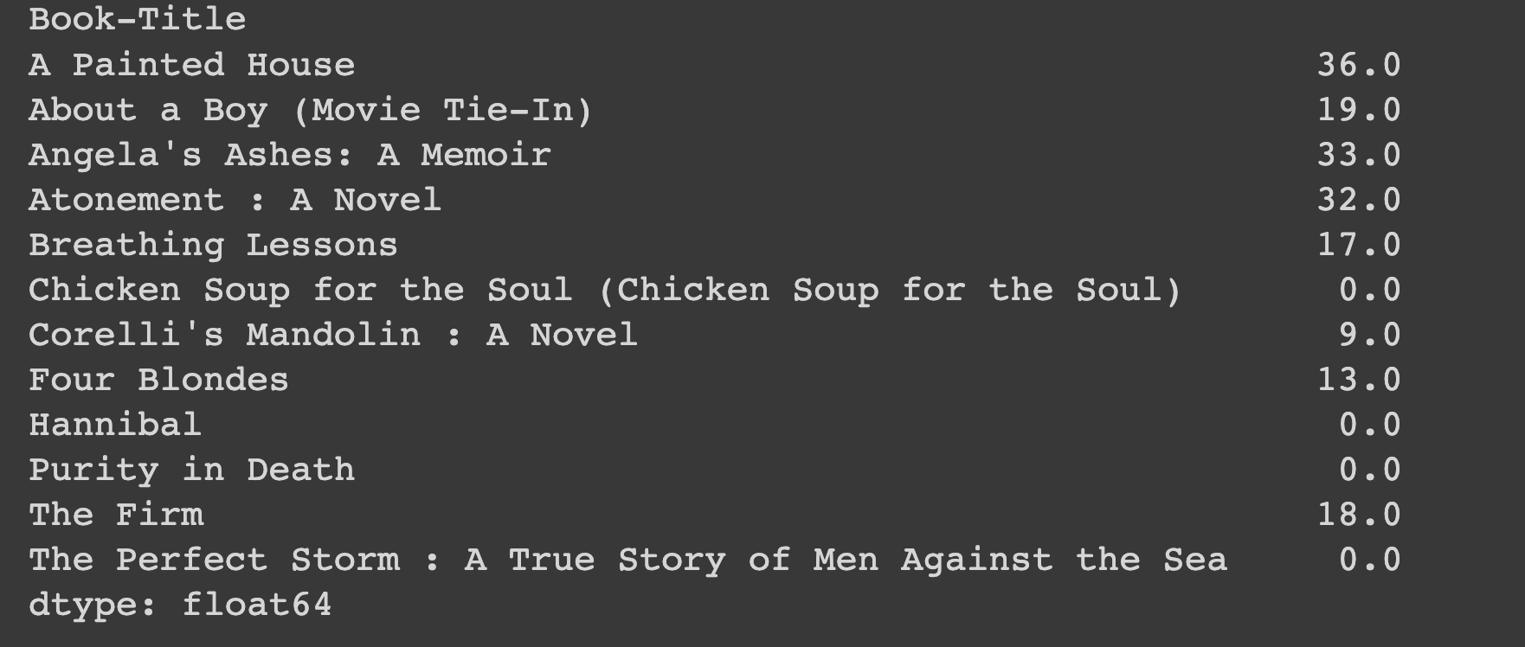
most popular books

Slide 10
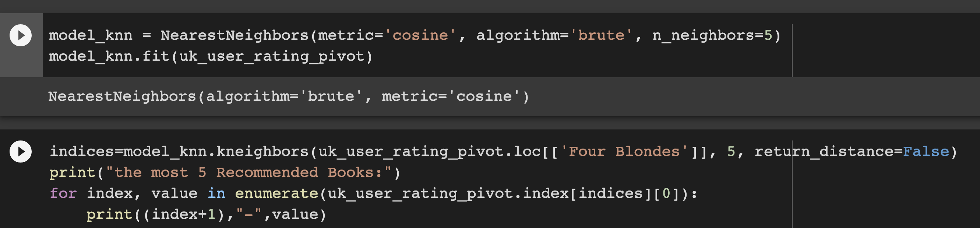
KNN implementation
implementing KNN algorithm in order to get the best recommend books

Slide 11
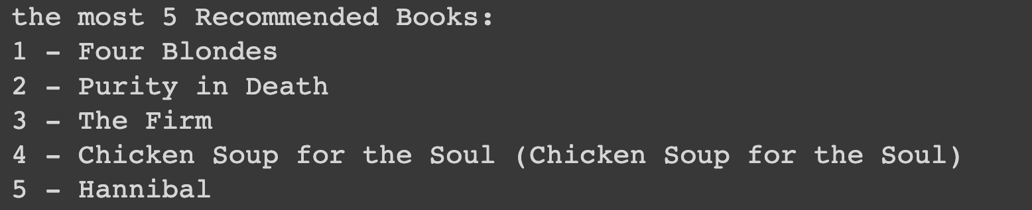
Final Result
the most 5 Recommended Books for the given book name:

Slide 12
Thank you
Maryam Alrubaye
B1905.090004

