Slide 1
Earnings in urban Sindh: how they are spread and their variation with age
PSLM 2019-20 person file | Variant 3: Sindh urban
2,644
Rs 264,000
5.80
earners aged 15-64
weighted median
p90 / p10 ratio
MARYAM MOHSIN | FA24-BEDS-043 | ECO346 Assignment 1, Section A
Notes:
Variant: last two digits 43 = 5 x 8 + 3, so variant 3, Sindh urban. Sample: earners aged 15-64 with earn_annual > 0, weighted by hhweight.

Slide 2
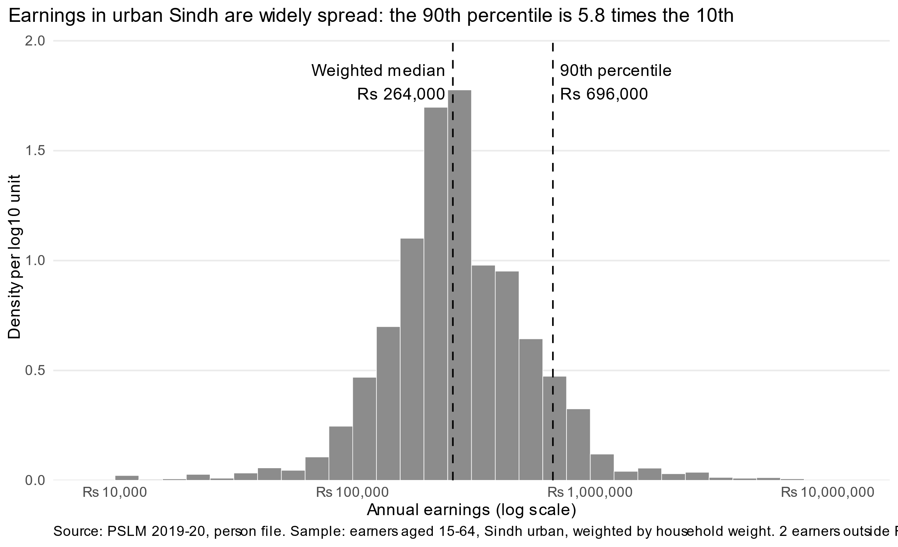
The 90th percentile of earnings is 5.8 times the 10th
Rs 264,000
weighted median
Rs 252,000
unweighted median
Rs 120,000
weighted 10th percentile
Rs 696,000
weighted 90th percentile
2 of 2,644 earners fall outside Rs 10,000 to Rs 10,000,000 and are excluded from the histogram.
Notes:
Weighted median is about 5% above the unweighted: weights give more influence to households that represent more people.

Slide 3
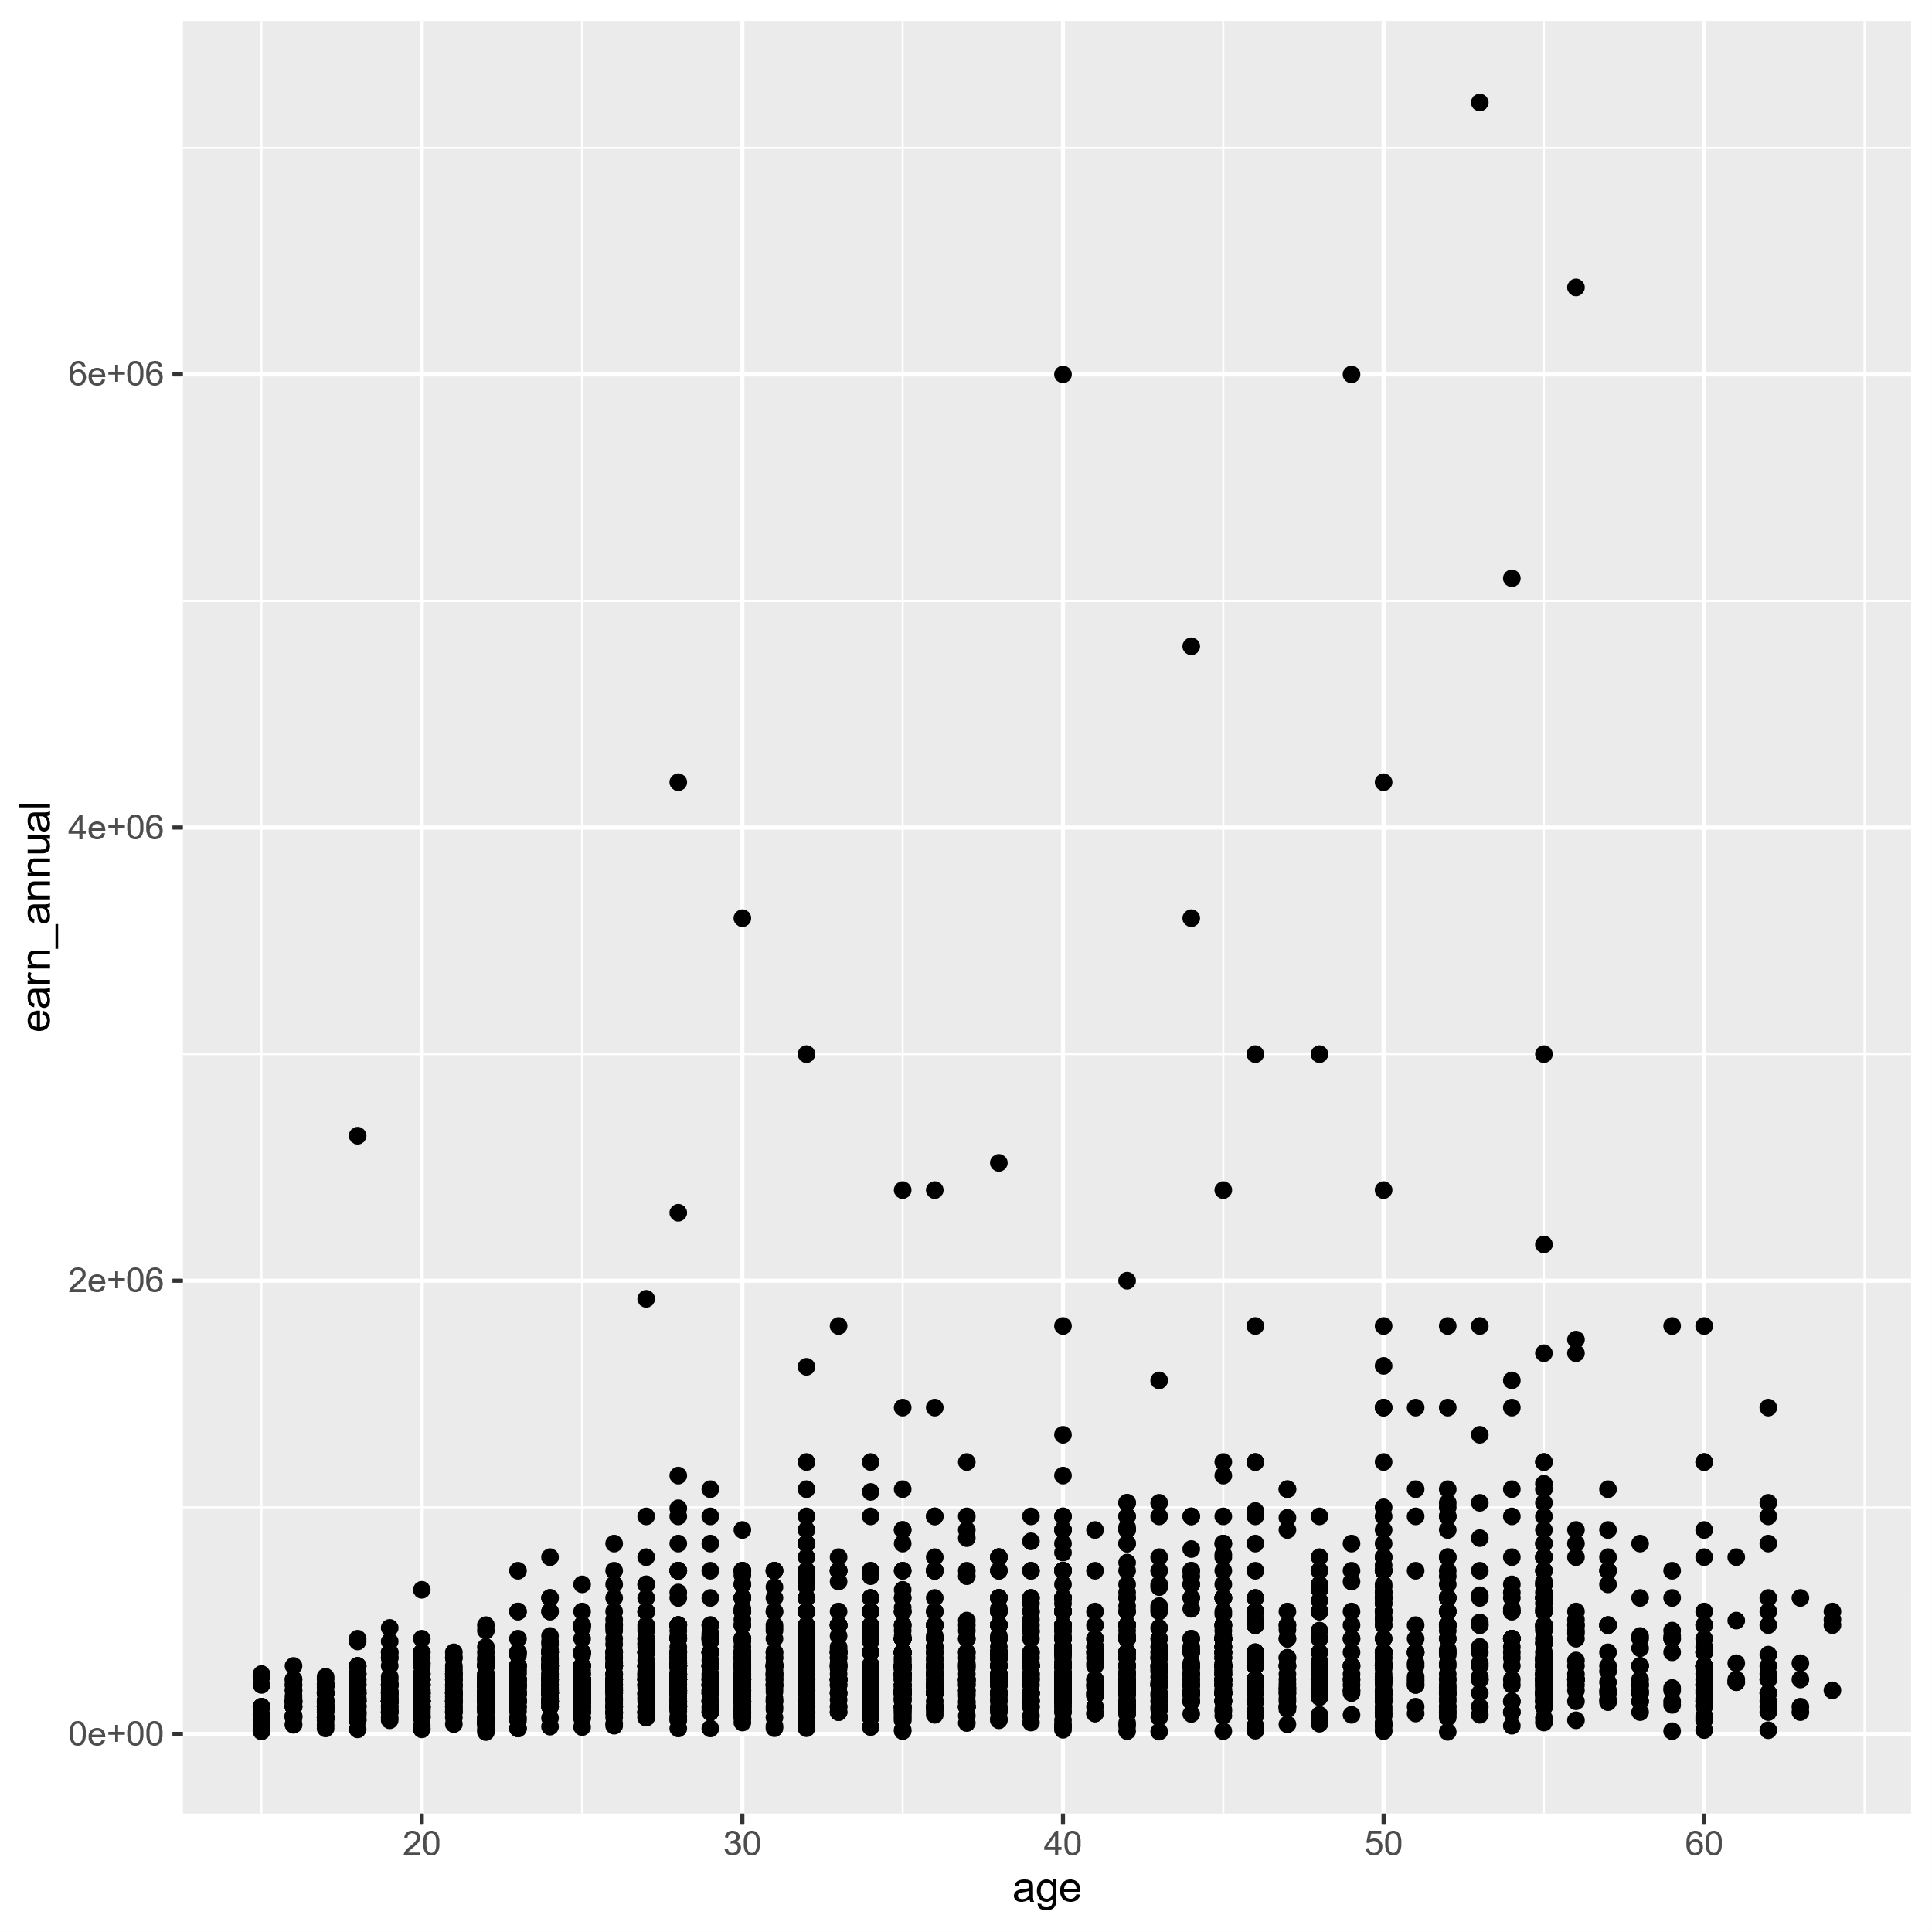
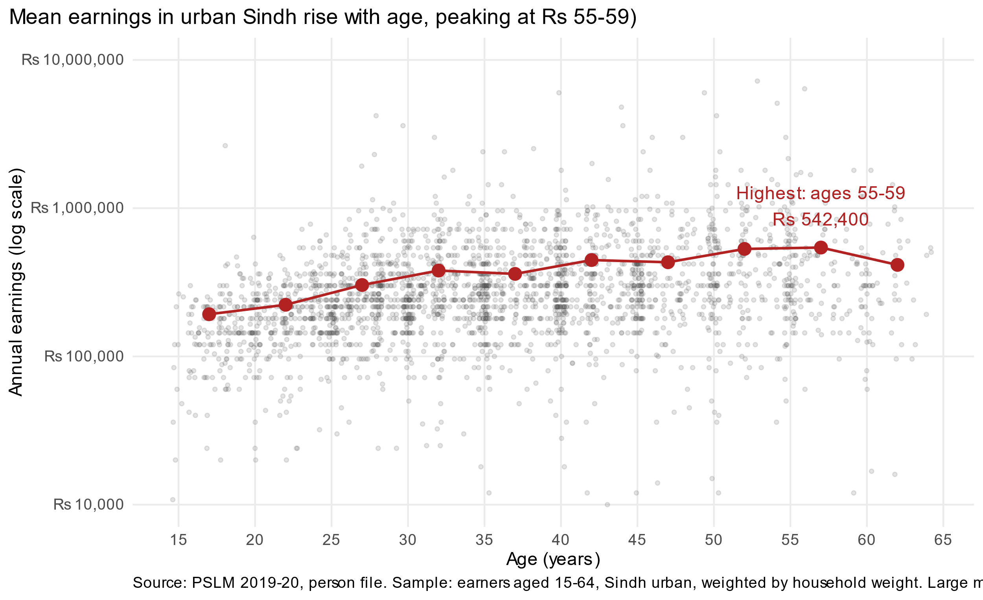
The makeover: from R's default to a figure that shows the pattern
Default
Redesign
Log scale in rupees
Alpha 0.15 + jitter 0.4
Weighted band means
Position on one common scale; spreads the skewed bulk
Cures overplotting at each integer age
Shows the conditional mean the cloud hides
The default shows the 2 earners outside Rs 10,000 to 10,000,000; the redesign hides them.
Notes:
Principles: perceptual ranking of channels (common-scale position), overplotting, log scale, conditional means, data-ink.

Slide 4
Mean earnings peak at Rs 542,400 at ages 55-59
Weighted mean annual earnings, Rs thousand
2.8x
mean at 55-59 vs 15-19
Rs 414,262
falls at ages 60-64
Limit: one cross-section, so age and birth cohort are confounded; it cannot show how one person's earnings change.
R and Python band tables agree to the rupee (band 25-29: Rs 303,154).
Notes:
Most important finding: the age profile of mean earnings. Small dips at 35-39 and 45-49. No band has fewer than 30 observations.

