Slide 1

Clustering
Mariam Busaleh

Slide 2
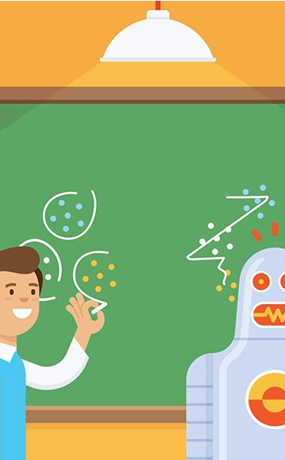
Agenda
Type of Machine learning
  Supervised vs. Unsupervised learning
What is clustering?
  Goal of clustering
  Type of clustering
K-means
  K-means basic algorithm
  Applications of K-means clustering
  Advantages/Limitation
  How to Perform K-Means Clustering in Python?
References

Slide 3
Type of Machine learning
Supervised learning
Unsupervised learning
Semi-Supervised Learning
Reinforcement Learning

Slide 4

Supervised vs. Unsupervised learning

Slide 5
Supervised vs. Unsupervised learning
What is the main distinction between Supervised and Unsupervised learning ?
Supervised learning | Unsupervised learning
Input data labeled | Input data unlabeled
Using training dataset | Use input dataset
Known number of classes | unknown number of classes

Slide 6
What is clustering?
Clustering (also called cluster analysis) is the task of grouping similar instances into clusters
More formally, clustering is the task of grouping the population of unlabeled data points into clusters in a way that data points in the same cluster are more similar to each other than to data points in other clusters
Clustering

Slide 7
Goal of clustering
Given a set of data points, each described by a set of attributes, find clusters such that:
Intra-cluster distances are minimized
Inter-cluster distances are maximized

Slide 8
Type of clustering
Partitional Clustering
A division of data objects into non-overlapping subsets (clusters)
Hierarchical clustering
A set of nested clusters organized as a hierarchical tree also called Dendrogram.
p1
p3
p4
p2
Original Points
Partitional Clustering
Hierarchical Clustering
Dendrogram

Slide 9
K-means
What is K-means?
K-means is partitional clustering technique that attempts to find a user-specified number of clusters (K), which are represented by their centroids
The center of a cluster is often a centroid, the average of all the points in the cluster
Each point is assigned to the cluster with the closest centroid

Slide 10
K-means basic algorithm

Slide 11
Applications of K-means clustering
Groups people of similar sizes together to make small, medium and large T-Shirts
  Tailor-made for each person: too expensive also one-size-fits-all: does not fit all
In marketing, segment customers according to their similarities
  To do targeted marketing.
Document Network Analysis of textual data
  To detect plagiarism and copyrights in the research articles submitted for patents

Slide 12
Advantages/Limitation of k-means
Advantages of k-means clustering methods:
  Relatively simple to implement
  Can be used to scale up to large datasets
  Can be used to form clusters of any shape and size
Limitations of k-means clustering:
  Sensitive to initial selection of centroids
  Sensitive to outliers in the data
  Cannot be used for non-linear data
  Cannot be used for categorical data

Slide 13
How to Perform K-Means Clustering in Python?

Slide 14
References
Introduction to Data Mining (Second Edition)
The Hundred-Page Machine Learning Book by Andriy Burkov
https://livebook.manning.com/book/mahout-in-action/chapter-10/47
https://www.guru99.com/supervised-vs-unsupervised-learning.html
https://c3.ai/introduction-what-is-machine-learning
https://halderadhika91.medium.com/k-means-clustering-understanding-algorithm-with-animation-and-code-6e644993afab
https://mdetiberiis.medium.com/clustering-8df9aa13c00b
https://github.com/Saibalajinikki/KMeans-Clustering/blob/master/Mall_Customers.csv
K-Means Clustering Model Using Python | Data Science Algorithms | Edureka

Slide 15
Thank you
Any question?

