Slide 1
Parts of speech
A Review

Slide 2



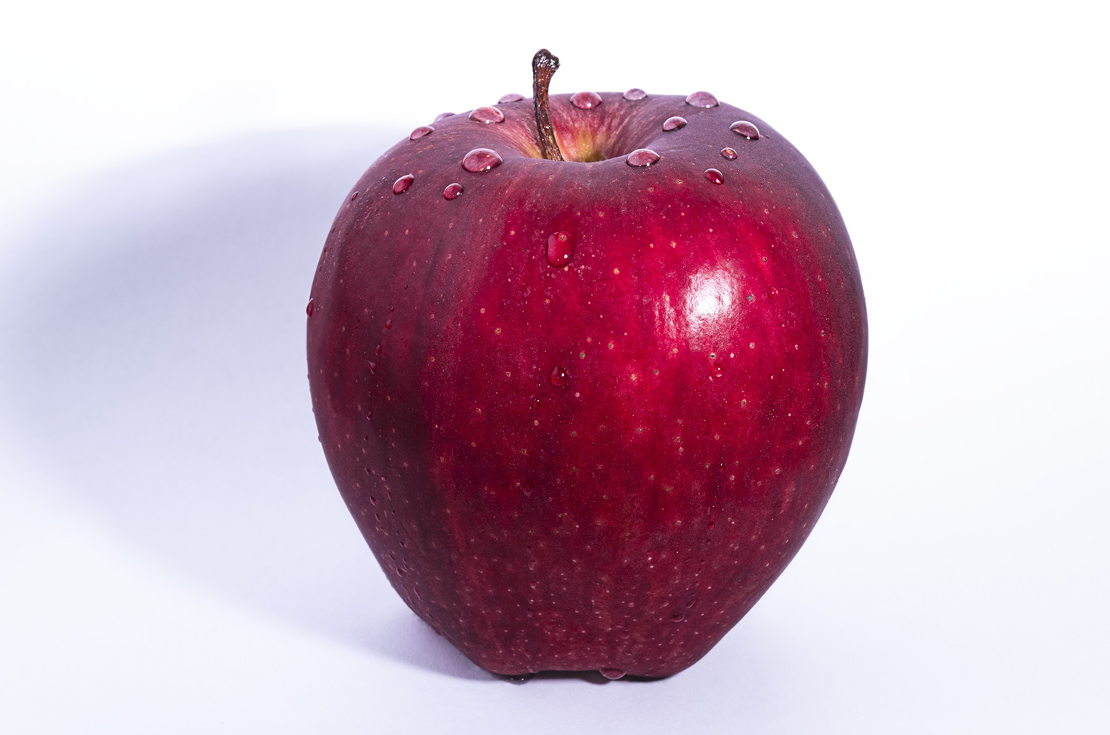
The nouns
Person
Place
Thing
Idea

