Slide 1



Acceleration toolbox for Bioinformatics
João Carlos Sequeira
István Nagy-Szepesi
Maria Kavoosi
Scientific Computing Advanced Core Facility

Slide 2
Workshop overview
1st day – Full Tutorial on Version control and GitHub
From your first repo to GH actions and pages and collaborative work
2nd day - Introduction to Containerization, DockerHub, and Singularity/Apptainer
How to build your own isolated OS for easy package management and reproducible analyses
3rd day – Introduction to Workflow Managers and Nextflow
Better reproducibility and documentation, easier management of workflow development and run
4th day – Introduction to Unit Testing with nf-test
Testing each part of pipelines so all together make a functional tool/analysis
5th day – Leveraging package managers and Q&A

Slide 3
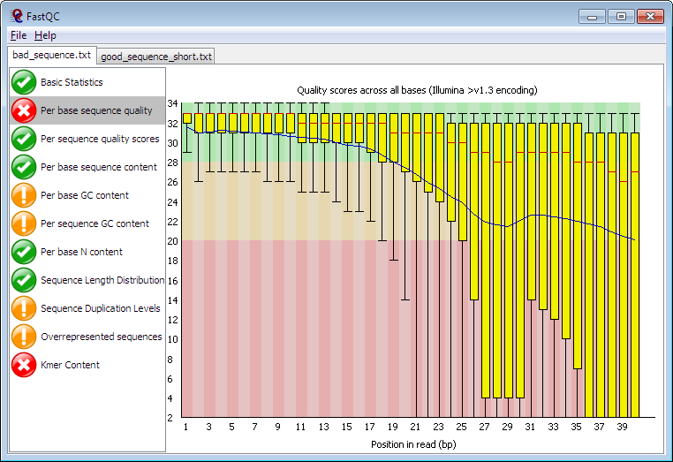
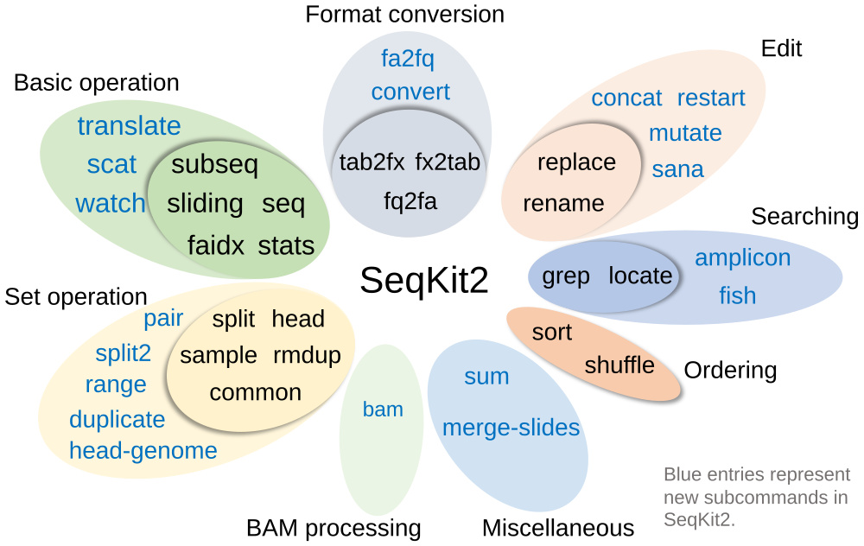
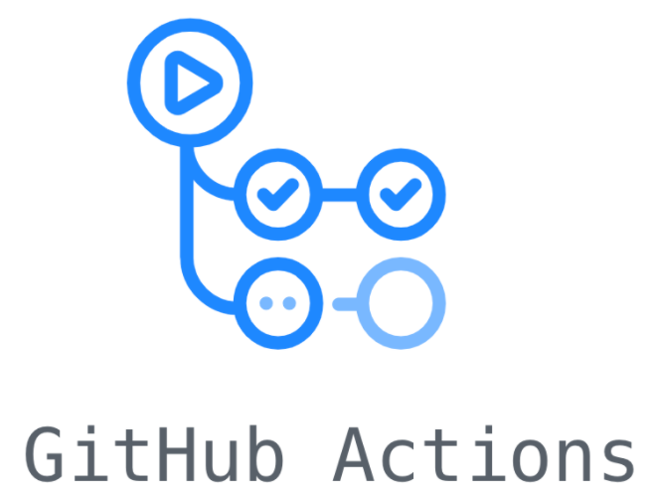
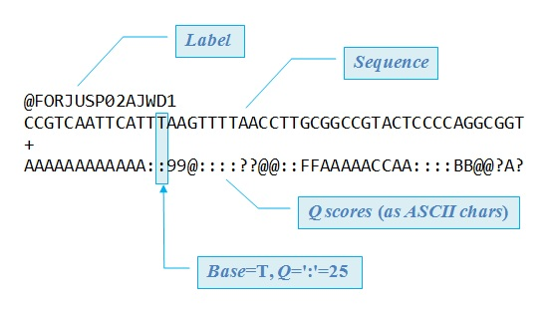



Overview of the GitHub pipeline
Your PI sent you some FastQ reads to analyze, identify presence of glucocorticoid responsive genes, and summarize all information in a web site report.
Quality reports/reads summary
FastQ reads
Pipeline testing and deployment
Annotation and reporting

Slide 4

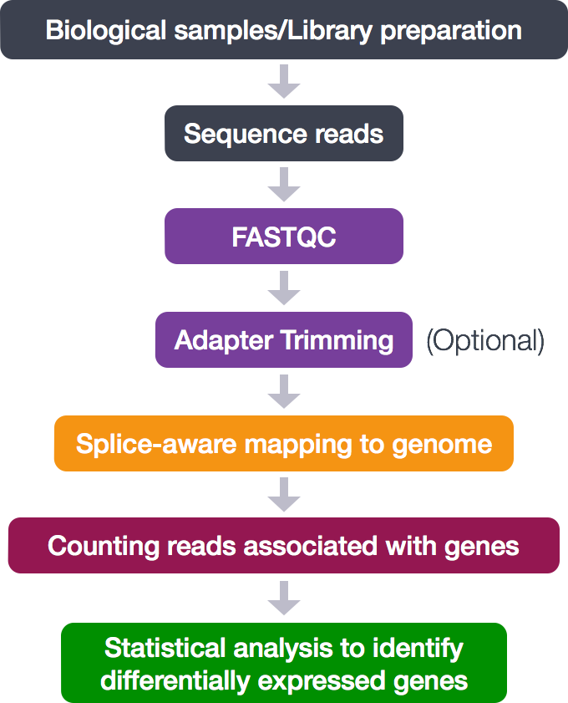
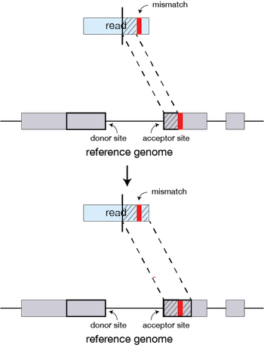

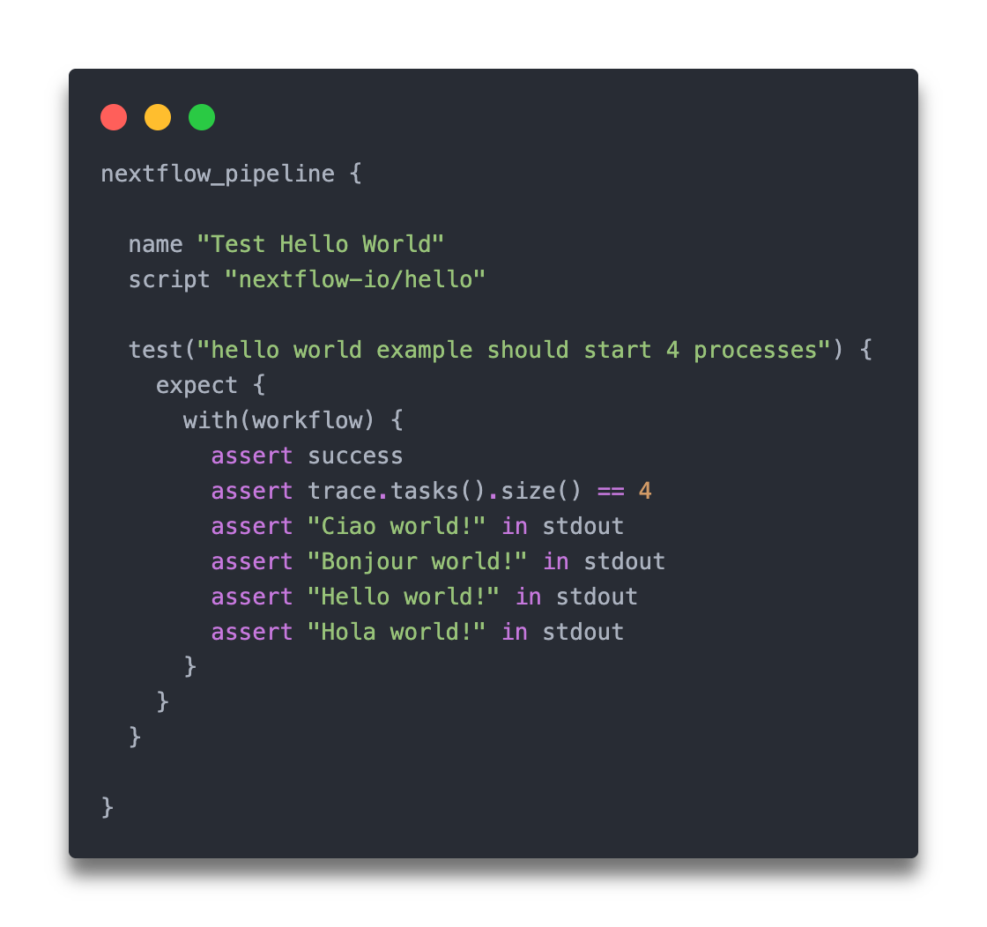
Overview of the NextFlow pipeline
Combine the execution of different tools into a formalized NextFlow application.
From FastQ reads to differential analysis
Each process only runs when needed (parameters changed, intermediate files changed or removed)
Keep analysis functional and robust with nf-test

Slide 5

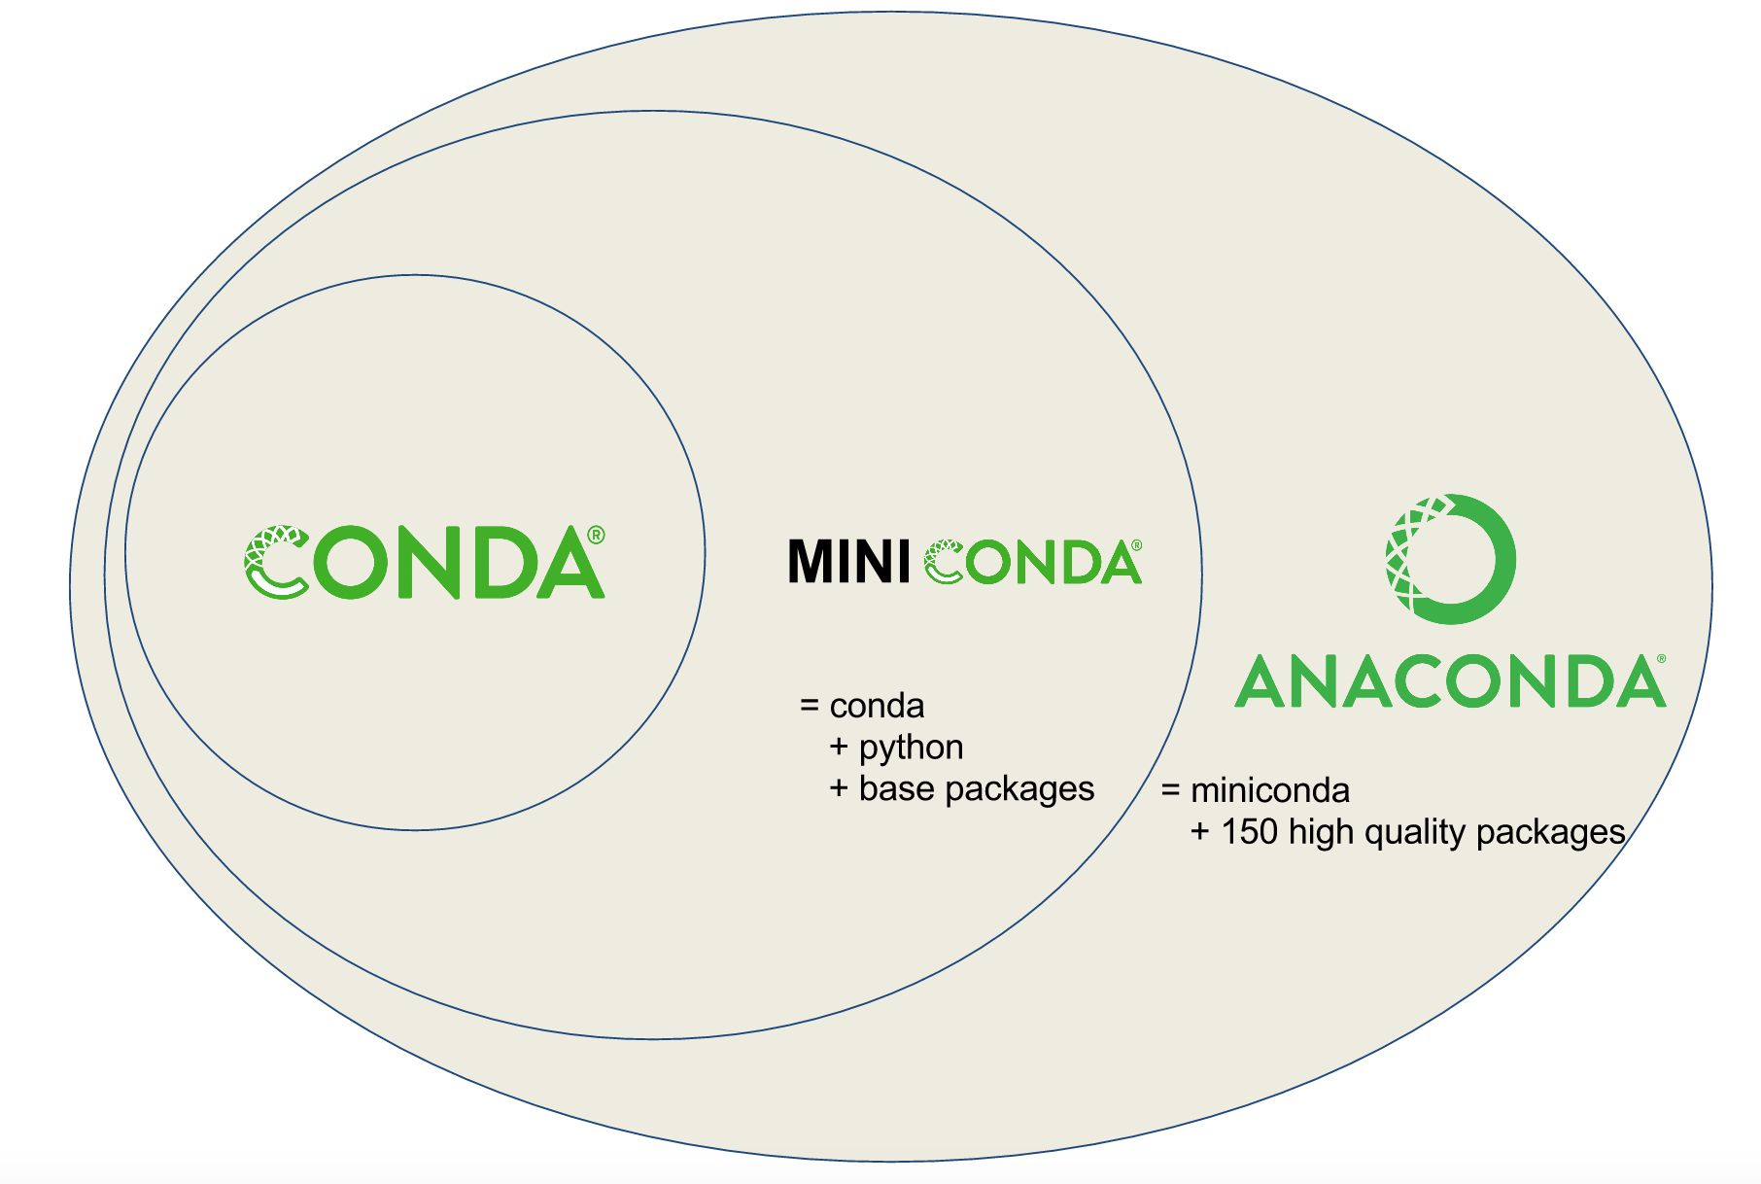
On the shoulders of little giants
Tools build on tools. Access the work of others, and publish your own.
Readily available pipelines for many case studies at nf-core
Learn about the Conda ecosystem and management of packages

Slide 6
Before the workshop – create a GitHub account
GitHub (https://github.com/) is where modern code happens.
Creating an account on GitHub will unlock many functionalities, some of which are required for this workshop.

Slide 7
Before the workshop – test access to Puli
If you didn’t access Puli before
Attempt accessing Puli through the command: ssh <username>@puli.hcemm.eu
Change <username> to the value provided by email
Input the password provided by email
If no error shows up, you have access to the supercomputer!
Otherwise, please email us:
maria.kavoosi@hcemm.eu
joao.sequeira@hcemm.eu

Slide 8
Before the workshop – install VS code
An IDE makes writing/running code easier
This tutorial will be based on VS code. You should bring a computer with it installed.
Five groups will be composed from the 10 trainees attending the workshop. As such, it is not required to install VS code, if your group partner (chosen at the time of the workshop) has it installed.
Still, if you intend to experiment the lessons on your system, it is highly advisable to install VS code.

Slide 9
See you at the workshop!
And for any questions, don’t hesitate contacting:
Maria.Kavoosi@hcemm.eu
Joao.Sequeira@hcemm.eu
Istvan.Szepesi-Nagy@hcemm.eu
9

