Slide 1
Hackathon – Netflix
Mary Sukhareva, 201
second year student of HSE

Slide 2
Dataset
“Netflix titles”:
show_id
type
title
director
cast
country
date_added
release_year
rating
duration
listed_in
description

Slide 3
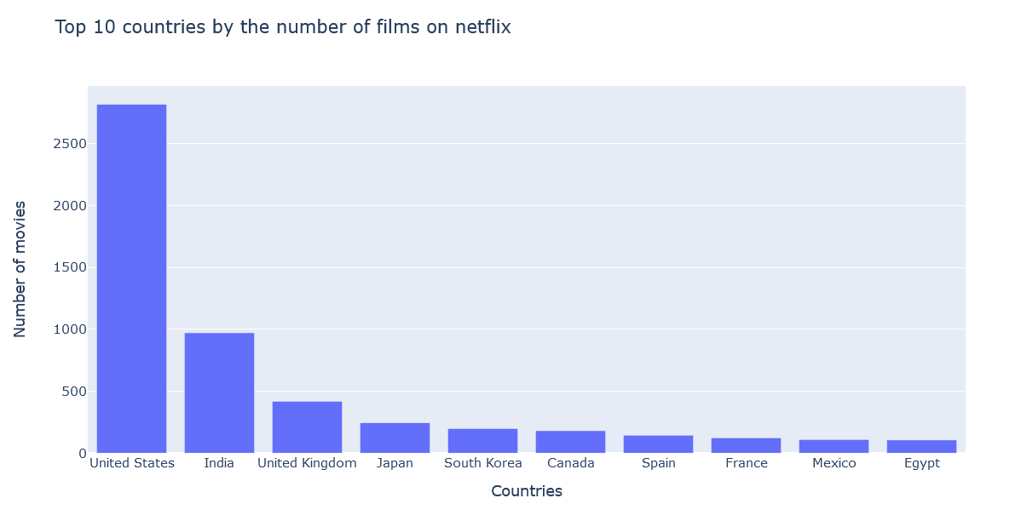
Countries

Slide 4
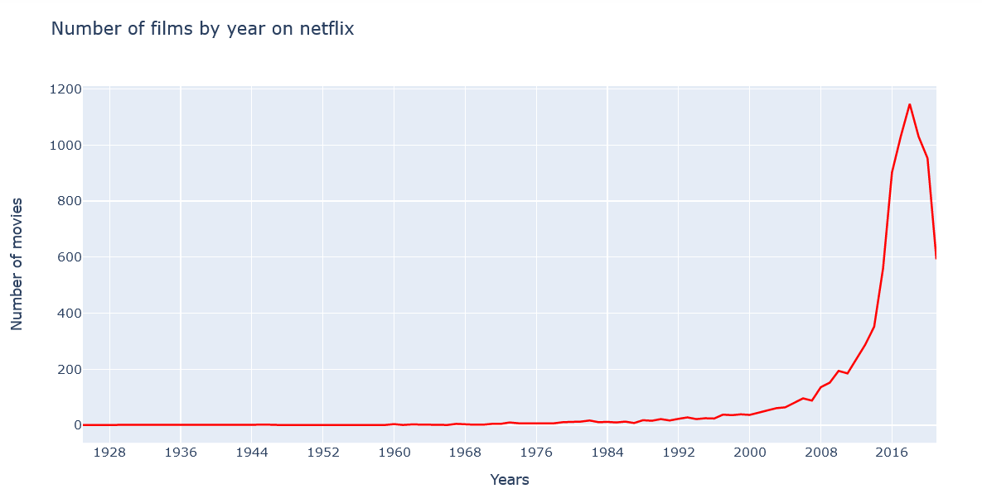
Years

Slide 5
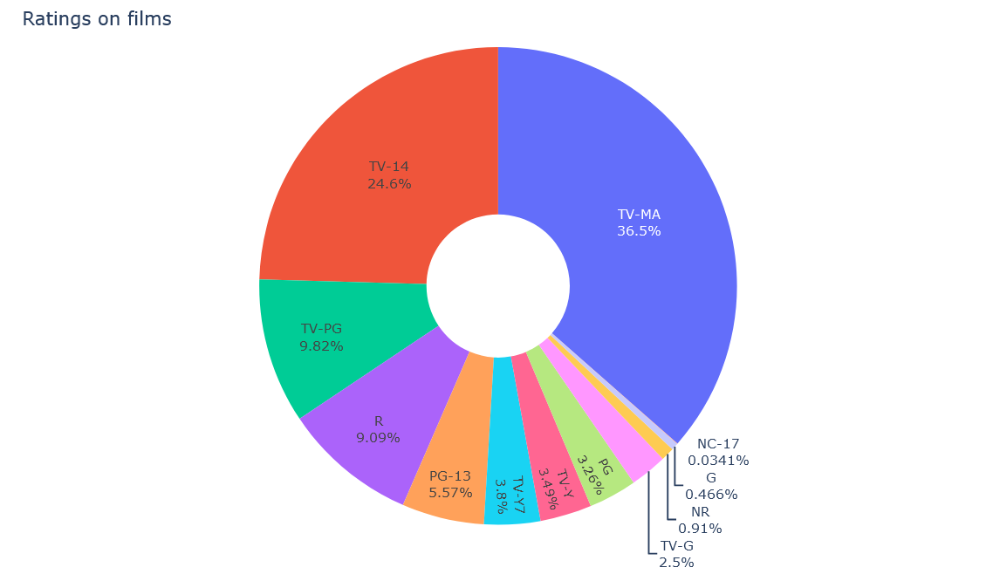
Ratings

Slide 6
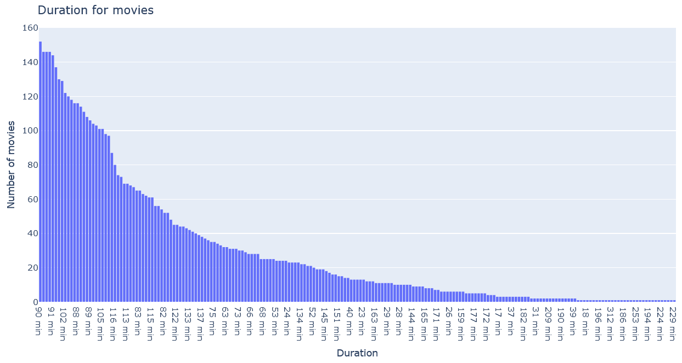
Duration (movies)

Slide 7
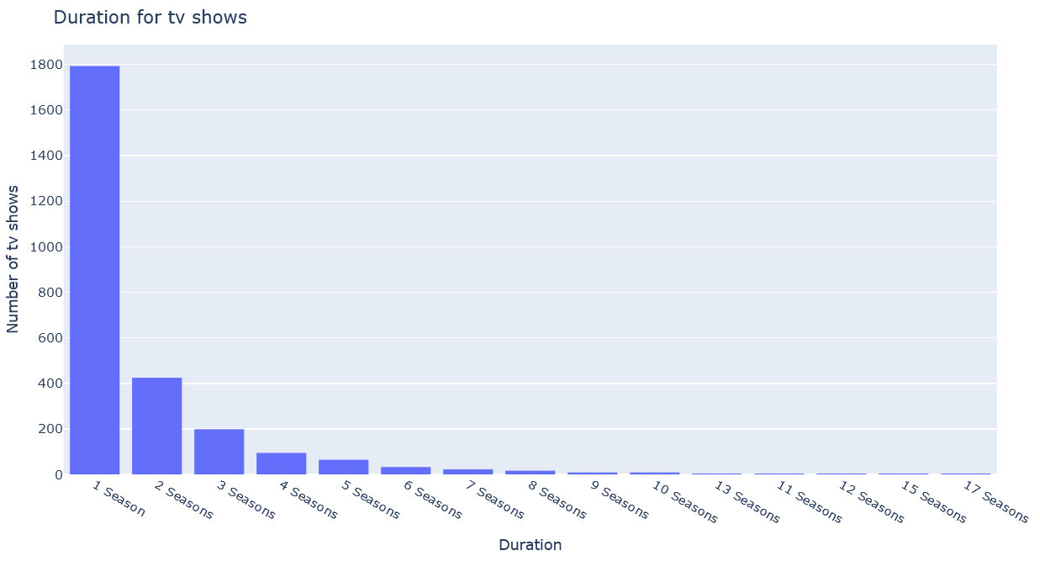
Duration (tv shows)

