Slide 1
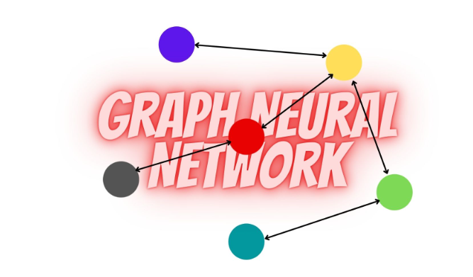
POOLING BY EDGE CUT

Slide 2

Introduction
The convolutional neural networks (CNNs) in artificial intelligence tasks. CNNs excel in learning meaningful patterns and hierarchical information from data that has a grid-like structure, such as images and text. They have emerged as state-of-the-art techniques in computer vision and natural language processing.
Notes:
הערה:
כדי לשנות את התמונה בשקופית זו, בחר את התמונה ומחק אותה. לאחר מכן, לחץ על סמל 'תמונות' במציין המיקום כדי להוסיף תמונה משלך.

Slide 3
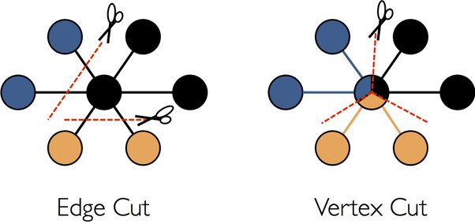
Pooling by edge cut
Learned pooling layer.
A novel approach based on edge cuts.
The definition of a regularization that aims at approximating the problem of minCUT.
Experimental results.

Slide 4
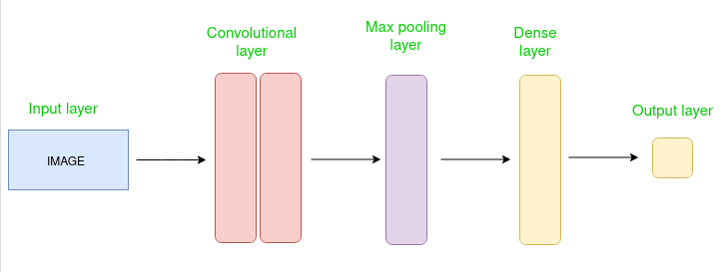
The Related Work To CNN
Deep models in images.
Graphs of CNN.
Pooling in graphs.

Slide 5
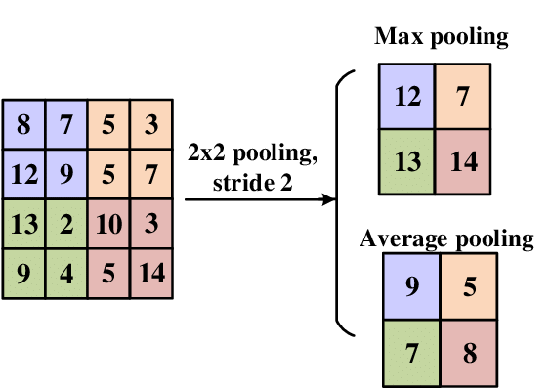
Pooling Strategies
Top-k.
Cluster identification.
Edge based pooling.
Deterministic coarsening strategies.

Slide 6
POOLING ARCHITECTURE
When designing a pooling layer, most algorithms need a number of classes for the pooling layer.
In this section, we present our pooling layer that is based on edge cutting and that does not necessitate any a priori on the number of classes that needs to be found.

Slide 7
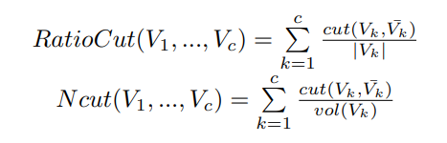
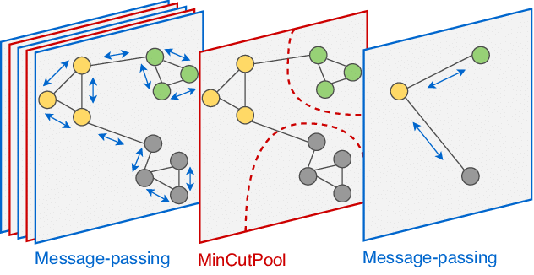
MIN CUTS
In community detection , the min cut problem aims at finding the separation, between disjoint subsets, that minimizes the cut.
In order to solve this problem, other objective functions can be defined such as RatioCut or the normalized cut (NCut).

Slide 8
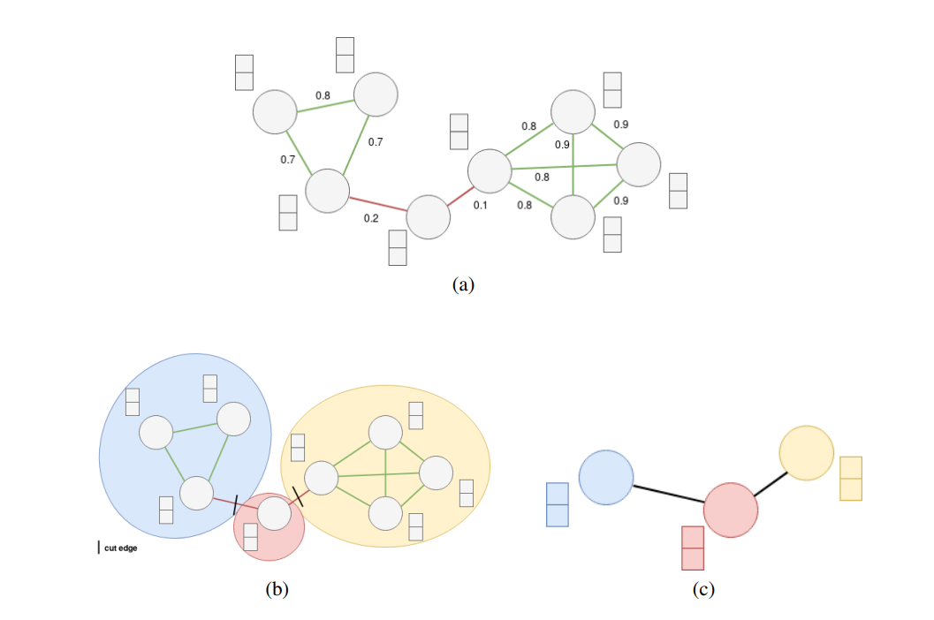
Graph Neural Networks
Graph Neural Networks (GNNs) are a class of neural networks designed to process and analyze structured data represented as graphs.

Slide 9
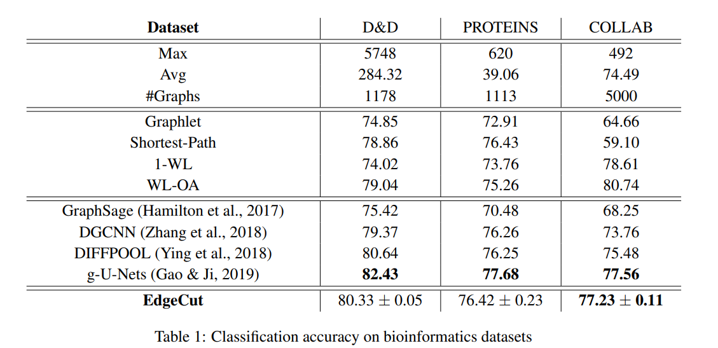
GRAPH CLASSIFICATION
Dataset: The datasets can be separated in two types. 2 bioinformatics datasets: PROTEINS and D&D; and a social network dataset: COLLAB.
Experimental setup: We perform a 10-fold cross-validation split which gives 10 sets of train, validation, and test data indices in the ratio 8:1:1.
Results: our pooling layer is challenging with state-of-the-art methods. Indeed, on most datasets, the score of our model is very close to those obtained by Gao & Ji (2019) and our model outperforms Ying et al. (2018) on these datasets.

Slide 10
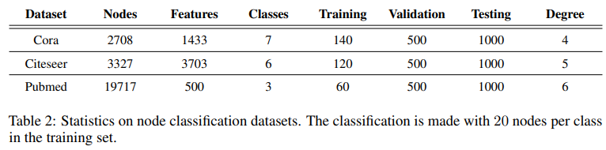
NODE CLASSIFICATION
Datasets: For node classification we conduct our experiments on three real-world datasets, Cora, citeseer and Pubmed.

Slide 11
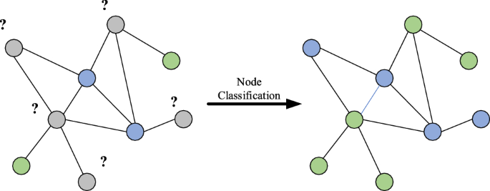
NODE CLASSIFICATION
Experimental setup: We split the edges into a training, a test and a validation set.
Architecture for node classification: In order to perform node classification with a pooling architecture we use a Graph U-Net model .

Slide 12
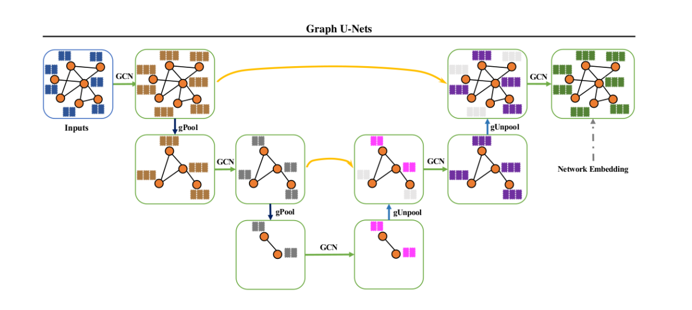
Graph U-Nets by Gao & Ji (2019)

Slide 13
CONCLUSION
We developed a new pooling layer based on edge cutting in graphs.
We proposed a method for calculating end scores to evaluate the importance of edges in the graphs.
The edge removal process is directly related to the minCUT problem.
We added a regularization term appropriate for the Normalized Cut problem to enhance the consistency of edge marking and cut edges.
Through extensive experiments, we demonstrated that this innovative approach competes with state-of-the-art methods.

Slide 14

Thank You

