Slide 1

An Application for secure email exchange: including encryption-decryption with FROG in CFB mode and secure secret key delivery using EC EL-GAMAL and Rabin signature

Slide 2
Overview
Encryption-decryption with (FROG) in CFB mode
Secret key delivery with using EC EL-GAMAL
Rabin signature
The flow of secure email exchange
Show the Application

Slide 3
Symmetric Encryption VS Asymmetric Encryption
Asymmetric Encryption | Symmetric Encryption | Comparison Factor
Asymmetric Encryption consists of two cryptographic keys. These keys are regarded as Public Key and Private Key. | Symmetric encryption incorporates only one key for encryption as well as decryption. | Number of Cryptographic Keys
Contribution from separate keys for encryption and decryption makes it a rather complex process. | Symmetric encryption is a simple technique compared to asymmetric encryption as only one key is employed to carry out both the operations. | Complexity
Because of encryption and decryption by two separate keys and the process of comparing them make it a tad slow procedure. | Due to its simplistic nature, both the operations can be carried out pretty quickly. | Swiftness of Execution
RSA Diffie-Hellman ECC El Gamal | AES DES FROG | Algorithms Employed

Slide 4
FROG algorithm
FROG is a block cipher
It was submitted in 1998 by TecApro, a Costa Rican software company, to the AES competition as a candidate to become the Advanced Encryption Standard.
The algorithm can work with any block size between 8 and 128 bytes and supports key sizes between 5 and 125 bytes. The algorithm consists of 8 rounds and has a very complicated key schedule.

Slide 5
implementation of FROG
cipher's job is to conceal the plaintext's information through a computational process of confusion and diffusion.
The basic idea behind the design of FROG is to conceal the definition of most of this process in a secret internal key.
The actual encryption algorithm operates as an interpreter that regards the secret internal key as a program and executes it as if it were a series of primitive

Slide 6
Encryption-decryption with FROG in CFB mode
Encryption:
Divide the plaintext message into fixed-size blocks, typically 64 bits each (e.g., using padding if necessary).
Generate an initial vector (IV), which is a random value of the same block size.
XOR the IV with the first plaintext block to create the ciphertext block.
Apply the FROG encryption algorithm to the ciphertext block using a secret key.
XOR the resulting encrypted block with the next plaintext block, and repeat the process for subsequent blocks.

Slide 7
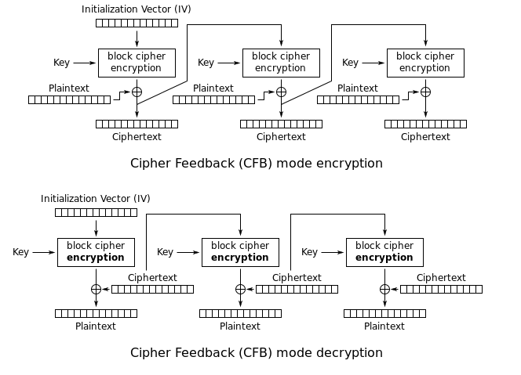

Slide 8
Decryption:
Generate the same IV that was used during encryption.
XOR the IV with the first ciphertext block to obtain the decrypted block.
Apply the FROG decryption algorithm to the decrypted block using the same secret key.
XOR the resulting decrypted block with the next ciphertext block, and repeat the process for subsequent blocks.

Slide 9
Secret key delivery with Elliptic Curve EL-Gamal
It was described by Taher Elgamal in 1985.
ElGamal encryption system is an asymmetric key encryption algorithm for public-key cryptography.
ElGamal encryption consists of three components: the key generator, the encryption algorithm, and the decryption algorithm.

Slide 10
Elliptic Curve
Elliptic-curve cryptography (ECC) is an approach to public-key cryptography based on the algebraic structure of elliptic curves over finite fields.
The idea of implementing public key encryption in finite fields created by an elliptical curve offers a significant need over other asymmetric encryption needs, due to the smaller encryption key

Slide 11
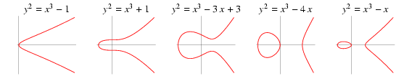

Elliptic Curve cont.
An elliptic curve is a plane curve defined by an equation of the form $y^{2}=x^{3}+ax+b$
Necessary condition:
$$4a^{3}+27b^{2}≢0\left(modp\right)$$
Examples:

Slide 12
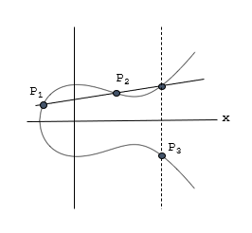
Idea behind Elliptic Curve

Slide 13
Elliptic Curve-generic procedure:
Both parties agree to some publicly-known data items
The elliptic curve equation
values of a and b
prime, p
The elliptic group computed from the elliptic curve equation
A base point, B, taken from the elliptic group
Similar to the generator used in current cryptosystems;
Key Each user generates their public/private key pair
Private = an integer, x, selected from the interval [1, p-1]
Public Key = product, Q, of private key and base point
(Q = x*B)

Slide 14
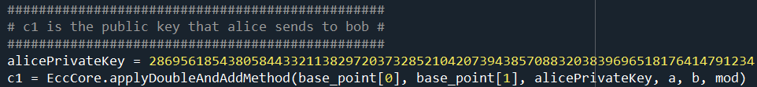
How it works – Encryption/Decryption
Suppose Alice wants to send to Bob an encrypted message.
Both agree on a base point, B.
Alice and Bob create public/private keys.
Alice
Private Key = a
Public Key = P_{A} = a * B
Bob
Private Key = b
Public Key = P_{B} = b * B

Slide 15
How it works – Encryption/Decryption cont
Alice takes plaintext message, M, and encodes it onto a point, P_{M}, from the elliptic group
To decrypt, Bob computes the product of the first point from PC and his private key, b
b* PA = b * (aB)
Bob then takes this product and subtracts it from the second point from PC
(PM + aPB) – [b(aB)] = PM + a(bB) – b(aB) = PM

Slide 16
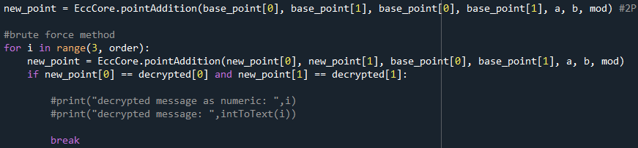
How it works – Encryption/Decryption cont
Bob then decodes PM to get the message, M.

Slide 17
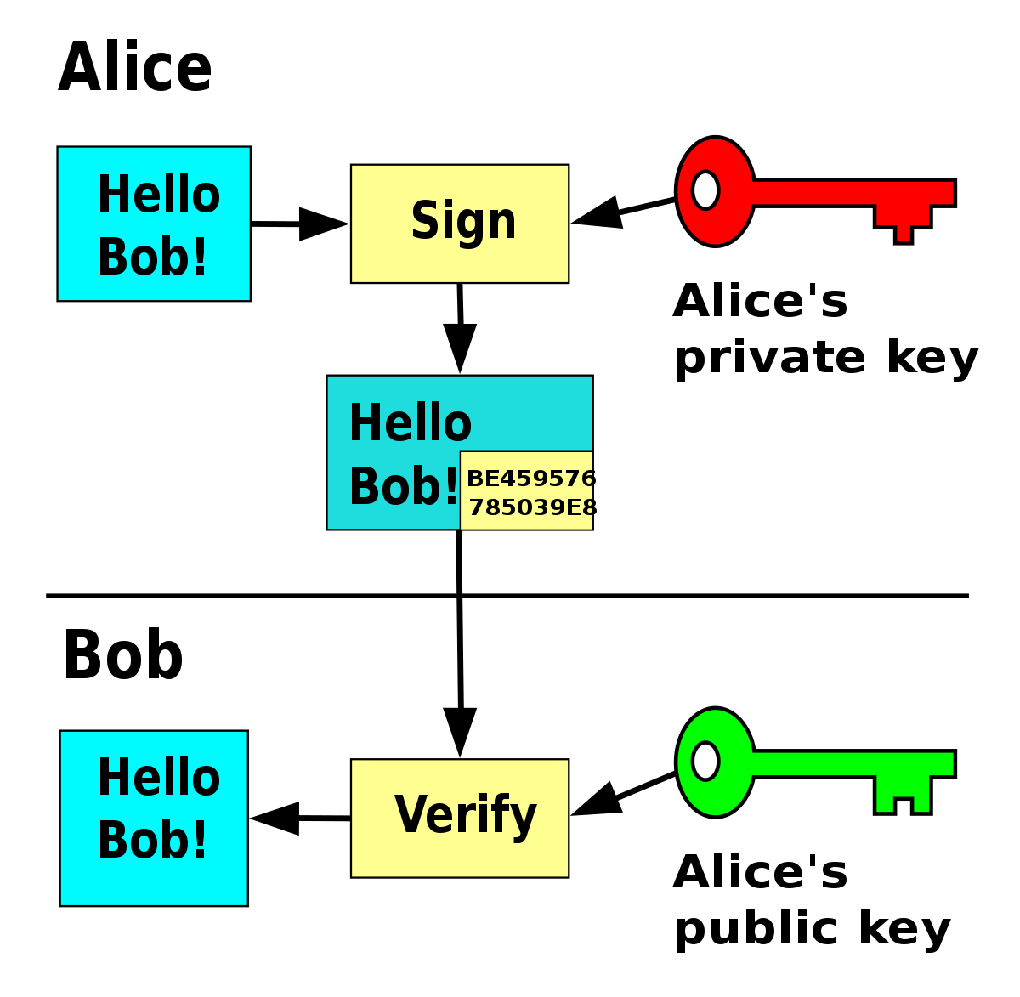
Digital signature
Authentication
Data integrity
Non-repudiation

Slide 18
Rabin signature
In cryptography, the Rabin signature algorithm is a method of digital signature originally proposed by Michael O. Rabin in 1978
Rabin digital signature algorithm resembles the RSA digital signature algorithm and is built of modulus n=pq when p and q are big prime numbers

Slide 19
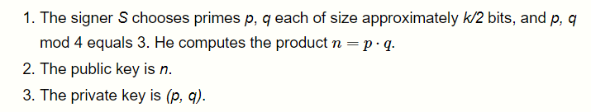
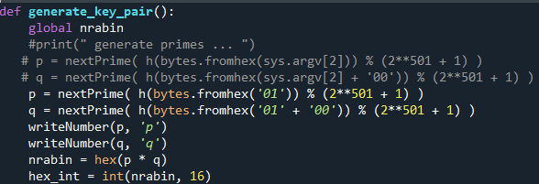
Key generation

Slide 20
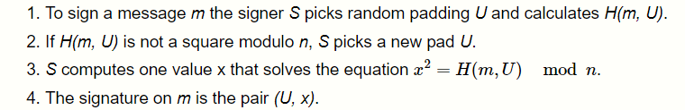
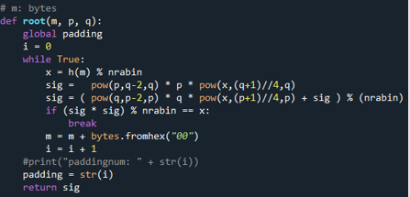
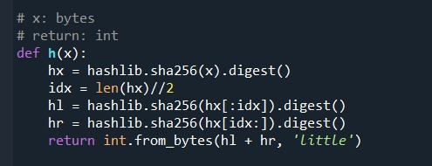
Signing

Slide 21


Verification

Slide 22
The flow of secure email exchange
Message as plain text
Signature verification by the receiver
Frog encrypt the message By using private key at CFB mode
True
False
Decrypt the key by using EC El-Gamal
Signing the encrypted message With rabin signature
Message compromised
Decrypts the message using the decrypted key with Frog
EC El-Gamal private key encryption Using the given public key and sender’s private key
Sending the encrypted message, public key for EC EL-Gamal encrypted coordinates (From EC El-Gamal) and digital signature

Slide 23
THANK YOU
Group 2

