Slide 1

NEURAL NETWORKS
A Python implementation of CryptoNets : Applying Neural Networks to Encrypted Data with High Throughput and Accuracy
Marzio Monticelli (1459333)
Dipartimento di Ingegneria informatica, automatica e gestionale Antonio Ruberti

Slide 2
INTRODUCTION
Emerging Deep Learning architectures and recurrent neural networks show a huge promise for artificial intelligence based application in fact have succeeded in many field including computer vision, speech and audio recognition.
This raises serious privacy concerns due to the risk of leakage of highly privacy-sensitive data. Such privacy concerns are hindering the applicability of neural network models for real world applications.
A Python implementation of CryptoNets : Applying Neural Networks to Encrypted Data with High Throughput and Accuracy
03/03/2020
Page 2

Slide 3

scenario
Consider the scenario in which a federal clinic wants to train an AI model to help diagnose and it has to rely on a third party service
In this scenario there is the need to ensure privacy as well as to compute predictions are based on the elaboration of sensitive user data.
A Python implementation of CryptoNets : Applying Neural Networks to Encrypted Data with High Throughput and Accuracy
03/03/2020
Page 3

Slide 4
two MAIN INGREDIENTS
The paper on which this work is based presents a method to convert learned neural networks to CryptoNets.
In particular it is based on the application of Homomorphic Encryption Schemes to Convolutional Neural Networks.
Neural Networks
Cryptography
A Python implementation of CryptoNets : Applying Neural Networks to Encrypted Data with High Throughput and Accuracy
03/03/2020
Page 4

Slide 5


The protocol
input data
Encryption
Neural Network
Decryption
Predictions
Client
Service provider
A Python implementation of CryptoNets : Applying Neural Networks to Encrypted Data with High Throughput and Accuracy
03/03/2020
Page 5

Slide 6
The protocol
MNIST
dataset
HE
encryption
Convolutional Neural Network
HE
decryption
Predictions
Client
Service provider
symmetric
symmetric
A Python implementation of CryptoNets : Applying Neural Networks to Encrypted Data with High Throughput and Accuracy
03/03/2020
Page 6

Slide 7
Network architecture
Dense (square)
Dense (softmax)
Convolution
Flatten
Dense (square)
The convolution has windows, or kernels, of size 3x3, a stride of (2,2) and a map-count of 5 (5 filters are used).
The input volume is flattened in a one-dimensional vector
Computes the dot product between the input and a weights matrix of dimension 245x100, squaring the value at each input node and summing the biases to the result.
Computes the dot product between the input and a weights matrix of dimension 100x10, squaring the value at each input node and summing the biases to the result.
Computes the dot product between the input and a weights matrix of dimension 10x10, applying the softmax activation function at each input node and summing the biases to the result.
A Python implementation of CryptoNets : Applying Neural Networks to Encrypted Data with High Throughput and Accuracy
03/03/2020
Page 7

Slide 8
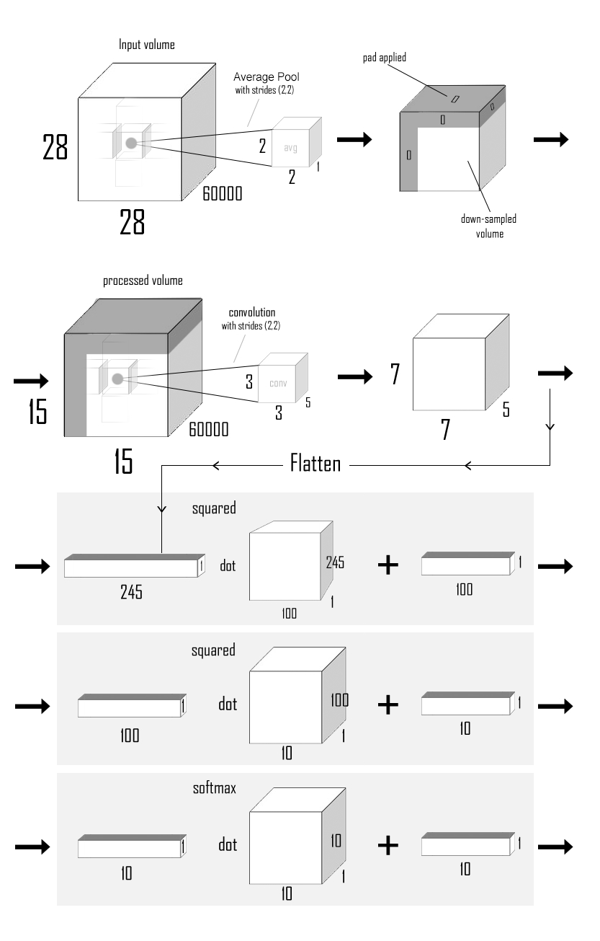

Slide 10
A Python implementation of CryptoNets : Applying Neural Networks to Encrypted Data with High Throughput and Accuracy
03/03/2020
Page 8

Slide 11
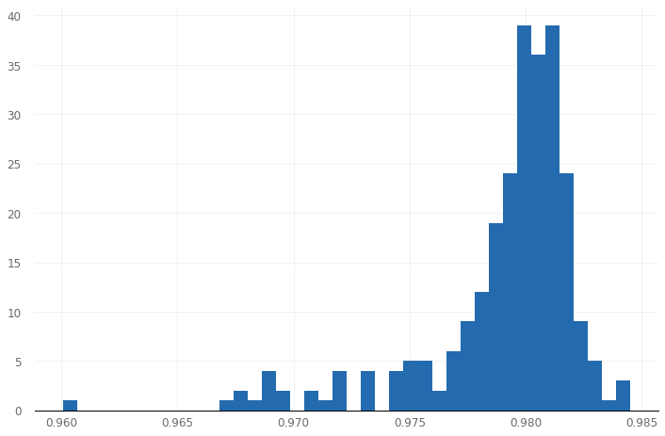
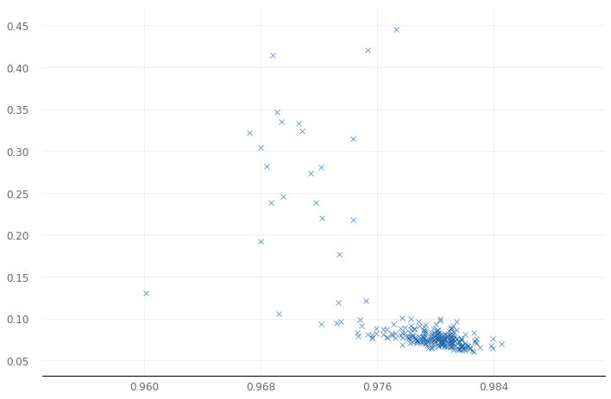
Network optimization
246 experiments on the original model are conducted with the aim to increase its accuracy
It was done trying to find best parameters with respect to the specific problem taken into consideration.
An accuracy of 0.98 seems to be the best we can do on the machine on which the project was developed
A Python implementation of CryptoNets : Applying Neural Networks to Encrypted Data with High Throughput and Accuracy
03/03/2020
Page 9

Slide 12
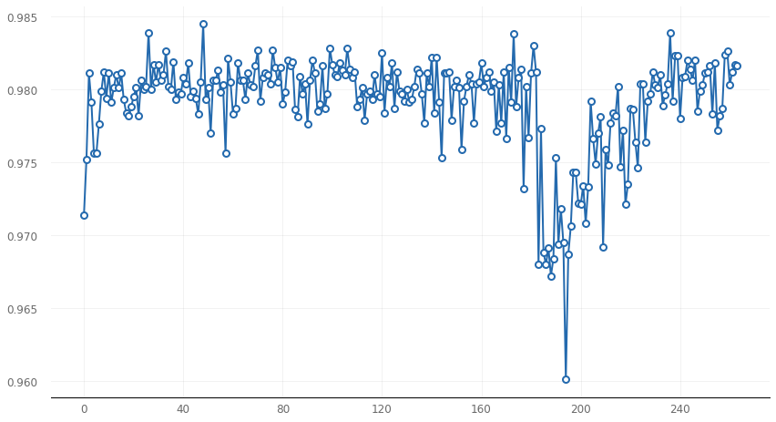
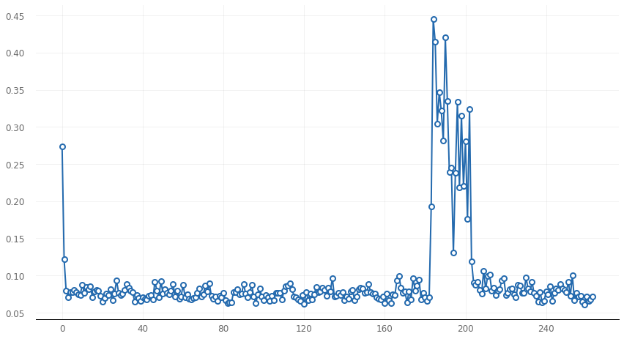
Network optimization
246 experiments on the original model are conducted with the aim to increase its accuracy
It was done trying to find best parameters with respect to the specific problem taken into consideration.
An accuracy of 0.98 seems to be the best we can do on the machine on which the project was developed
A Python implementation of CryptoNets : Applying Neural Networks to Encrypted Data with High Throughput and Accuracy
03/03/2020
Page 10

Slide 13
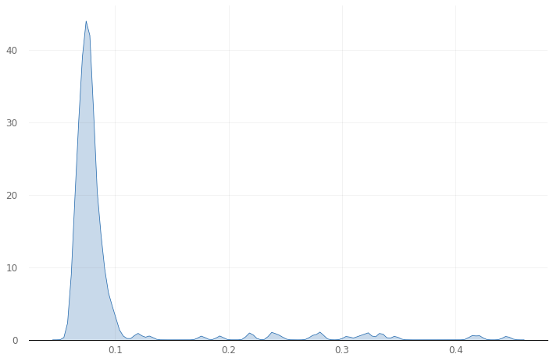
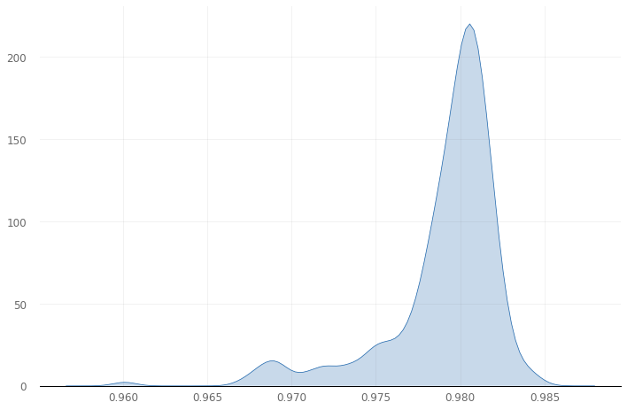
Network optimization
246 experiments on the original model are conducted with the aim to increase its accuracy
It was done trying to find best parameters with respect to the specific problem taken into consideration.
An accuracy of 0.98 seems to be the best we can do on the machine on which the project was developed
A Python implementation of CryptoNets : Applying Neural Networks to Encrypted Data with High Throughput and Accuracy
03/03/2020
Page 11

Slide 14
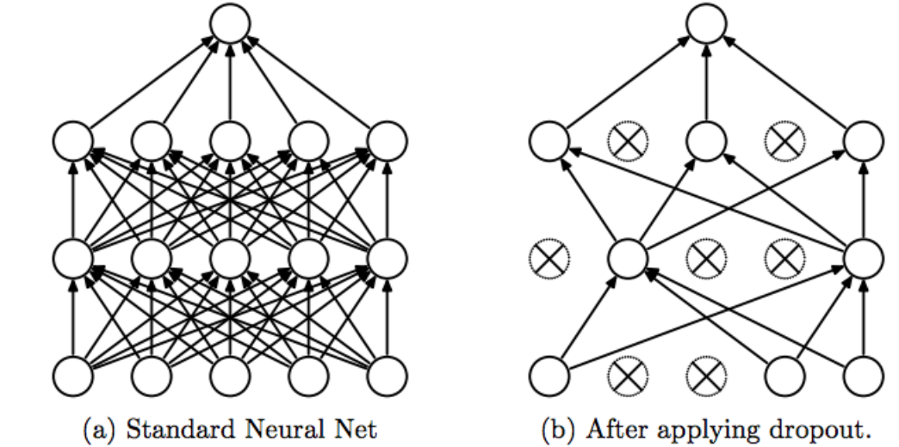
Dropout
Dropout has the effect of making the training process noisy, forcing nodes within a layer to probabilistically take on more or less responsibility for the inputs
A Python implementation of CryptoNets : Applying Neural Networks to Encrypted Data with High Throughput and Accuracy
03/03/2020
Page 12

Slide 15
Homomorphic Encryption
Lets consider x1, x2 ∈ Z
Φ(x1 + x2) = Φ(x1) + Φ(x2)
Φ(x1 · x2) = Φ(x1) · Φ(x2)
HE is an asymmetric scheme based on an invertible one-way function Φ(•); such function can be inverted only with a specific private key generated when the cryptographic context is created.
(Φ ^−1)(Φ(x1 + x2)) =
(Φ ^−1)((Φ(x1) + Φ(x2)) = x1 + x2
(Φ ^−1)(Φ(x1 · x2)) =
(Φ ^−1) ((Φ(x1) · Φ(x2)) = x1 · x2
Differently from traditional cryptography both additive and multiplicative structure of the rings must be preserved so that to have the possibility to perform such operations over encrypted data
Φ(•) : Z ⇒ Z_13 such that Φ(x) := x(mod13),
Φ(•) is a ring homomorphism between the ring Z and Z_13
A Python implementation of CryptoNets : Applying Neural Networks to Encrypted Data with High Throughput and Accuracy
03/03/2020
Page 13

Slide 16
Homomorphic Encryption
Given two random polynomials f’, g ∈ R(^n)_q (a structure preserving map)
h := (t· g· f^(−1)) is the public key
f := (t· f’ + 1) is the secret key
Since not every element in f’ , g ∈ R(^n)_q is invertible, these steps are iterated until the corresponding f has an inverse and h can be computed.
R(^n)_q elements can be thought of a sets of the form { p(x) + q(x)(x^n − 1) : q(x) ∈ Z_q[x], p(x) ∈ Z_q[x] } and where the general Z_m is composed by integers modulo m can be thought of as sets of the form { i + am : a ∈ Z } where i is an integer and where the set Z[x] is composed by polynomials with coefficients in a commutative ring Z that is itself a ring
A Python implementation of CryptoNets : Applying Neural Networks to Encrypted Data with High Throughput and Accuracy
03/03/2020
Page 14

Slide 17
Homomorphic Encryption
Given the public key h, a message m ∈ R(^n)_t is encrypted by computing
c := [q/t · m + e + hs]_q
where e and s are random noise polynomials in R(^n)_q with coefficients of small absolute value and with [•]_q is denoted the reduction of the coefficients of a modulo q to the symmetric interval of length q around 0.
While the decryption is done by computing:
m := [ t/q · f · c]_t
where the product f· c is computed in R(^n)_q , coefficients are interpreted as integers, scaled by t/q , rounded to the nearest integers and finally interpreted modulo t
A Python implementation of CryptoNets : Applying Neural Networks to Encrypted Data with High Throughput and Accuracy
03/03/2020
Page 15

Slide 18
Operations over encrypted data
Since the original maps are relative to commutative rings it is possible to perform addition and multiplication over data encrypted. Given two ciphertexts:
c1 := [[q/t]m1 + e1 + hs1]_q c2 := [[q/t]m2 + e2 + hs2]_q
It is possible to add them together in R(^n)_q to yield the encryption of m1 + m2.
c1 + c1 := ([q/t] · m1 + e1 + hs1) + ([q/t] · m2 + e2 + hs2) :=
[ q/t ](m1 + m2) + (e1 + e2) + h(s1 + s2)
While the multiplication between two cyphertext is possible by computing
[ t/q · c1· c2] = [ q/t ](m1· m2) + e’ + h^2 · s1· s2
where e’ is small noise term. It decrypts to m1 · m2 but under the secret key f^2 ∈ R(^n)_q . To decrypt the resulting cyphertext with the original secret key it necessary to use a method called relinerarization (we need to rectify this phenomenon by reducing the dimensionality of the cyphertext up to two at the price of additional noise).
A Python implementation of CryptoNets : Applying Neural Networks to Encrypted Data with High Throughput and Accuracy
03/03/2020
Page 16

Slide 19

Parameters selections
It is fundamental to select a q large enough to support the increased noise and a large t to prevent coefficients of the plaintext polynomials from reducing modulo t at any point during computation.
Another important aspect is to choose a large n for security reason.
A Python implementation of CryptoNets : Applying Neural Networks to Encrypted Data with High Throughput and Accuracy
03/03/2020
Page 17

Slide 20
Pyfhel
PYthon For Hmomorphic Encryption Libraries implements some functionalities of Homomorphic Encryption libraries such as sum, multiplication, or scalar product in Python
It works with three main classes:
• Pyfhel : The main class exposes all operations can be performed between cyphertexts and plaintexts. It is used both to generate the cryptographic context and relative keys
• PyPtxt : It is used to represent plaintexts and to use them inside the cryptographic context created through the Pyfhel class
• PyCtxt : It is used to represent cyphertexts so that to perform operations between them inside the cryptographic context.
A Python implementation of CryptoNets : Applying Neural Networks to Encrypted Data with High Throughput and Accuracy
03/03/2020
Page 18

Slide 21
Pyfhel
Pyfhel
SEAL
Helib
SEAL library it is also invoked when the cryptographic context is created. The plain modulus and the polynomial modulus are setted through the contextGen function creating the SEAL Context while the coefficient modulus is generated thanks to HElib starting from the security level passed
A Python implementation of CryptoNets : Applying Neural Networks to Encrypted Data with High Throughput and Accuracy
03/03/2020
Page 19

Slide 22
Project workflow
PlainNet
EncodedNet
CryptoNet
Restyling the original architecture taking into account the cryptographic scheme checking the correctness of each layer
Debug the encoding process by testing parameters feasibility with respect to input data. Ensuring no value overfit the t/2 parameter during the computation
Compute final results by putting together partial results from the two schemes are applied
A Python implementation of CryptoNets : Applying Neural Networks to Encrypted Data with High Throughput and Accuracy
03/03/2020
Page 20

Slide 23
Input pre-processing
Input images
Down sample
process
Encoding process
Usable input
Weights and Biases
Encoding process
Usable Weights and Biases
A Python implementation of CryptoNets : Applying Neural Networks to Encrypted Data with High Throughput and Accuracy
03/03/2020
Page 21

Slide 24
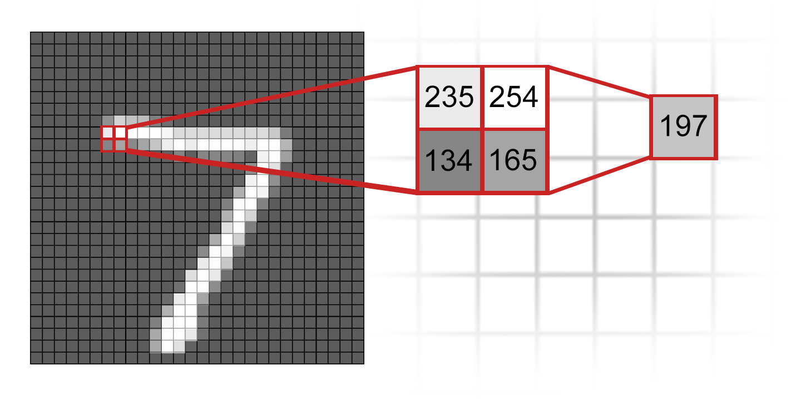
The average pool layer
A window of size 2 by 2 is scrolled over the image averaging the RGB value of the 4 pixels in the window. The final result is an image with half of the dimension of the original one and where each pixel is the average of 4 pixels in the original image.
Before saving final dataset pixel values are reshaped from the range [0, 255] to [0, 1] and a zero pad is applied to the upper and left side of each image.
A Python implementation of CryptoNets : Applying Neural Networks to Encrypted Data with High Throughput and Accuracy
03/03/2020
Page 22

Slide 25
Data encoding
0.2543
* 10 ^ (2)
25
Encoding is done through a function that given a precision pr and a floating point number ni returns the integer representation of the floating point number multiplying its value by (10)^pr and rounding the result to the closer integer.
This procedure it is necessary since it is possible to encrypt only integer values within the HE scheme.
A Python implementation of CryptoNets : Applying Neural Networks to Encrypted Data with High Throughput and Accuracy
03/03/2020
Page 23

Slide 26
Handling negative Numbers
When the encryption process is performed, neural network weights and biases are reduced modulo t and the CryptoNet is not able to compute the right result without handling negative numbers since a lot of information would be lost
Negative numbers are mapped to the interval [(t/2)+1, t] while positive numbers are mapped to the interval (0, t/2] . As rebound of this procedure only t/2 positive numbers can be encoded or, to be more precise, all integers in the range (0, t/2] while only (t/2) negative numbers can be encoded or more precisely all negative numbers in the interval [−(t/2), 0)
-t/2
0
t/2
0
t/2
t
A Python implementation of CryptoNets : Applying Neural Networks to Encrypted Data with High Throughput and Accuracy
03/03/2020
Page 24

Slide 27
Chinese Remainder Theorem
An element p can be uniquely represented by elements p1, . . . , pn such that pi ∈ R/pi and this allows breaking p into n smaller values p1, . . . , pn can be obviously used to reconstruct the original p.
Big numbers issue
Parallel computation
Splitting t parameter
Multiple CRT Batching
A Python implementation of CryptoNets : Applying Neural Networks to Encrypted Data with High Throughput and Accuracy
03/03/2020
Page 25

Slide 28
The cryptonet
t > 2^80
t1= 1099511922689
t2 =
1099512004609
The encrypted version of the network uses two parameters t exploiting the CRT technique as in the original paper. As well as the t parameter, the parameter q is selected to match the original scheme: in particular the network is evaluated separately for each parameter t and the final result given by each scheme is than composed and evaluated together so that to reconstruct the congruent result starting from its decomposition.
A Python implementation of CryptoNets : Applying Neural Networks to Encrypted Data with High Throughput and Accuracy
03/03/2020
Page 26

Slide 29
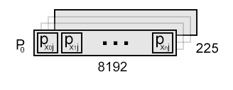
SImD operations
We need to perform operations between single pixels…
Im_0
Im_1
Im_n
One solution is to encrypt all pixels at the same position in the same ciphertext so that to be able to compute SIMD operations.
Let consider (im_0, . . . , im_n) images such that im_i ≡ (pxi_0, . . . , pxi_224) where pxi_j is the j-th encoded pixel of the i-th image.
The j-th cyphertext c_j is generated through the application of the encryption function enc_pk(•) to the set Pj ≡ (px0_j , px1_j , . . . , pxn_j) given the public key pk:
c_j = enc_pk(Pj), j ∈ (0, 224),
Pj ≡ (px0_j , px1_j , . . . , pxn_j)
A Python implementation of CryptoNets : Applying Neural Networks to Encrypted Data with High Throughput and Accuracy
03/03/2020
Page 27

Slide 30
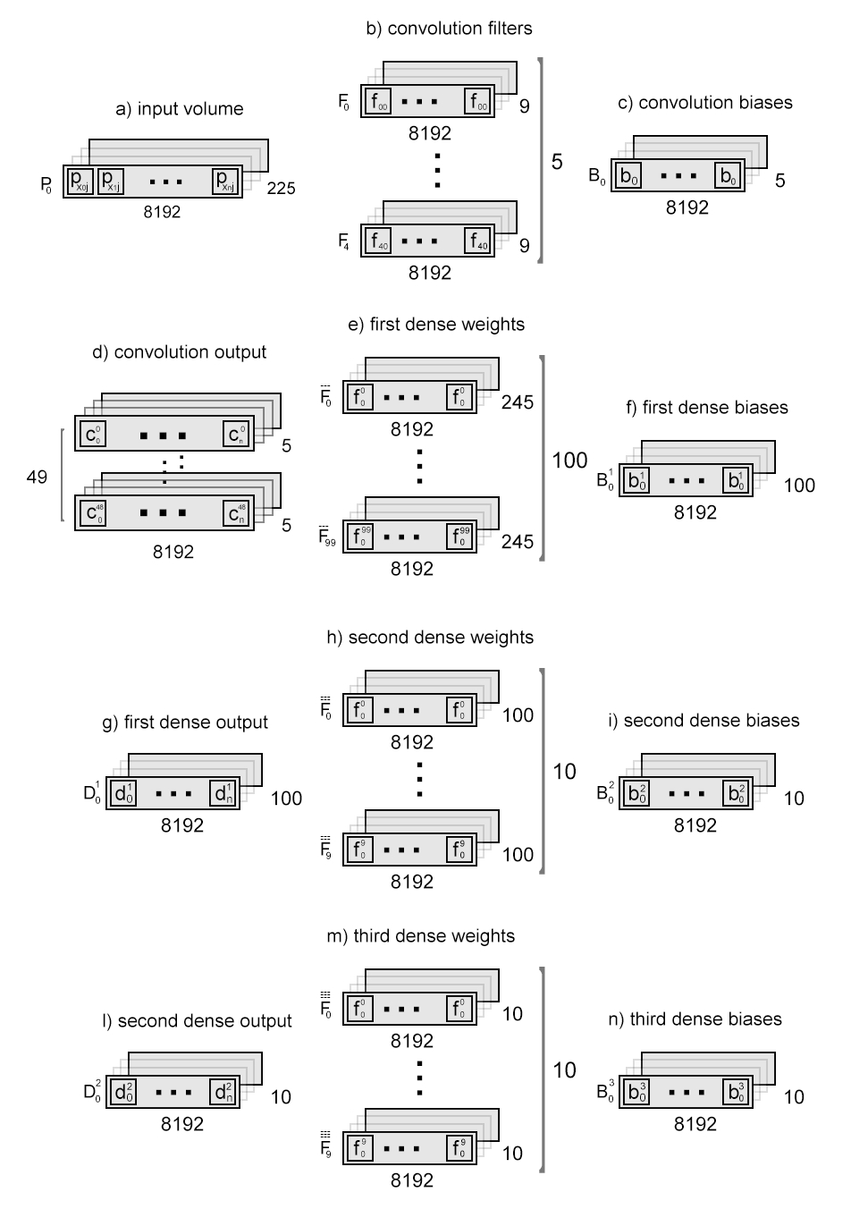

Slide 32
A Python implementation of CryptoNets : Applying Neural Networks to Encrypted Data with High Throughput and Accuracy
03/03/2020
Page 28

Slide 33
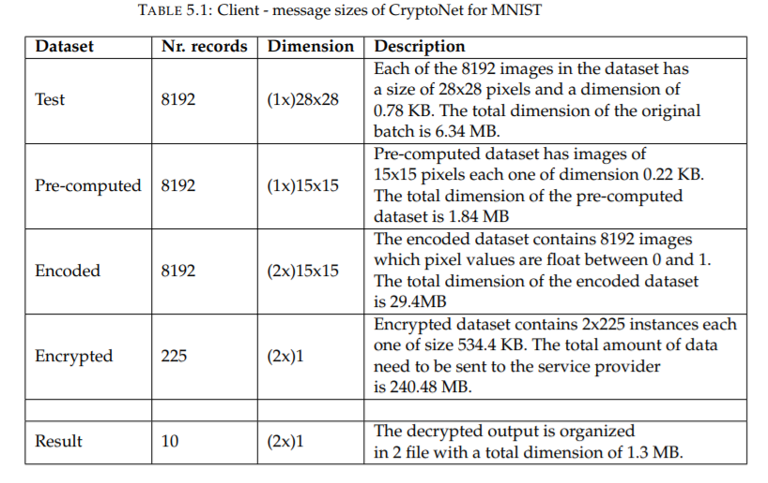
results
Generated data is bigger in size than the ones presented in the original paper: as explained encrypted values are maintained within dedicated classes which also contains a lot of information useful to restore values from saved files. This fact is also connected to the approximation used to represent integer values and relative computations are operated by the layers using the batching technique.
A Python implementation of CryptoNets : Applying Neural Networks to Encrypted Data with High Throughput and Accuracy
03/03/2020
Page 29

Slide 34
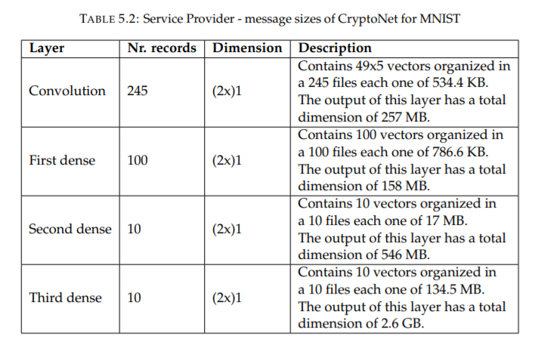
results
Generated data is bigger in size than the ones presented in the original paper: as explained encrypted values are maintained within dedicated classes which also contains a lot of information useful to restore values from saved files. This fact is also connected to the approximation used to represent integer values and relative computations are operated by the layers using the batching technique.
A Python implementation of CryptoNets : Applying Neural Networks to Encrypted Data with High Throughput and Accuracy
03/03/2020
Page 30

Slide 35
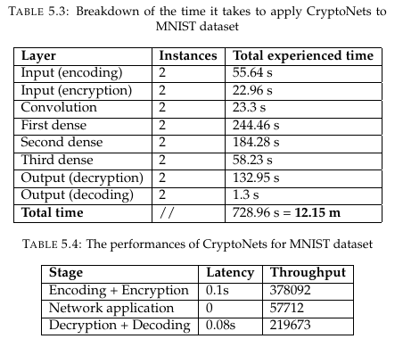
results
Since apply the network allows making 8192 predictions simultaneously, this PC can sustain a throughput of 57712 predictions per hour. Encoding and encryption processes take 78 s to be computed, therefore if 8192 instances are encoded a throughput of 378092 instances per hour can be encoded and encrypted. Decrypting data takes 132.95 s and additional 1.3 seconds to decode predictions for the two instances. Therefore a throughput of 219673 decryptions and decoding per hour is achievable with our setup.
A Python implementation of CryptoNets : Applying Neural Networks to Encrypted Data with High Throughput and Accuracy
03/03/2020
Page 31

Slide 36
thanks
Marzio Monticelli (1459333)
Dipartimento di Ingegneria informatica, automatica e gestionale Antonio Ruberti

