Slide 1
Stampify
Giving you more control
Choose Where & When

Slide 2
STAMPIFY
Paramveer
Singh
AI Engineer with a focus on NLP
A Masters candidate in Finance
A former International cricket player
Simply Control Your Life
MADE FOR THE RESTLESS

Slide 3
STAMPIFY
TIME IS PRECIOUS, WE GIVE YOU CONTROL OVER IT
Ever found yourself scrolling through the timelines on a video looking for something specific?
Simply Control Your Life

Slide 4
STAMPIFY
TIME IS PRECIOUS, WE GIVE YOU CONTROL OVER IT
Looking for a specific discussion in your fav podcast or lecture video, but just can't find it?
Simply Control Your Life

Slide 5
STAMPIFY
TIME IS PRECIOUS, WE GIVE YOU CONTROL OVER IT
Been there, done that. Scrolling through the video endlessly, over and over again.
Simply Control Your Life

Slide 6
STAMPIFY
TIME IS PRECIOUS, WE GIVE YOU CONTROL OVER IT
STAMPIFY
Introducing
your one stop solution.
More Control
|
More Efficient
Simply Control Your Life

Slide 7
STAMPIFY
FOCUSED
FOR ALL
STAMPIFY gives users more controlled focus on what they want in an era where there is Information Overload.
Therefore, allowing them to focus on other priorities.
- Over 2 BILIION ACTIVE Youtube Users.
- STAMPIFY can assist people on a global scale from school going children to the elderly looking for the step in the recipe.
Simply Control Your Life

Slide 8
STAMPIFY
AI Entity Based Searching
Gets you the top mentioned Entities
Simply Control Your Life
MADE FOR THE RESTLESS

Slide 9
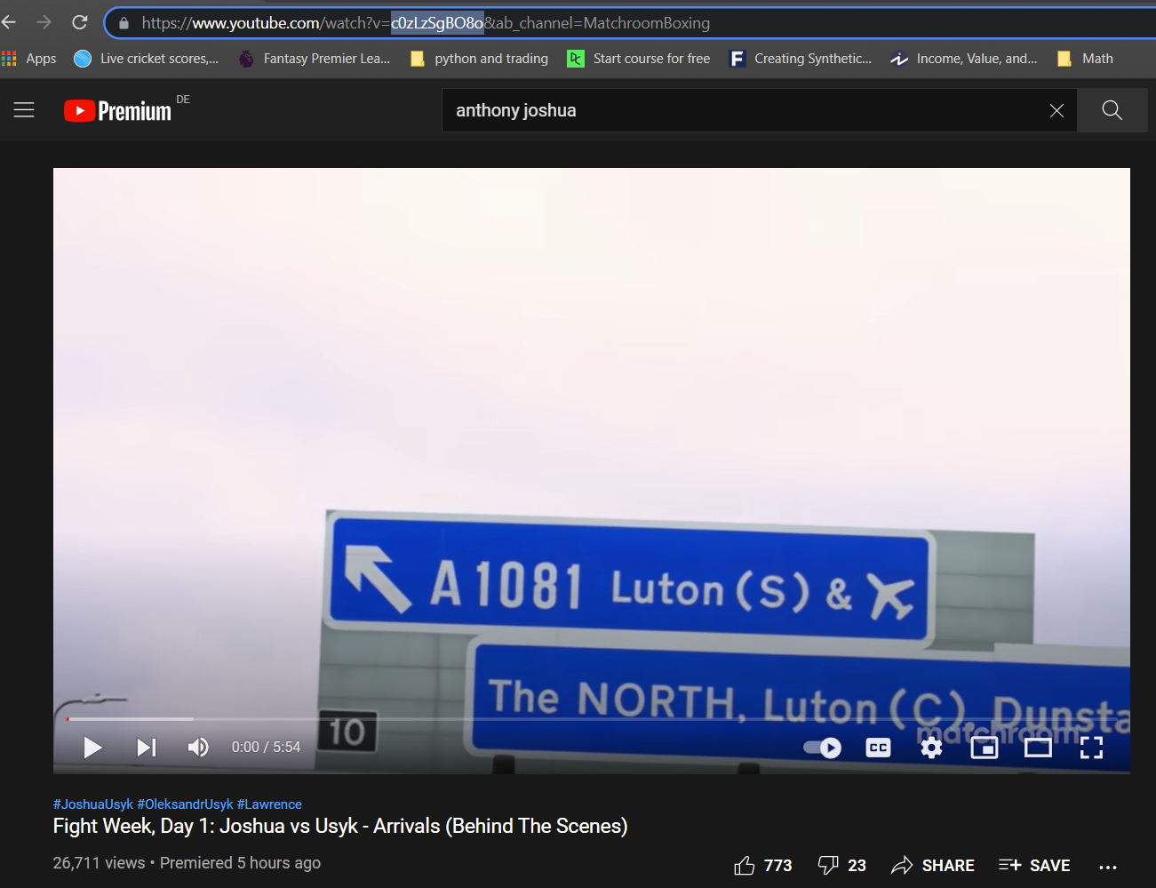
STAMPIFY
AI Entity Based Searching
Simply Control Your Life
MADE FOR THE RESTLESS

Slide 10
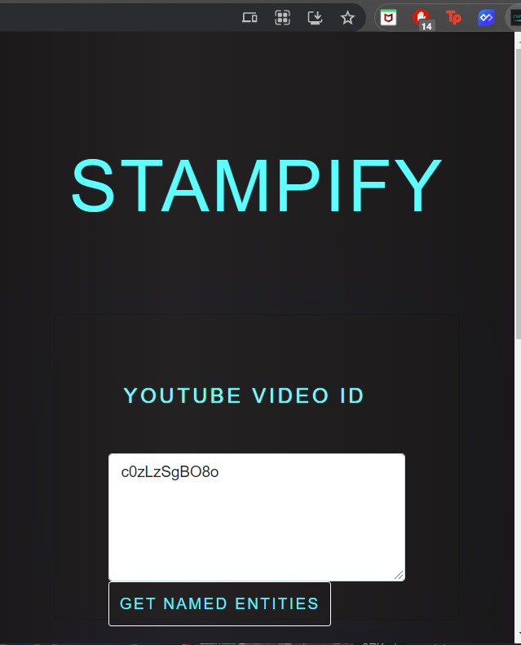
STAMPIFY
AI Entity Based Searching
Simply Paste the Video ID
Simply Control Your Life
MADE FOR THE RESTLESS

Slide 11
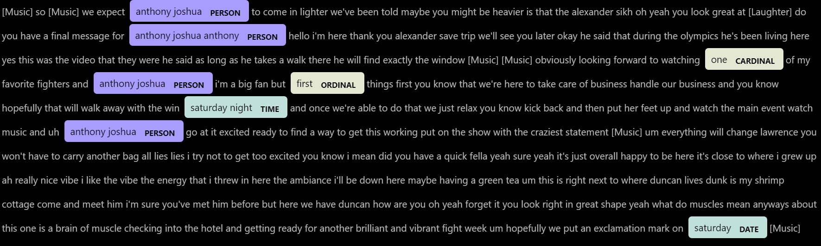
STAMPIFY
AI Entity Based Searching
Voila!
Simply Control Your Life
MADE FOR THE RESTLESS

Slide 12





STAMPIFY
TECH STACKS
Simply Control Your Life
MADE FOR THE RESTLESS

Slide 13
STAMPIFY
Insert Video
AI Generated Video Timestamps
SHOW CASE A NON-TIMESTAMPED VIDEO ON YOUTUBE AND PROCEDURE USING THE CHROME EXT TO GENERATE THE TIMESTAMPS
20 seconds demo video
Simply Control Your Life
MADE FOR THE RESTLESS

Slide 14
STAMPIFY
Contact Information
PHONE NUMBER
+4915226429106
EMAIL ADDRESS
pgsingh7297@gmail.com
GITHUB
https://github.com/Marzipan78
LINKEDIN
https://www.linkedin.com/in/paramveer-singh07/
FOR QUESTIONS OR COMMENTS

