Slide 1

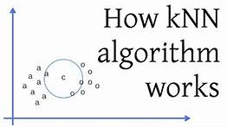
Eunice Oyeniyi

Slide 2
What is KNN?
K-NN popularly known as a lazy learner, is a supervised nonparametric method used for both classification and regression
It uses proximity to make prediction about the grouping of an individual data point. It is mostly used for classification problem.
K represents the number of nearest neighbours the classifier will use to make its prediction
Lazy leaner because it memorizes the training instances.
For Classification problems, a class is assigned based on a majority vote
For regression problems, average of the k-nearest neighbour is taken to make prediction

Slide 3
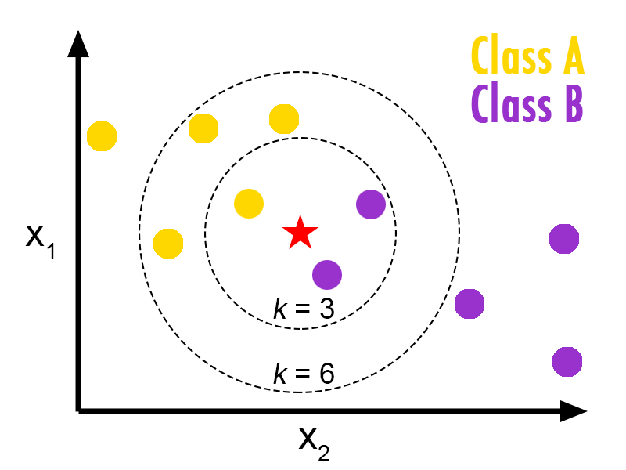
When do we need a K-NN Algorithm?

Slide 4
How are the distance between the data points are calculated?
In order to determine which data points are closest to a given query point, the distance between the query point and the other data points will need to be calculated
Euclidean distance
Manhattan distance
Minkowski distance
Hamming distance:

Slide 5
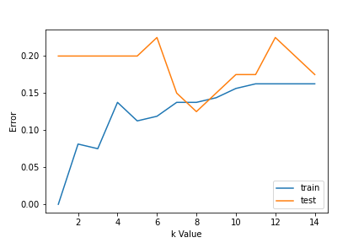
How do we choose the best k?
It is recommended to have an odd number for k to avoid ties in classification
Make a plot of different accuracy based on the value of k
Using error curves
at low k value, the test error is high and train is low. Leading to overfitting of data

Slide 6
how does it work?
Start with a dataset with known categories
Select the number of K neighbors
Calculate the distance of K numbers of neighbors
Take the K nearest neighbors with reference to the distance
Count the number of data points in each category and take the max vote

Slide 7
Advantages of KNN Algorithm
It is simple to implement
Has no assumption
No training steps requires as it stores the training data
Few hyperparameters
Variety of distance criteria

Slide 8
Disadvantages of KNN Algorithm
Always needs to determine the value of K which may be complex some time.
The computation cost is high because of calculating the distance between the data points for all the training samples
Sensitive to outliers
Imbalanced data causes problems
Curse of dimensionality

Slide 9

Thanks for listening

