Slide 1
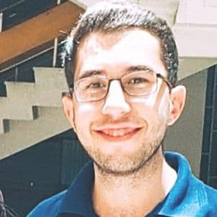
military status: postponed
PROFILE
Student in Electronics and Communication in the final years and g my graduation project was: “smart bracelet to monitor and locate the patient using internet of things”.
Mohammad marzok ajaj
EXPERIENCE
participant at FMEE exhibition Damascus university | Aug 2021 To Oct 2021
The exhibition of the Faculty of Mechanical and Electrical Engineering.
0954464994
0993758049
COURSES
mohamadjjjj418@gmail.com
Python for every body 5 course about data structure and using database with python using python to access web data on coursera.org 2022.
Ccnp 350 – 401 – on the internet by ahmed nazmy in 2022.
CCNA 200 – 301 – on the internet by ahmad nazmy in 2021.
Mobile communication systems (2021) – Dr. Ayman alsawah .
Certification for participating at FMEE exhibition 2021.
Components ,installation and preparation of base stations for celluler systems by _Dr Ayman alsawah .
Syria, Damascus, baramkeh
22 years old
APPLICATION SKILLS
LANGUAGES
MS WORD
ARDUINO C
Arabic : Fluent
English : good
MS POWERPOINT
MS EXCEL
Notes:
جميع الحقوق محفوظة لموقع www.bestfreecv.com

