Slide 1


Student performance predictor
Data Science and AI ML
Team Members:
1.Avinash
2.Shamanth
3.Sathwik
4.Chaithanya
5.Sumaira Marzuqa Bashir
6.Divyashree
Guide: Kavya Rao

Slide 2
Agenda:
Introduction
SMART Objectives
5W1H Analysis and SCAMPER Ideation
Literature Insights (Short)
Proposed Solution
System Overview (Basic Diagram)
Gantt Chart
Expected Outcome

Slide 3
Problem Statement
Many students fall behind academically before teachers can identify the problem. Traditional monitoring methods rely on manual observation and delayed results. Lack of predictive tools prevents early intervention. As a result, students do not receive timely support, leading to poor academic performance. Institutions need an automated system to predict student performance and risk level.

Slide 4
Introduction
Student performance is crucial, but delayed detection and traditional monitoring lead to late interventions and reduced improvement chances.
Students, teachers, and educational institutions facing challenges due to lack of timely support and reliance on manual evaluation methods, leading to reduced overall performance.
The issue occurs across all learning environments, including schools, colleges, universities, training institutions, and online learning platforms.
Advancements in machine learning and data analytics enable early prediction of student performance using academic and behavioral data, helping identify at-risk students and provide timely intervention and support.

Slide 5
Objectives :-
The goal is to predict whether a student is performing well or is at risk based on their data (marks, attendance, etc.)
The system measures success by prediction accuracy, identifying at-risk students, and improving performance monitoring.
The system is achievable using technologies like Flask, Python libraries, and structured student datasets.
The project is relevant in modern education as it enables early detection of low-performing students and helps improve academic performance.
The project is completed step-by-step from data preparation to model training, development, and final testing.

Slide 6
5W1H Analysis
Category
WHO
WHAT
WHY
WHERE
WHEN
HOW
Explanation
Teachers, Admin, and Students use the system. Teachers monitor performance, admin manages data, and Students can view their progress.
A web-based application that predicts student performance using machine learning based on attendance, study hours, previous marks, and assignments.
To identify at-risk students early, improve academic performance, and helps teachers to take actions early.
Used in educational institutions such as schools, colleges, or universities through a web application.
During the academic period, especially before exams to analyze student performance.
The system uses a Random Forest machine learning model, Flask web framework, and student dataset to analyze inputs and generate predictions.

Slide 7
Literature Insights:
Predicting Student Performance Using Random Forest Algorithm
Uses Random Forest for accurate prediction of student scores.
Gap: Works on small dataset
Student Performance Prediction Using Supervised Machine Learning
Compares algorithms like Logistic Regression, SVM, Decision Trees.
Gap: No single best model; results vary across datasets.
Student Performance Prediction Based on Random Forest
Focuses on academic features like marks and attendance.
Gap: Ignores behavioral and psychological factors.
Classification and Prediction Using Various ML Algorithms
Evaluates multiple ML models for classification accuracy.
Gap: Models are not integrated into real-world systems.

Slide 8
Proposed Solution
System Capabilities
Feature Importance (Top 5)
AI
AI Prediction:
total_score
44.4%
ExtraTreesRegressor, 85.4% R2, 14 features
3R
3-Role System:
academic_score
19%
Admin, Teacher, Student - separate dashboards
BP
Bulk Predict:
internal_avg
8.1%
Upload class CSV - predictions for every student
TIPS
Improvement Tips:
high_study
7.7%
Personalised suggestions for at-risk students
AUTH
Signup & Auth:
study x attend
3.4%
Role-specific login with password hashing
STAT
Analytics:
Class avg, risk %, at-risk student table

Slide 9
System Overview
SP
Frontend (Browser)
HTML + CSS (Dark Theme) | Jinja2 Templates | 16 Template Files
Flask Web Application
app.py - Routes & Logic | database.py - SQLite Auth | Session Management
ML Prediction Engine
ExtraTreesRegressor | 14 Engineered Features | 85.4% R2 Accuracy
Data Layer
students_data.csv (900 students) | users.db (SQLite) | models/*.pkl
User Roles
ADM
TCH
STU
Admin
Teacher
Student
Manage users & data
Predict & bulk upload
View score & tips

Slide 10
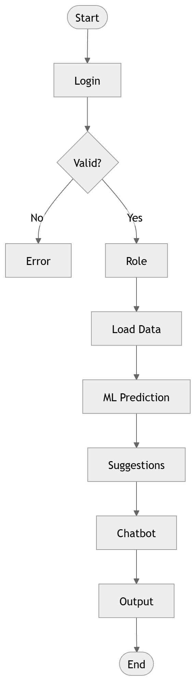

Slide 11
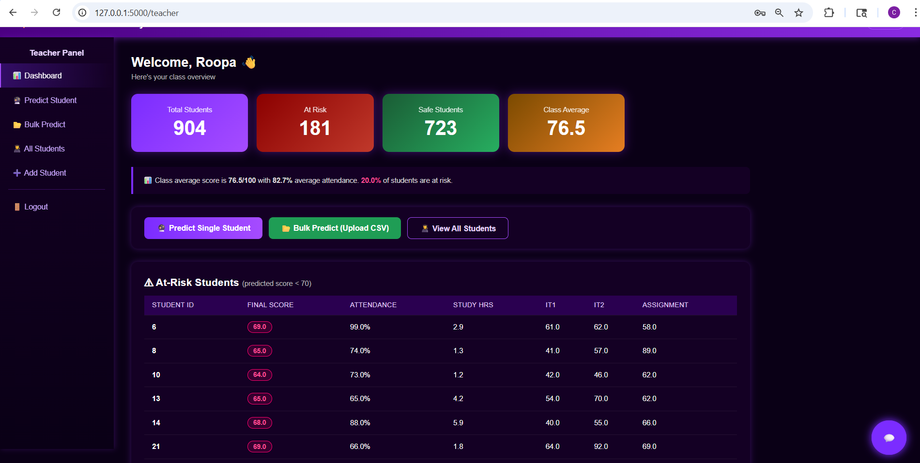
Screenshot of model

Slide 12
Gantt Chart
Project Details | Week 1 | Week 2 | Week 3 | Week 4 | Week 5 | Week 6 | Week 7 | Week 8 | Week 9 | Week 10 | Week 11 | Week 12 | Week 13 | Week 14 | Week 15 | Week 16
Problem analysis |  | ■ | ■
Literature survey |  |  | ■ | ■
Requirement analysis |  |  | ■ | ■ | ■
System design |  |  |  | ■ | ■
Data collection & Preparation |  |  |  |  | ■ | ■ | ■
ML model |  |  |  |  |  |  |  | ■ | ■ | ■ | ■
Backend Setup |  |  |  |  |  |  |  |  |  | ■ | ■ | ■
Frontend development |  |  |  |  |  |  |  |  |  |  | ■ | ■ | ■
System integration |  |  |  |  |  |  |  |  |  |  |  | ■ | ■ | ■
Documentation |  |  |  |  |  |  |  |  |  |  |  |  |  | ■ | ■
Report |  |  |  |  |  |  |  |  |  |  |  |  |  |  |  | ■

Slide 13
Expected Outcome:
Predict student performance using key academic data
Identify at-risk students early
Reduce manual work through automation
Provide insights using dashboards and alerts
Improve decision-making and student outcomes
Provide personalized guidance using an AI chatbot

