Slide 1
node test.js
NodeJS Process
Single Thread
Event Loop

Slide 2
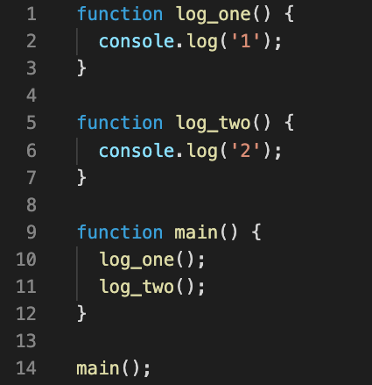
console.log(‘1’)
log_one()
log_one()
log_one()
main()
main()
main()
main()
Exit NodeJS
console.log(‘2’)
log_two()
log_two()
log_two()
main()
main()
main()
main()
main()

Slide 3
Message queue
console.log(‘2’)
setTimeout(log_one, 0)
log_two()
log_two()
main()
main()
main()
main()
log_one()
Exit NodeJS
console.log(‘1’)
log_two()
log_one()
log_one()
log_one()
main()
main()

Slide 4
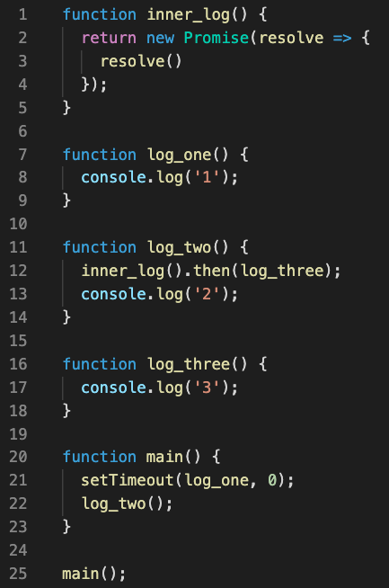
Message queue
inner_log()
console.log(‘2’)
setTimeout()
log_two()
log_two()
log_two()
log_two()
main()
main()
main()
main()
main()
main()
log_one()
Job queue
console.log(‘3’)
console.log(‘1’)
log_three()
log_three()
log_three()
log_two()
log_one()
log_one()
log_one()
main()
main()
main()
main()
main()
log_three()
Exit NodeJS

