Slide 1

Diamond Price Prediction
Project
Students Names:
Momen Shhada Masa Abdallah
Moaed Adres

Slide 2
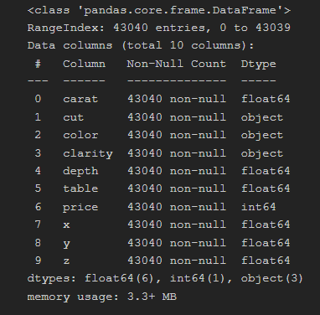
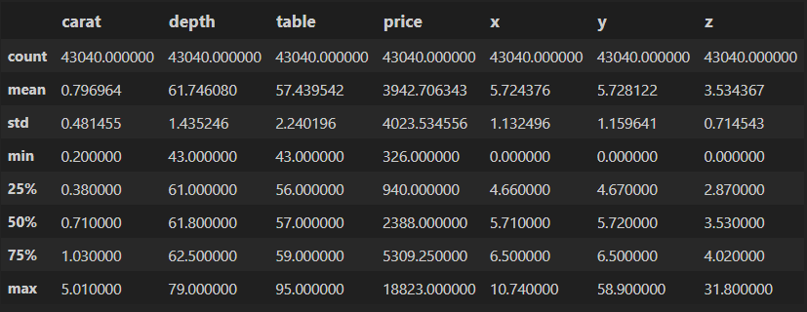
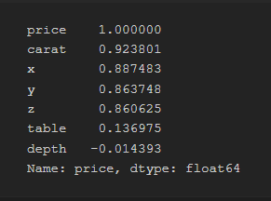
Before Working on Data
Before Working on data We used pandas and matplotlib to get an overview of the data and here’s some of the functions we used with their results:
diamond.info() diamond. describe() diamond.corr()

Slide 3
Before Working on Data
Here’s some notes about the previous data:
The data don’t have any null values in any column so we don’t need to drop rows or use any filling method
some of the attribute is well distributed around the mean (the standard deviation has a rational value) but some of them not.
If we look at the correlation between attribute we can see some interesting one such as ( carat ,x, y, z ) and other we can drop like the depth attribute.

Slide 4
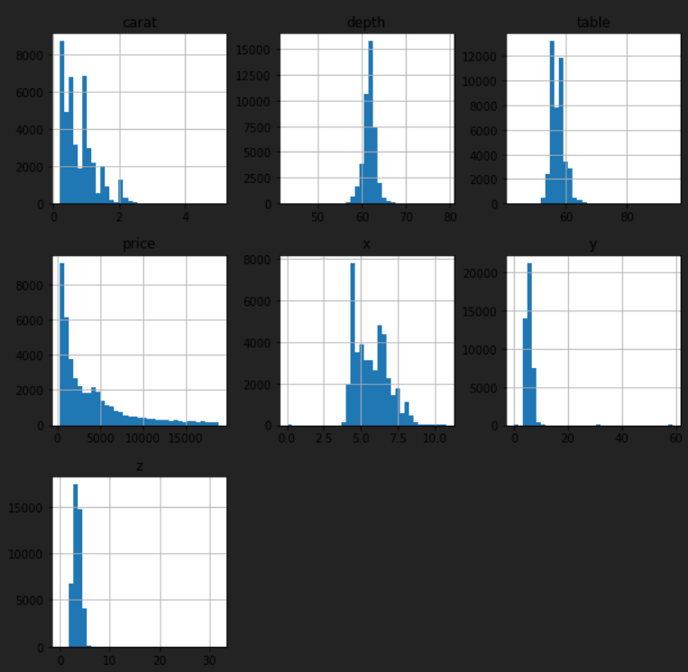
Data Analyzing
We used a couple of functions so we can understand the data more:
First we used diamond.hist() to know how the values of the attribute is distributed :

Slide 5
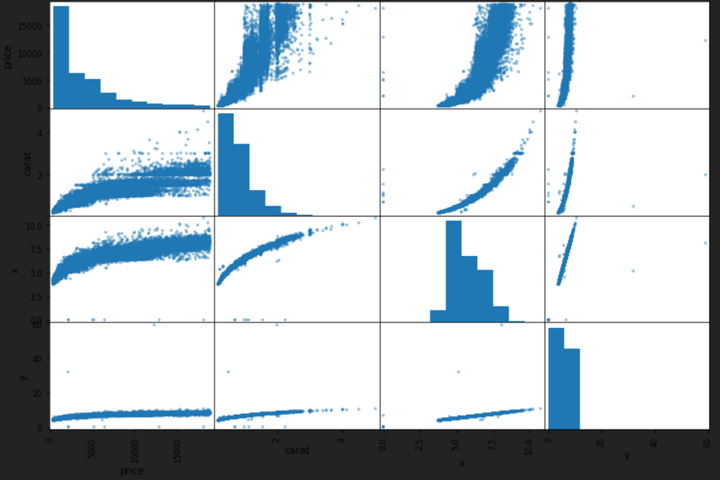
Data Analyzing
2. second we used scatter_matrix to get a closer look on the correlation between interesting attribute:

Slide 6
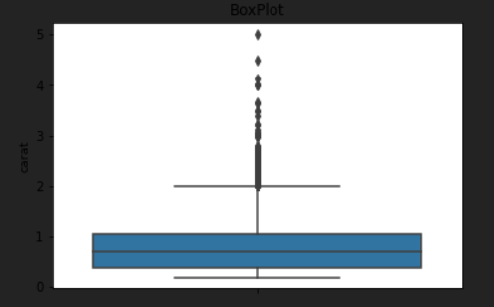
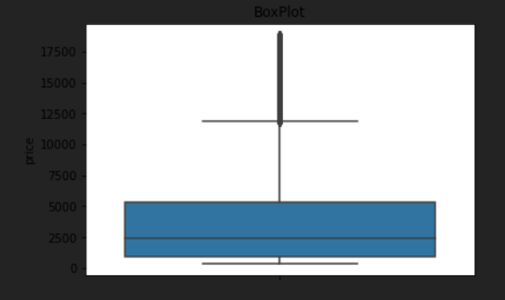
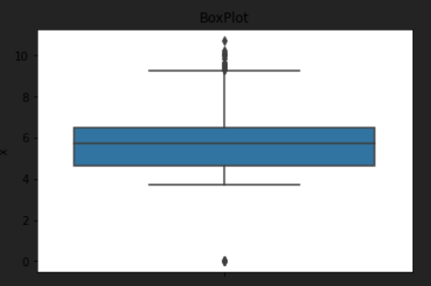
Data Analyzing
3. Boxplots for some features:
Carat
Price
X

Slide 7
Processing the Data
We Applied the following steps to process the data we used:
First We split the dataset to 3 subset “numerical data, categories need to be in order, categories don’t need to be in order:
We tried standard scalar on the numerical data
We used ordinal encoder on in order categories
We used one hot encoder on not in order categories
Then we reassembled the data again to one Data Frame
Finally we combined the x, y, z features to one feature we named volume

Slide 8
Preparing the Data
To prepare the data we did the following:
We dropped the index column and storing the labels column(price)
2. we split the “train data” we have to ( x_train, x_test, y_train, y_test ) to evaluate the models and pick the best one to make the prediction on the “test data” .the shape of the data looks like this:

Slide 9
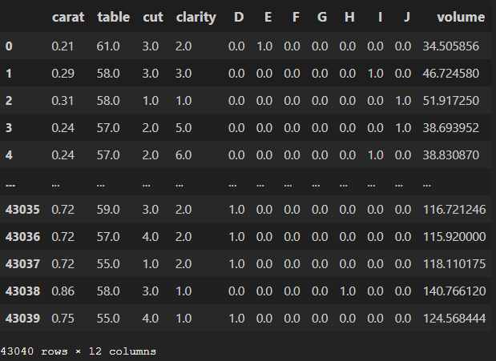
Preparing the Data

Slide 10
Training and Evaluate the Model
After a many attempts we found that Random Forest Regressor is the best model to use and we used three ways to evaluate it:
Using cross validation:
we splits the training set into 10 distinct subsets using cross
validation and the mean score was about 600$
2. Using mean_square_error:
we split the data using train_test_split function and after train the model on the train data we evaluated on the test data by MSE and the score was about 500$
3.Using r2score:
finally to know the accuracy of the model we used r2score with the
test data (x_test,y_test) and the accuracy was about 98.1%

Slide 11
The End

