Slide 1



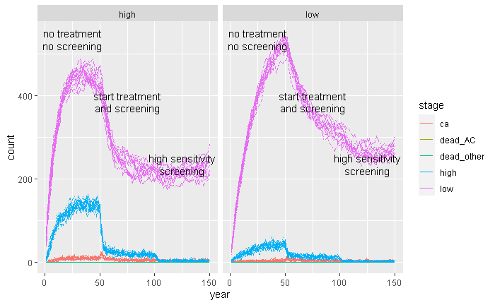
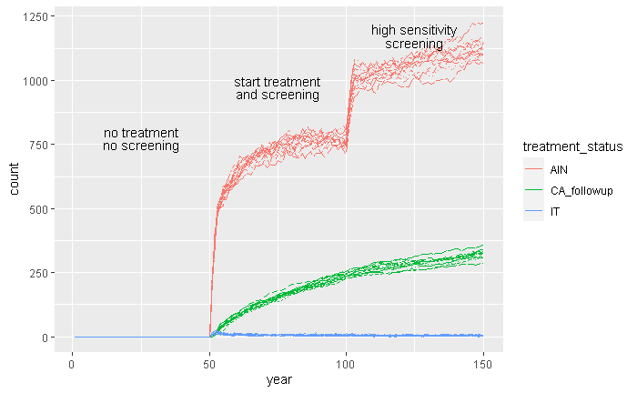


HRA IN ANAL HPV-RELATED CHANGES: OPTIMIZING TRAINING AND CARE
Maša Kušar MD PhD, Institute of Biostatistics and Medical Informatics, University of Ljubljana
Urška Kogovšek MD, Department of Abdominal Surgery, UMC Ljubljana
Intro
HRA offers improved sensitivity in detecting HSIL, which leads to an increased number of patients requiring care
actual numbers vary according to risk factors within the population and screening strategy
increase in patient interactions may overwhelm even the most affluent healthcare settings
Monte Carlo simulation can be used to estimate changes in patient flow when risk factors and screening methods change.
Take a picture to see
the simulation code.
Extra Tables & Figures:
Conclusions
improved screening leads to better results for patients, but increases the burden on the healthcare system
Monte Carlo simulations can be used to anticipate these effects ahead of time
modelling different risk groups by varying population parameters
modelling screening strategies by varying screening parameters
finding an appropriate balance before implementing changes to guidelines
identifying appropriate modifications for specific settings
Methods
set of assumptions about disease progression
two screening strategies
progression assumptions and screening strategy can be altered as needed
Monte Carlo simulation gives a range of possible outcomes
Results
In the sample case a more sensitive screening method led to:
- increased number of patients with known disease
- increased number of required patient encounters
- decreased number of patients with active disease

