Slide 1
進捗報告
04/13(火)
熊田 匡仁

Slide 2
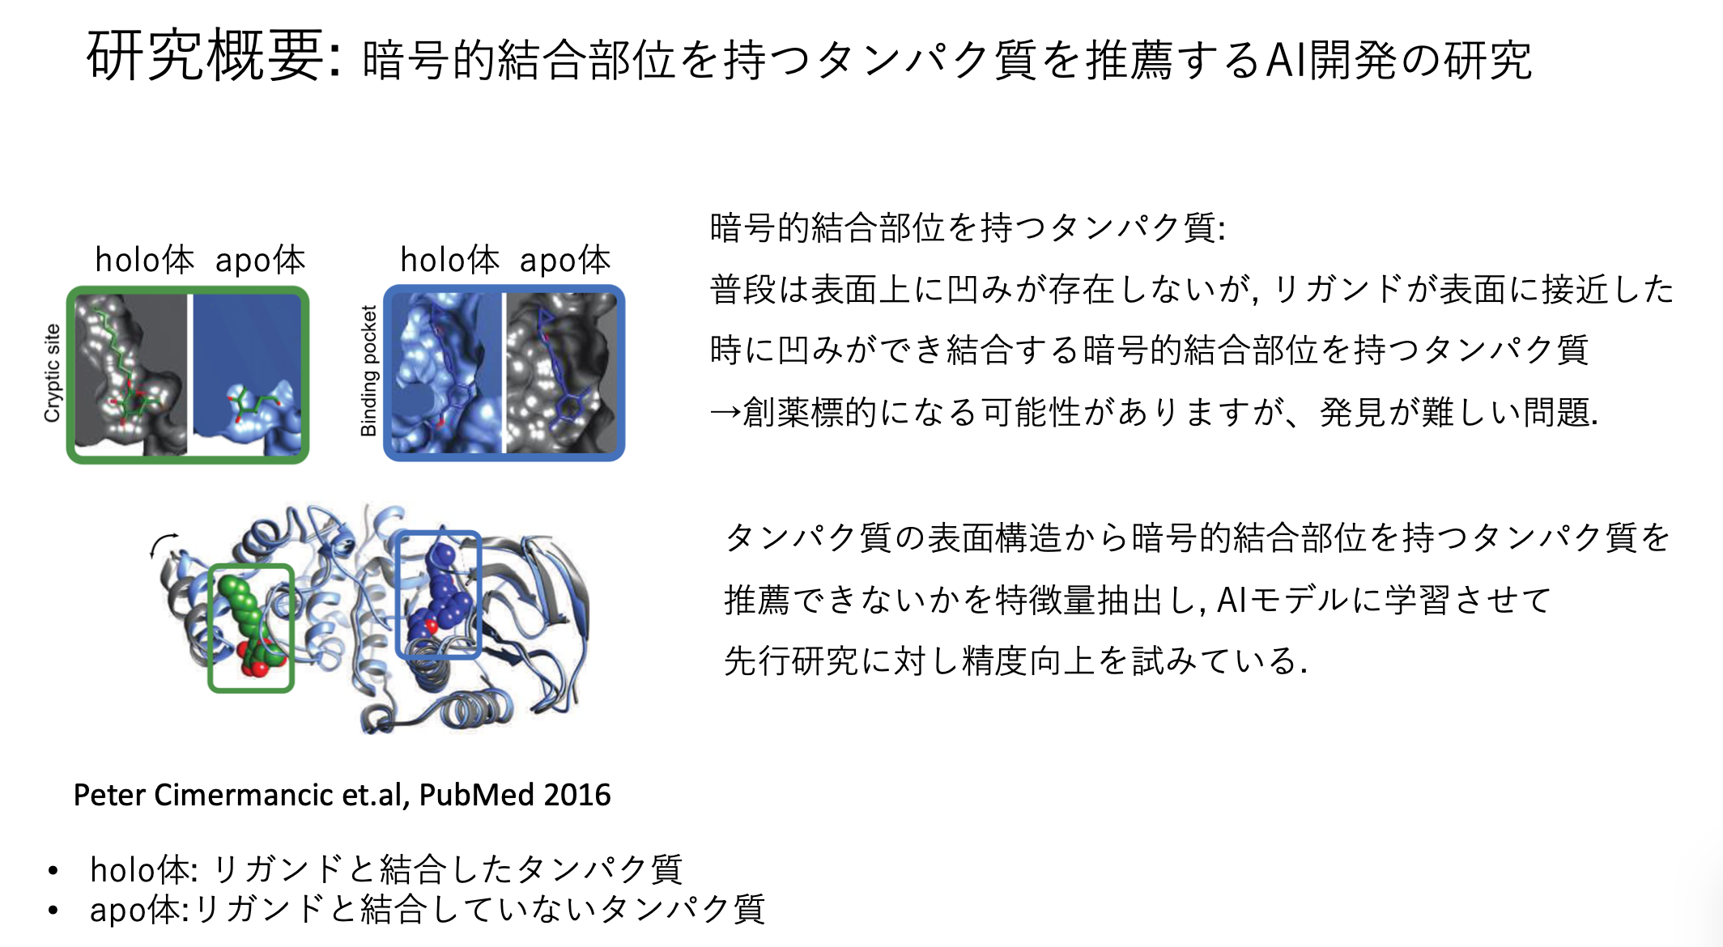

Slide 3
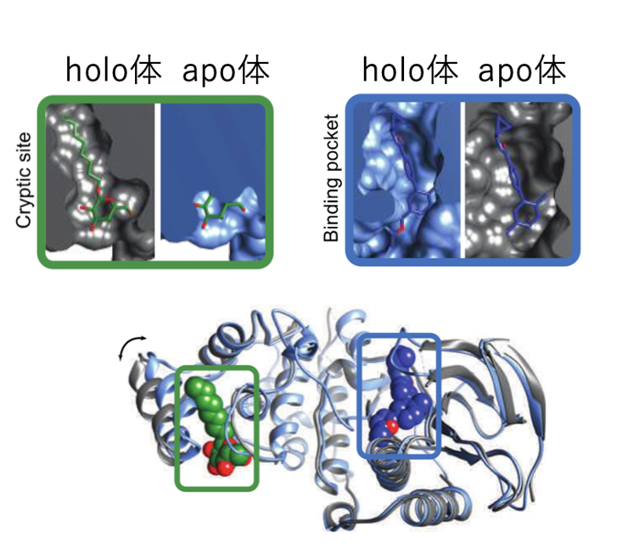
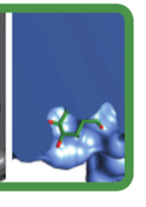
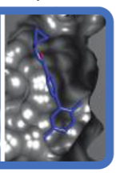
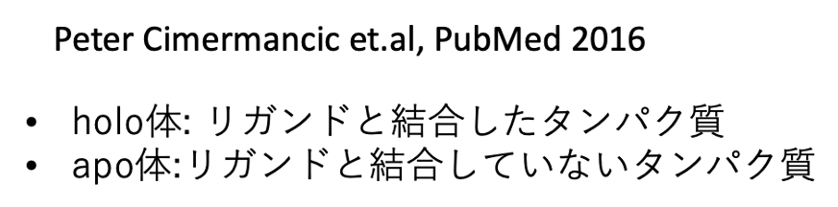
今やっていること
apo体
apo体
Cryptic Binding Site
Normal Binding Site
個数： 150 152

Slide 4
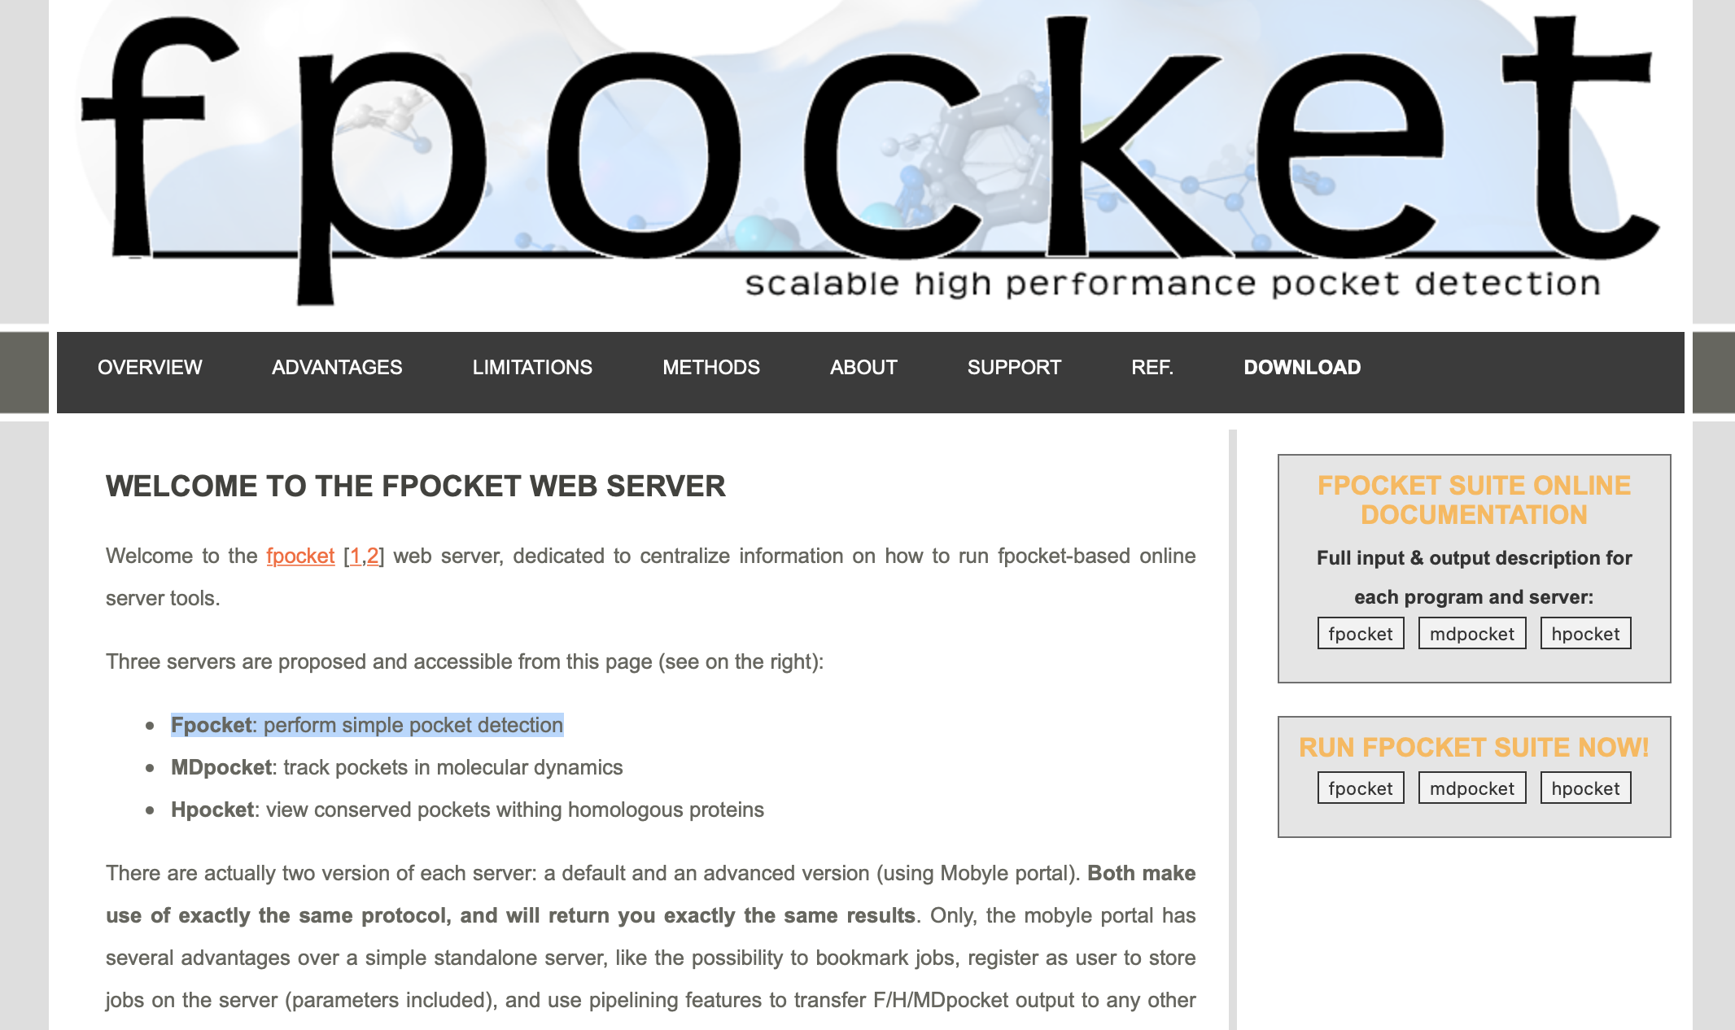

Slide 5
データ収集とデータセット作成
PDB Name,
Score,Druggability Score,
Number of Alpha Spheres,
Total SASA,
Polar SASA,
Apolar SASA,
Volume,
Mean local hydrophobic density,
Mean alpha sphere radius,
Mean alp. sph. solvent access,
Apolar alpha sphere proportion,
Hydrophobicity score,
Volume score,
Polarity score,
Charge score,
Proportion of polar atoms,
Alpha sphere density,
Cent. of mass - Alpha Sphere max dist,
Flexibility,
cryptic pocket flag
Cryptic Binding Site
Nomal Binding Site
78種類のタンパク質から
Fpocketを用いて計150の
ポケットの特徴量を作成
126種類のタンパク質から
Fpocketを用いて計152の
ポケットの特徴量を作成

Slide 6
各特徴量の比較（ヒストグラム）

Slide 7
各特徴量の比較（ヒストグラム）

Slide 8
モデルとデータについて
モデル：
Xgboost と LightGBM を0.5:0.5で重み付けしたアンサンブル学習
データ：
全データ約300, 教師データとテストデータを8:2で分割し, 交差分割法（k-stratified, 2分割）で学習
評価指標：
F1_macro

Slide 9
学習
Xgboost LightGBM
[0] validation_0-logloss:0.64084
[10] validation_0-logloss:0.39870
[20] validation_0-logloss:0.31049
[30] validation_0-logloss:0.27878
[40] validation_0-logloss:0.27087
[50] validation_0-logloss:0.26077
[60] validation_0-logloss:0.25328
[70] validation_0-logloss:0.25174
[80] validation_0-logloss:0.25055
[90] validation_0-logloss:0.24715
[100] validation_0-logloss:0.24558
[110] validation_0-logloss:0.24591
[111] validation_0-logloss:0.24595
fit fold=1 0.225[s]
Fold 0 F1_MACRO: 91.62946428571428
[0] validation_0-logloss:0.64323
[10] validation_0-logloss:0.41320
[20] validation_0-logloss:0.33093
[30] validation_0-logloss:0.29463
[40] validation_0-logloss:0.27582
[50] validation_0-logloss:0.27480
[60] validation_0-logloss:0.26337
[68] validation_0-logloss:0.26485
fit fold=2 0.142[s]
Fold 1 F1_MACRO: 87.3949579831933
FINISHED | Whole F1_MACRO: 89.5280
[10] valid_0's binary_logloss: 0.452674
[20] valid_0's binary_logloss: 0.351476
[30] valid_0's binary_logloss: 0.320377
[40] valid_0's binary_logloss: 0.281119
[50] valid_0's binary_logloss: 0.262199
[60] valid_0's binary_logloss: 0.249083
[70] valid_0's binary_logloss: 0.235701
[80] valid_0's binary_logloss: 0.236241
[90] valid_0's binary_logloss: 0.232907
[100] valid_0's binary_logloss: 0.227977
Early stopping, best iteration is:
[99] valid_0's binary_logloss: 0.226214
fit fold=1 0.172[s]
Fold 0 F1_MACRO: 93.30357142857143
Fold 0 F1_MACRO: 93.30357142857143
Training until validation scores don't improve for 10 rounds
[10] valid_0's binary_logloss: 0.446281
[20] valid_0's binary_logloss: 0.333503
[30] valid_0's binary_logloss: 0.29055
[40] valid_0's binary_logloss: 0.292851
Early stopping, best iteration is:
[37] valid_0's binary_logloss: 0.286303
fit fold=2 0.074[s]
Fold 1 F1_MACRO: 86.54607122668175
FINISHED | Whole F1_MACRO: 89.9538

Slide 10
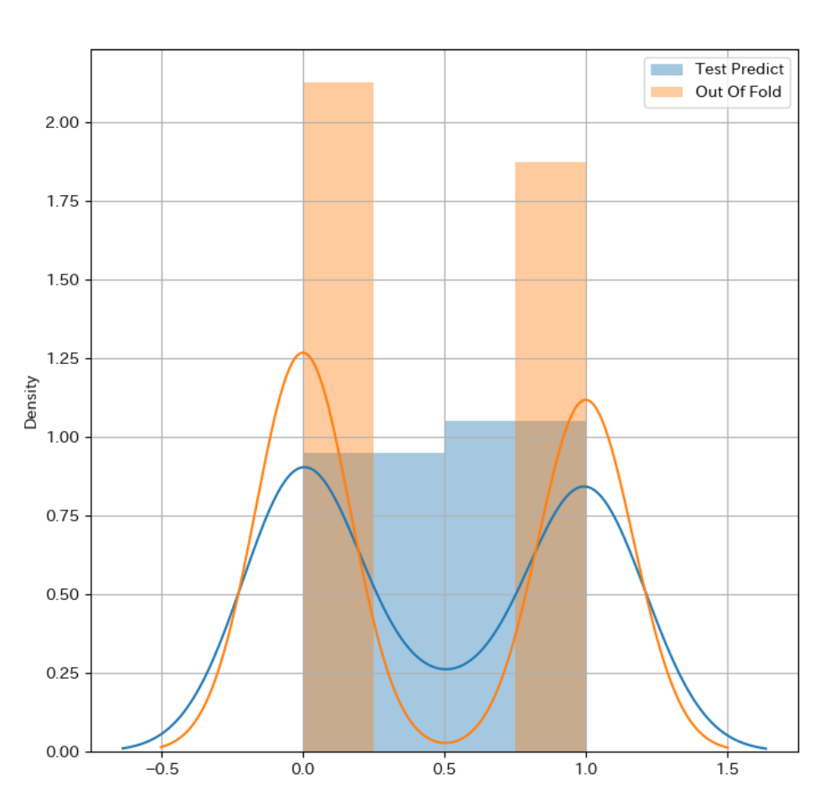
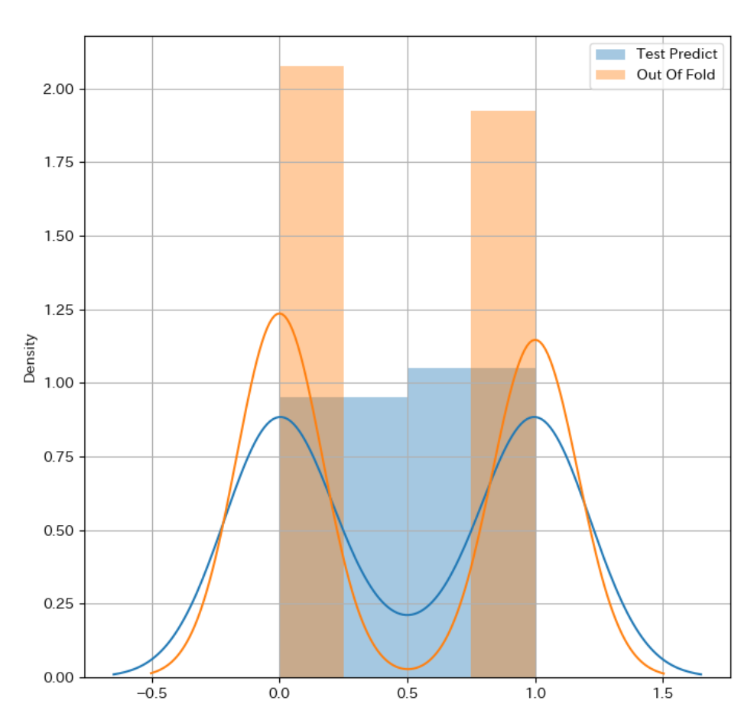
結果
学習はできているようだ.
Xgboost
LightGBM

Slide 11
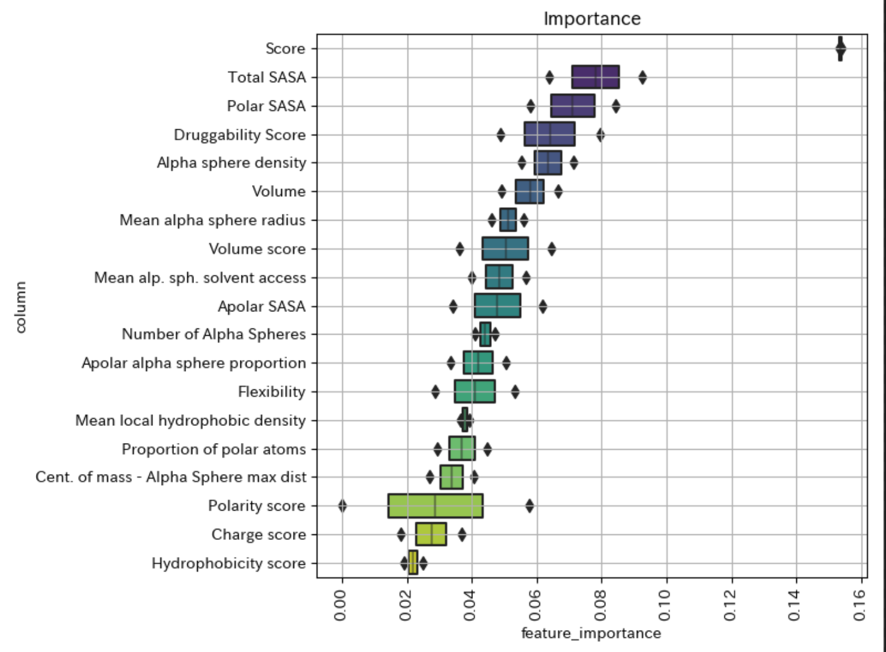
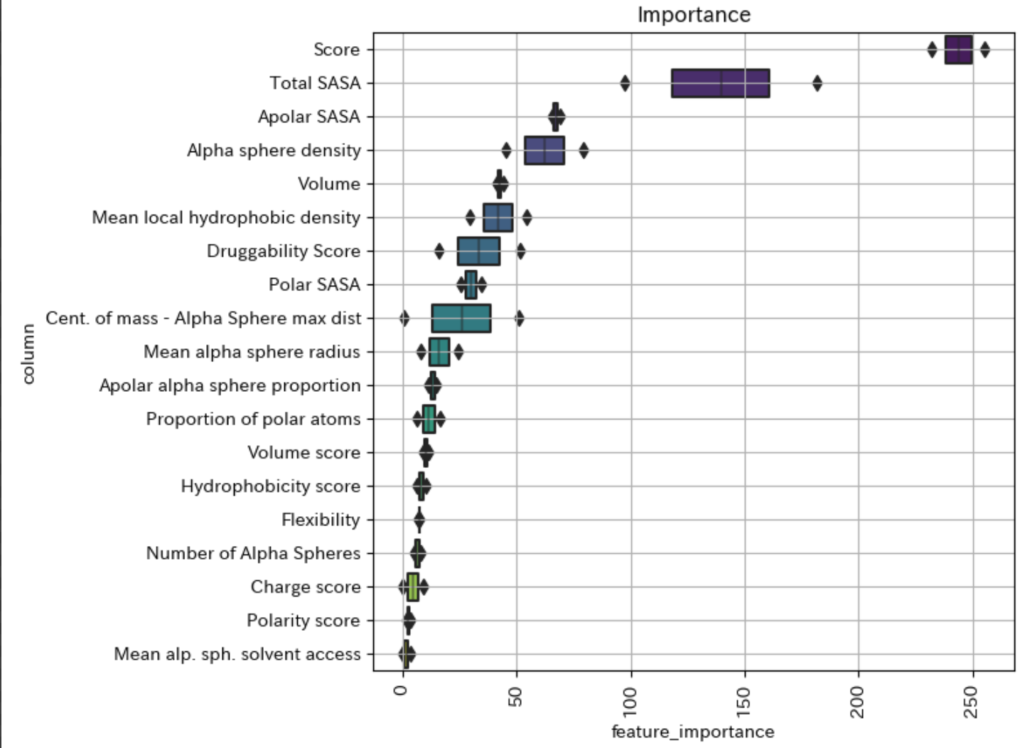
結果
F1_macro: 88.51
Xgboost
LightGBM

