Slide 1
09.28進捗
熊田 匡仁

Slide 3
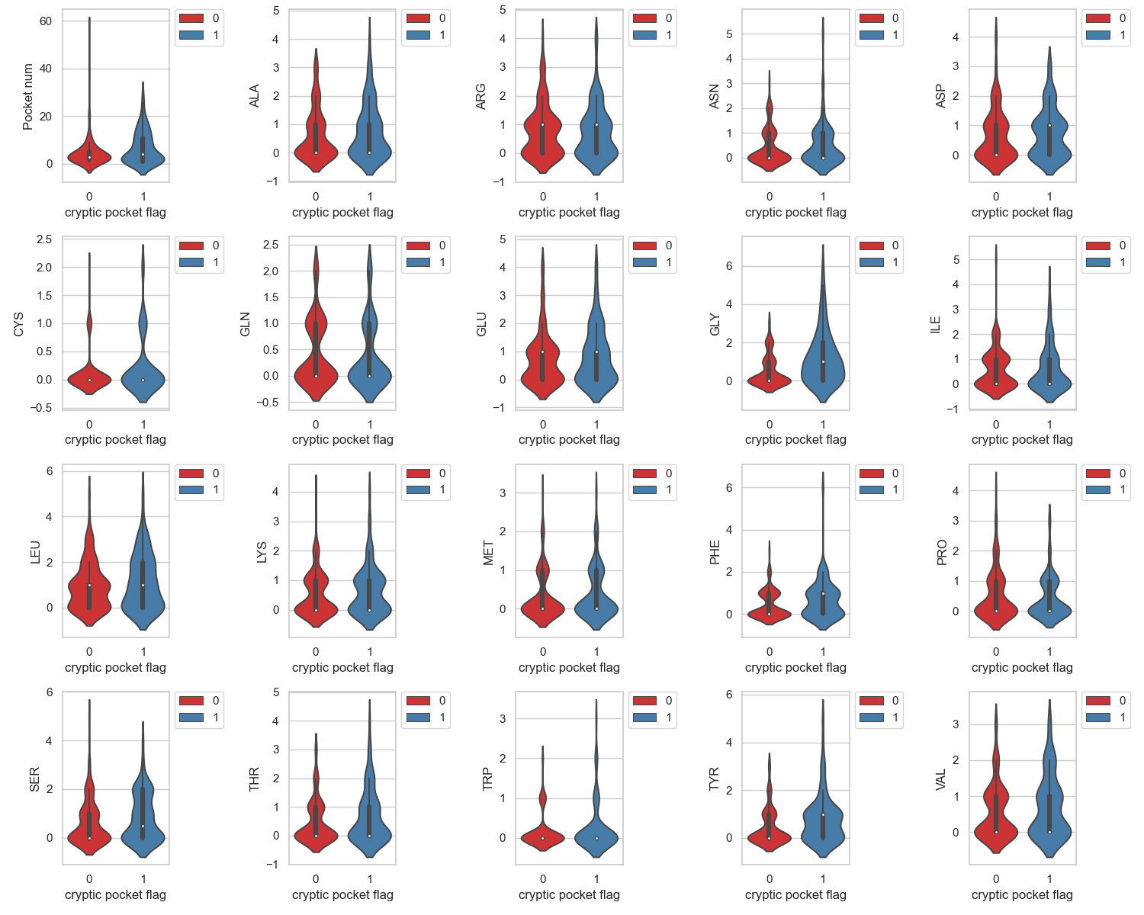

Slide 4
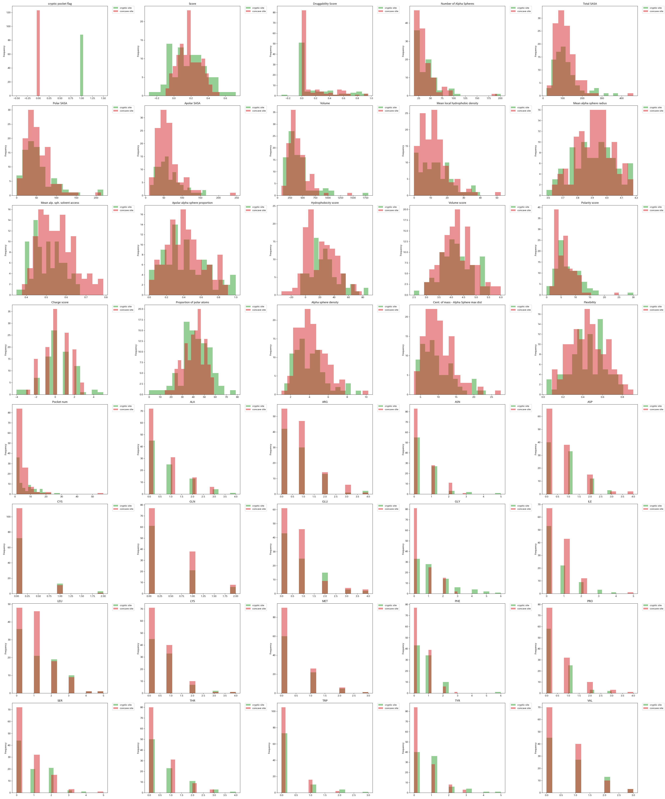
アルファ球近傍(5Å)の残基のヒストグラム

Slide 5
column name: GLY, p value: 0.00038
column name: TYR, p value: 0.00757

Slide 6
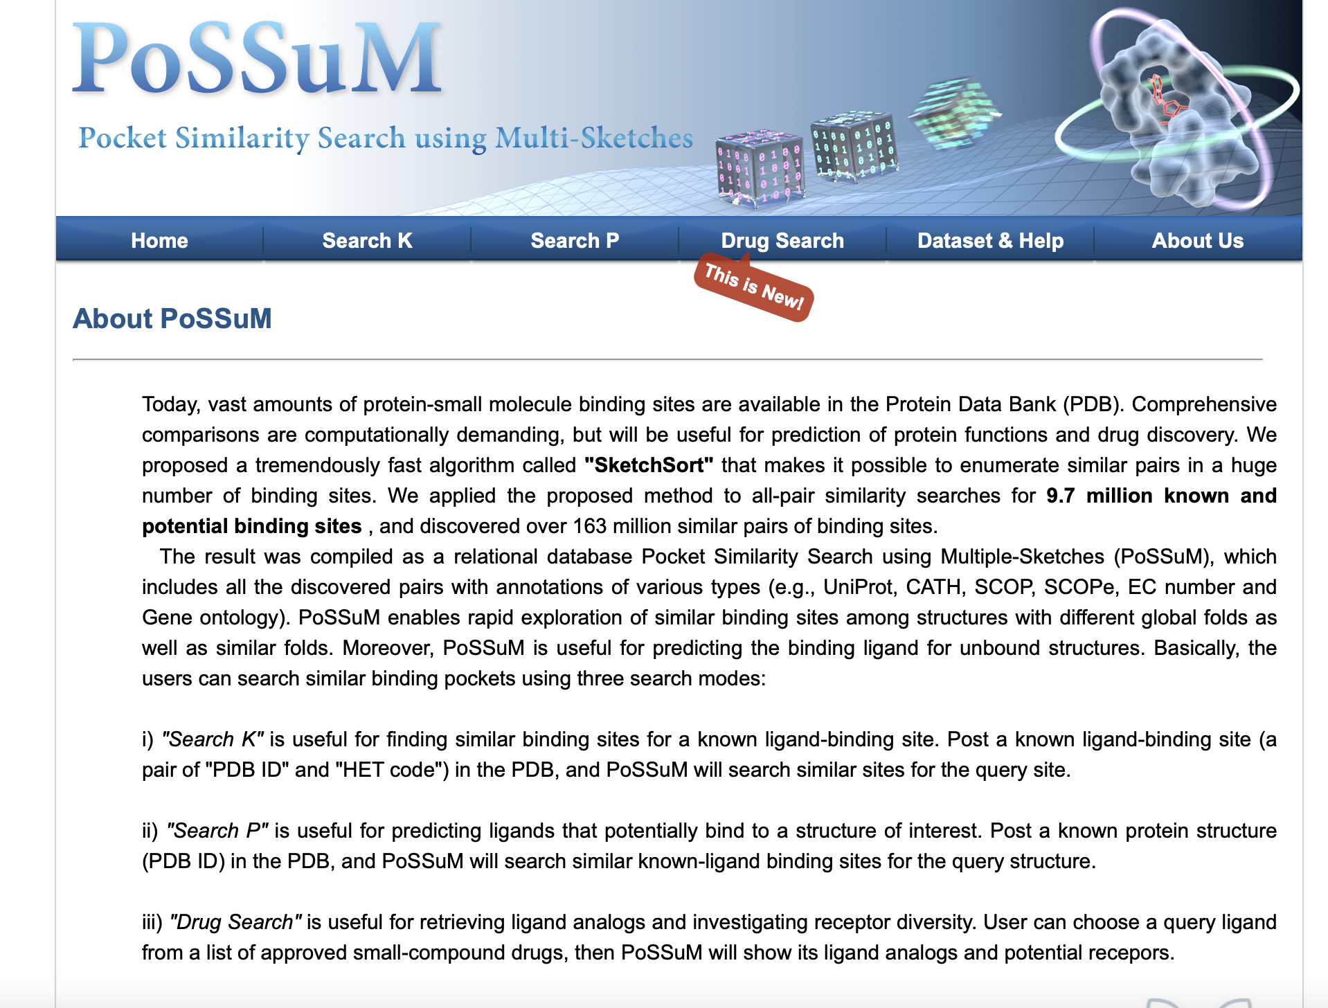
Pocket Similarity Search using Multi-Sketches

Slide 7
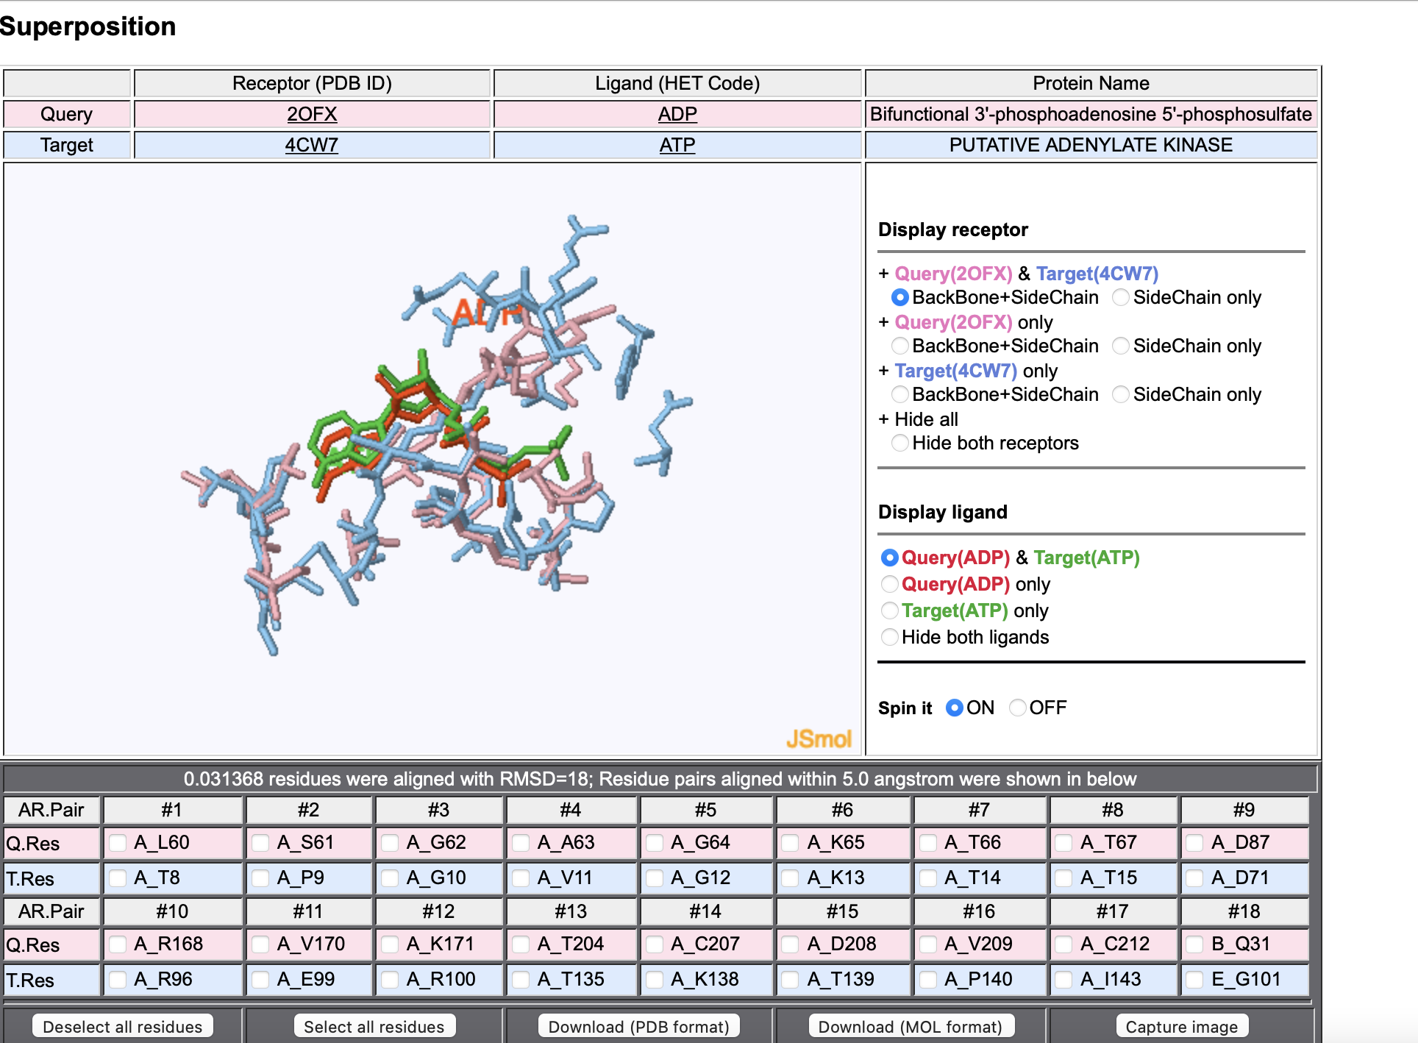
Pocket Similarity Search using Multi-Sketches

Slide 8
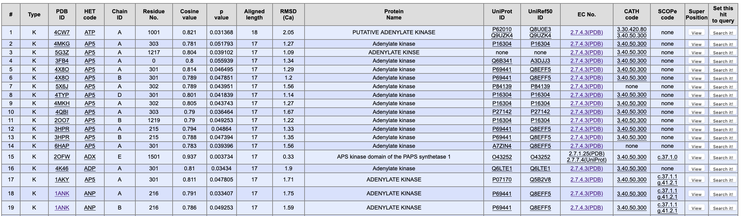
Pocket Similarity Search using Multi-Sketches

