Slide 1
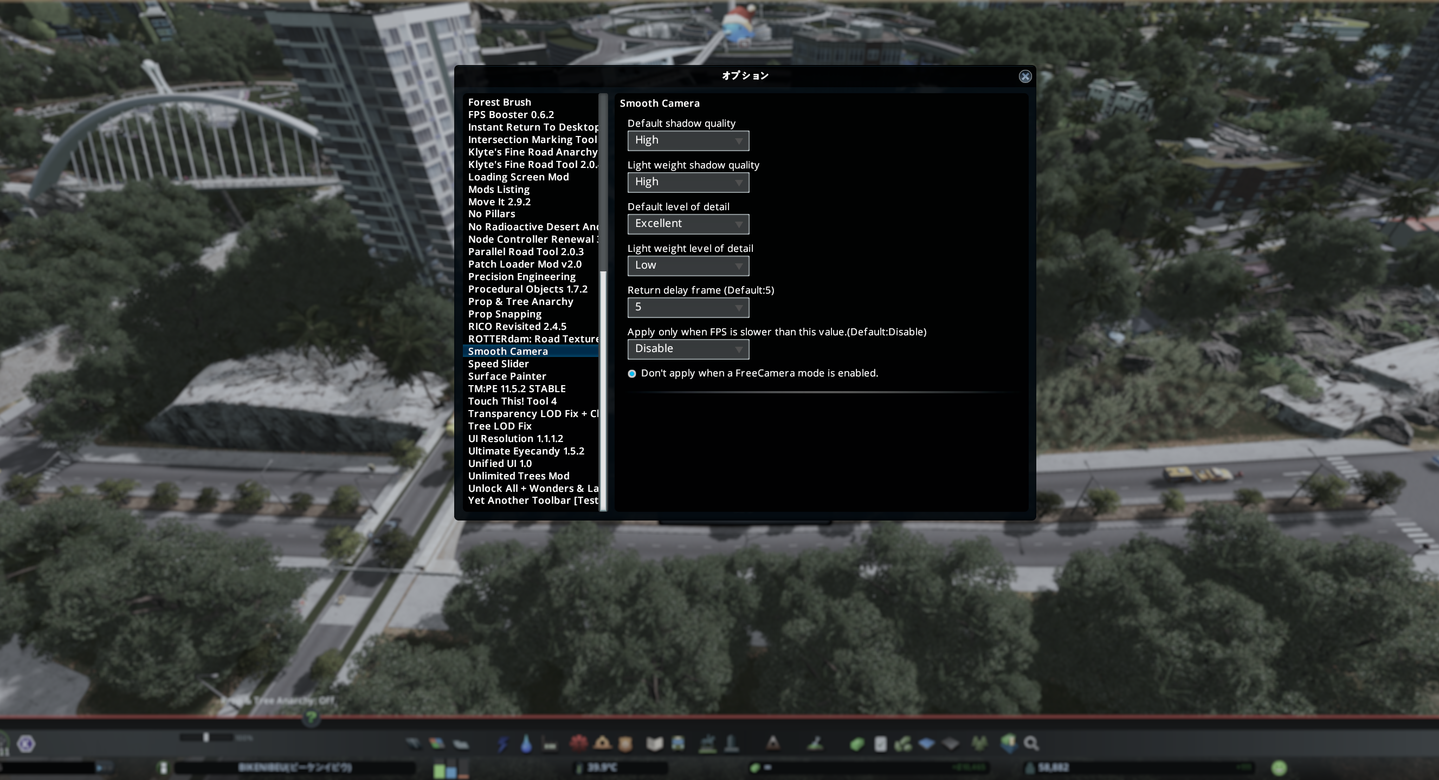
Shadow quality when camera is stopped.
Shadow quality when camera is moving.
Object LOD quality when camera is stopped.
Object LOD quality when camera is moving.

