Slide 1

SYSTEM MODELLING AND DESIGN
Presentation By
GROUP 3
CEF440 - Internet & Mobile Programming
Instructor - Dr Valery Nkemeni
Academic Year: 2024/2025

Slide 2
INTRODUCTION
Purpose: Translate requirements into structured visual system representations.
Key Models: Context, Dataflow, Use Case, Sequence, Class, Deployment diagrams.
Goals: Clarify system functionality, guide implementation, improve scalability.

Slide 3
System Modelling vs System Design
Modelling:
What system does, user interaction, data usage
Includes: Use Case, Context, Dataflow, Class diagrams
Design:
How system is implemented (structure, interactions, deployment)
Includes: Sequence, Deployment, Class diagrams

Slide 4
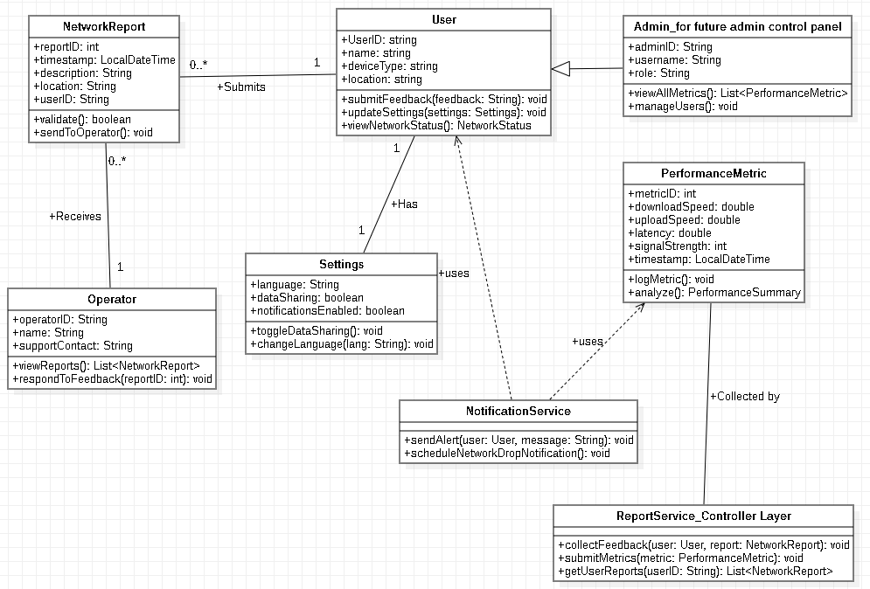
Class Diagram Overview
Definition: Shows classes, attributes, operations, and relationships
Importance: Blueprint for coding, aids communication and scalability
Key Classes:
User, NetworkReport, PerformanceMetric, Settings, Operator, Admin, ReportService, NotificationService

Slide 5
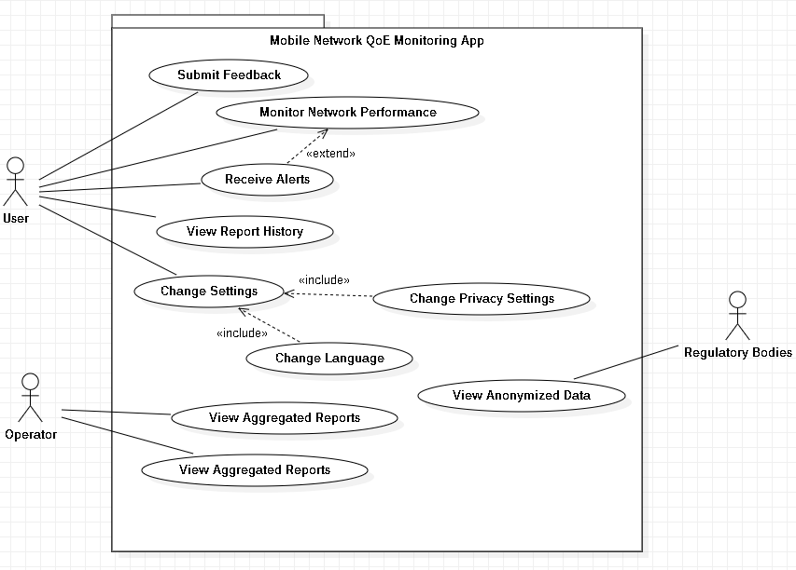
Use Case Diagram
Overview
Definition: Shows user interactions and system functionalities
Importance: Clarifies user needs and system scope
Main Actors: User, Network Operator, Regulatory Authority
Key Use Cases: Submit Feedback, Monitor Performance, View Reports, etc.
Use Case Relationships
Actor → Use Case associations
Use Case → Use Case:
Extend: e.g., Monitor → Receive Alerts
Include: e.g., Change Settings → Language, Privacy
Respond to Reports

Slide 6
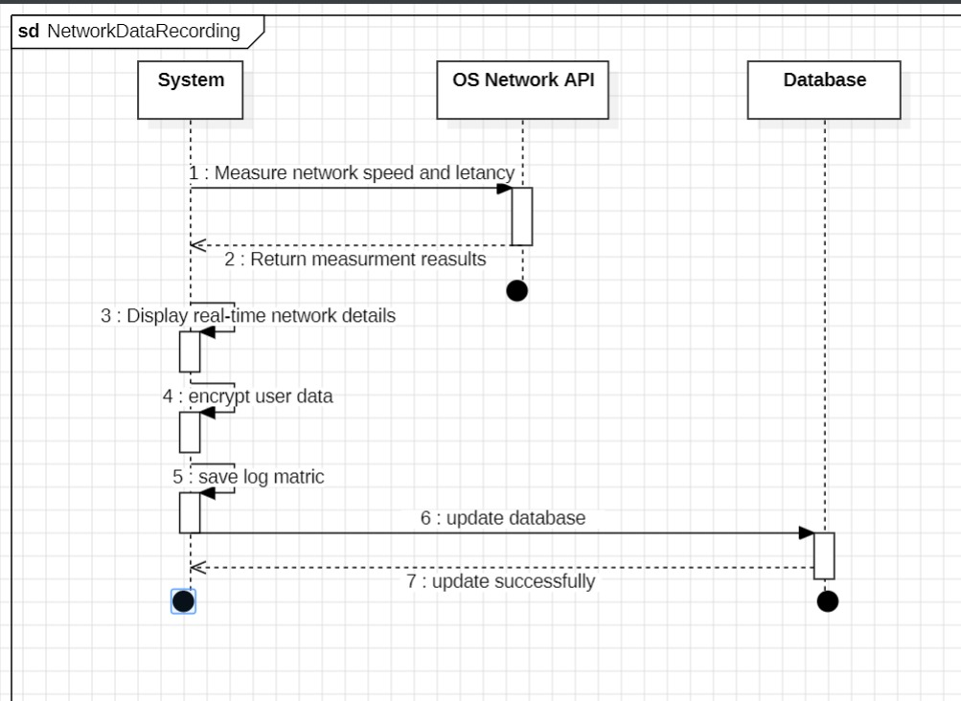
Sequence Diagram
Overview
Purpose: Visualize flow of operations over time
Benefits: Clarifies task logic and timing, supports integration
Network Data Recording
System measures and logs speed, latency
Uses OS APIs, encrypts data, updates DB
Supports real-time analysis and visualization

Slide 7
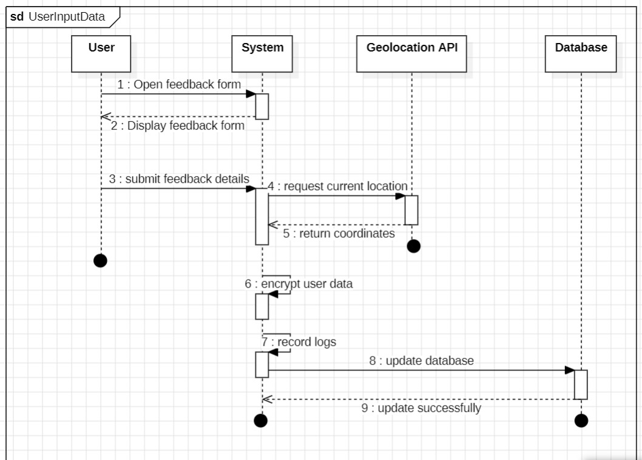
User Input Data
Processing
Feedback form interaction
Captures feedback + location
Encrypts and stores in DB, sends confirmation
Security & Performance
Security: TLS 1.2+, AES-256, key management
Performance: Minimize network load, fast feedback, efficient DB writes

Slide 8
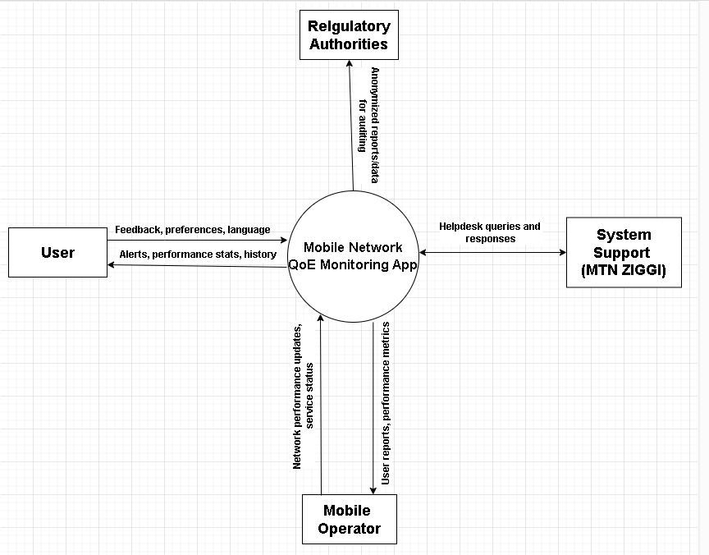
Context Diagram
Overview
Shows system boundary, external actors, data flows
Actors: User, Operator, Regulator, Support System
Data exchanged: feedback, reports, alerts, preferences

Slide 9
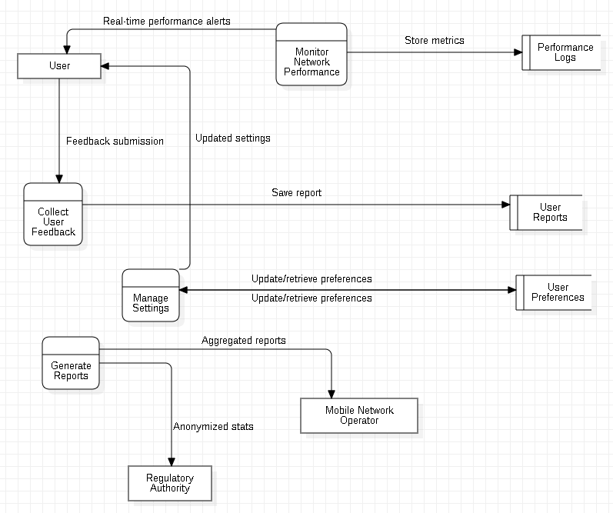
Data Flow Diagram (DFD) Overview
Shows processes, data stores, and flows
Key Processes: Monitor, Feedback, Settings, Reports
Data Stores: Reports, Logs, Preferences

Slide 10
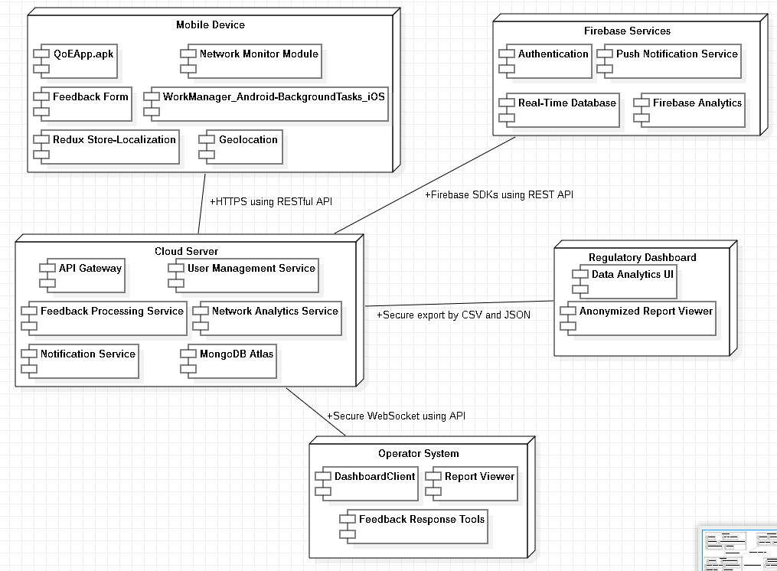
Deployment Diagram Overview
Shows physical setup: devices, software, connections
Nodes: Mobile Device, Cloud Server, Firebase, Operator System, Regulator
Communication: HTTPS, Firebase SDK, WebSockets, Exports

Slide 11
Conclusion
Modelling bridges requirements and implementation
Diagrams ensure clarity, support devs, align stakeholder vision
Foundation for a robust QoE Monitoring App

