Slide 1
Does Real Madrid overperform in the UCL knockout stages?
Stat 143 final project
Spring 2021

Slide 2


Slide 3
Contents
Collect data about matches.
Build a model for predicting results.
Train the model on 5 seasons.
Run the model for the next 5 seasons, record the difference between the expected and actual outcome for Real Madrid, for both UCL knockouts and the rest of the matches.
Perform Hypothesis testing.

Slide 4
Contents
Collect data about matches.
Build a model for predicting results.
Train the model on 5 seasons.
Run the model for the next 5 seasons, record the difference between the expected and actual outcome for Real Madrid, for both UCL knockouts and the rest of the matches.
Perform Hypothesis testing.

Slide 5
The Data
Top Seven Leagues (England, Spain, Italy, France, Germany, Netherlands, Portugal) for the last ten seasons:
https://www.football-data.co.uk/data.php
Champions League and Europa League for the last ten seasons:
https://fbref.com/en/
Provided by Professor Shaw.

Slide 6
Contents
Collect data about matches.
Build a model for predicting results.
Train the model on 5 seasons.
Run the model for the next 5 seasons, record the difference between the expected and actual outcome for Real Madrid, for both UCL knockouts and the rest of the matches.
Perform Hypothesis testing.

Slide 7
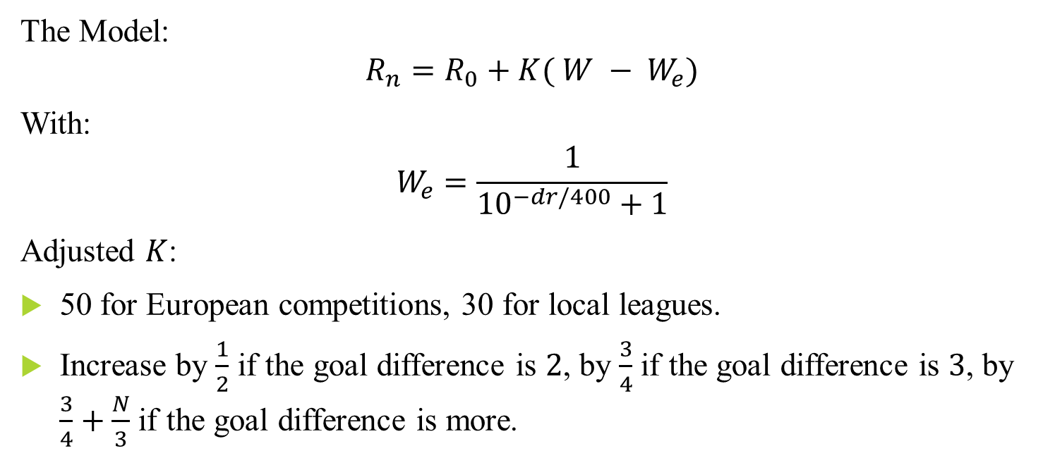
Predicting The Results: ELO Ratings
The Model:
$$R_{n}=R_{0}+K( W − W_{e})$$
With:
$$W_{e}=\frac{1}{{10}^{−dr/400}+1}$$
Adjusted $K$:
50 for European competitions, 30 for local leagues.
Increase by $\frac{1}{2}$ if the goal difference is $2$, by $\frac{3}{4}$ if the goal difference is $3$, by $\frac{3}{4}+\frac{N}{3}$ if the goal difference is more.

Slide 8
Contents
Collect data about matches.
Build a model for predicting results.
Train the model on 5 seasons.
Run the model for the next 5 seasons, record the difference between the expected and actual outcome for Real Madrid, for both UCL knockouts and the rest of the matches.
Perform Hypothesis testing.

Slide 9
Contents
Collect data about matches.
Build a model for predicting results.
Train the model on 5 seasons.
Run the model for the next 5 seasons, record the difference between the expected and actual outcome for Real Madrid, for both UCL knockouts and the rest of the matches.
Perform Hypothesis testing.

Slide 10

Hypothesis Testing: T-test
Are the two sets of samples drawn from the same distribution?
$$p=0.032$$
Simple answer: No.

Slide 11
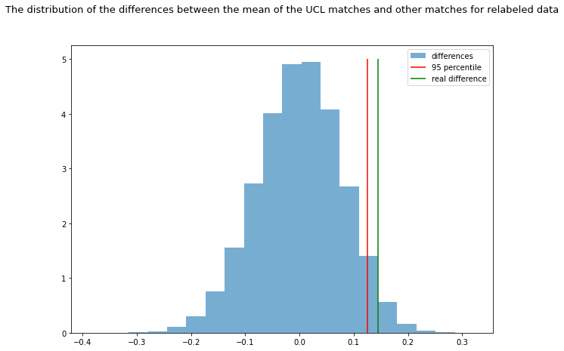

Hypothesis Testing: Permutation test
The distribution of the differences between the mean of the UCL matches and other matches for relabeled data
For how many permutations do we get the same or larger difference?
$$p=0.02794$$
Distribution
Difference

Slide 12
Conclusions
We got a statistical significance: It looks like Real Madrid does overperform in the UCL knockout stages.

Slide 13
Questions?

