Slide 1
Models of Infectious Diseases (I) <Last Updated on October 8, 2020>
Taisuke Nakata
Graduate School of Public Policy
University of Tokyo

Slide 2
Outline
(1) SI Model
(2) SIS Model
(3) SIR Model

Slide 3
Key takeaways from this lecture
Our first look at mathematical models to help better understand reality.
These are not economic models, but share many similarities with them.
In particular,
Find “steady states.”
Compute “dynamics”
Convergence towards a steady state,
Analyze the effect of exogenous shocks.
Analyze “welfare.”

Slide 4
Outline
(1) SI Model
(2) SIS Model
(3) SIR Model

Slide 5

SI Model
Susceptible
$$γ$$
Infected

Slide 6
SI Model
HIV, Herpes, etc.
Once you get infected, there is no treatment.
A backward-looking model (easy to solve)
Not optimization based.

Slide 7
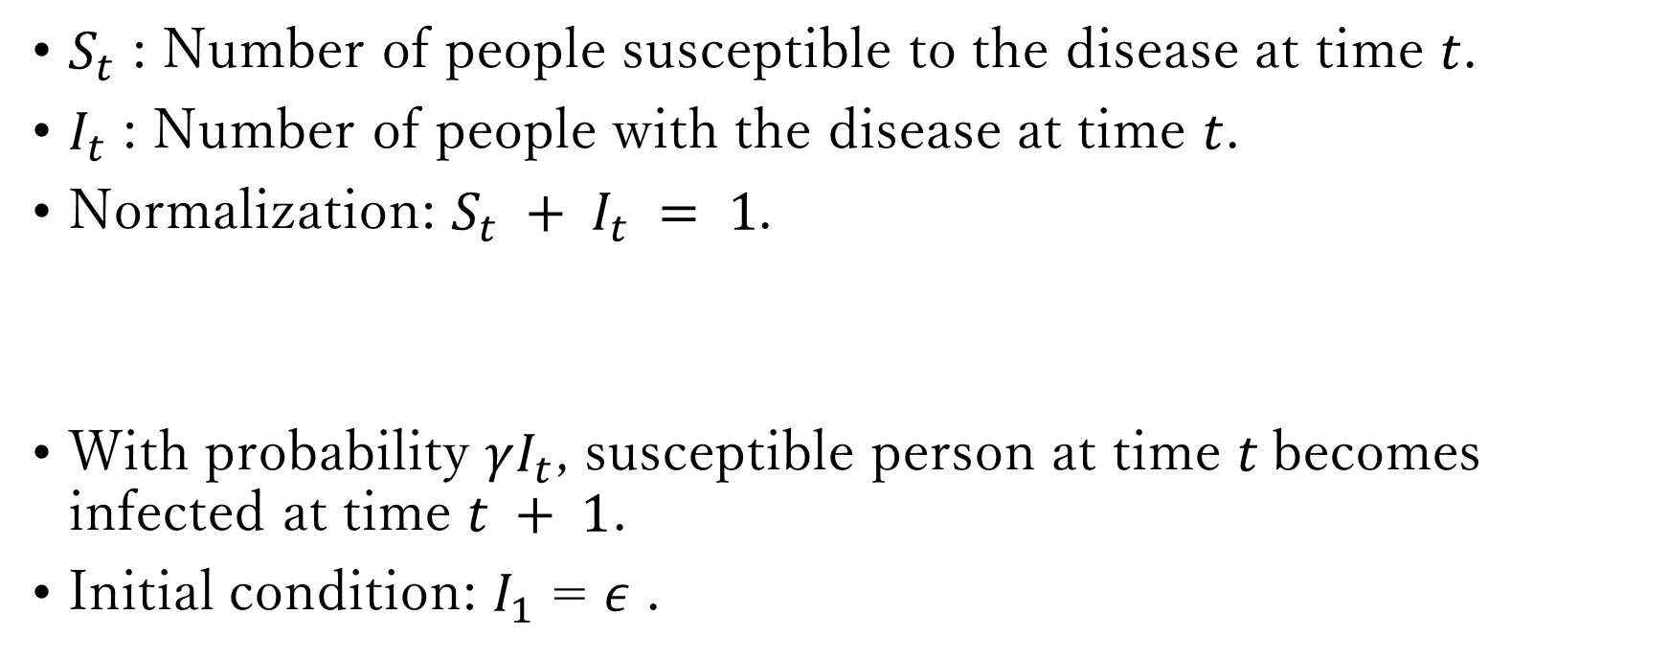
$S_{t}$ : Number of people susceptible to the disease at time $t$.
$I_{t}$ : Number of people with the disease at time $t$.
Normalization: $S_{t} + I_{t} = 1$.
With probability $γI_{t}$, susceptible person at time $t$becomes infected at time $t + 1$.
Initial condition: $I_{1}$ = $ε$ .

Slide 8

$S_{t+1}−S_{t}=−γI_{t}S_{t}$
$I_{t+1}−I_{t}=γI_{t}S_{t}$
$S_{t} + I_{t} = 1$

Slide 9

Find “steady states.”
A steady state is where $X_{t+1}=X_{t}$ for any variable $X$in the model.
Let $X_{ss}$ denote a steady state of $X$.
At a steady state of SI model, we have
$S_{ss}−S_{ss}=−γI_{ss}S_{ss}$
$I_{ss}−I_{ss}=γI_{ss}S_{ss}$
$S_{ss} + I_{ss} = 1$

Slide 10

Thus, at a steady state, we have
$0=−γI_{ss}S_{ss}$
$0=γI_{ss}S_{ss}$
$S_{ss} + I_{ss} = 1$
The first two equations are the same in the sense that, if one is satisfied, the other is also satisfied.
Eliminate $S_{ss}$ to obtain
$0=γI_{ss}(1−I_{ss})$

Slide 11
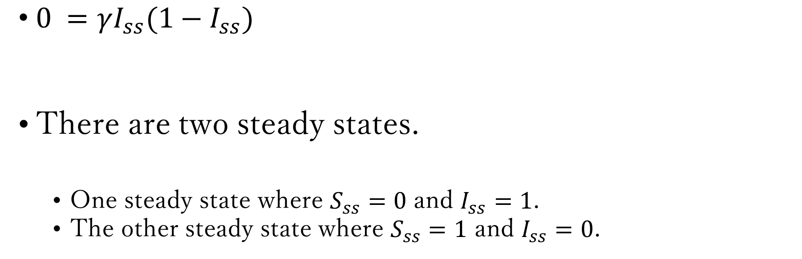
$0 =γI_{ss}(1−I_{ss})$
There are two steady states.
One steady state where $S_{ss}=0$ and $I_{ss}=1$.
The other steady state where $S_{ss}=1$ and $I_{ss}=0$.

Slide 12
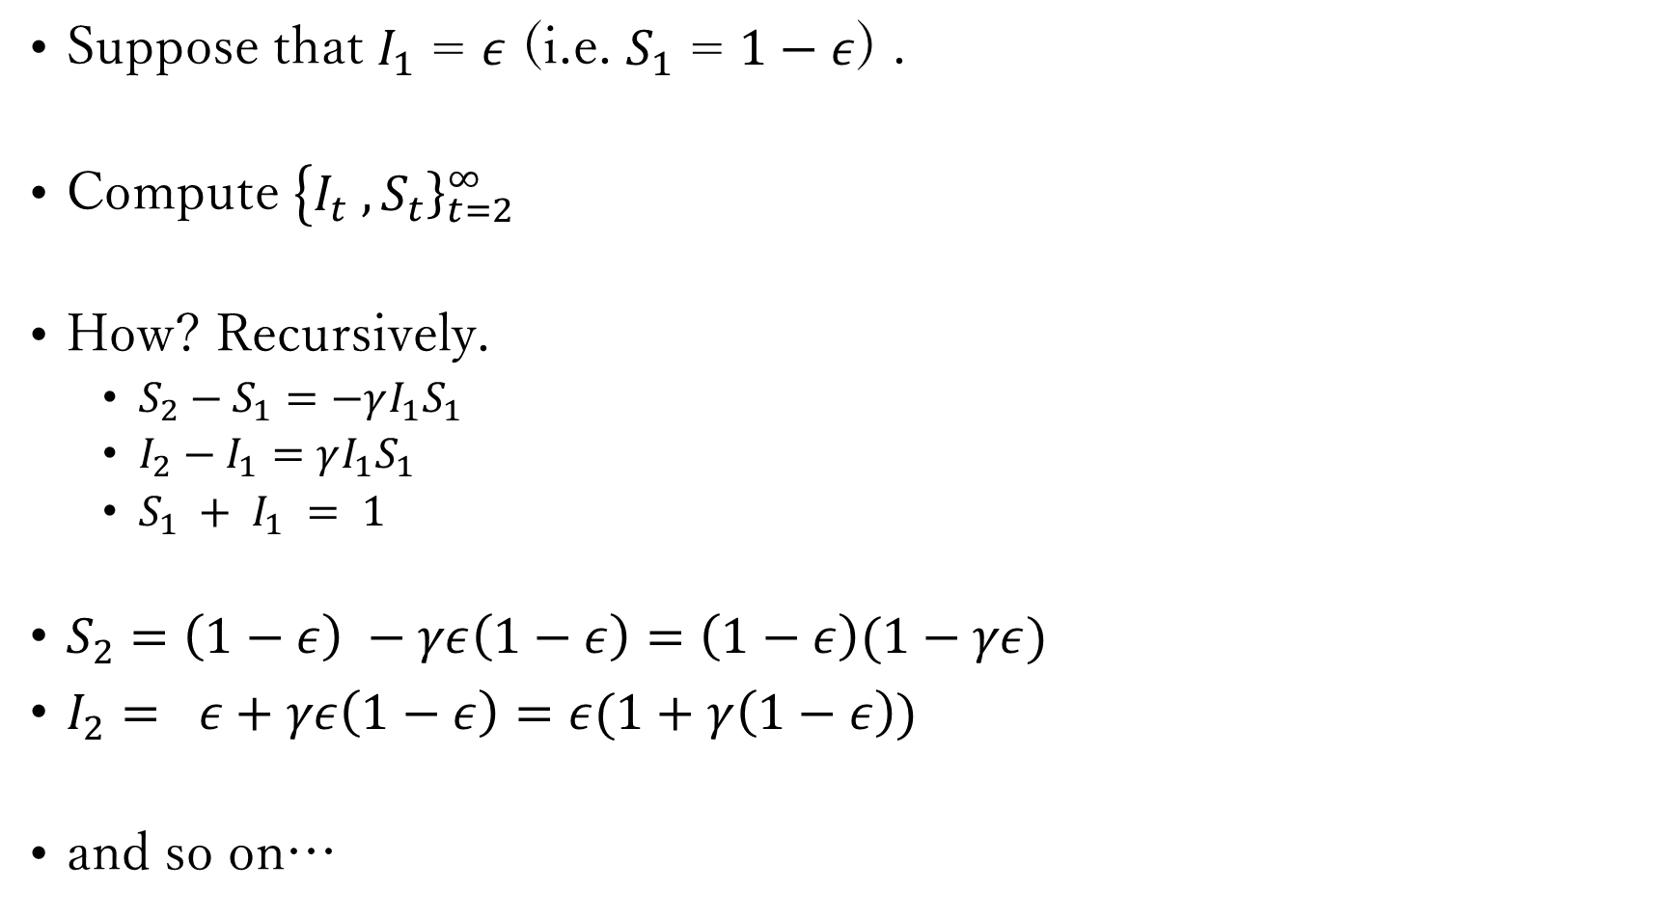
Compute “dynamics” (convergence to steady state)
Suppose that $I_{1}$ = $ε$ (i.e. $S_{1}$ = $1−ε$) .
Compute $\left\{I_{t}\right. ,{\left.S_{t}\right\}}_{t=2}^{∞}$
How? Recursively.
$S_{2}−S_{1}=−γI_{1}S_{1}$
$I_{2}−I_{1}=γI_{1}S_{1}$
$S_{1} + I_{1} = 1$
$S_{2}=\left(1−ε\right) −γε\left(1−ε\right)=\left(1−ε\right)(1−γε)$
$I_{2}= ε+γε\left(1−ε\right)=ε(1+γ\left(1−ε\right))$
and so on…

Slide 13
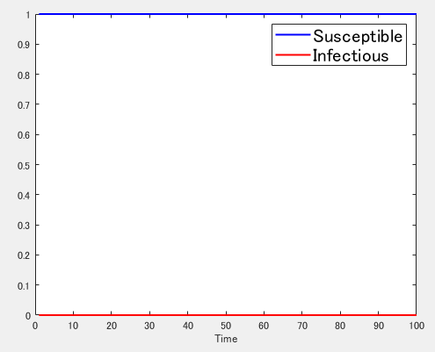
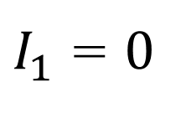
$I_{1}$ = $0$

Slide 14
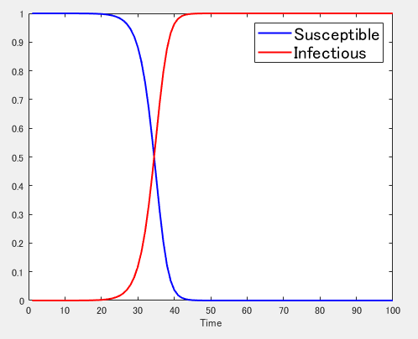
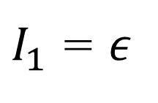
$I_{1}$ = $ε$

Slide 15
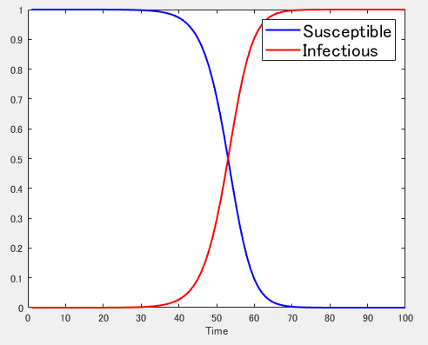
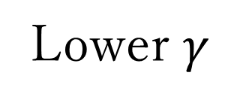
Lower $γ$

Slide 16

Compute “dynamics” (exogenous shocks)
Introduce “Lockdown” policy.
$α_{t}$ : degree of lockdown at time t.
$α_{t}$ is an exogenous shock.
$S_{t+1}−S_{t}=−γ(1−α_{t})I_{t}S_{t}$
$I_{t+1}−I_{t}=γ(1−α_{t})I_{t}S_{t}$
$S_{t} + I_{t} = 1$

Slide 17

Suppose that $α_{t}=0.5$ for 31<=t<=80.

Slide 18
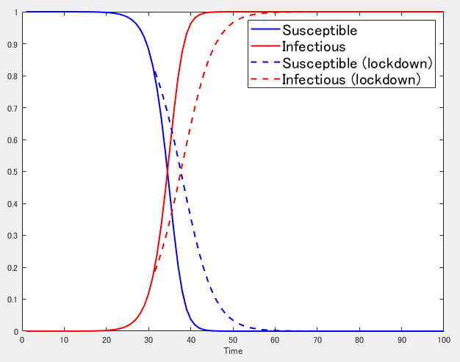

Slide 19
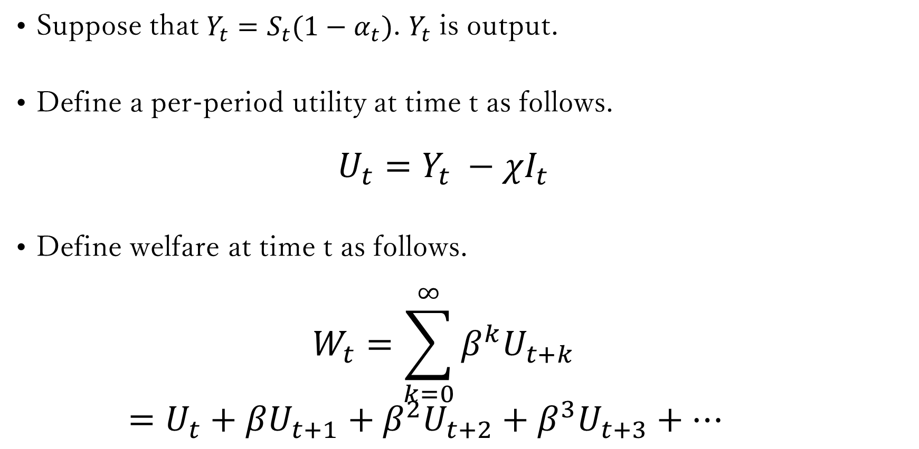
Analyze “welfare.”
Suppose that $Y_{t}=S_{t}(1−α_{t})$. $Y_{t}$ is output.
Define a per-period utility at time t as follows.
$$U_{t}=Y_{t} −χI_{t}$$
Define welfare at time t as follows.
$$W_{t}=\sum_{k=0}^{∞}{β^{k}U_{t+k}}$$
$=U_{t}+βU_{t+1}+β^{2}U_{t+2}+β^{3}U_{t+3}+…$

Slide 20
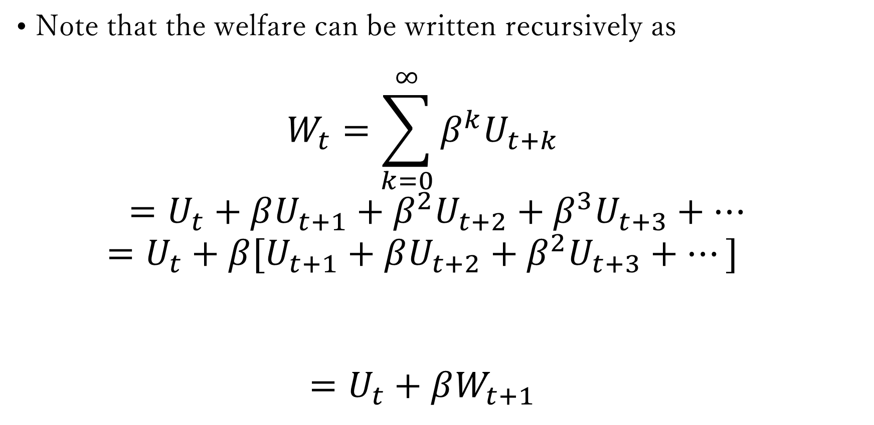
Note that the welfare can be written recursively as
$$W_{t}=\sum_{k=0}^{∞}{β^{k}U_{t+k}}$$
$=U_{t}+βU_{t+1}+β^{2}U_{t+2}+β^{3}U_{t+3}+…$
$$=U_{t}+β[U_{t+1}+βU_{t+2}+β^{2}U_{t+3}+…]$$
$$=U_{t}+βW_{t+1}$$

Slide 21
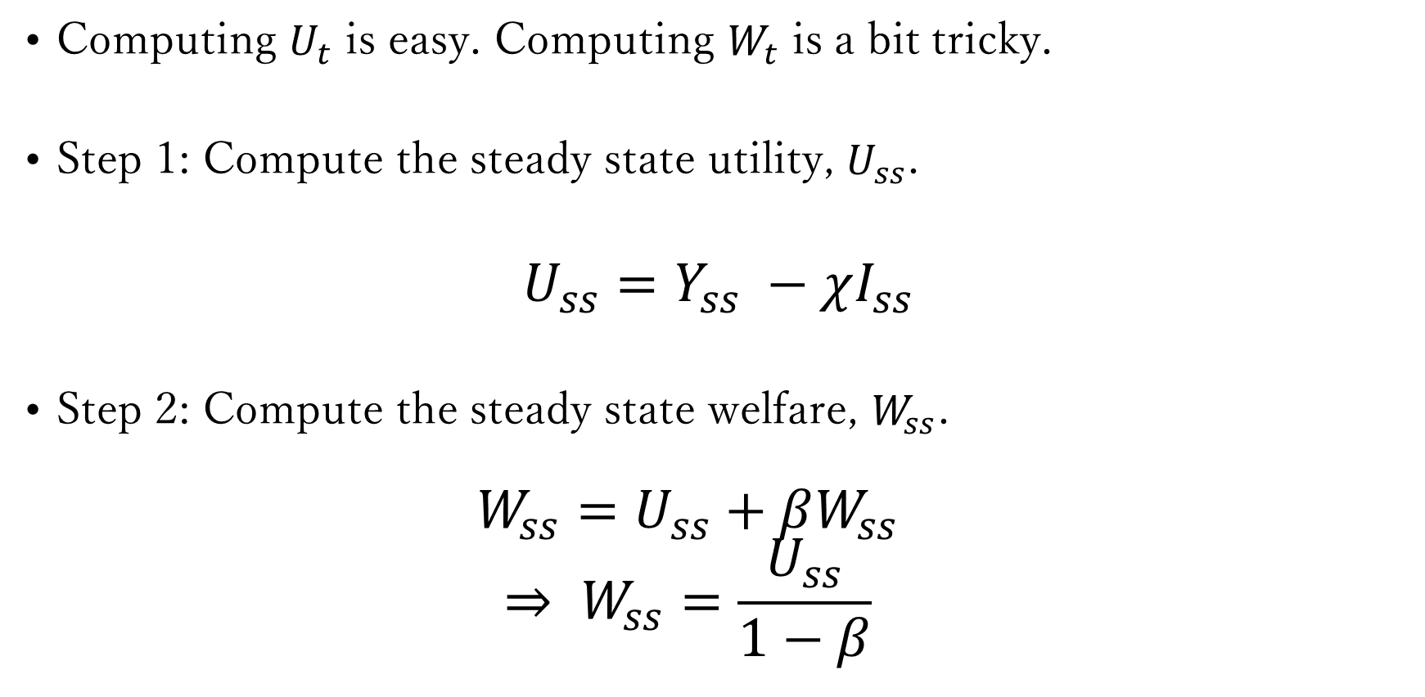
Computing $U_{t}$ is easy. Computing $W_{t}$ is a bit tricky.
Step 1: Compute the steady state utility, $U_{ss}$.
$$U_{ss}=Y_{ss} −χI_{ss}$$
Step 2: Compute the steady state welfare, $W_{ss}$.
$$W_{ss}=U_{ss}+βW_{ss}$$
$$⇒ W_{ss}=\frac{U_{ss}}{1−β}$$

Slide 22
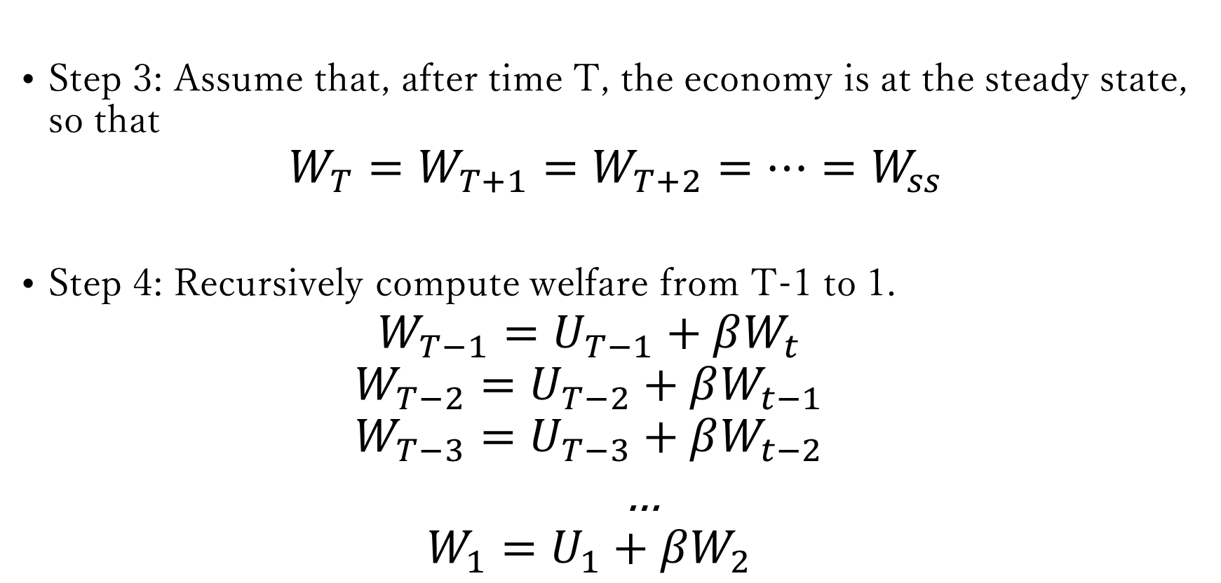
Step 3: Assume that, after time T, the economy is at the steady state, so that
$$W_{T}=W_{T+1}=W_{T+2}=…=W_{ss}$$
Step 4: Recursively compute welfare from T-1 to 1.
$$W_{T−1}=U_{T−1}+βW_{t}$$
$$W_{T−2}=U_{T−2}+βW_{t−1}$$
$$W_{T−3}=U_{T−3}+βW_{t−2}$$
…
$$W_{1}=U_{1}+βW_{2}$$

Slide 23
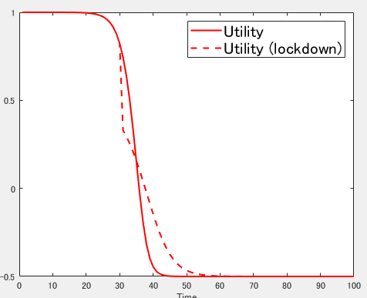

Slide 24
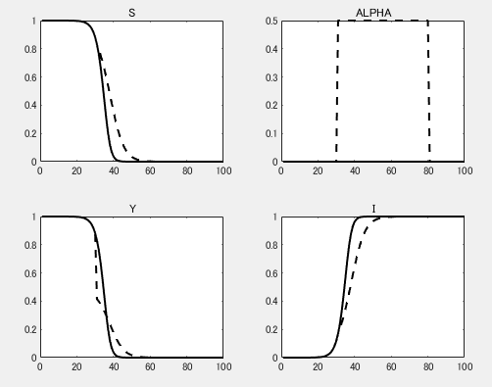

Slide 25
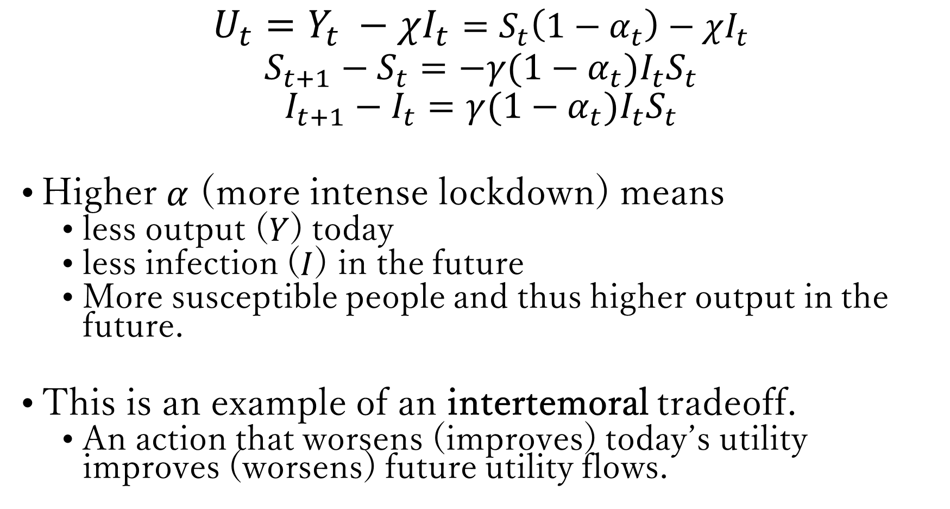
$$U_{t}=Y_{t} −χI_{t}=S_{t}\left(1−α_{t}\right)−χI_{t}$$
$$S_{t+1}−S_{t}=−γ(1−α_{t})I_{t}S_{t}$$
$$I_{t+1}−I_{t}=γ(1−α_{t})I_{t}S_{t}$$
Higher $α$ (more intense lockdown) means
less output ($Y$) today
less infection ($I$) in the future
More susceptible people and thus higher output in the future.
This is an example of an intertemoral tradeoff.
An action that worsens (improves) today’s utility improves (worsens) future utility flows.

Slide 26
The opposite of intertemporal tradeoff is intra-temporal (or static) tradeoff.
In the SI model, there is no intratempotal tradeoff.
You will see different kinds of intra- and inter-temporal tradeoffs throughout the course.
Today’s consumption versus future consumption (inter-).
Today’s consumption versus today’s leisure (intra-).
Today’s inflation versus future inflation (inter-).
Today’s inflation versus today’s output gap (intra-).

Slide 27
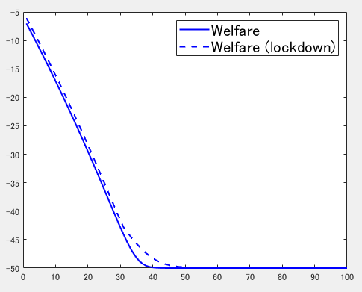

Slide 28
In this example, lockdown policy improves welfare at all time t.
In particular, government can improve welfare by implementing the lockdown at time 31.
You could also analyze the optimal timing and intensity of lockdown in this framework, though that would be a bit technically challenging in this model.
Easier in the New Keynesian model.

Slide 29
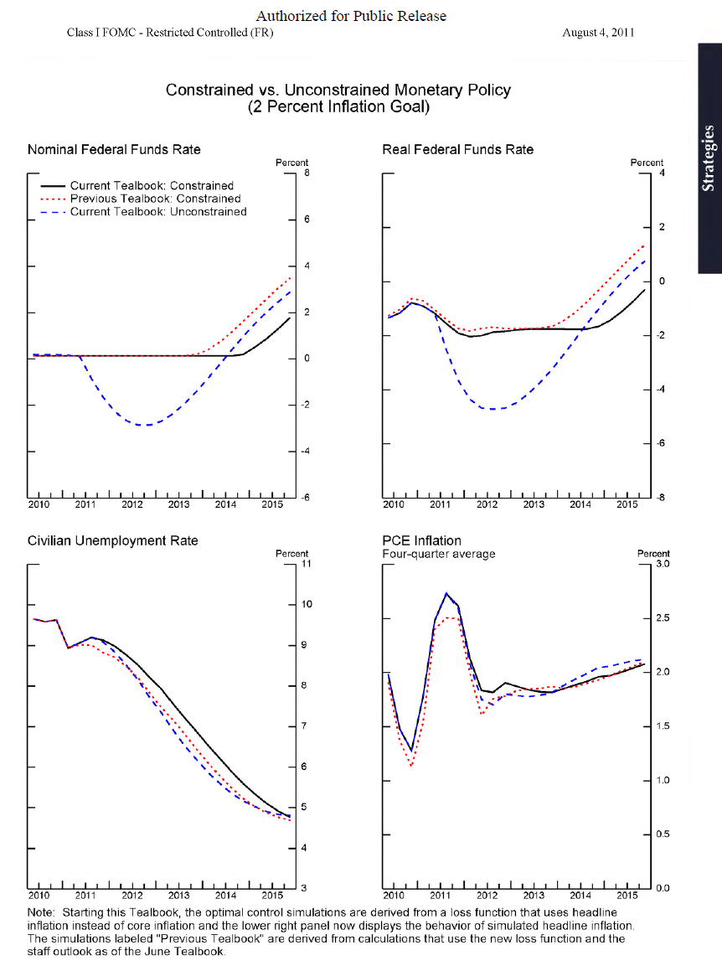
Normative question
https://www.federalreserve.gov/monetarypolicy/files/FOMC20110809tealbookb20110804.pdf

Slide 30
There are cases in which a certain policy improves welfare at the time of implementation, and but not for all dates in the future.
In the example above, that could happen if the solid line and dashed line crossed at some future date.
Such policies are said to be “time-inconsistent” and thought to be hard to implement. Examples of time-inconsistent policy includes:
Bailout policy for banks by the financial regulator.
Inflation overshooting policy by the central bank.

Slide 31
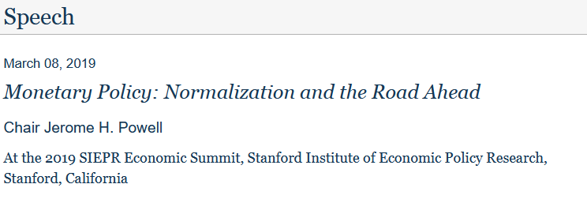
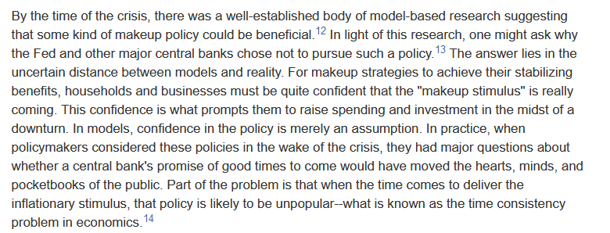

Slide 32
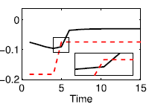
Welfare evolution associated with the inflation overshooting policy by the central bank.

Slide 33
Outline
(1) SI Model
(2) SIS Model
(3) SIR Model

Slide 34


SIS Model
$$τ$$
Susceptible
Infected
$$γ$$

Slide 35
SIS Model
Malaria, common cold, and chlamydia, etc.
After you get infected, you can recover, but without obtaining immunity (so that you can get infected again).
Everyone can get infected.
A backward-looking model (easy to solve)
Not optimization based.

Slide 36
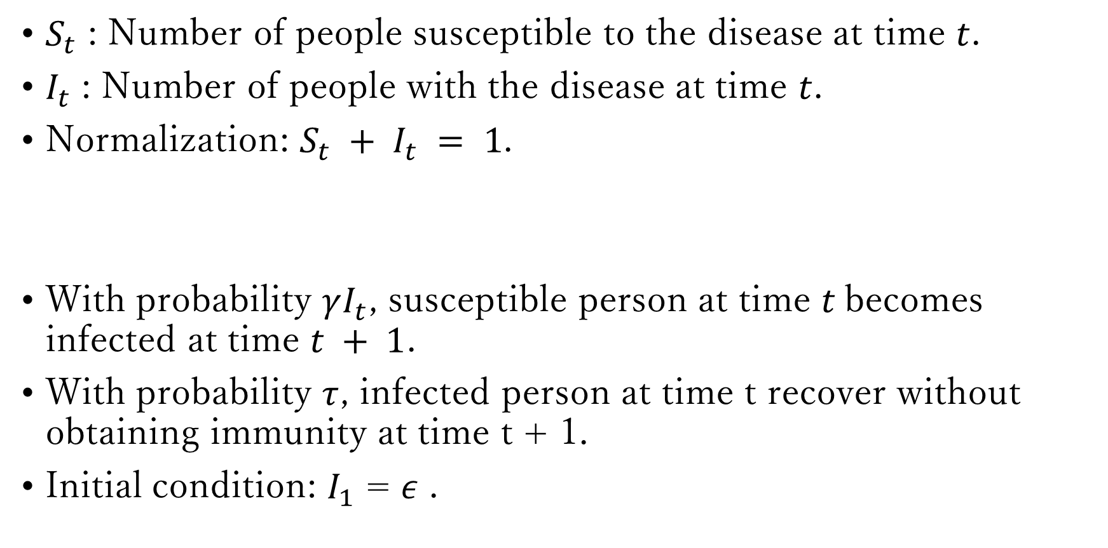
$S_{t}$ : Number of people susceptible to the disease at time $t$.
$I_{t}$ : Number of people with the disease at time $t$.
Normalization: $S_{t} + I_{t} = 1$.
With probability $γI_{t}$, susceptible person at time $t$becomes infected at time $t + 1$.
With probability $τ$, infected person at time t recover without obtaining immunity at time t + 1.
Initial condition: $I_{1}$ = $ε$ .

Slide 37

$S_{t+1}−S_{t}=−γI_{t}S_{t}+τI_{t}$
$I_{t+1}−I_{t}=γI_{t}S_{t}−τI_{t}$
$S_{t} + I_{t} = 1$

Slide 38

Find “steady states.”
$S_{ss}−S_{ss}=−γI_{ss}S_{ss}+τI_{ss}$
$I_{ss}−I_{ss}=γI_{ss}S_{ss}−τI_{ss}$
$S_{ss} + I_{ss} = 1$

Slide 39
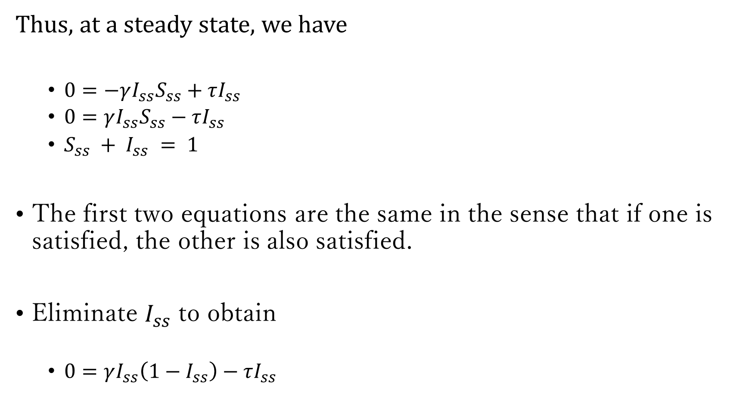
Thus, at a steady state, we have
$0=−γI_{ss}S_{ss}+τI_{ss}$
$0=γI_{ss}S_{ss}−τI_{ss}$
$S_{ss} + I_{ss} = 1$
The first two equations are the same in the sense that if one is satisfied, the other is also satisfied.
Eliminate $I_{ss}$ to obtain
$0=γI_{ss}\left(1−I_{ss}\right)−τI_{ss}$

Slide 40
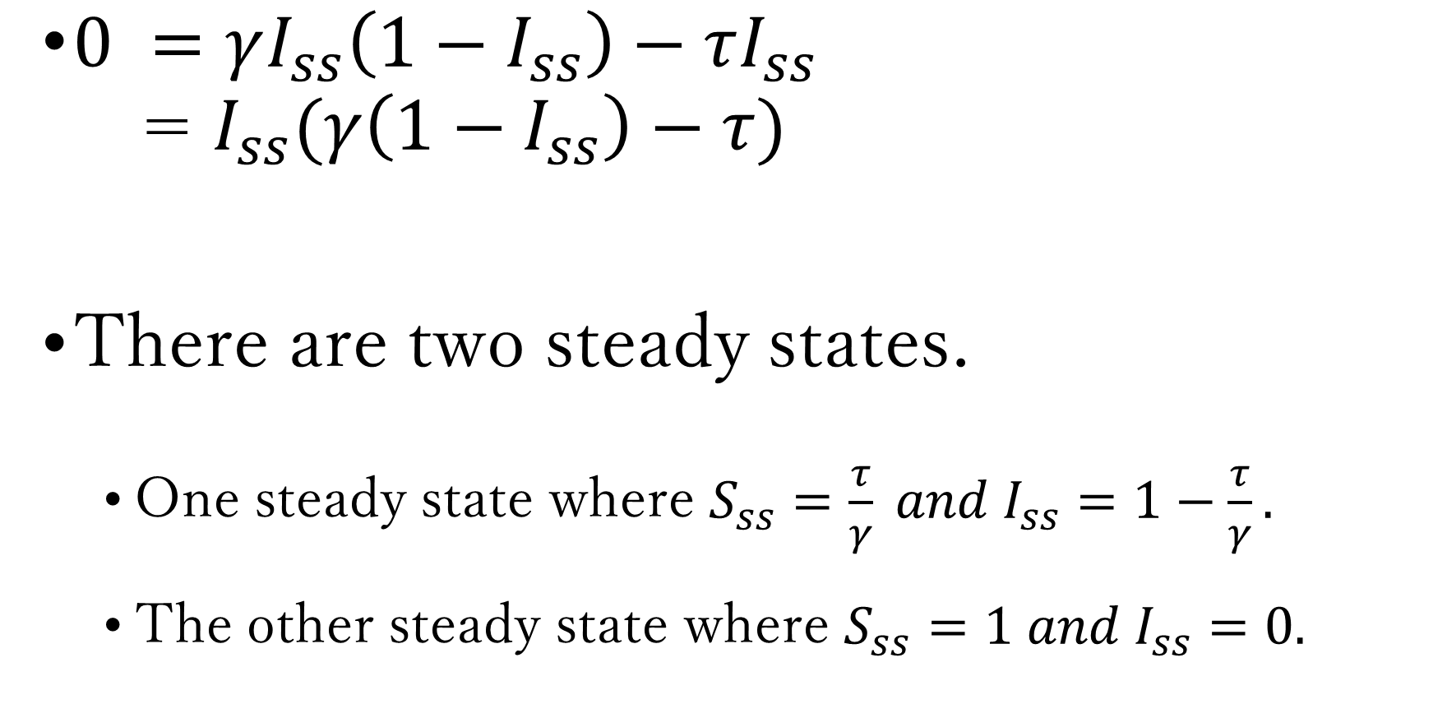
$0 =γI_{ss}\left(1−I_{ss}\right)−τI_{ss}$
= $I_{ss}(γ\left(1−I_{ss}\right)−τ)$
There are two steady states.
One steady state where $S_{ss}=\frac{τ}{γ} and I_{ss}=1−\frac{τ}{γ}.$
The other steady state where $S_{ss}=1 and I_{ss}=0.$

Slide 41
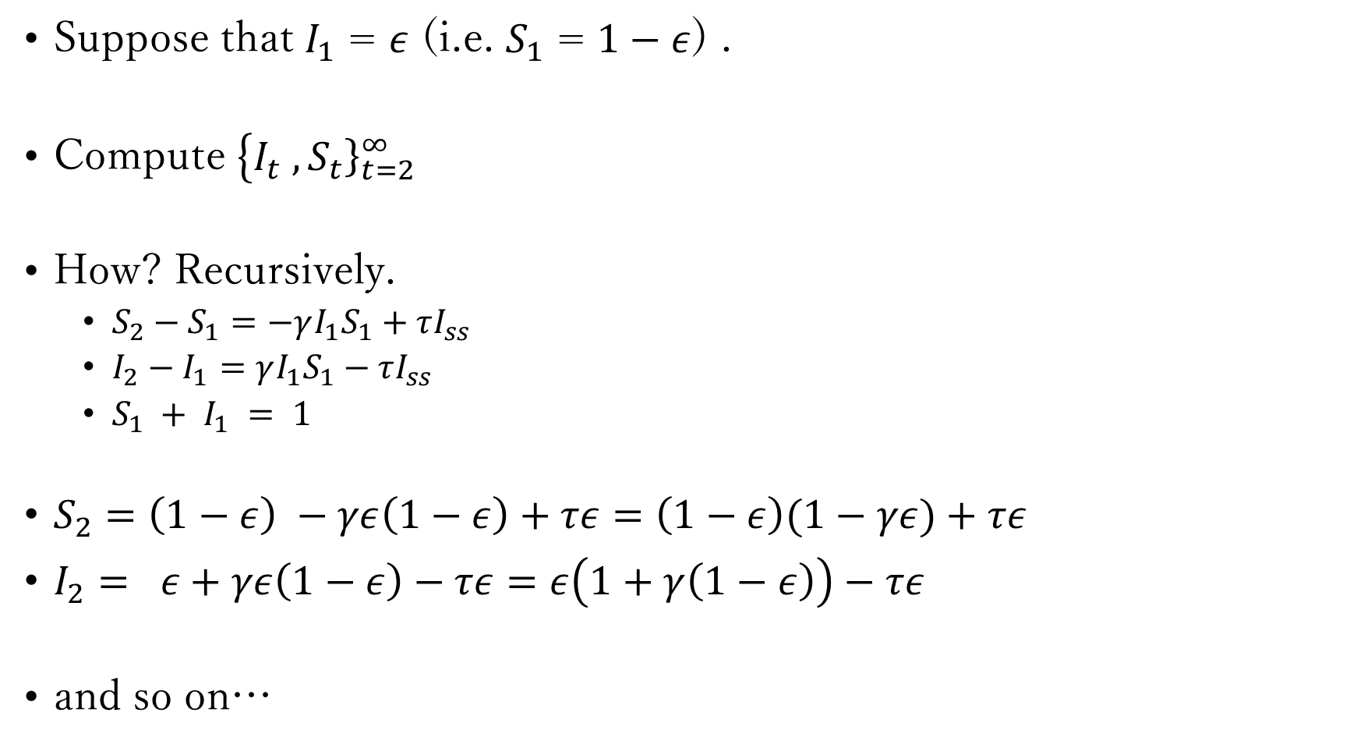
Compute “dynamics” (convergence toward steady state).
Suppose that $I_{1}$ = $ε$ (i.e. $S_{1}$ = $1−ε$) .
Compute $\left\{I_{t}\right. ,{\left.S_{t}\right\}}_{t=2}^{∞}$
How? Recursively.
$S_{2}−S_{1}=−γI_{1}S_{1}+τI_{ss}$
$I_{2}−I_{1}=γI_{1}S_{1}−τI_{ss}$
$S_{1} + I_{1} = 1$
$S_{2}=\left(1−ε\right) −γε\left(1−ε\right)+τε=\left(1−ε\right)(1−γε)+τε$
$I_{2}= ε+γε\left(1−ε\right)−τε=ε\left(1+γ\left(1−ε\right)\right)−τε$
and so on…

Slide 42
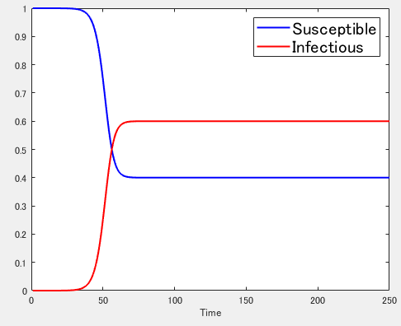

Slide 43
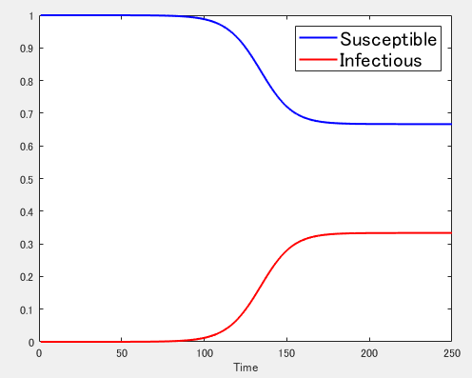

Lower $γ$

Slide 44

Compute “dynamics” (exogenous shocks).
Introduce “Lockdown” policy.
$α_{t}$ : degree of lockdown at time t.
$S_{t+1}−S_{t}=−γ(1−α_{t})I_{t}S_{t}$ $+τI_{ss}$
$I_{t+1}−I_{t}=γ\left(1−α_{t}\right)I_{t}S_{t} −τI_{ss}$
$S_{t} + I_{t} = 1$

Slide 45

Suppose that $α_{t}=0.4$ for 51<=t<=150.

Slide 46
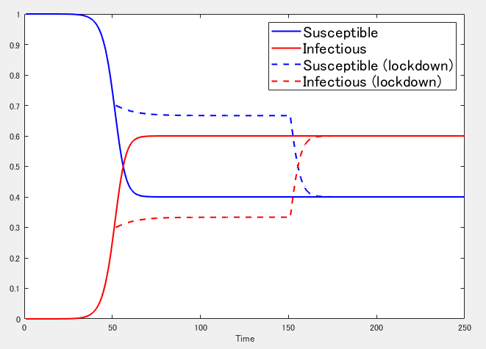

Slide 47
Analyze “welfare.”
Suppose that $Y_{t}=S_{t}(1−α_{t})$. $Y_{t}$ is output.
Define a per-period utility at time t as follows.
$$U_{t}=Y_{t} −χI_{t}$$
Define welfare at time t as follows.
$$W_{t}=\sum_{k=0}^{∞}{β^{k}U_{t+k}}$$
$=U_{t}+βU_{t+1}+β^{2}U_{t+2}+β^{3}U_{t+3}+…$

Slide 48
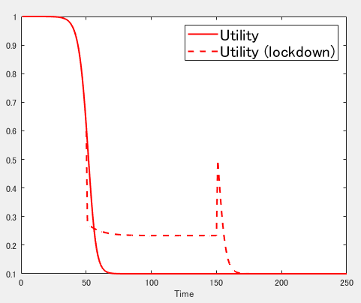

Slide 49
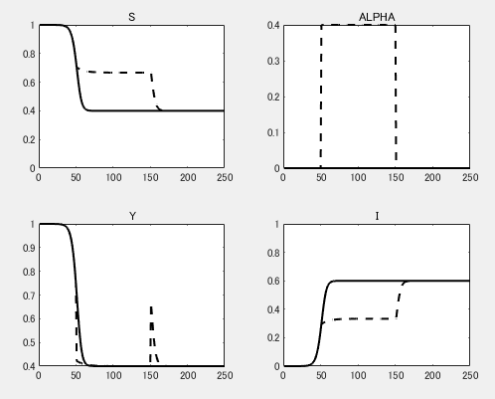

Slide 50
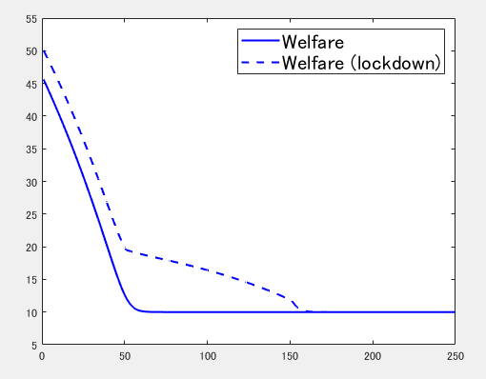

Slide 51
Exercises

Slide 52

1. SIS-D Model
$S_{t+1}−S_{t}=−γI_{t}S_{t}+τI_{t}$
$I_{t+1}−I_{t}=γI_{t}S_{t}−τI_{t}−φI_{t}$
$D_{t+1}−D_{t}=φI_{t}$
$S_{t} + I_{t}+ D_{t}= 1$

Slide 53


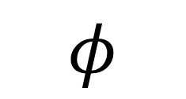
SIS-D Model
$$τ$$
Susceptible
Infected
$$γ$$
$$φ$$
Dead

Slide 54
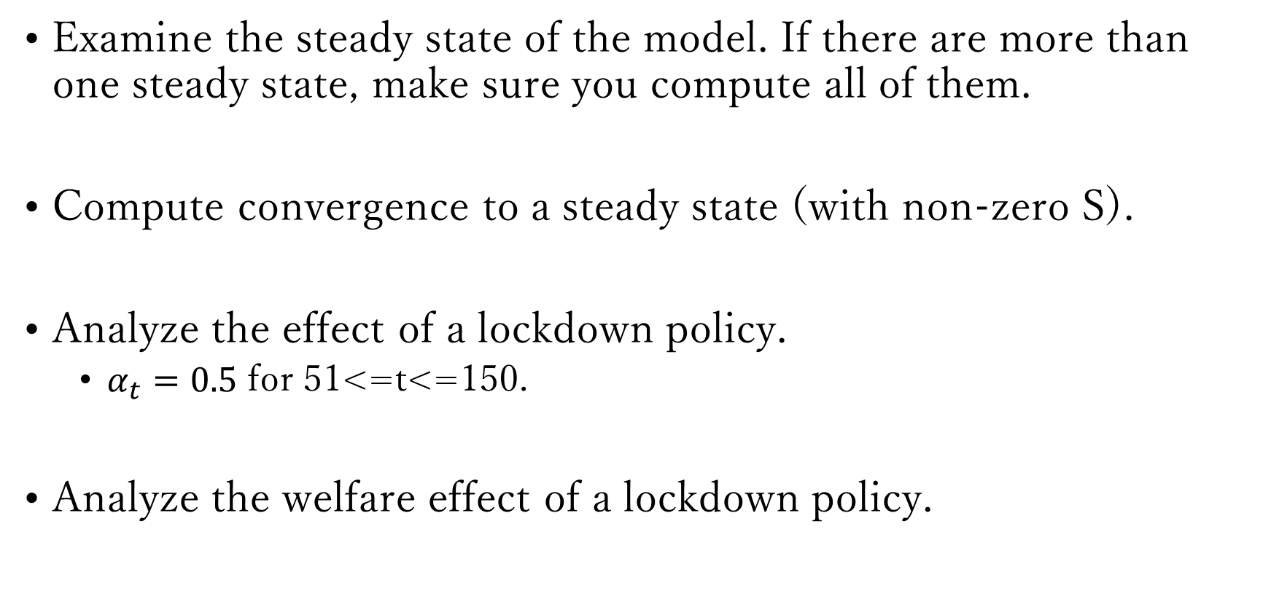
Examine the steady state of the model. If there are more than one steady state, make sure you compute all of them.
Compute convergence to a steady state (with non-zero S).
Analyze the effect of a lockdown policy.
$α_{t}=0.5$ for 51<=t<=150.
Analyze the welfare effect of a lockdown policy.

