Slide 1
Models of Infectious Diseases (II) <Last Updated on October 14, 2020>
Taisuke Nakata
Graduate School of Public Policy
University of Tokyo

Slide 2
Useful references:
Andrew Atkeson “On Using SIR Models to Model Disease Scenarios for COVID-19.”
https://www.minneapolisfed.org/research/quarterly-review/on-using-sir-models-to-model-disease-scenarios-for-covid-19
Ben Moll “Lockdowns in SIR Models.”
https://benjaminmoll.com/wp-content/uploads/2020/05/SIR_notes.pdf

Slide 3
Outline
(1) SI Model
(2) SIS Model
(3) SIR Model

Slide 4


SIR Model
Susceptible
Infected
Recovered
$$γ$$
$$τ$$

Slide 5
SIR Model
Covid-19, etc.
After you get infected, you can recover with immunity (so that you won’t get infected again).
Initially, everyone can get infected.
A backward-looking model (easy to solve)
Not optimization based.

Slide 6
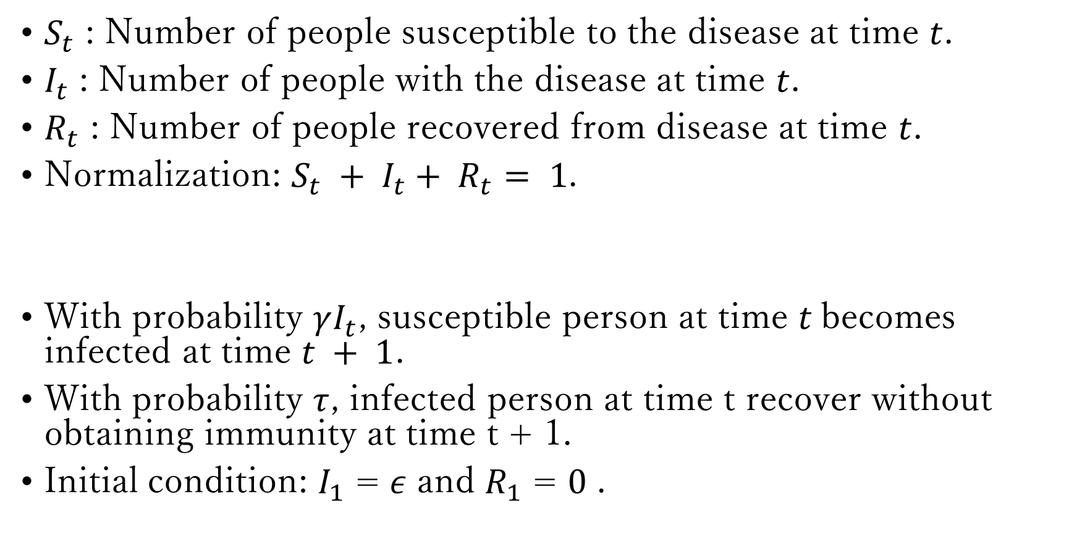
$S_{t}$ : Number of people susceptible to the disease at time $t$.
$I_{t}$ : Number of people with the disease at time $t$.
$R_{t}$ : Number of people recovered from disease at time $t$.
Normalization: $S_{t} + I_{t}+ R_{t}= 1$.
With probability $γI_{t}$, susceptible person at time $t$becomes infected at time $t + 1$.
With probability $τ$, infected person at time t recover without obtaining immunity at time t + 1.
Initial condition: $I_{1}$ = $ε$ and $R_{1}$ = $0$ .

Slide 7

$S_{t+1}−S_{t}=−γI_{t}S_{t}$
$I_{t+1}−I_{t}=γI_{t}S_{t}−τI_{t}$
$R_{t+1}−R_{t}=τI_{t}$
$S_{t} + I_{t}+ R_{t}= 1$

Slide 8

Find “steady states.”
$S_{ss}−S_{ss}=−γI_{ss}S_{ss}$
$I_{ss}−I_{ss}=γI_{ss}S_{ss}−τI_{ss}$
$R_{ss}−R_{ss}=τI_{ss}$
$S_{ss} + I_{ss}+ R_{ss}= 1$

Slide 9

Thus, at a steady state, we have
$0=−γI_{ss}S_{ss}$
$0=γI_{ss}S_{ss}−τI_{ss}$
$0=τI_{ss}$
$S_{ss} + I_{ss}+ R_{ss}= 1$
From the third equation, we have
$I_{ss}=0$
We are left with
$0=γ∗0∗S_{ss}$
$S_{ss} + R_{ss}= 1$

Slide 10
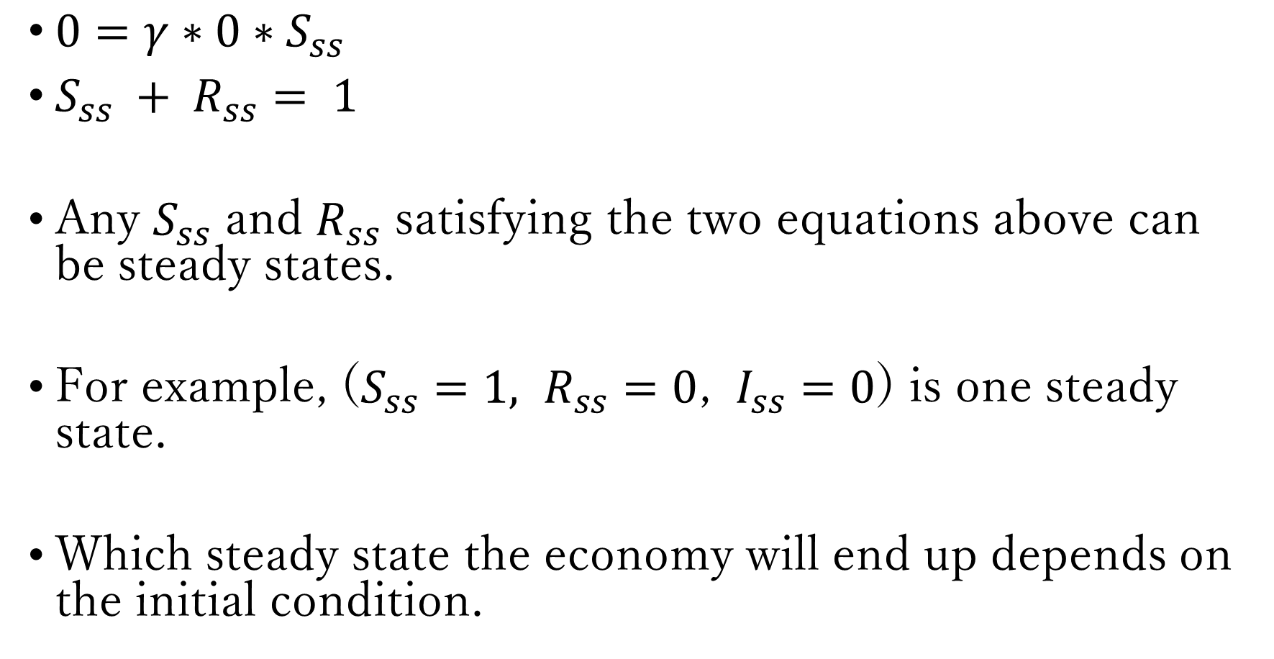
$0=γ∗0∗S_{ss}$
$S_{ss} + R_{ss}= 1$
Any $S_{ss}$ and $R_{ss}$ satisfying the two equations above can be steady states.
For example, ($S_{ss}=1, R_{ss}=0$, $I_{ss}=0$) is one steady state.
Which steady state the economy will end up depends on the initial condition.

Slide 11
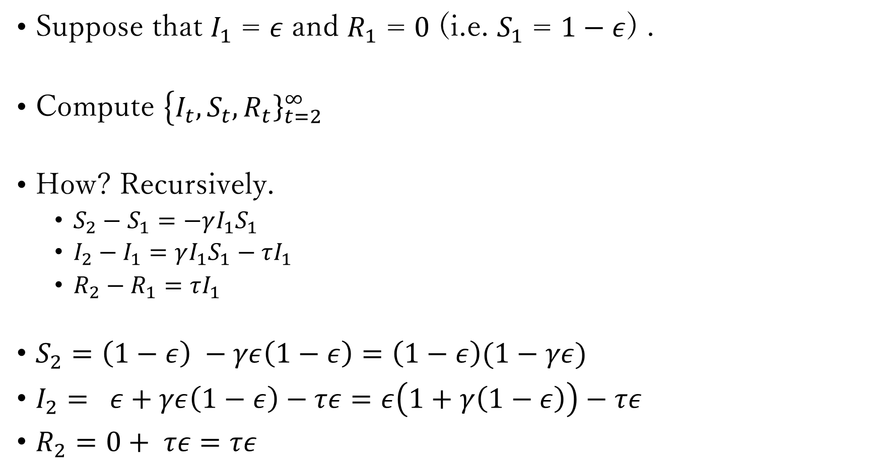
Compute “dynamics” (convergence towards steady state)
Suppose that $I_{1}$ = $ε$ and $R_{1}$ = $0$ (i.e. $S_{1}$ = $1−ε$) .
Compute $\left\{I_{t}\right.,{\left.S_{t}, R_{t}\right\}}_{t=2}^{∞}$
How? Recursively.
$S_{2}−S_{1}=−γI_{1}S_{1}$
$I_{2}−I_{1}=γI_{1}S_{1}−τI_{1}$
$R_{2}−R_{1}=τI_{1}$
$S_{2}=\left(1−ε\right) −γε\left(1−ε\right)=\left(1−ε\right)(1−γε)$
$I_{2}= ε+γε\left(1−ε\right)−τε=ε\left(1+γ\left(1−ε\right)\right)−τε$
$R_{2}=0+ τε=τε$

Slide 12
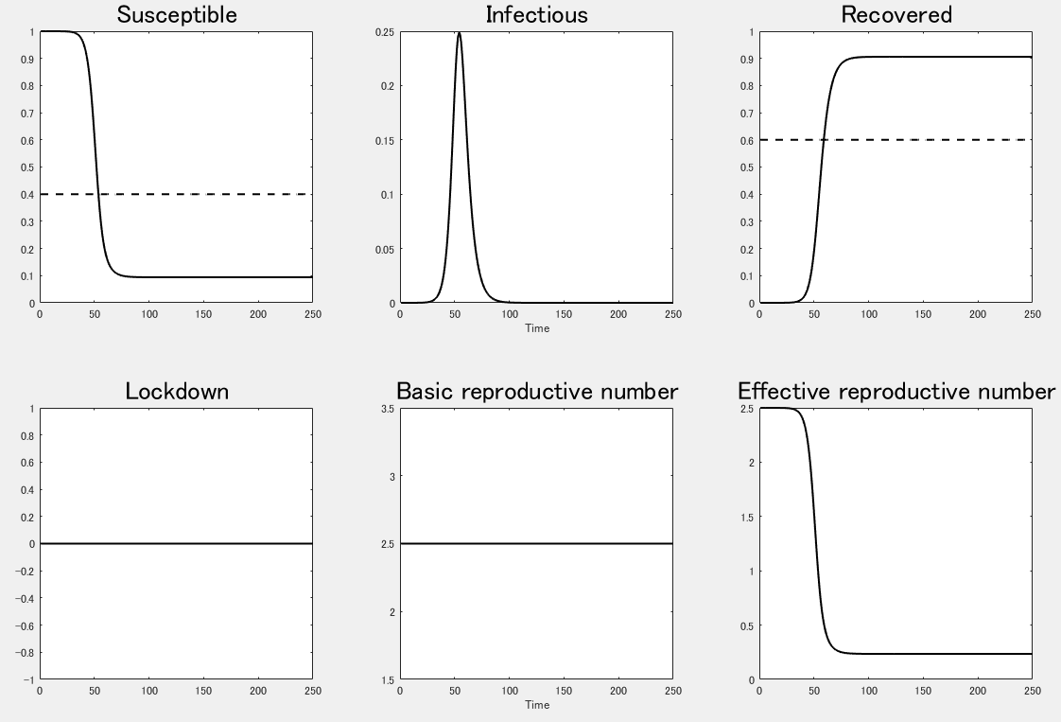

Slide 13
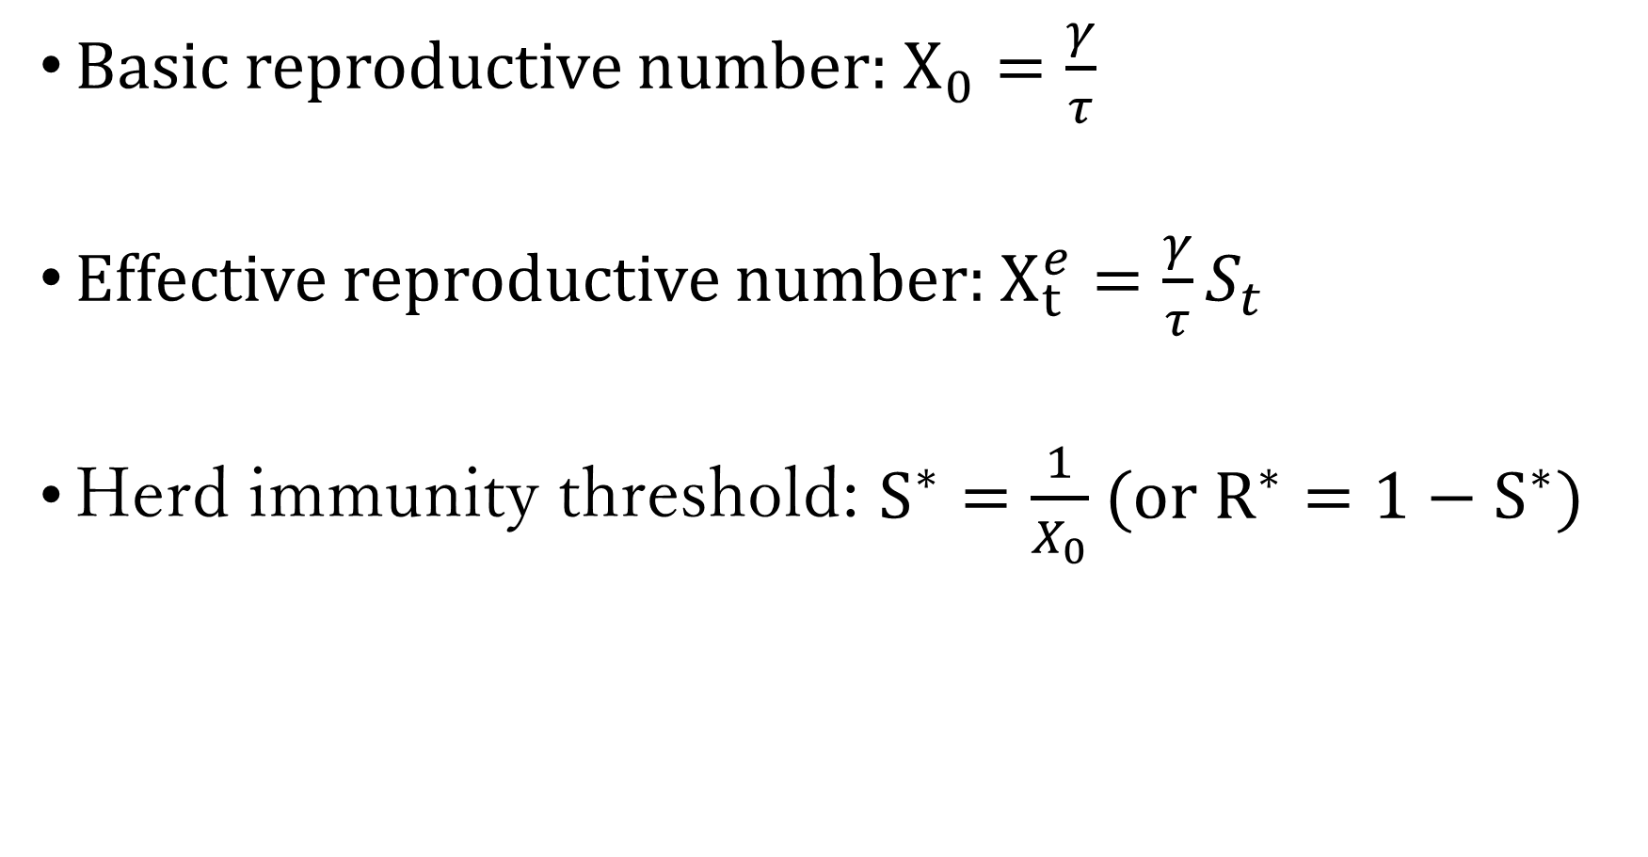
Basic reproductive number: $X_{0}=\frac{γ}{τ}$
Effective reproductive number: $X_{t}^{e}=\frac{γ}{τ}S_{t}$
Herd immunity threshold: $S^{∗}=\frac{1}{X_{0}}$ (or $R^{∗}=1−S^{∗})$

Slide 14

$I_{t+1}−I_{t}=γI_{t}S_{t}−τI_{t}>0$
$$⇒γS_{t}−τ>0$$
$$⇒S_{t}>\frac{τ}{γ}=\frac{1}{X_{0}}=S^{∗}$$
$I_{t}$ peaks when $S_{t}=S^{∗}$.

Slide 15
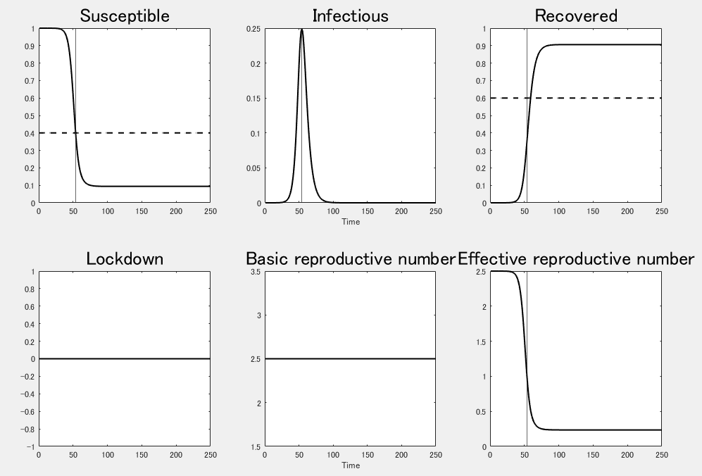

Slide 16
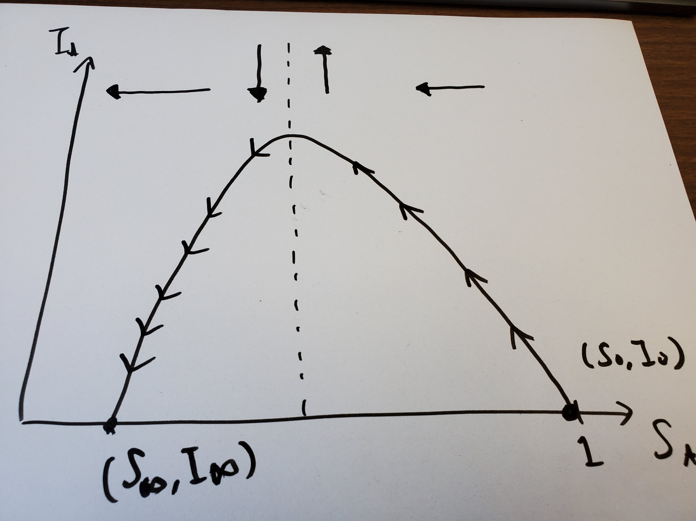

Slide 17

$I_{t+1}−I_{t}=γI_{t}S_{t}−τI_{t}<0$
$$⇒\frac{γ}{τ}<\frac{1}{S_{t}}$$
$$⇒X_{0}<\frac{1}{S_{t}}$$
$$⇒X_{0}<1<\frac{1}{S_{t}}$$
If $X_{0}<1$, then $X_{0}<\frac{1}{S_{t}}$ because $S_{t}<1$ for any t.
So, if $X_{0}<1$, $I_{t}$ declines at any time.

Slide 18
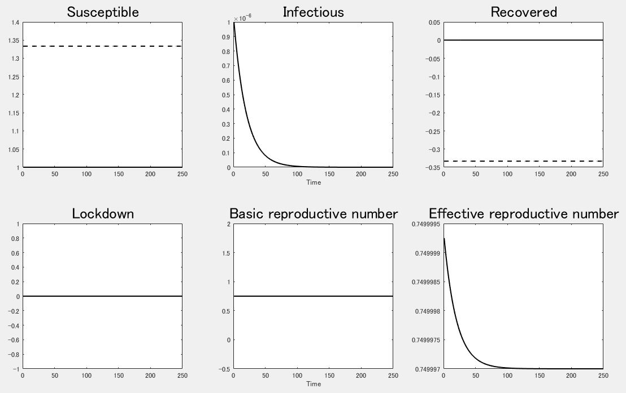

Slide 19
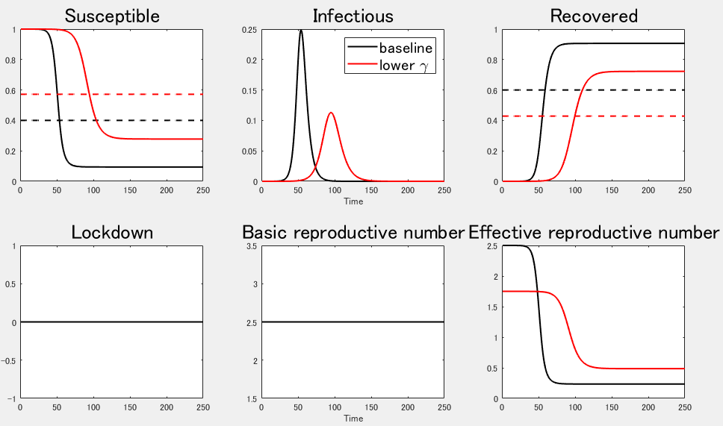

Slide 20
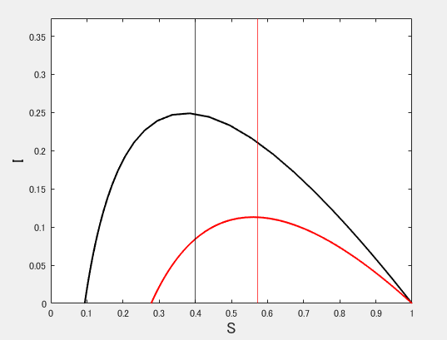

Slide 21
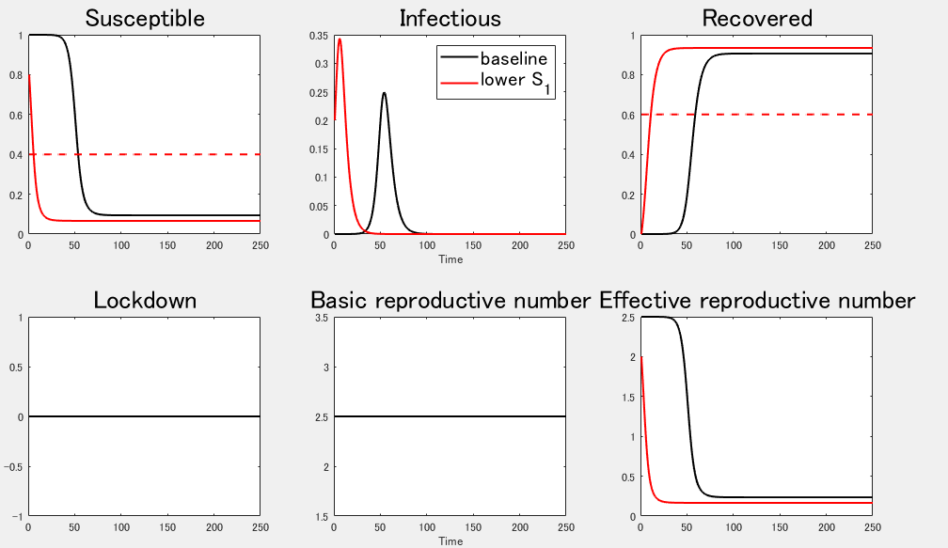

Slide 22
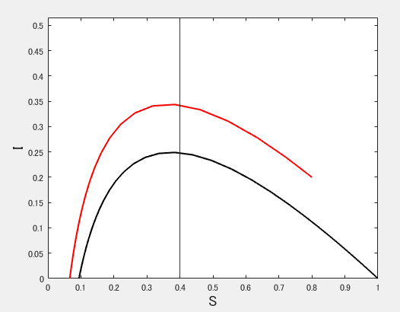

Slide 23

Compute “dynamics” (exogenous shocks)
Introduce “Lockdown” policy.
$α_{t}$ : degree of lockdown at time t.
$S_{t+1}−S_{t}=−γ\left(1−α_{t}\right)I_{t}S_{t}$
$I_{t+1}−I_{t}=γ\left(1−α_{t}\right)I_{t}S_{t} −τI_{t}$
$R_{t+1}−R_{t}=τI_{t}$
$S_{t} + I_{t}+ R_{t}= 1$

Slide 24

Suppose that $α_{t}=0.5, 0.25, 0.75$ for all $41≤t≤100$.

Slide 25
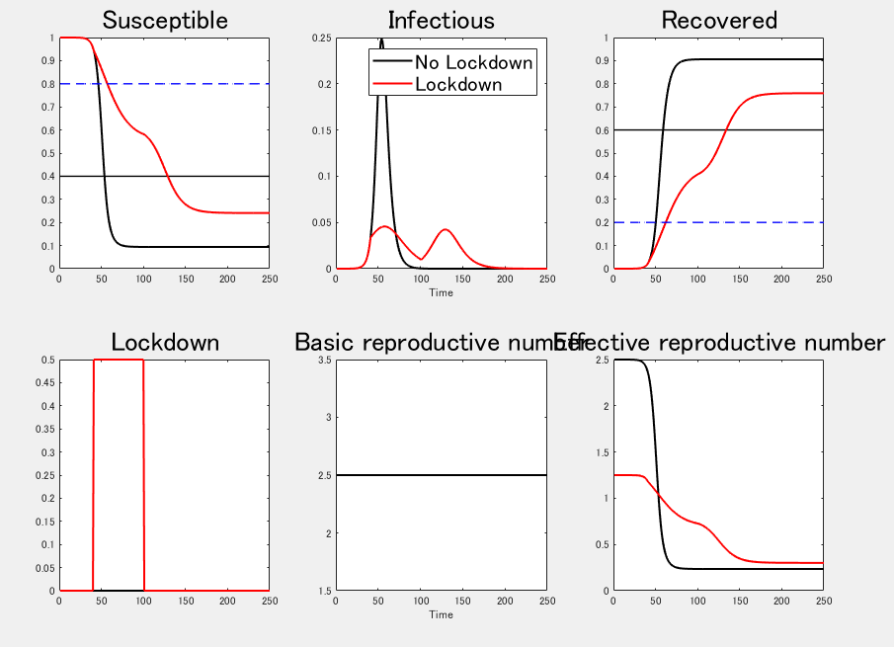

Slide 26
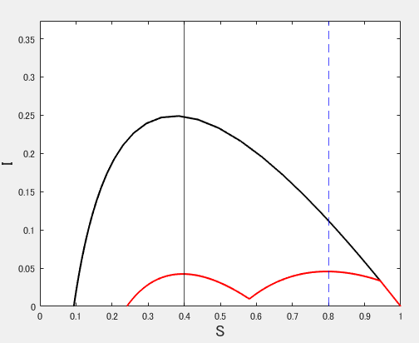

Slide 27
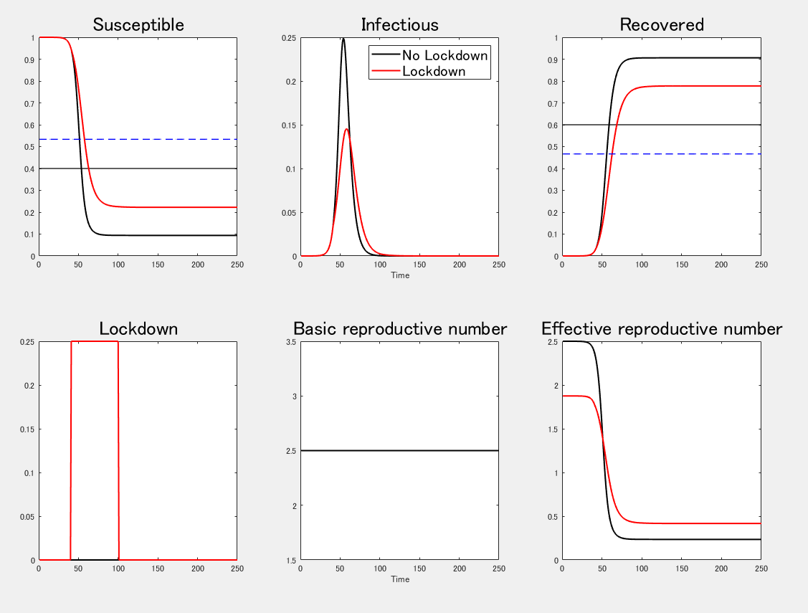

Slide 28
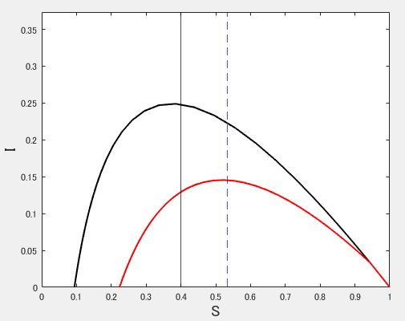

Slide 29
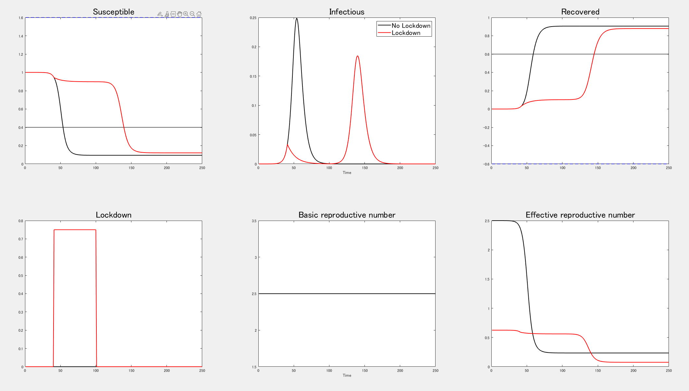

Slide 30
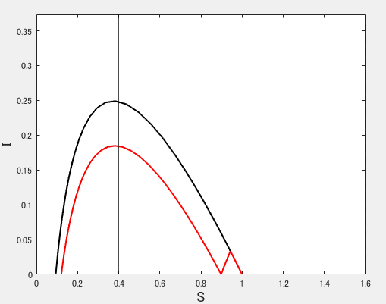

Slide 31
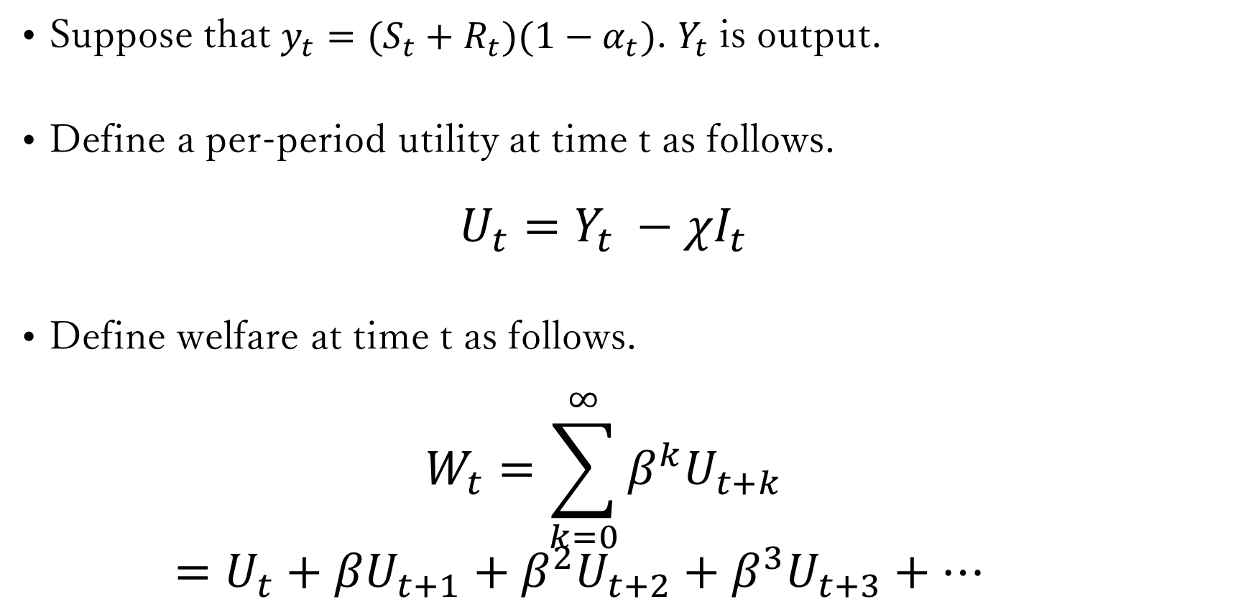
Analyze “welfare.”
Suppose that $y_{t}=(S_{t}+R_{t})(1−α_{t})$. $Y_{t}$ is output.
Define a per-period utility at time t as follows.
$$U_{t}=Y_{t} −χI_{t}$$
Define welfare at time t as follows.
$$W_{t}=\sum_{k=0}^{∞}{β^{k}U_{t+k}}$$
$=U_{t}+βU_{t+1}+β^{2}U_{t+2}+β^{3}U_{t+3}+…$

Slide 32
Suppose that $α_{t}=0.5, 0.25, 0.75$ for all $41≤t≤100$.

Slide 33
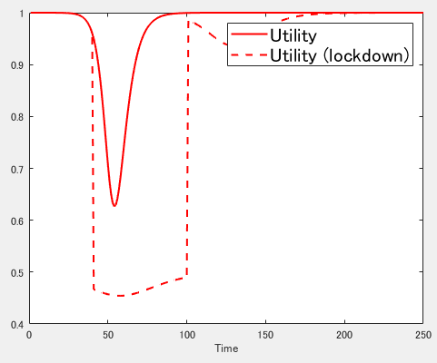
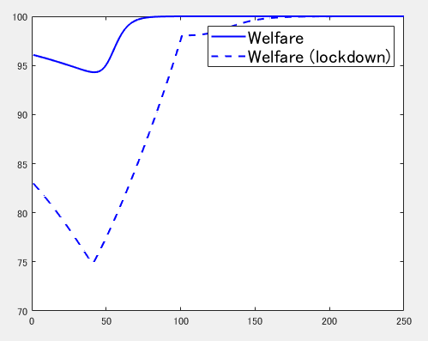

Slide 34
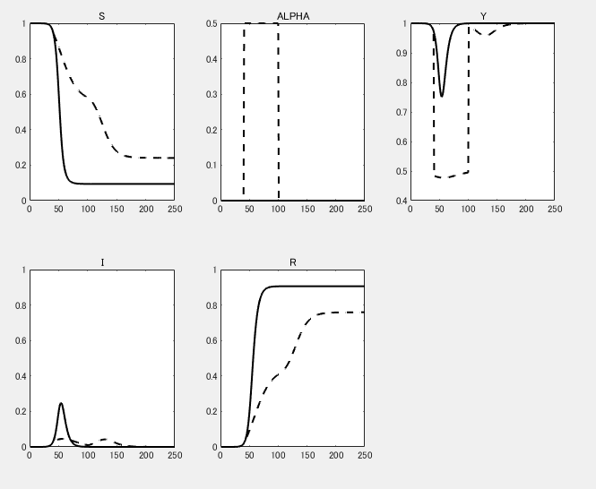

Slide 35
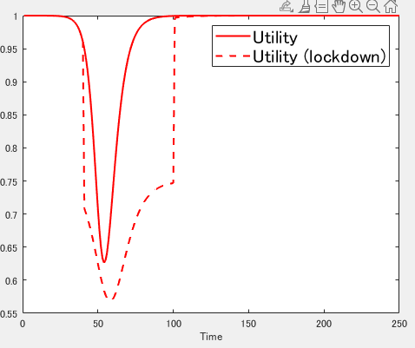
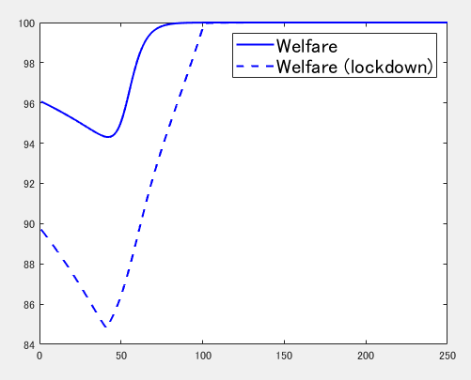

Slide 36
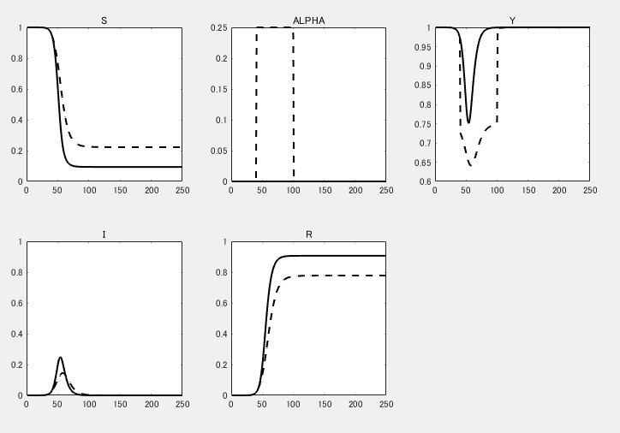

Slide 37
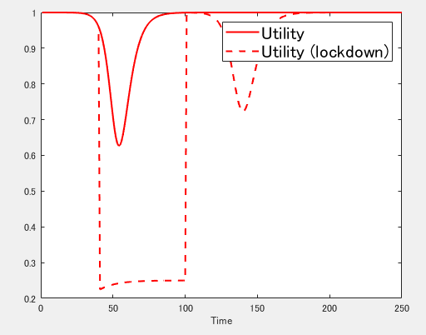
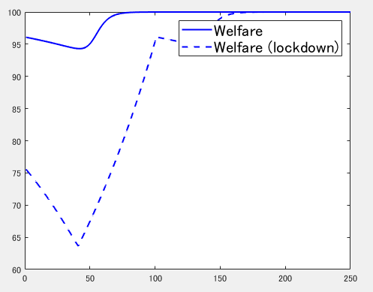

Slide 38
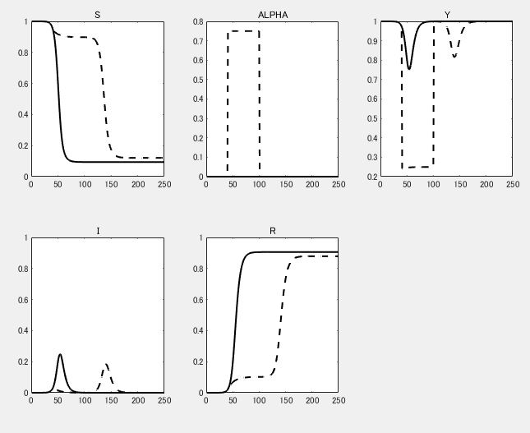

Slide 39
Exercises

Slide 40

1. SIR-D Model
$S_{t+1}−S_{t}=−γI_{t}S_{t}$
$I_{t+1}−I_{t}=γI_{t}S_{t}−τI_{t}−φI_{t}$
$R_{t+1}−R_{t}=τI_{t}$
$D_{t+1}−D_{t}=φI_{t}$
$S_{t} + I_{t}+ R_{t}+D_{t}= 1$

Slide 41


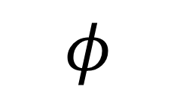
SIR-D Model
Susceptible
Infected
Recovered
$$γ$$
$$τ$$
$$φ$$
Dead

Slide 42
Examine the steady state of the model.
Compute convergence to a steady state.
Analyze the effect of a lockdown policy.
Analyze the welfare effect of a lockdown policy.

Slide 43

2. SEIR Model
$S_{t+1}−S_{t}=−γI_{t}S_{t}$
$E_{t+1}−E_{t}=γI_{t}S_{t}−σE_{t}$
$I_{t+1}−I_{t}=σE_{t}−τI_{t}$
$R_{t+1}−R_{t}=τI_{t}$
$S_{t}+E_{t}+ I_{t}+ R_{t}= 1$

Slide 44

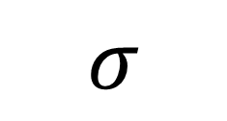
SEIR Model
Susceptible
Infected
Recovered
$$τ$$
$$γ$$
$$σ$$
Exposed

Slide 45
Examine the steady state of the model.
Compute convergence to a steady state.
Analyze the effect of a lockdown policy.
Analyze the welfare effect of a lockdown policy.

