Slide 1
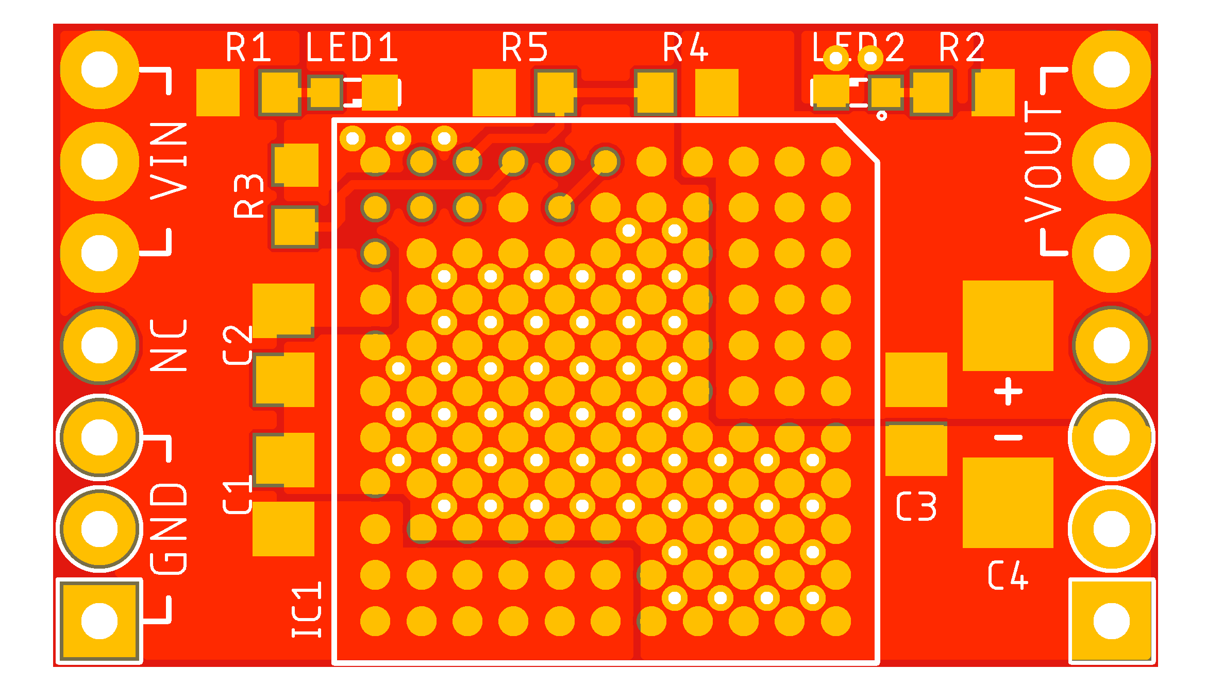
V_{IN}
V_{OUT}
NC
NC
GND
GND

Slide 2
