Slide 1
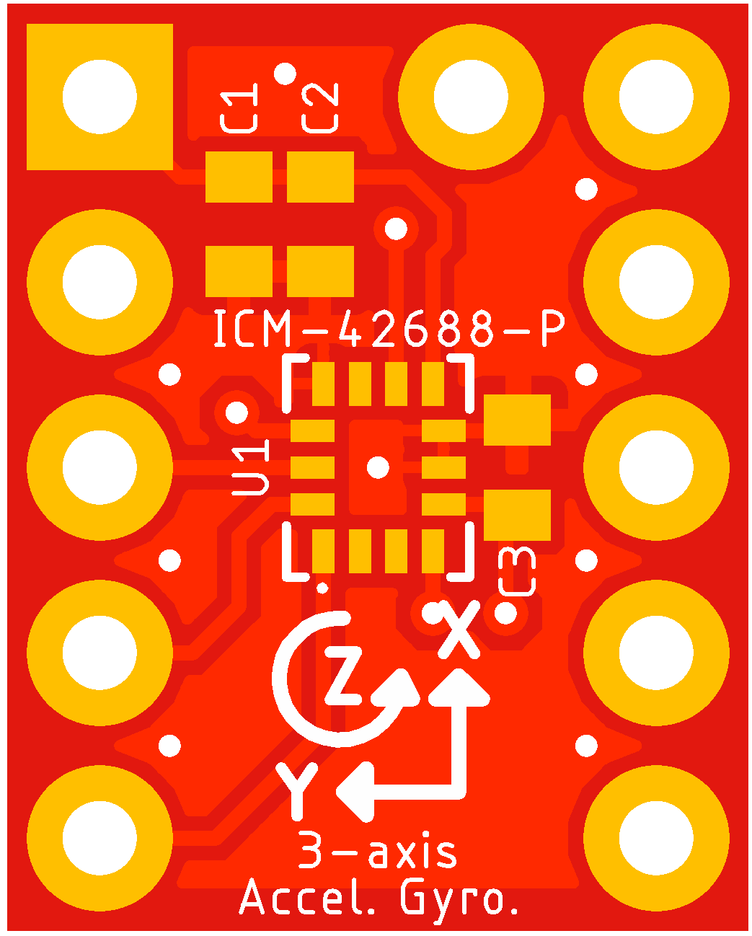
INT2 / FSYNC / CLKIN
VDD 1.71V to 3.6V
GND
VDDIO 1.71V to 3.6V
INT1 / INT
SCL / SCLK
NC
SDA / SDI
NC
AD0 / SDO
CS

