Slide 1
INT2 / FSYNC / CLKIN
VDD 1.71V to 3.6V
GND
VDDIO 1.71V to 3.6V
INT1 / INT
SCL / SCLK
NC
SDA / SDI
NC
AD0 / SDO
CS

Slide 2
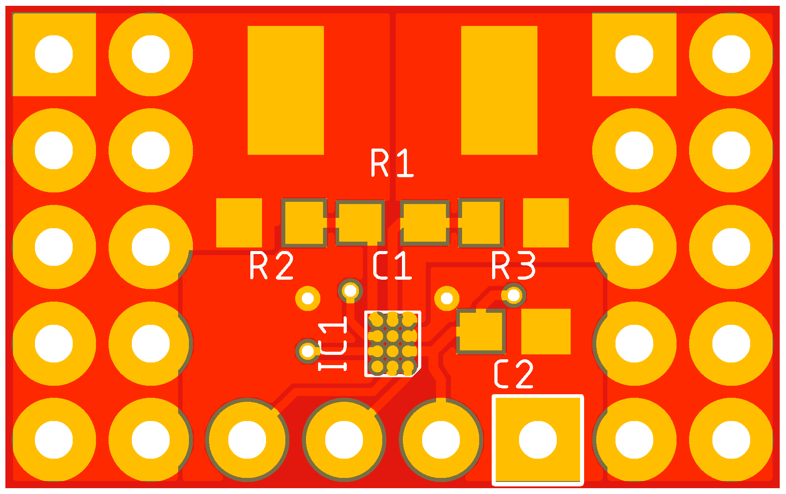
V_{IN+}
V_{IN-}
SDA
SCL
VS
GND

Slide 3
