Slide 1
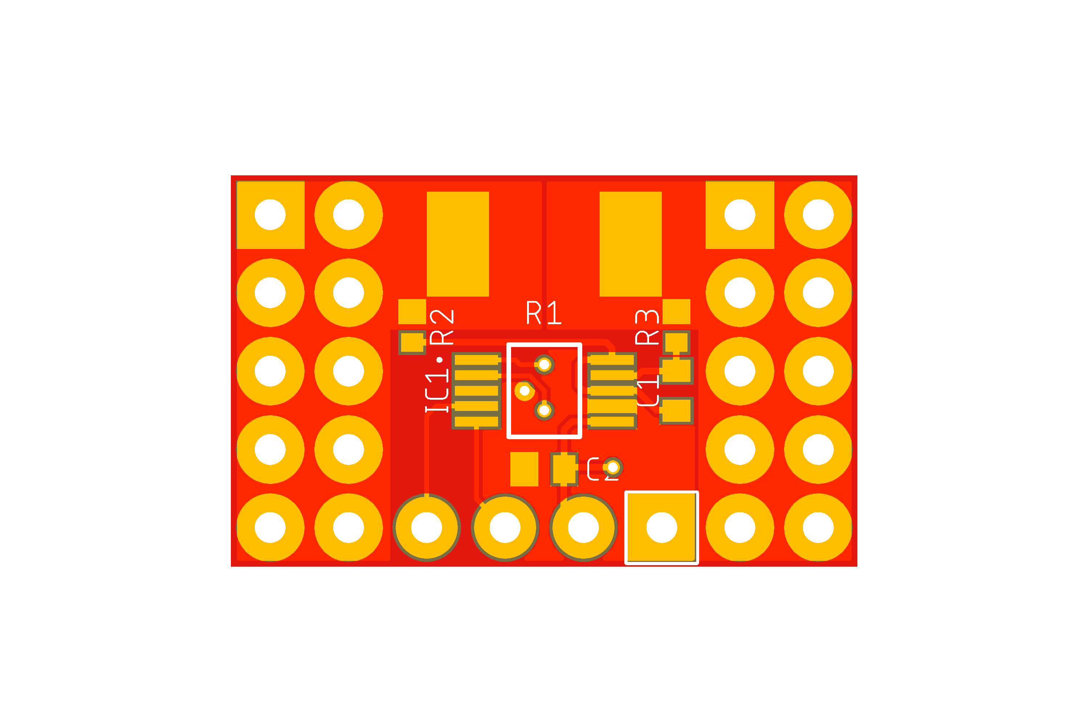
V_{IN+}
V_{IN-}
SDA
SCL
VS
GND

Slide 2
SDA
SCL
VS
GND
Power Monitor Module
V_{IN+}
V_{IN-}
Power Supply 0 V to 36V
Load Max. 20A
GND

