Slide 1
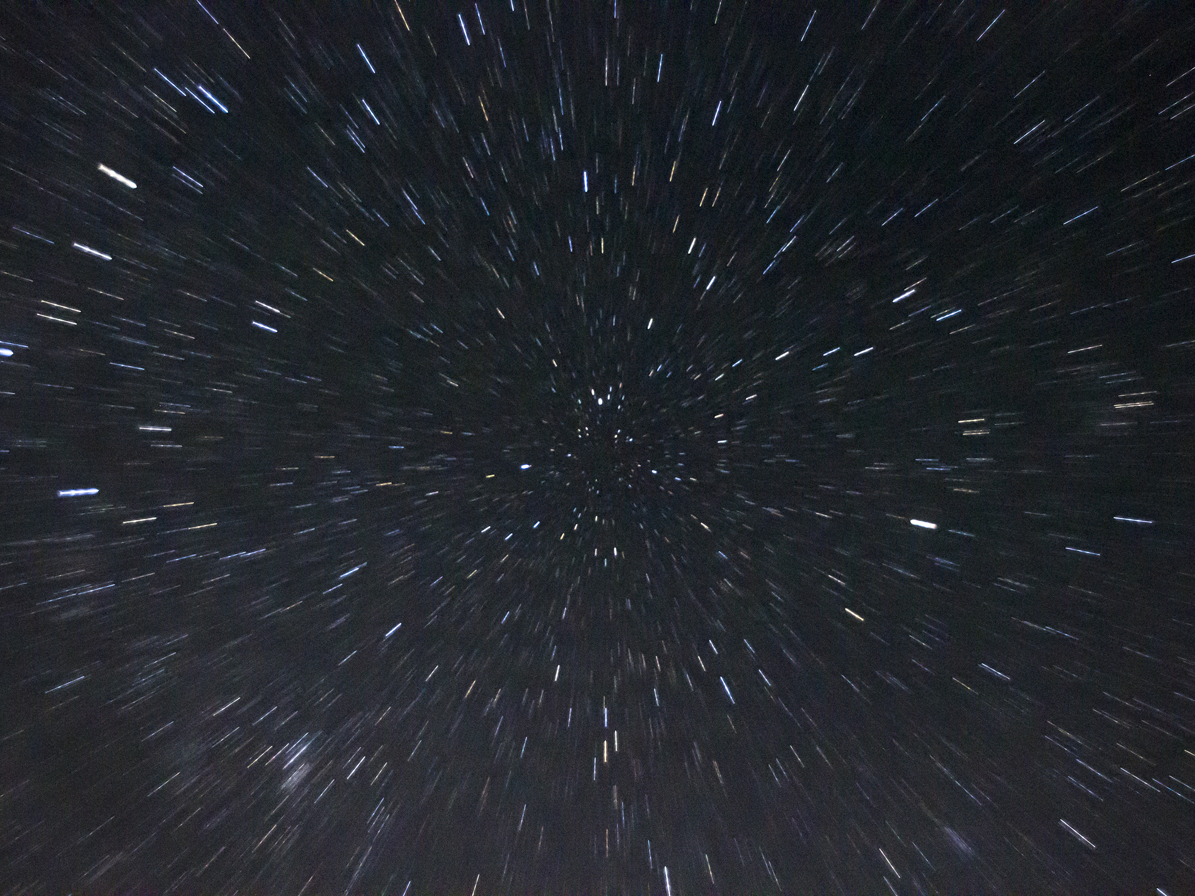
Network Architecture
Arch
Computer Architecture

Slide 2
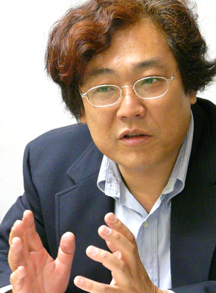
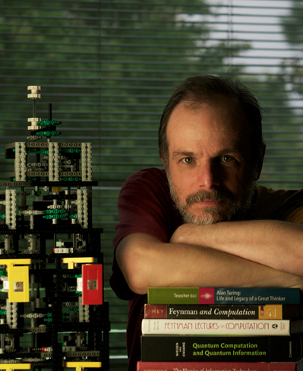

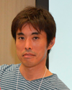
Faculty
Osamu Nakamura
( osamu )
Web, IPv6, Wireless
Rodney Van Meter
( rdv )
Quantum computing
Doctor
Yohei Kuga
( sora )
Network measurement
Takeshi Matsuya
( macchan )
Network Environment by FPGA

Slide 3
Regular Meeting :
Laboratory :
General Language :
Tendency :
Contact :
Thursday 18:30~ ΔN111
Δ North
C [, Verilog ]
Speed prioritized
arch@sfc.wide.ad.jp
Undergraduate research example
Visualization
Low delay data transmission
General Purpose GPU
Distributed computing
Communication protocol
Parallel computation compiler

